Slide 1
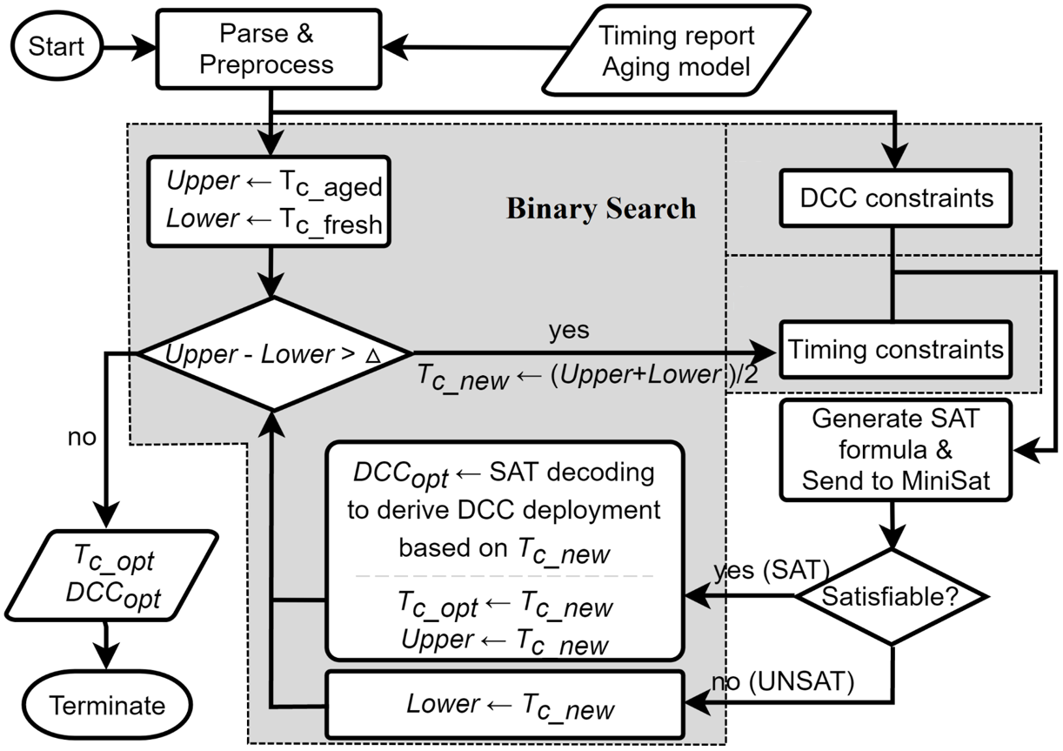
Section IV-B
Section IV-C

