Slide 1
B-Shopping
THE BEST SHOPPING Experience You will ever have.
Present By Team [太chain了吧]

Slide 2
Outline
Introduction
Implementation
Demo

Slide 3
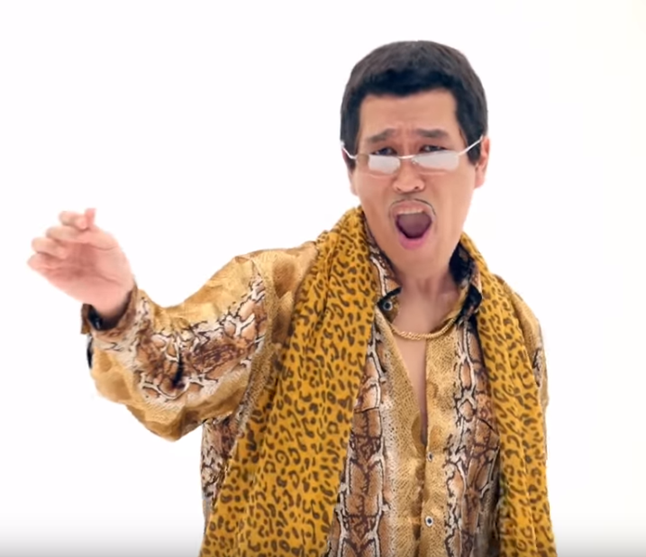










I have a 購物平台

Slide 4
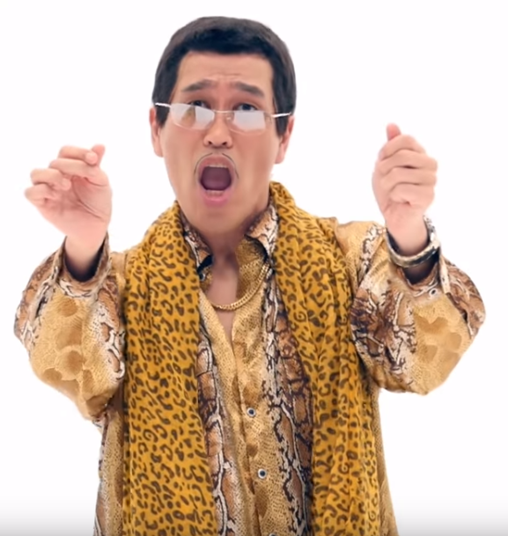

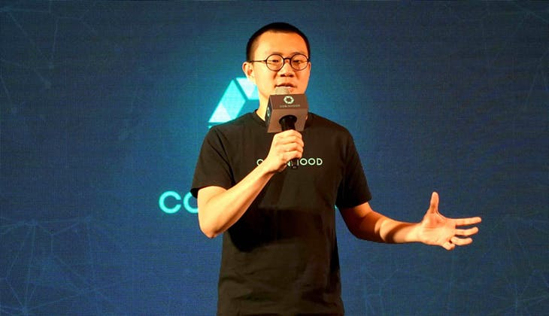

I have a BlockChain

Slide 5
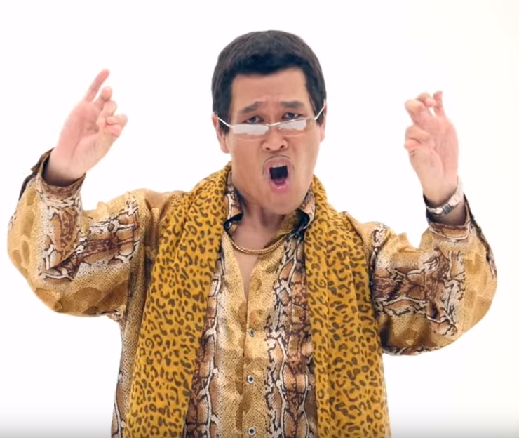
太chain了吧

Slide 6
What are we?
電商平台+區域物流
C2C
B2C

Slide 7
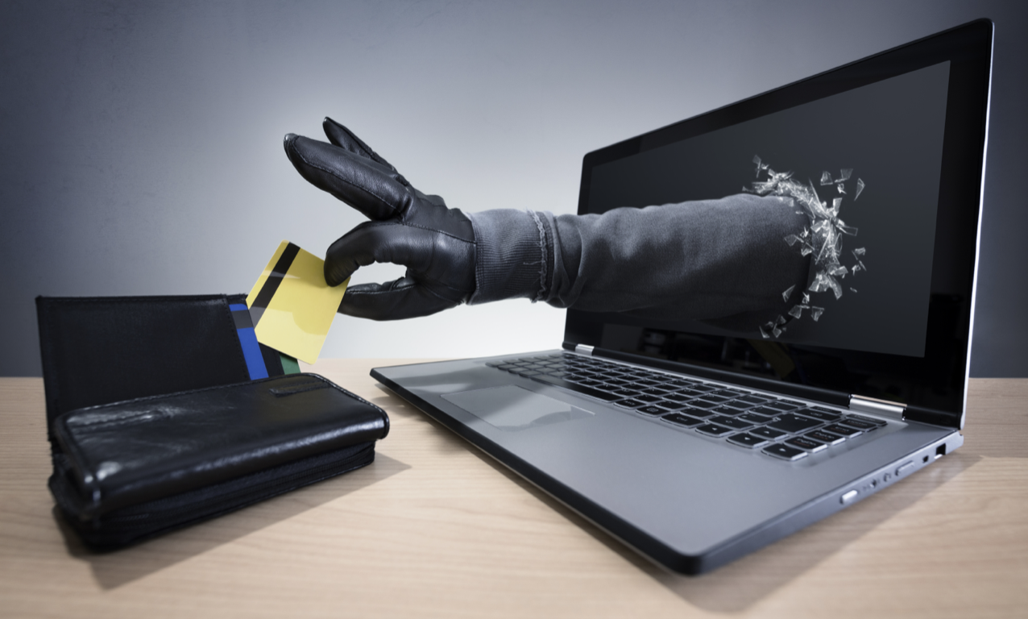
個資安全

Slide 8
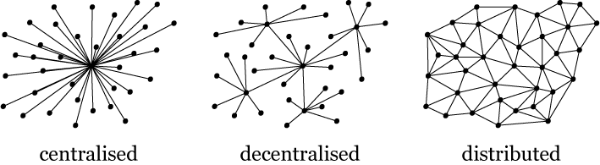
Dynamic Shipping
multi-node relationship

Slide 9

0 管理費

Slide 10
And That’s
B-Shopping

Slide 11
Implementation

Slide 12
Reputaion: 1~10
Balance:$
Held Balance: $
Contract
Order
Post
Block-Chain
Buy
Rate
Sell
Rate
Accept
Get Product
Send Product
Deliver
use Block-Chain IOT to verification

Slide 13
Demo
+
Q&A

