Slide 1
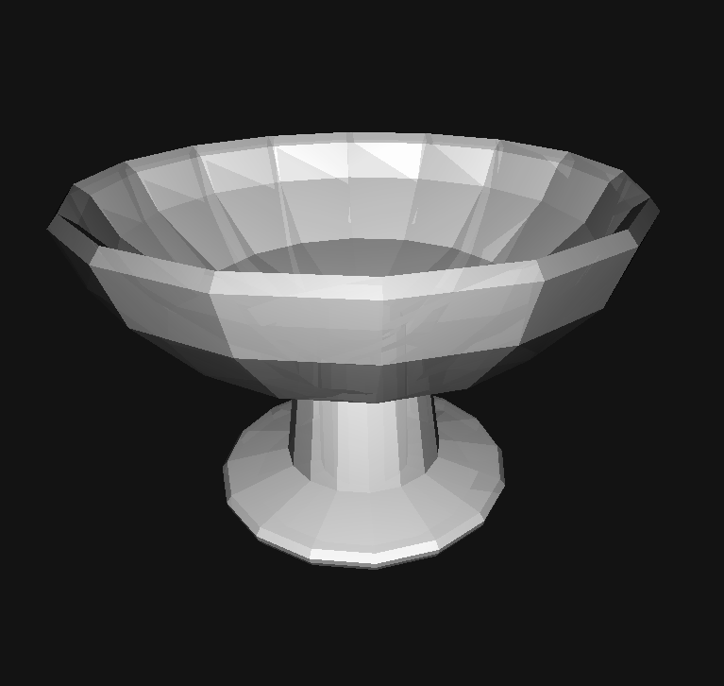
CAD.js
Eric Principato

Slide 2
Goals
Basic CAD / 3D modeling environment
Polygons, Extrusions, Revolutions
CSG operations (union, difference, intersect)
Handle concave polygons

Slide 3
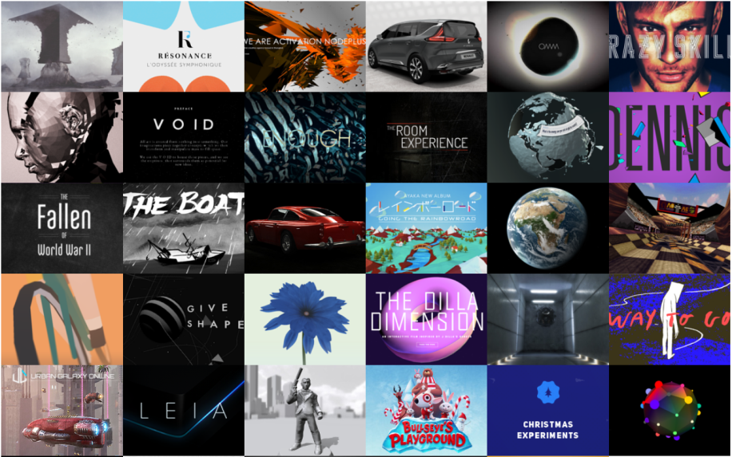
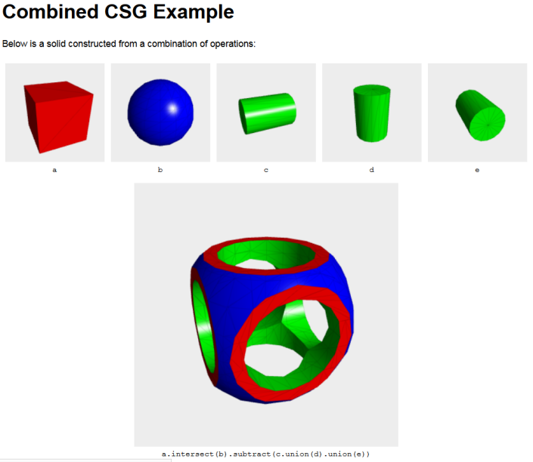
Approach
THREE.js: rendering and vector math
CSG.js: CSG ops
Face and vertex list data structure

Slide 4
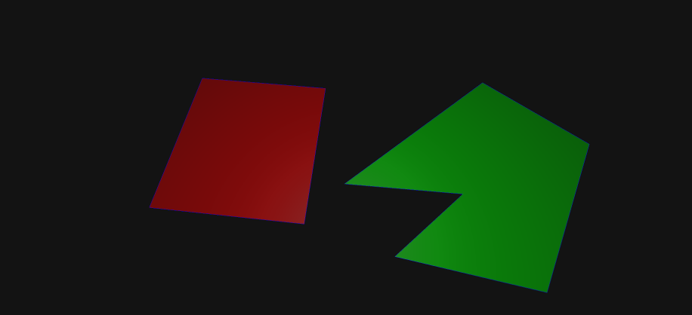
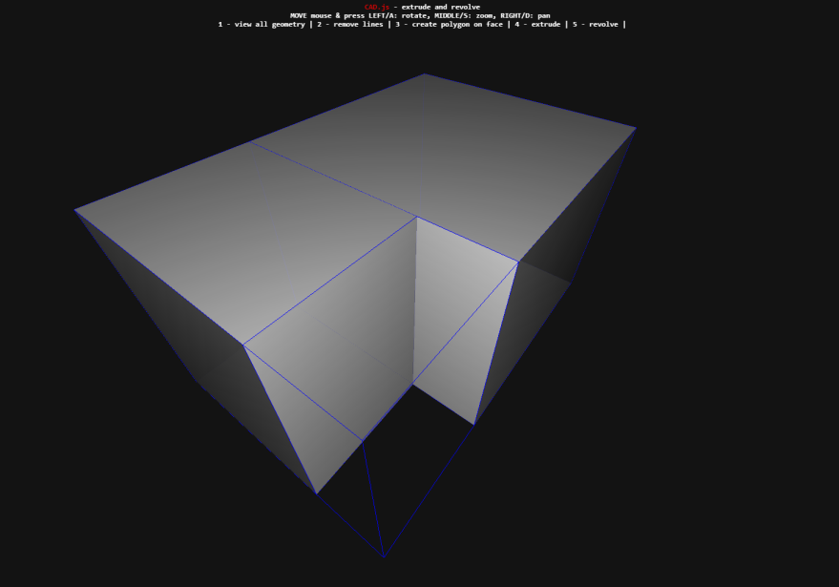
Polygon
Created from plane
Re-triangulated when vertex added
(Stored internally)
Converted to CSG polygon (direction matters)

Slide 5
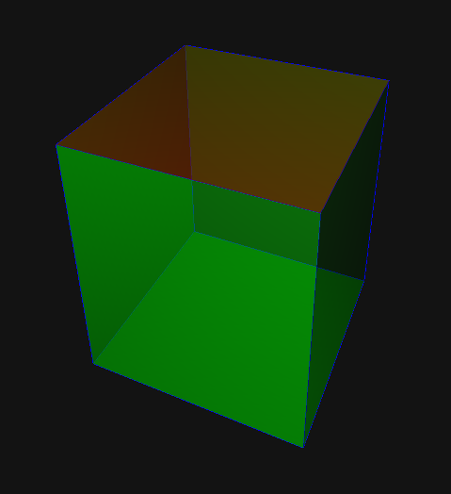
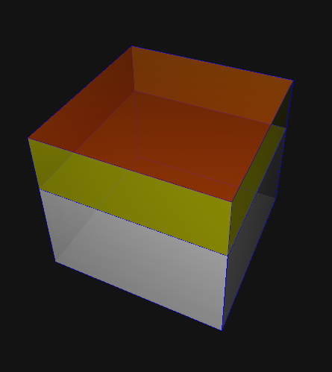
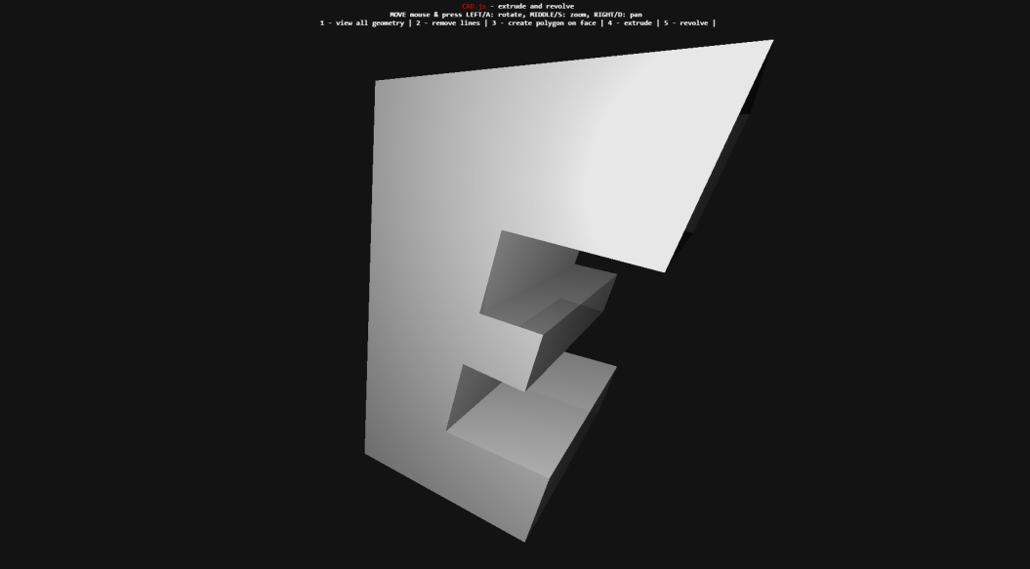
Extrusion
Adds new polygons to mesh on creation
Length set by mouse position (preview)
Union, difference, intersection

Slide 6
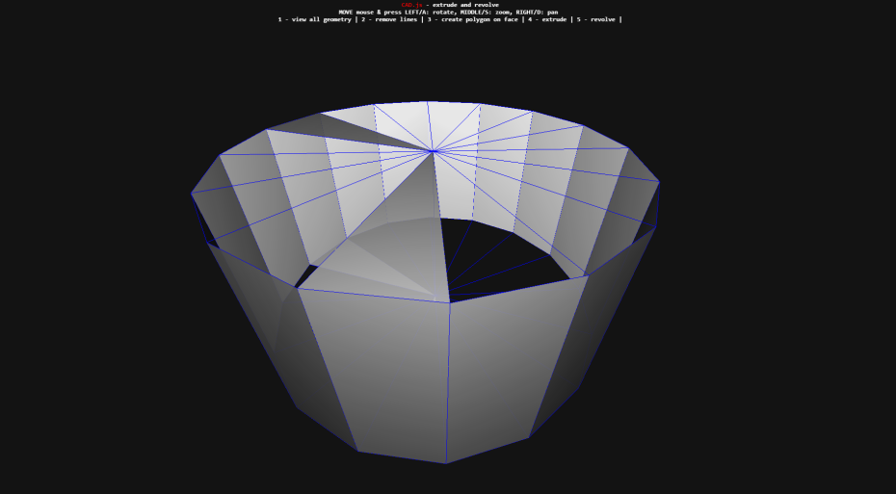
Revolution
Polygonal approx. of surface of revolution
Select polygon and axis
Occasional odd behavior

Slide 7
Rendering
THREE WebGLRenderer
Perspective camera w/ point light source
Polygon sets / meshes
All faces
CSG mesh
Active faces
Selected faces

Slide 8
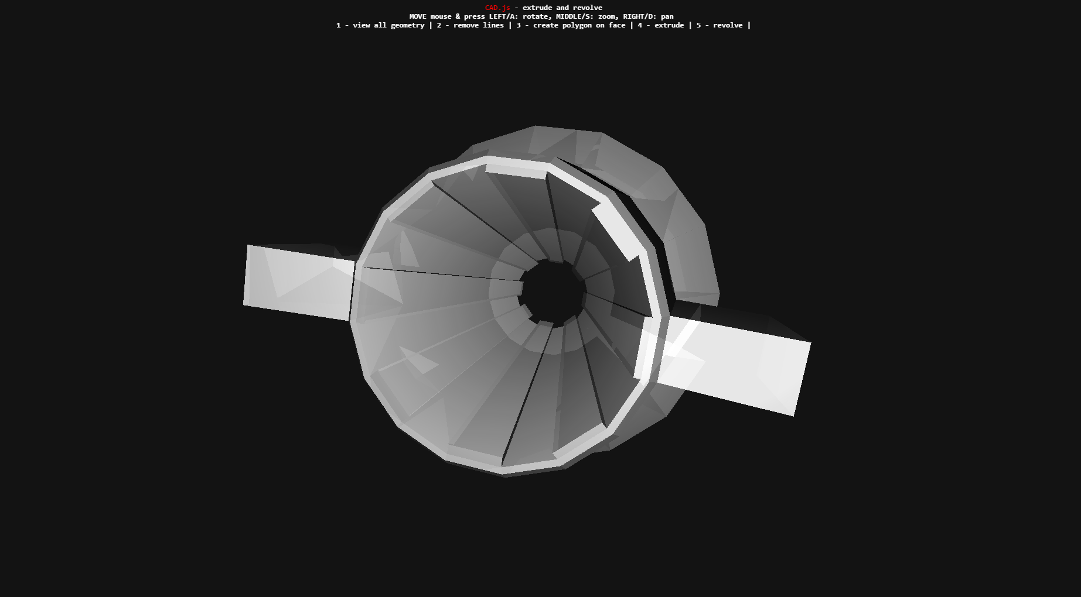
Program Flow

Slide 9
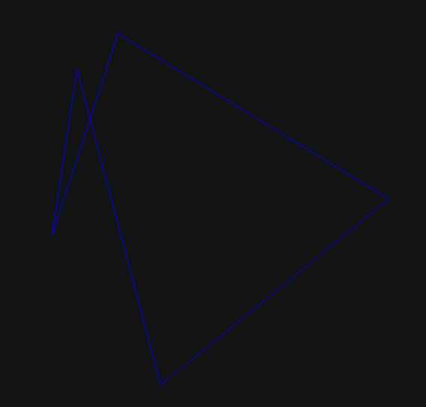
Issues
Concave triangularization (sometimes)
Revolution of polygon about its edge
Mouse/key event handling

Slide 10

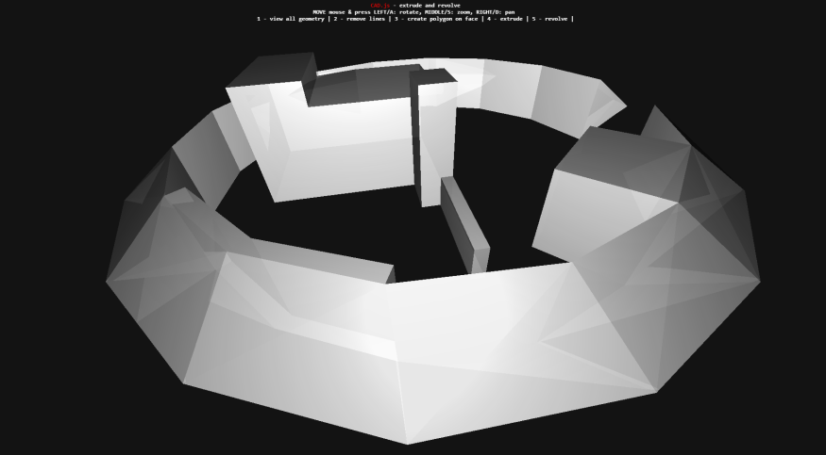
Conclusion
Able to perform basic CAD operations with open source tools
Fun to play with
Lots of potential for improvement!

Slide 11
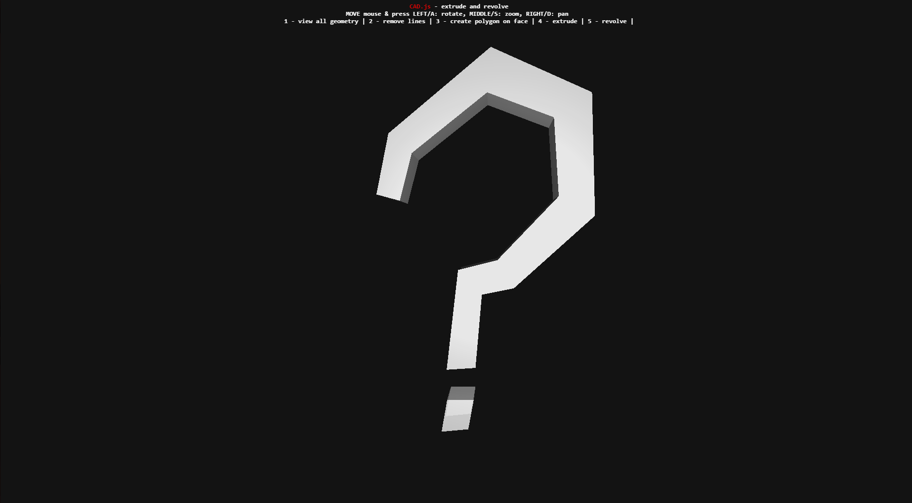
Questions

