Slide 1

Southern California R User Group Hackathon
April 2 — 3, 2022 Paul Merage Business School • University of California, Irvine

Slide 2
Goals of the Hackathon
The focus is on education & teamwork
Competition is used to frame the event, give a concrete goal to work toward
Please freely share your experience and expertise, help others when you can
What might success look like?
You’ve tackled a real world data set, and done something interesting with it
You’ve learned something new about R and data analysis
You’ve connected with others and grown from the experience

Slide 3
Rules
All participants must abide by our code of conduct
All work presented by the teams must be based upon work performed at the hackathon
Feel free to help others, even across teams
Please be courteous of the facilities, handle your trash, etc.
https://github.com/socalrug/hackathon-2022-04/blob/master/code-of-conduct.md

Slide 4
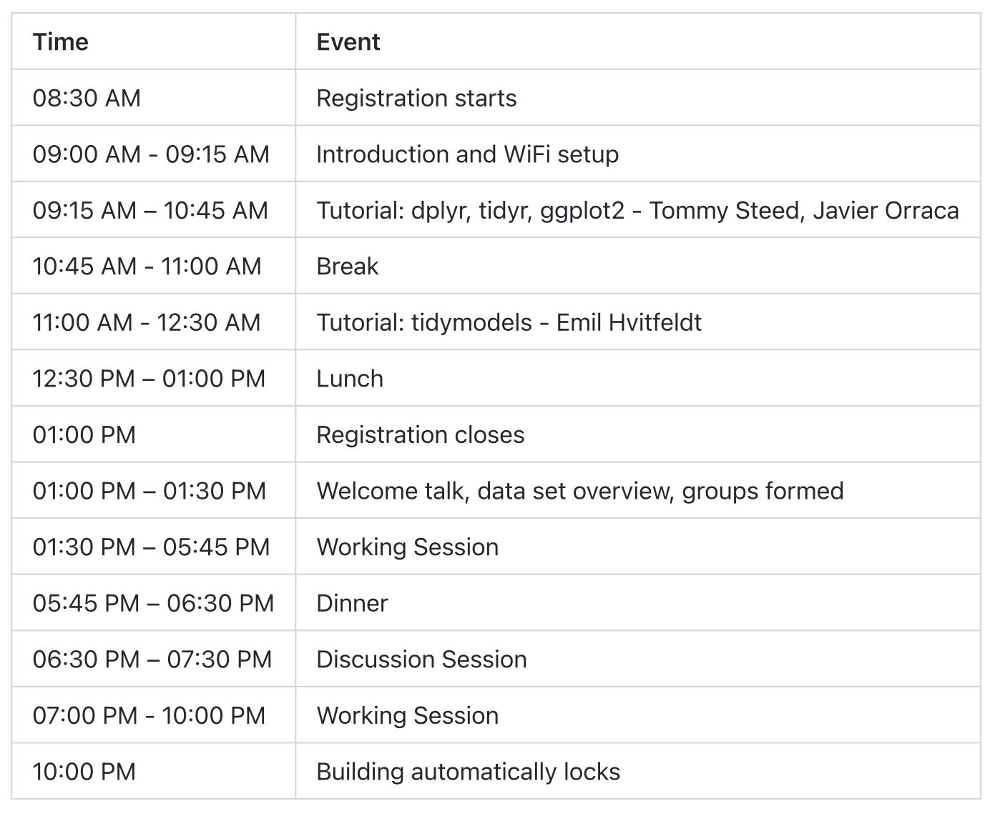
Schedule - Saturday

Slide 5
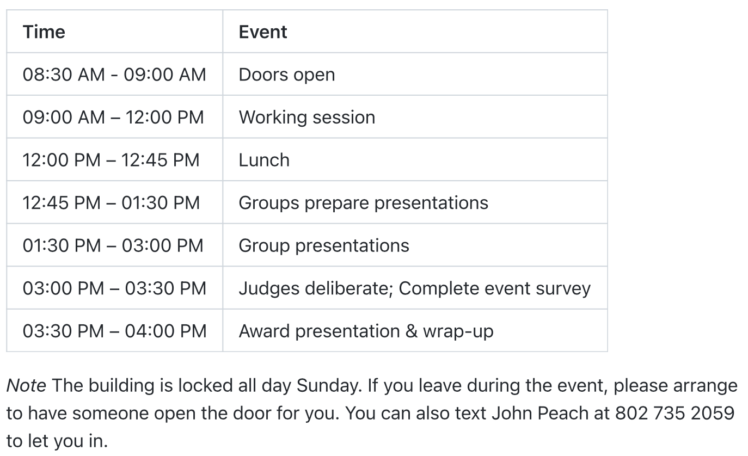
Schedule - Sunday

Slide 6
Awards Categories
Best Insight
Best Visualization
Best Analysis
Best Presentation
More info on the judging guidelines:
https://github.com/socalrug/hackathon-2022-04/blob/master/admin/judging_guidelines.md

Slide 7
Team Formation
Everyone needs to be on a team with 2 — 5 people
We encourage teams to have 5 people
For teams already formed with less than 5 people, consider inviting additional people to join you
We will finalize the teams at 1:00 when we release the data.
For Participants that need a team & existing teams that need more members

Slide 8
Presentations
All teams will submit a short 2 - 3 page PDF summary of their findings
Teams will have 5 minutes to present their work
The panel of judges will review the work and decide on the awards
Try to have a good idea about what you’ll be presenting by Saturday night!

Slide 9
Logistics
Building door locks at 10 PM.
Sunday the building is locked. Doors are open between 8:30-9:00.
If you leave, please arrange to have someone from your team let you in.
We have several breakout rooms for teams to us. Please keep the door open.
The patio can be used throughout the event.
Please be mindful of others in the building.
Let us know if you see anything that might need our attention.
The Slack channel #hackathon-2022-04 will be used for announcements and you are encouraged to post questions / comments

Slide 10
Logistics
Masks are optional but encouraged.
No food or drink (other that water) in the classrooms.
Please clean up your mess or any mess that you see.
Pull the latest hackathon GIT repo before starting.
There is a ton of information about the hackathon in the README file.
Updates to the hackathon repo will be made throughout the event.
Meals will generally be on the patio.
Coffee, tea, water, soda and snacks will be available.
Please fill out the post-event feedback survey.

Slide 11
WiFi Setup
Connect to SSID: UCInet Mobile
Go to https://oit.uci.edu/reg
Register your device as a guest
If you have problems: OIT support line at (949) 824-2222 option 3 Merage IT support line at (949)824-0852

Slide 12
Slack Setup
Slack Group Sign-up: https://tinyurl.com/socalrug-slack-signup
Slack channel: https://socalrug.slack.com
Join: hackathon-2022-04

Slide 13

The PacMan Rule
When standing as a group of people, always leave room for 1 person to join your group.
Leave some space here

Slide 14







Thanks to our Sponsors!
Anaheim
Ducks

Slide 15

Thanks to our Volunteers!!!
Organizers
John Peach, Ryan Benz, Pablo Barajas, Javier Orraca
Tutorials
Tommy Steed, Javier Orraca, Emil Hvitfeldt
Judges
Alan Foote, Ken Murphy, Mohamed Abdelhamid
Mentors
Chris Pounds, Dwight Wynne, Emil Hvitfeldt, Tommy Steed, Carey Huh
Sally Han Andrew Samson Akshay Garret Brian Alex

Slide 16
Questions?

