Slide 1
Healthy and Ready to Learn: State ESSA Plans to Support Student Health and Wellness

Slide 2

Welcome and Context Setting
Overview of ESSA and School Health and Wellness
State ESSA Plans to Support Student Health and Wellness: A Framework for Action
State Examples: Illinois and Colorado
Questions
Future Work
Notes:
Rochelle will moderate.
Welcome everyone.
Restate the purpose of the webinar.
Review the agenda.
Tell people how and when they can ask questions.
Frame the partership between HSC and Alliance

Slide 3

About Healthy Schools Campaign
Notes:
Rochelle provides a 3 minute overview of HSC and why we are working on ESSA

Slide 4

About Alliance for a Healthier Generation
Notes:
Nancy provides a 3 minute overview of Alliance and why they are doing this.

Slide 5
Defining Student Health and Wellness
A school setting that understands and supports students’ well-being and student health as a foundation for learning. In this environment, good nutrition, physical activity, basic safety, clean air and water, access to care and building the knowledge and skills for students to make healthy choices that allow them to thrive.
Access to care includes physical, behavioral and mental health, dental and vision, prevention, screening and disease management.
In a healthy school, students learn—through lessons and through examples—to value their own health and that of the environment.

Slide 6
Introduction to the Every Student Succeeds Act
Notes:
Rochelle provides overview of ESSA and why we see this as an important opportunity (Unless this happens as part of the framing of the webinar)
Should we also talk about the theory of change behind this? That ESSA is designed to address equity in education. That has been the role of the federal government. For the last 15 years, NCLB has been the policy in place and the theory behind this is that schools and school districts needed to be held accountable to student performance and if standards were not met then, first school received additional resources and then, if improvement did not happen, more punitive measures were taken, like removing leadership or being taken over by the state. Another key element of this approach was public disclosure of information in the form of school report cards. School report cards are designed to “grade” the school on how they were performing on key metrics. Report cards were required to breakdown student performance by race. This information was shared publically and compared the school's performance to other schools in their district and the state.
ESSA is based on the same theory of change but with a number of key changes- a recognition that the conditions of learning matter, less prescriptive/less punitive consequences, a broader sense of how to measure student performance, a bigger role for states--states have an invitation to leverage ESSA to advance student health and wellness but not a requirement.
Introduced Dana

Slide 7
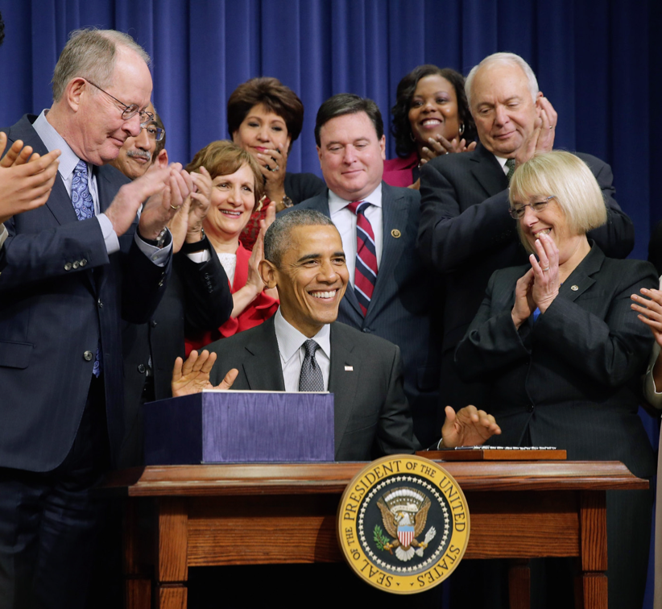
Every Student Succeeds Act
Notes:
DANA
On December 10, 2015, President Obama signed into law the bipartisan Every Student Succeeds Act (ESSA), a reauthorization of the Elementary and Secondary Education Act. Last reauthorized as No Child Left Behind in 2001.
ESSA recognizes the need for schools to support the whole child and specifically acknowledges the importance of promoting physical and mental health and wellness. The implementation of ESSA at the federal level and subsequent compliance with the new law by state education agencies (SEAs) and local educational agencies (LEAs) provides an important opportunity to more fully integrate student health into education policy and practice. An overview of the primary opportunities for advancing healthy schools and student health through ESSA follows.

Slide 8
Opportunities for Supporting Student Health
Title I: funding to states and school districts with high percentages of low-income children
Title II: professional development and literacy
Title IV: Student Support and Academic Enrichment Grants and community support for school success
Notes:
DANA
I assume Dana has some of her own content for the ESSA overview, but have some recycled content here
In December 2015, President Obama signed into law the bipartisan Every Student Succeeds Act (ESSA), a reauthorization of the Elementary and Secondary Education Act. This is the first major overhaul of our national education law since the No Child Left Behind Act (NCLB) was signed into law in 2001.
ESSA recognizes the need for schools to support the whole child and specifically acknowledges the importance of mental health and wellness. The implementation of ESSA at the federal level and compliance with the new law by state educational agencies (SEAs) and local education agencies (LEAs), such as state boards of education and school districts, provides an opportunity to more fully integrate health and wellness into education policy and practice.
In short, ESSA can put policies into place that reflect what educators and parents know: healthy students are better prepared to learn and succeed.
Prioritizing Health State by State
Under ESSA, regulatory power shifts from the federal government to the states. As a result, our education system could look very different by the 2017-2018 school year, with different accountability systems and education funding priorities in every state.
Because states and school districts have significantly more authority and flexibility to create standards for accountability and regulate school performance, every state has a critical opportunity to put education policies into place that connect health and learning.

Slide 9
Title I
State accountability systems: required measure of school quality or success
Report cards: required to include chronic absenteeism
School improvement: required to include evidence-based interventions and identify resource inequities; informed by needs assessment
Schoolwide Title I programs: informed by needs assessment
Notes:
DANA

Slide 10

Title II
Increased flexibility around how professional development funding can be used
Allowable uses include supporting school staff in addressing chronic absenteeism
Notes:
DANA

Slide 11
Title IV
Student Support and Academic Enrichment Grants
Needs assessment
Programs that promote student health and well-rounded education
Community Schools
Promise Neighborhoods
Notes:
DANA

Slide 12
Additional Opportunities
Equity: language about equity appears in Titles I and II
Well-rounded education: including physical education and health education
Early childhood education: professional development for early childhood educators; transition to elementary schools
Notes:
Dana

Slide 13
State Plans
Title I requires states to create plans that describe:
State standards
Plans for student assessments
Accountability systems, including measures and methods for identifying school districts in need of improvement
Methods for engaging stakeholders
States are currently in the process of convening stakeholders and soliciting input on state plans
Notes:
Dana

Slide 14
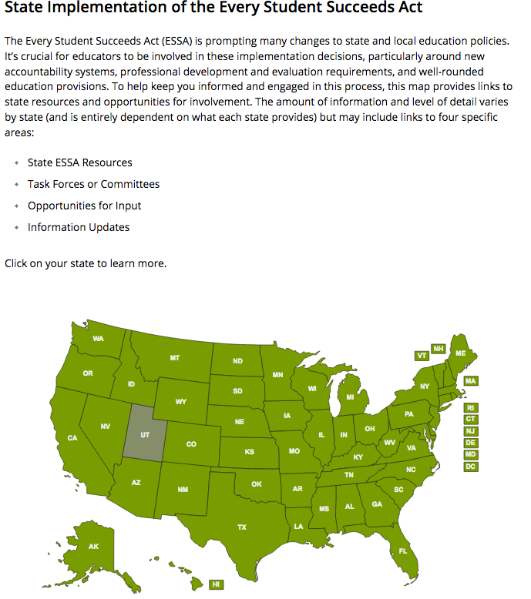
State Planning Processes ASCD’s State ESSA State Implementation Map http://www.ascd.org/public-policy/ESSA-State-Implementation-Map.aspx

Slide 15
State ESSA Plans to Support Student
Health and Wellness:
A Framework for Action
Find document at healthyschoolscampaign.org/state-essa-framework
Notes:
Nancy, Need to point out that guidance is based on proposed rules. We will update the framework on the rules are finalized and let them know.

Slide 16
State ESSA Plans to Support Student Health and Wellness: A Framework for Action
Getting Started
Engaging Stakeholders
Incorporating Health and Wellness into Key Levers
Other key elements of ESSA
Transferability
Student Support and Academic Enrichment Grants
Notes:
Nancy
Healthy Schools Campaign and Alliance for a Healthier Generation have completed a first draft of the state framework document. The document will be a guide intended to support
school health and wellness advocates who want to work with their state policymakers as they respond to the new requirements and opportunities in ESSA. It focuses on a few key places of the law, where the potential impact on student health is the greatest, and provides recommendations and advice for how health and wellness priorities can be integrated into the state’s plan.
Overview of ESSA
The framework explains:
How ESSA is structured and what role it plays in our education system
How states meet the requirements of ESSA
How stakeholders can identify key decision makers and understand the existing policy landscape
What existing tools and resources will be helpful
How to Engage Stakeholders
The framework discusses what is required in ESSA related to stakeholder engagement and outlines action steps for advocates to ensure quality input.
How to Implement a State Accountability System that Supports the Health and Learning Connection
The framework explains why it is important to include measures of health and wellness in accountability systems and what is required for the inclusion of a non-academic indicator. Action steps are outlined and a discussion of possible non-academic metrics is included. Chronic absenteeism, school climate, social and emotional learning, school connectedness, and school discipline are all discussed and case studies are included.
How to Create a State School Report Card that Supports the Health and Learning Connection
The framework explains why it is important to include measures of health and wellness on state report cards, and how report cards are different from accountability systems. This is followed by a discussion around what ESSA requires for the report cards, as well as action steps, and case studies. Possible metrics to include in the report card are discussed, including School Climate, School Connectedness, Social and Emotional Learning, access to school health services, minutes of physical education, meal participation rates, and presence of school nurses and other health professionals.
How to Integrate Health and Wellness into School-Level Needs Assessments
The framework explains how we can achieve equity by explicitly addressing underlying factors affecting academic achievement, especially health, in the development and implementation of school improvement plans. Needs assessments can provide advocates with an opportunity to ensure that schools and LEAs are considering the impact of health and wellness. A discussion of existing tools, suggested action steps, and case studies are included.
How to Ensure Professional Development Programming Supports Student Health and Wellness
The framework discusses the benefits of professional development and workplace wellness initiatives as part of the comprehensive strategy to support student health and wellness and academic achievement. ESSA offers new flexibility to in funding for these programs and action steps are suggested accordingly.
How to Support the Transition from Early Childhood Programs to Elementary School
The framework discusses the importance of supporting a smooth transition into elementary school, potentially including schools with age-appropriate wrap-around services, behavioral support, or social emotional learning. It could also mean building connections between schools and supportive community-based organizations. There is a discussion around what is included in the law related to early childhood education, including the preschool development grants, as well as recommended action steps.
Transferring Funding to Strengthen ESSA Health and Wellness Programming
The framework explains how, with some limitations, ESSA allows states and LEAs to transfer funds that were initially intended for a program under one Title to a program under another Title.
State Academic Standards, Assessments, and a Well-Rounded Education
The framework explains the shift from “core subjects” under NCLB to “well-rounded education” under ESSA.
Student Support and Academic Enrichment Grant
The framework describes how ESSA consolidated 49 grant programs, some of which focused on student health, into a new grant program, Student Support and Academic Enrichment Grants. SEAs and LEAs can use this to promote student health, increase access to well-rounded education and improve the use of technology.

Slide 17
State ESSA Plans to Support Student Health and Wellness: A Framework for Action
Comprehensive approach. The most effective approach is a comprehensive one linking accountability systems and report cards to needs assessments, evidence-based interventions and professional development.
Building on existing structures. We recommend identifying and building on existing policies and data systems as a way of leveraging existing resources.
Notes:
nancy

Slide 18
Key Levers Included in the Framework
State Accountability System
State School Report Cards
Needs Assessment
Professional Development
Transition from Early Childhood Programs to Elementary School
Well-Rounded Education
Notes:
Nancy

Slide 19
Structure of Key Levers Section
Why is this important to advancing student health and wellness?
What does the law say?
Action Steps
Notes:
Nancy

Slide 20
Other Features of the Framework
Case Studies
Links to supplemental information on a select set of measures:
Chronic Absenteeism
School Climate
Social and Emotional Learning
School Connectedness
School Discipline
Links to other resources
Notes:
Nancy

Slide 21
Next Phase
Develop recommendations around specific school health issues
A Health Impact Assessment on ESSA and Needs Assessment
Update based on final rules

Slide 22

State spotlight:
Illinois
Notes:
DANA
On December 10, 2015, President Obama signed into law the bipartisan Every Student Succeeds Act (ESSA), a reauthorization of the Elementary and Secondary Education Act. Last reauthorized as No Child Left Behind in 2001.
ESSA recognizes the need for schools to support the whole child and specifically acknowledges the importance of promoting physical and mental health and wellness. The implementation of ESSA at the federal level and subsequent compliance with the new law by state education agencies (SEAs) and local educational agencies (LEAs) provides an important opportunity to more fully integrate student health into education policy and practice. An overview of the primary opportunities for advancing healthy schools and student health through ESSA follows.

Slide 23
Chronic absenteeism and physical fitness as measures in accountability systems
 | Chronic absenteeism | Physical fitness
Is valid, reliable and comparable across all LEAs in the state | ✓ | ✓
Can be disaggregated for each subgroup of students | ✓ | ✓
Includes a different measure than the state uses for any other indicator | ✓ | ✓
Is supported by research finding a connection to student achievement | ✓ | ✓
Aids in meaningful differentiation among schools by demonstrating varied results across schools | ✓ | ✓

Slide 24
Chronic Absenteeism Recommendations in Illinois
As an Accountability Measure
Reductions in the percent of students who are chronically absent
School Report Cards
Needs Assessments
Evidenced-Based Interventions
Professional development

Slide 25

State spotlight: Colorado

Slide 26
Translating ESSA for Health Champions in Colorado
Amy Dyett, Director of Health and Wellness
November 17, 2016
Notes:
AMY

Slide 27


Colorado Education Initiative
Vision
Every student in Colorado is prepared and unafraid to succeed in school, work, and life, and ready to take on the challenges of today, tomorrow, and beyond.
Mission
The Colorado Education Initiative unlocks the unique potential of every student in Colorado by incubating innovation, shining a spotlight on success and investing in sustainable change that improves outcomes for students.
Professional Learning
Next Generation Learning
Colorado Legacy Schools
STEM
Health & Wellness
Notes:
We are a non-profit that partners closely with the Colorado Department of Education to accelerate educational improvement and innovation across Colorado. WE do so by investing in educators so that there is an effective leader in every school, and effective teacher in every classroom and a healthy and safe environment that ignites a passion for learning for every student.
We work across the education spectrum and currently have 5 bodies of work:
Professional Learning – which focuses on the development of all educators
Next Generation Learning – for provides personalized teaching and learning experiences
Colorado Legacy Schools – for increasing the number and diversity of Colorado high school students who are succeeding in advanced placement classes
STEM - strengthening STEM education & training
Health and Wellness – for creating healthy and engaging learning environments to support the whole child
Our relationship to our Dept. of Education has been instrumental and the means to the progress we have made around te SIP and currently on ESSA.

Slide 28

CEI’s Health and Wellness Initiative
Strategically Align H&W Efforts To Boost Academic Performance For All Students
Notes:
This is what you need to know…

Slide 29
Our Approach to Systems Change
Become informed
Identify the opportunities
Know the politics
Leverage partnerships
Convene the field
Build upon existing work
Make the case
Notes:
Learn more about ESSA to be able to join the conversations – more clout in the eyes of schools when you can speak their language and understand what they are dealing with
Identify specific opportunities for school health
Know the politics and prioritize you actions accordingly

Slide 30

ESSA 101
Bi-partisan bill passed in December 2015
Replaces No Child Left Behind (NCLB)
Governs all aspects of the education system
Major changes:
Point of Control
“Well-rounded Education”
“Equity”
Notes:
Description: December 2015 marked the passing of the bipartisan federal Every Student Succeeds Act (ESSA), a reauthorization of the Elementary and Secondary Education Act first passed in 1965, which replaces No Child Left Behind (NCLB). ESSA regulates the education system as well as appropriates federal funding for elementary and secondary education. This session will give an overview of ESSA and highlight the provisions aimed directly at improving equity, physical health, mental health, and safety in our nation’s schools. ESSA will impact the district, building and classroom level and provides an invaluable opportunity to incorporate school health. So, attend, learn, get ahead and participate in opportunities to provide your voice as the Colorado Department of Education drafts the ESSA plan for Colorado!
This is what you need to know…

Slide 31
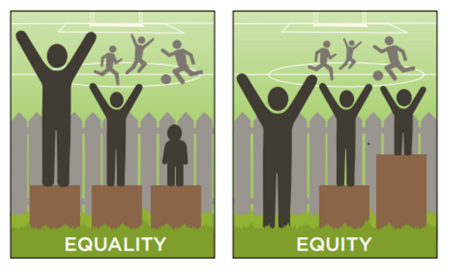
ESSA 101
Notes:
This is what you need to know…

Slide 32
ESSA Opportunities for School Health
Title I
Well-rounded education (replaces “core”)
Definition includes health education and PE
State Accountability Systems
Must add a 5th indicator
Title II
Applies to ALL school staff
Broader definition for professional development
Notes:
Health needs to be foundational to the education system. Integrate health into the systems, policies and environment of schools. Take time to learn the education landscape, collect relevant and local data and provide support/resources. “In the end, it’s simply doing what’s right for kids.”
TITLE I
School-wide programs & targeted assistance schools (40%+ FRL)
Schools can use this funding to develop school-wide health programs, such as hiring a school nurse/counselor, implementing nutrition and PA/PE programs, positive behavior and social-emotional support strategies
Needs Assessments
State Accountability Systems
What we measure now
This is what’s on School Performance Framework
Therefore, data that is used on UIP/how we determine how those Title I funds are used
5th indicator must be same for school level, must be reliable and valid tool, must be able to disaggregate for sub groups – another change, homeless and military youth added to subgroups. ELL, Race/ethnicity, SPED, etc
indicator of school quality or student success
Title II
For example, funds may support PD around behavioral and mental health needs of students

Slide 33
ESSA Opportunities for School Health
Title IV
Part A, Student Support and Academic Enhancement
Well-rounded Education – 20%
Safe and Healthy Students – 20%
Effective Use of Technology – 15%
Part B, 21st Century Community Learning Centers
School-community Partnerships
Funds afterschool programs – includes nutrition education and physical activity
Needs Assessment and Implementation Plan
Notes:
New Title IV: Block grants to states – distributed to school districts
Part A, Part B
Needs Assessment – Smart Source
Federal appropriations – SHAPE website if you are interested in doing more
Even if dollar amounts approved this year, but in the future, this allows for Title IV and therefore requires school health to be included in the UIP!

Slide 34
Our Approach to Systems Change
Become informed
Identify the opportunities
Know the politics
Leverage partnerships
Convene the field
Build upon existing work
Make the case
Notes:
Leverage partnerships
Because of CEI’s unique positioning, we worked to create, build and strengthen relationships at all levels within our DOE
Sit on spoke committees
Seen as connectors to the field of practioners

Slide 35
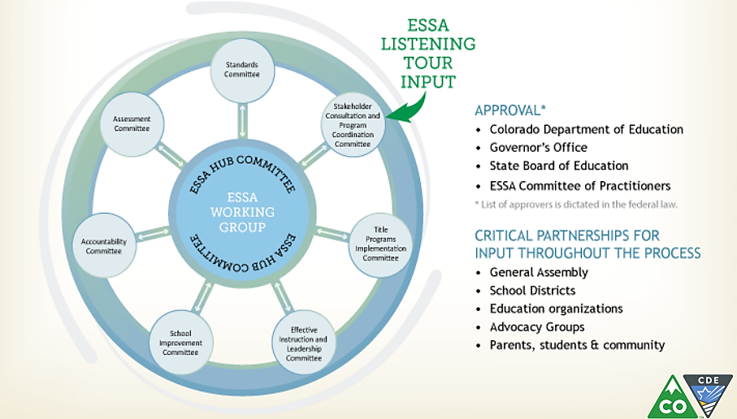
Colorado Hub and Spoke Committees
Notes:
Colorado chose a Hub and Spoke model to draft the ESSA State plan:
Standards
Assessment
Accountability
School Improvement
Quality Instruction and Leadership
Title Program
Stakeholder Consultation
Who sits on Hub and Spokes…

Slide 36
Our Approach to Systems Change
Become informed
Identify the opportunities
Know the politics
Leverage partnerships
Convene the field
Build upon existing work
Make the case
Notes:
Convene the field
Meaningfully engage the field to create awareness and inform so that they can provide insight, feedback and voice – they are the experts, give them the tools to be the champions for this work
Using our relationships with membership orgs and other agencies
ESSA Summit
Health Champion meetings
Agency meeting

Slide 37
Colorado Events
CDE’s ESSA Listening Tours and newsletter
Professional Learning Community – November 3, 2016
December 2016 - February 2017 Public Comment Period!
ESSA Summit – January 17, 2016
Notes:
Systems change #1 – AWARENESS…continue to make the case between healthy students and better learners!
Convene the field
Meaningfully engage the field to create awareness and inform so that they can provide insight, feedback and voice – they are the experts, give them the tools to be the champions for this work
Using our relationships with membership orgs and other agencies
ESSA Summit
Health Champion meetings
Agency meeting

Slide 38
Our Approach to Systems Change
Become informed
Identify the opportunities
Know the politics
Leverage partnerships
Convene the field
Build upon existing work
Make the case
Notes:
Build upon existing work
* Don’t’ make H&W one more thing, integrate it into the system

Slide 39

School Health Assessment of Policies and Practices
Streamlines how data are collected and reported
Developed and informed by multiple stakeholders
Administered statewide to all school-levels
Used to inform improvements to school health efforts
Comprehensive of all school health components
Notes:
For example, using systems that are already created and highly utilized vs creating something new…hoping smart source is connected to needs assessments
Smart Source is a school-level tool to assess policies and practices related to health
Comprehensive and focuses on all components of school health including PA, Nutrition, and Health Services but also policies and practices related to social emotional health and school climate
Developed and informed by various stakeholders (i.e. school/district staff, funders, content experts, state agency reps, researchers and evaluators)
It is administered statewide to any school who would like to participate.
There is an elementary tool, a secondary tool and a combined tool for schools that serve both elementary and secondary grades.
In 2015-16, 451 schools participated in Smart Source (that’s ¼ or 25% of all schools in Colorado).
The tool is primarily a self-assessment for schools to inform improvements to school health efforts but also yields data at the district, regional and state levels to help inform how resources (such as funding and professional development) are allocated
Having health data, especially local data has been vital to including health in the UIP process…

Slide 40
Our Approach to Systems Change
Become informed
Identify the opportunities
Know the politics
Leverage partnerships
Convene the field
Build upon existing work
Make the case
Notes:
Make the case
* Continue to be the voice, create awareness, share research/data and make the case between healthy students and better learners!

Slide 41

Why incorporate Health and Wellness?
ESSA State Plan will drive school- and district-level priorities and funding allocation.
What is included in this plan is what gets measured and accomplished on an ongoing basis.
Health is foundational to a students ability to learn and this lends the clout for integration.
Notes:
I found that I not only need to make the case for why H&W champions should care about ESSA…
THIS IS OUR OPPORTUNITY TO BE FORWARD THINKING AND GIVE RELEVANCE TO THE WORK YOU HAVE DONE OVER THE YEARS. LET’S GET IT IN NOW. Health needs to be foundational to the education system. Integrate health into the systems, policies and environment of schools. Take time to learn the education landscape, collect relevant and local data and provide support/resources. “In the end, it’s simply doing what’s right for kids.” Quote from Superintendent of Lake County School District.
..

Slide 42

Why incorporate Health and Wellness?
Increased
Learning readiness
Decreased
Absenteeism
School engagement
Academic performance
Behavior issues
Truancy
Notes:
But also have to make the case to educators regarding why H&W fits within ESSA.
We also continue to make the case. The UIP can provide an opportunity to bridge health and education expertise on shared goals and also can be used as best practice strategies…let’s look at a few examples..

Slide 43
Thank you!
Amy Dyett, MAT
Director, Health and Wellness
720-502-4716
adyett@coloradoedinitiative.org

Slide 44
Questions

Slide 45
Stay Connected
Update to guidance when final rules are issues
Develop issue specific recommendations
ESSA and Needs Assessment: A Health Impact Assessment
Share your work on ESSA state plans with us
Let us know how we can help
Access document at healthyschoolscampaign.org/state-essa-framework
Email: Ryan@healthyschoolscampaign.org
Notes:
My email address? Mention forthcoming addendum

