Slide 1

Metro Nashville public school data & Nashville crime rates
By erica henley
Notes:
Hello everyone

Slide 2
About the project
Explored enrollment rates, graduation rates and how crime stats impact them
Used Excel & Python
Tableau dashboard
Notes:
For this project, I explored enrollment rates, graduation rates, and how crime stats interact with them using data from the last five years, when possible. I used excel and python to clean and explore the data. And I will be making a tableau dashboard at some point.

Slide 3

Goals
To discover which public schools have the highest graduation rates
To discover which public schools have the lowest graduation rates
To discover if crime rates seem to impact these statistics

Slide 4



Data sources
Metro Nashville Public School Open Data: https://www.mnps.org/about/communications/opendata
Tennessee Dept. of Education https://www.tn.gov/education/districts/federal-programs-and-oversight/data/data-downloads.html
Nashville Open Data https://datanashvillegov-nashville.hub.arcgis.com/datasets/d747436243e9439e968fce056545016a_0/explore?location=35.885029%2C-86.948355%2C7.34

Slide 5
Issues encountered
Missing values
Formatting errors
Zip code info in police data
Notes:
There were some issues I encountered during this project. There were several missing values from the data, specifically within the enrollment data. Each dataset was also formatted differently so I had to figure that out. And the zip code info was input in a few different ways in the police dataset I looked at. It was difficult to navigate these problems.

Slide 6
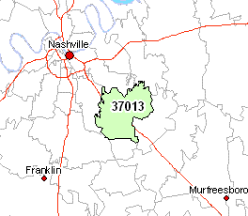
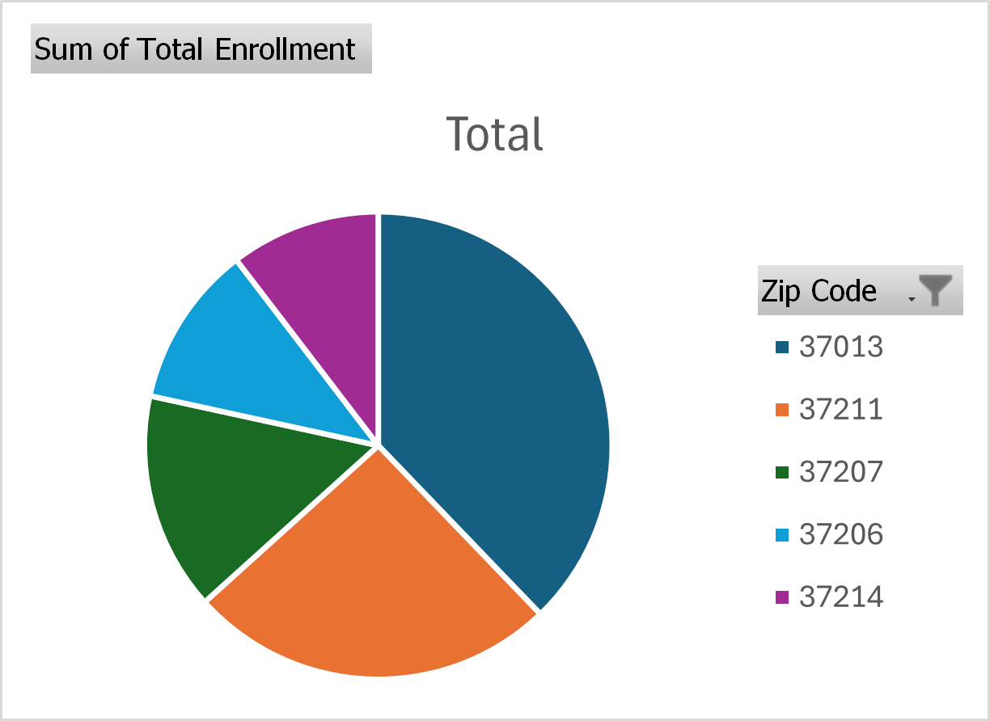
Enrollment rates in metro public schools
Notes:
The zip code with the best enrollment rates across the board was consistently 37013, which is the Antioch area. These rates included all grades and types of schools

Slide 7

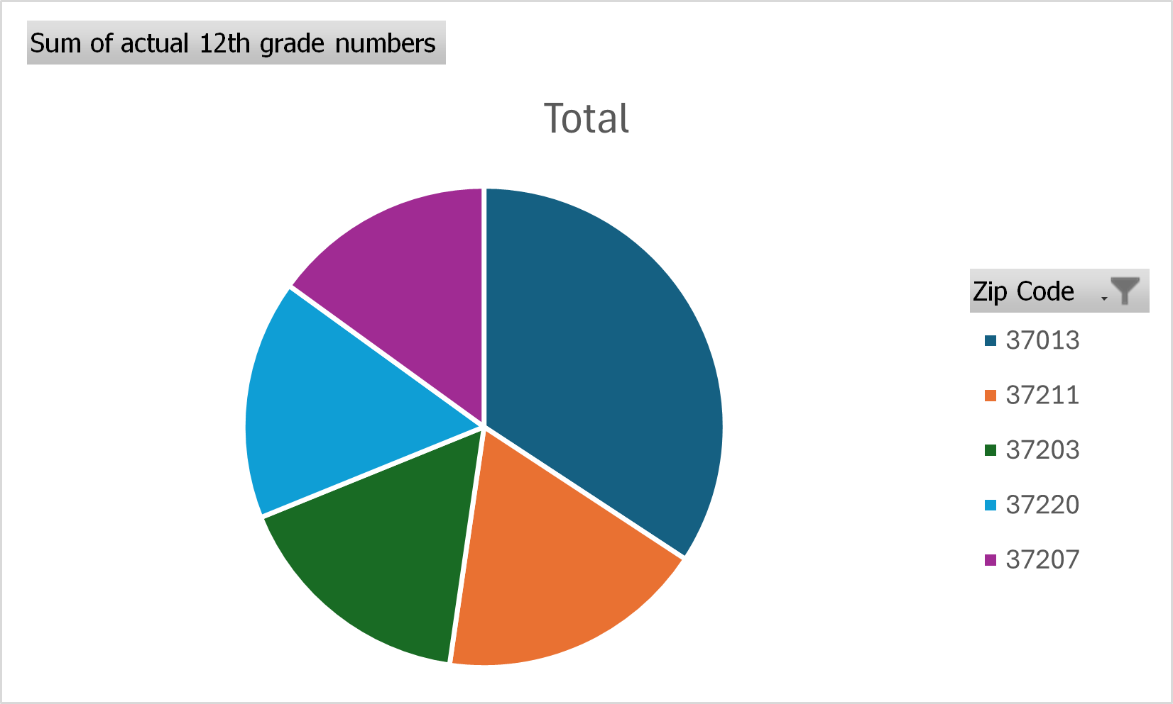
12th grade enrollment rates
37013 consistently had the highest 12th grade enrollment rates
Notes:
When focusing on just 12th grade stats, 37013 consistently had the highest rates.

Slide 8
Avg, other stats
Notes:
I am considering adding other stats from the schools, like demographics, if I have time and if anyone thinks that could be interesting so let me know☺

Slide 9
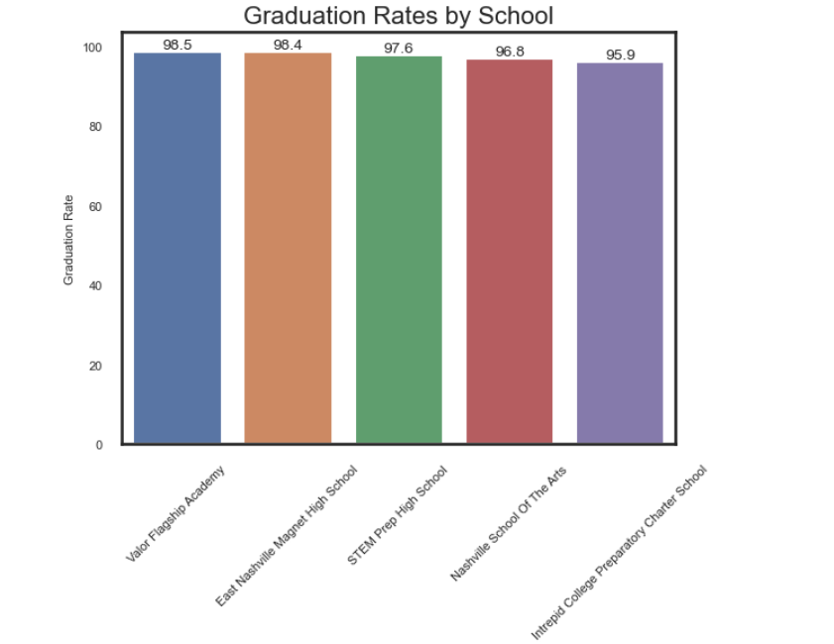
Graduation rates
Notes:
Overall, the best rates went to East Nashville Magnet High School and Valor Flagship Academy. Valor Flagship is a charter school and had lower numbers overall, but higher rates. This chart shows the top graduation rates from 2023. Unfortunately, I did not have access to graduation data from 2024.

Slide 10
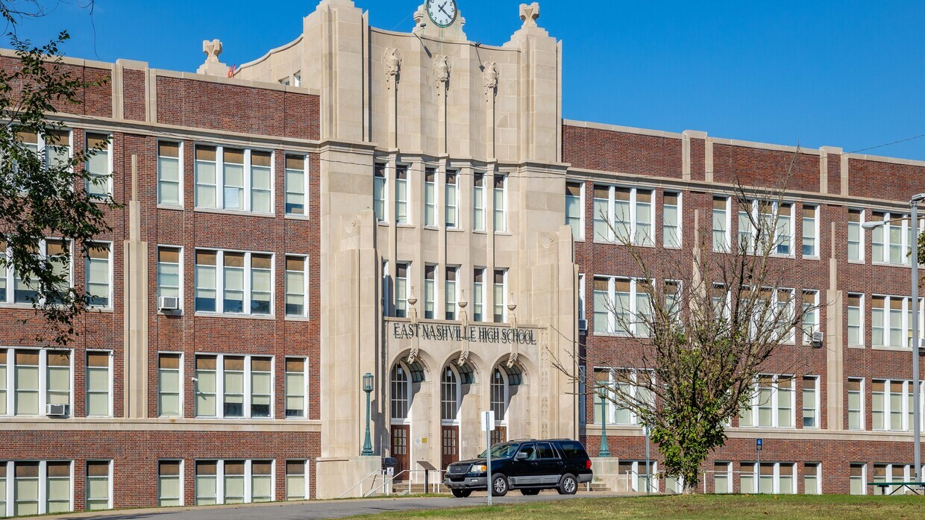
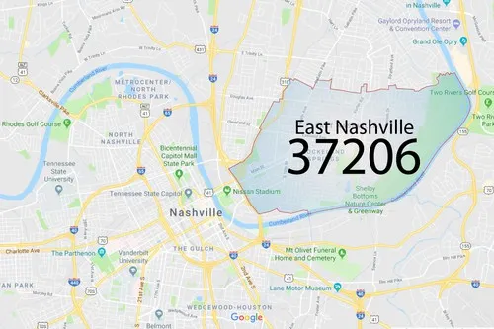
Best Graduation Rates
East Nashville Magnet High School
Notes:
When it comes to non-charter schools, East Nashville Magnet High in 37206 consistently had the highest graduation rates.

Slide 11
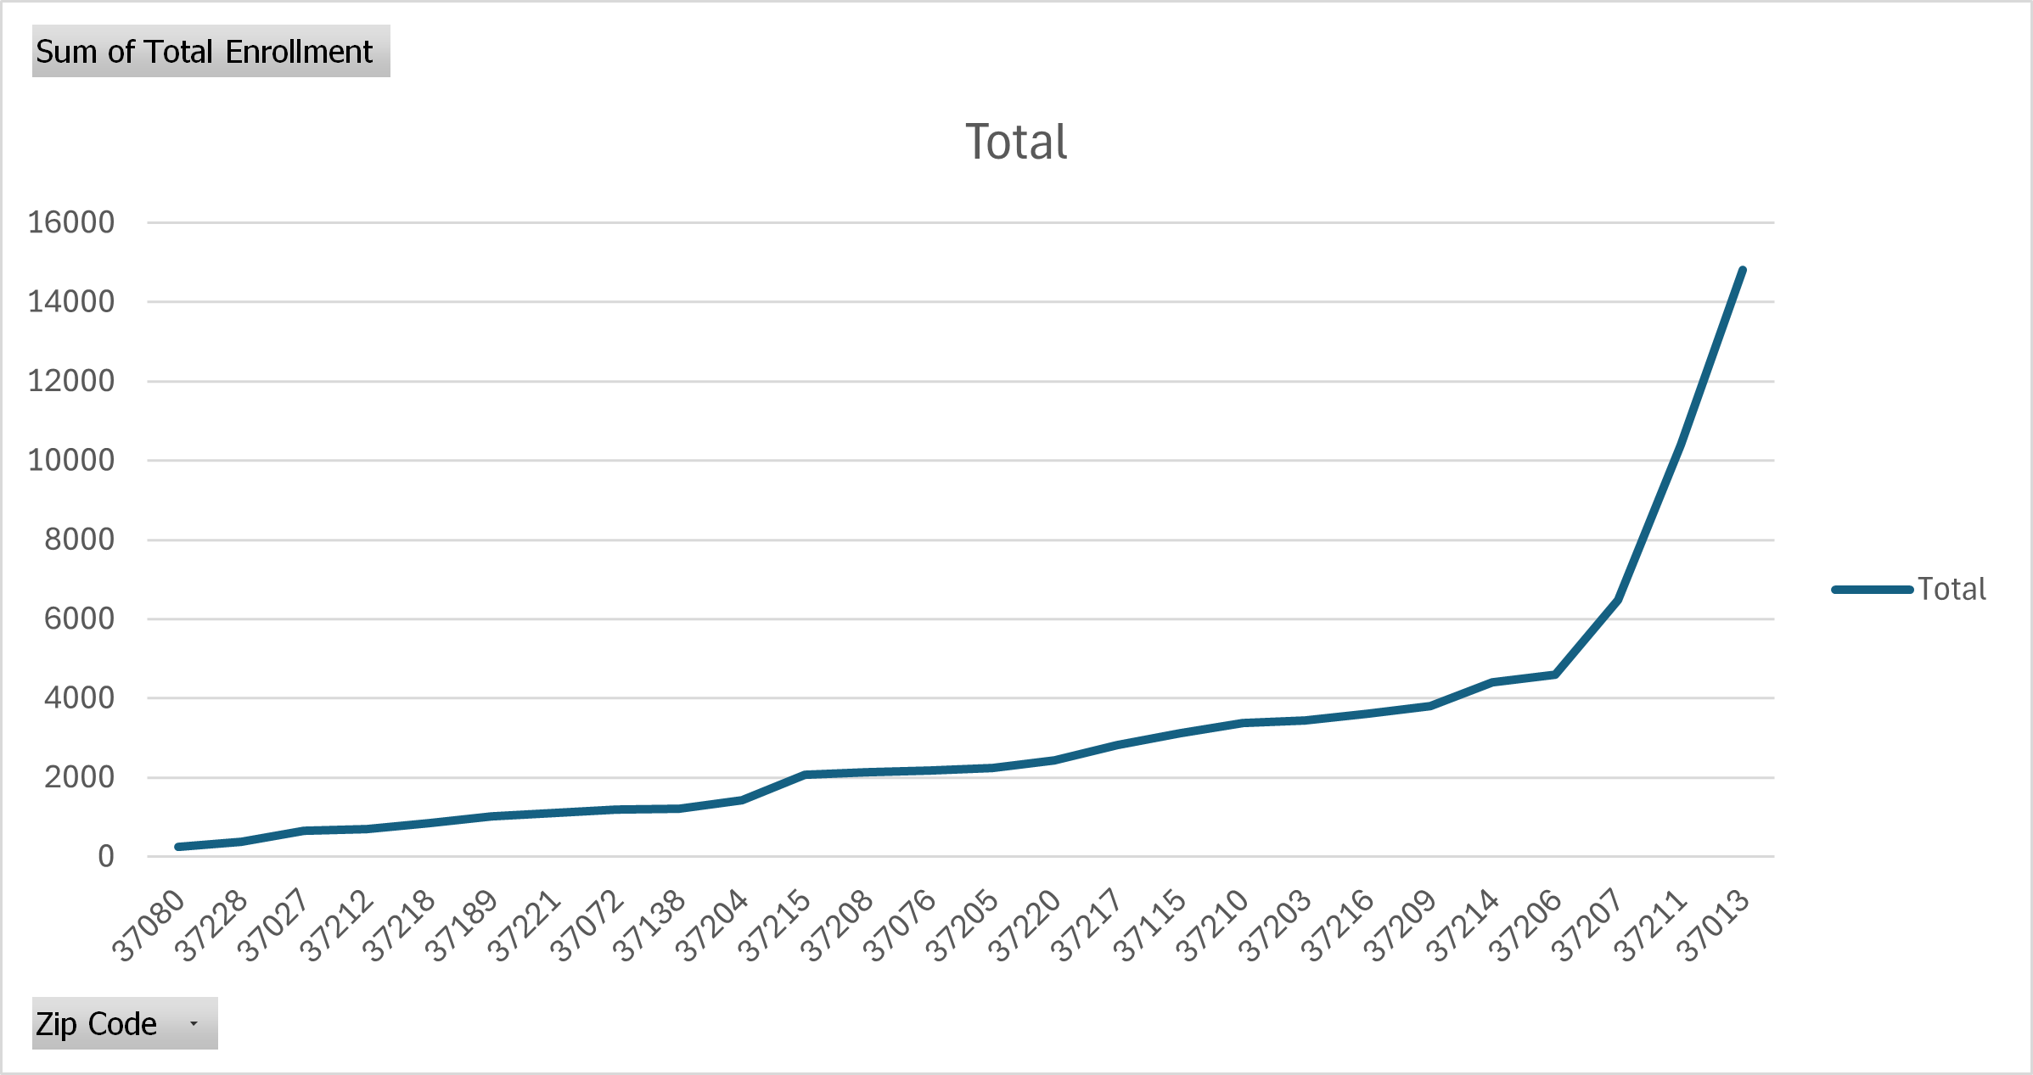
Lowest Rates
Notes:
The zip code with the lowest enrollment rates among all grades was 37080 but the zip codes with the lowest 12th grade enrollment rates differed each year.
Schools with the lowest graduation rates were in the

Slide 12
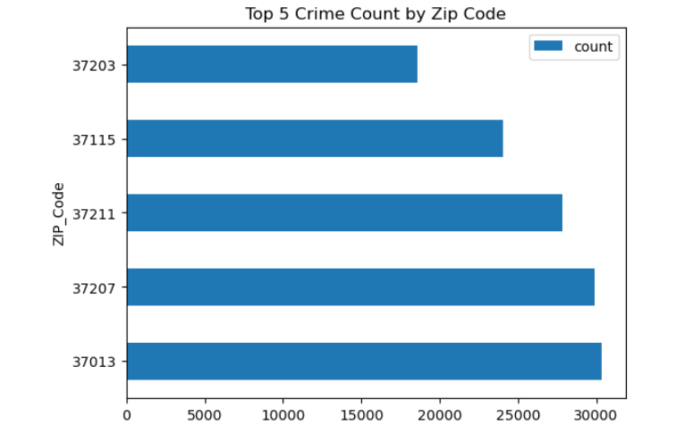
Does crime rate impact enrollment or graduation rates?
Notes:
Now that we know what areas had the highest and lowest enrollment and graduation rates, we can look into crime statistics. I specifically looked into the zipcodes talked about earlier. Recall that 37013 had the overall highest enrollment rates of all zipcodes.. When I looked into the crime stats for this zipcode, they were very high. This could impact the graduation rate.

Slide 13
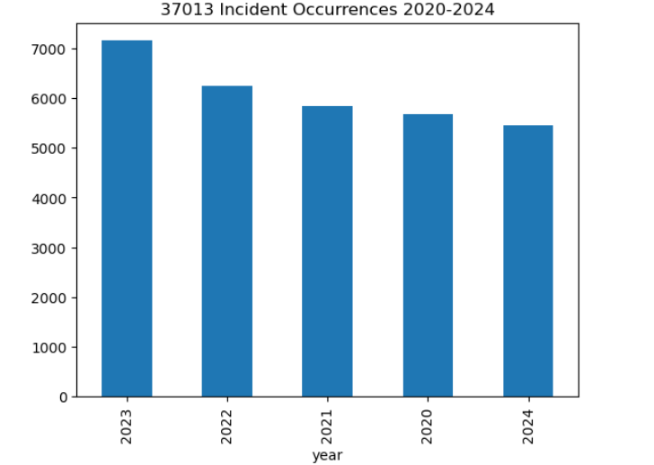
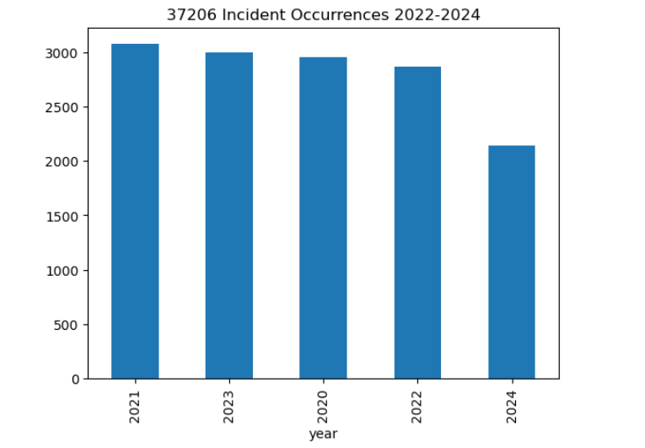
Crime rates in 37013 vs 37206
Notes:
The crime rates for 37013, which had the highest overall enrollment rates, were significantly higher than for zip code 37206, which had the highest graduation rates. This could mean that crime impacted graduation rates in 37013

Slide 14

Insights
37013 crime seems to impact graduation rates
37206 graduation rates were the greatest for high schools overall
More data is needed to gain further insight into whether more correlations exist.

Slide 15

Questions

