Slide 1

Metro Nashville public school data & Nashville crime rates
By erica henley

Slide 2
About the project
Explored enrollment rates, graduation rates and how crime stats impact them
Used Excel & Python
Tableau dashboard

Slide 3

Goals
To discover which public schools have the highest graduation rates
To discover which public schools have the lowest graduation rates
To discover if crime rates seem to impact these statistics

Slide 4



Data sources
Metro Nashville Public School Open Data: https://www.mnps.org/about/communications/opendata
Tennessee Dept. of Education https://www.tn.gov/education/districts/federal-programs-and-oversight/data/data-downloads.html
Nashville Open Data https://datanashvillegov-nashville.hub.arcgis.com/datasets/d747436243e9439e968fce056545016a_0/explore?location=35.885029%2C-86.948355%2C7.34

Slide 5
Issues encountered
Missing values
Formatting errors
Zip code info in police data

Slide 6
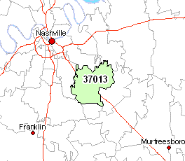
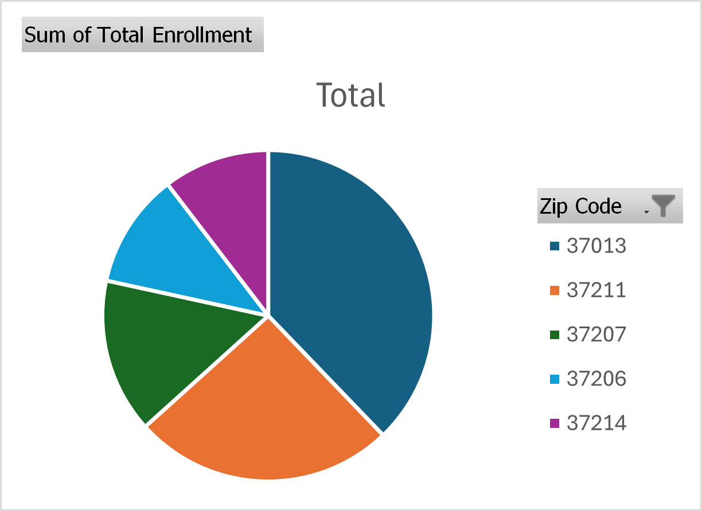
Enrollment rates in metro public schools

Slide 7
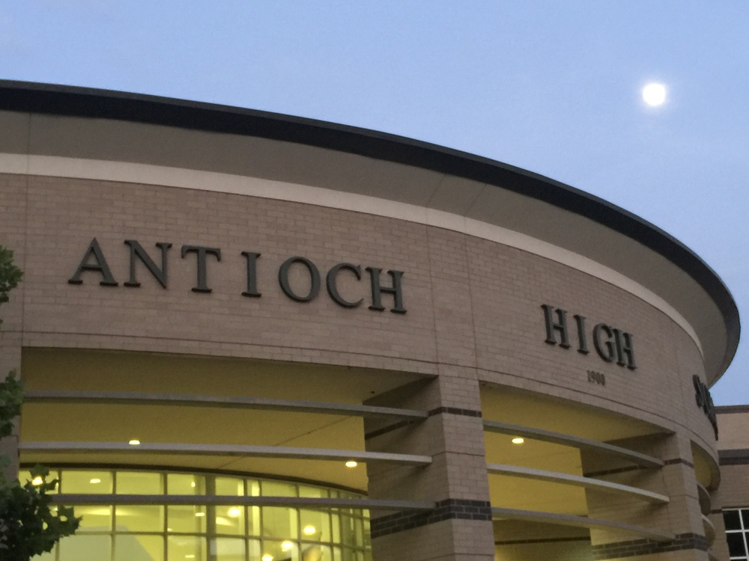
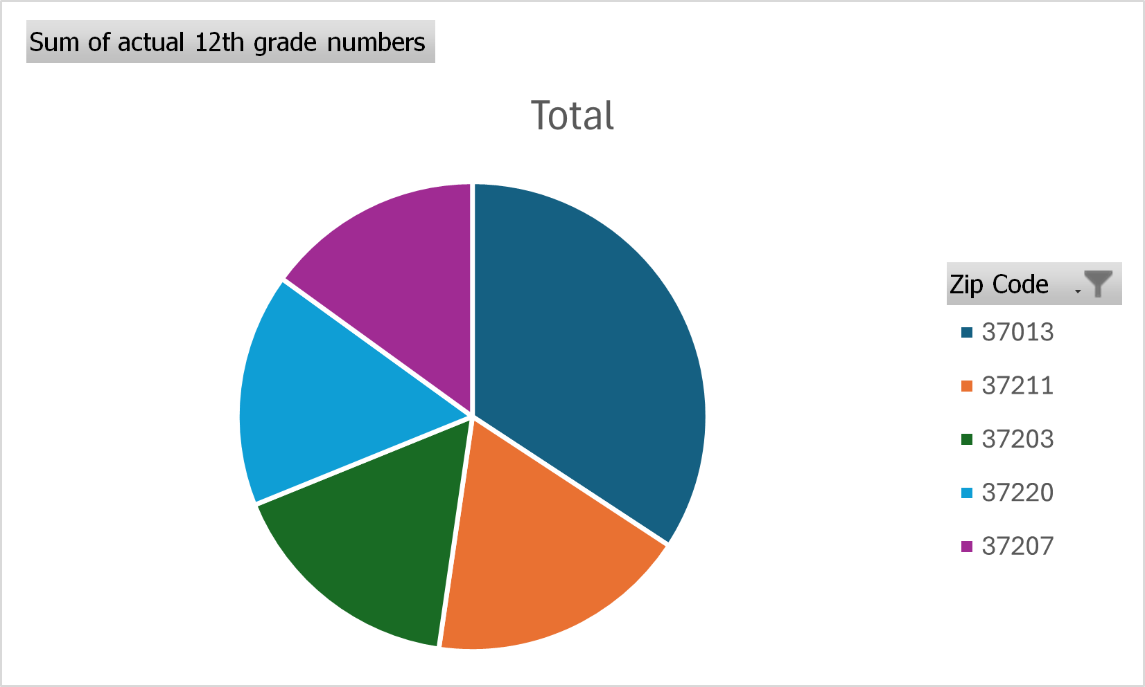
12th grade enrollment rates
37013 consistently had the highest 12th grade enrollment rates

Slide 8
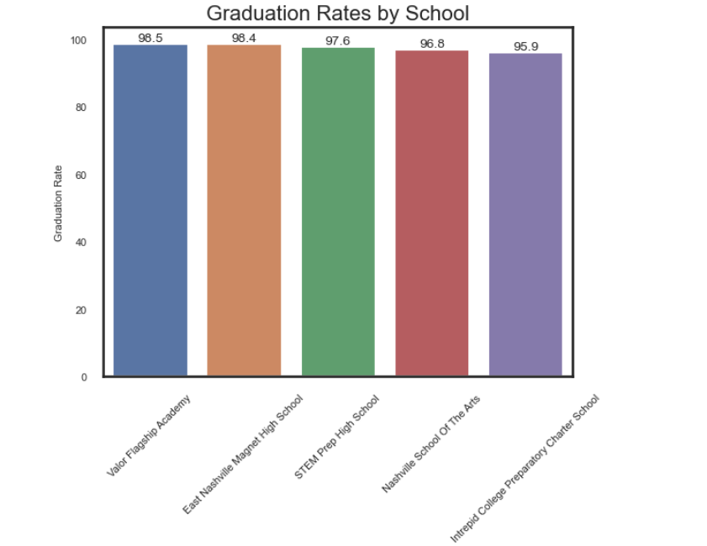
Graduation rates

Slide 9
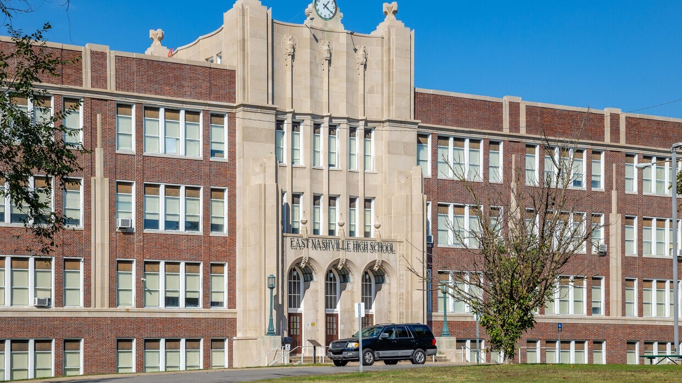
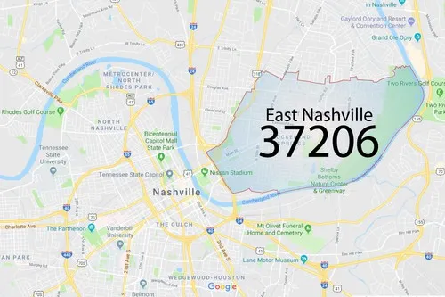
Best Graduation Rates
East Nashville Magnet High School

Slide 10
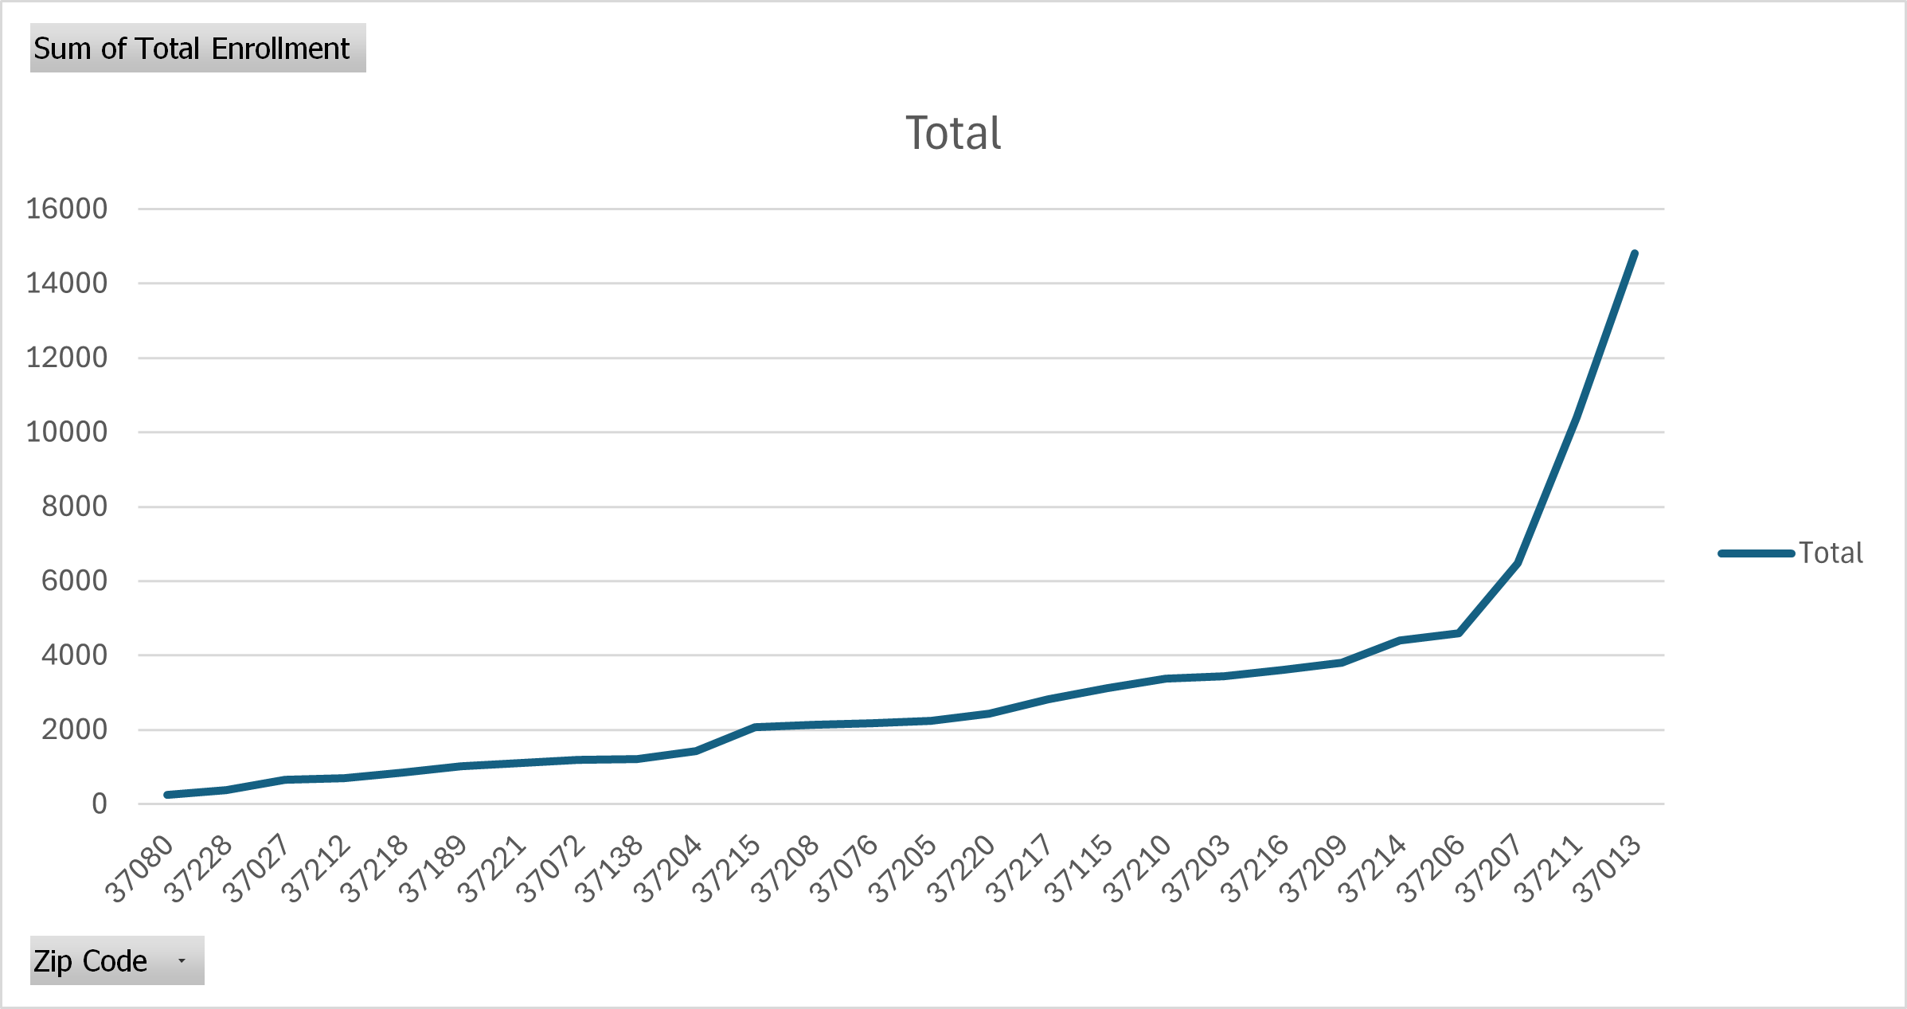
Lowest Rates

Slide 11
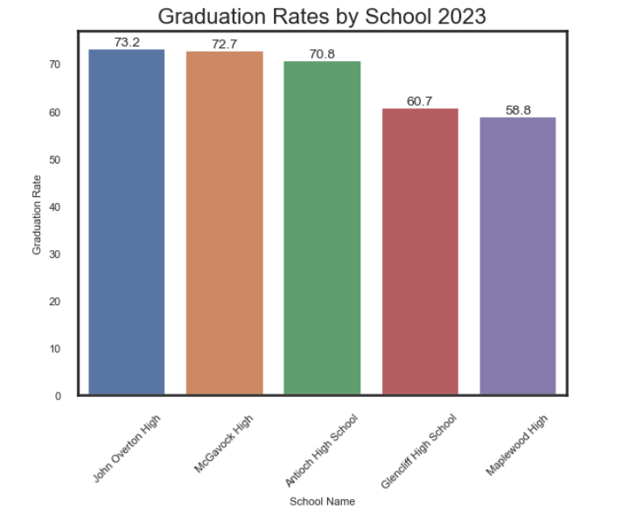
Lowest Graduation rates in 2023
Maplewood High – 37216
Glencliff High – 37211
Antioch High – 37013
McGavock High – 37214
John Overton High – 37220

Slide 12
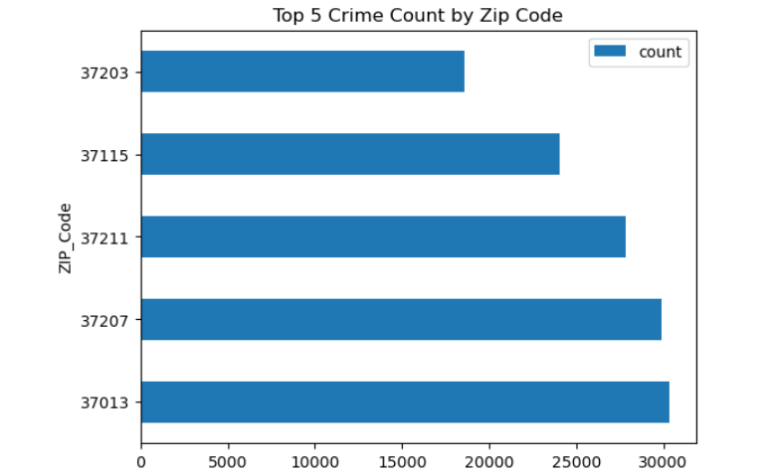
Does crime rate impact enrollment or graduation rates?

Slide 13
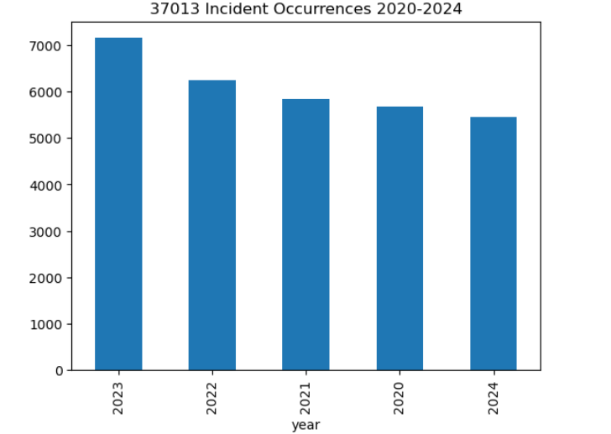
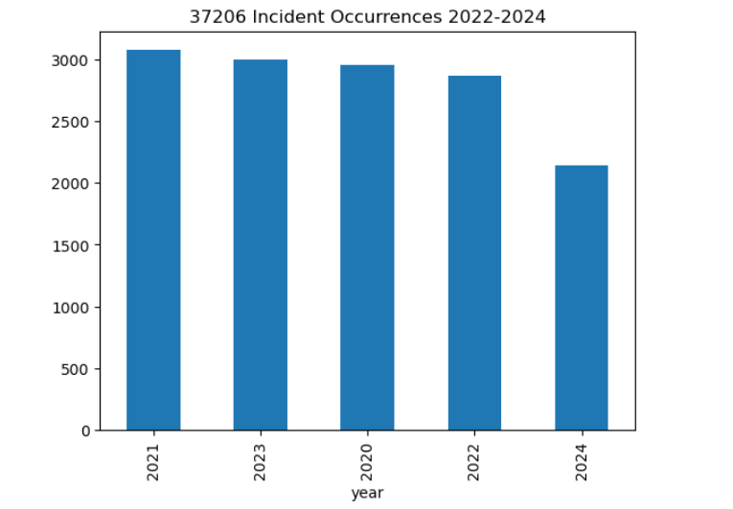
Crime rates in 37013 vs 37206

Slide 14

Insights
37013 crime seems to impact graduation rates
37206 graduation rates were the greatest for high schools overall
More data is needed to gain further insight into whether more correlations exist.

Slide 15

Questions

