Slide 1

Metro Nashville public school data vs Nashville crime rates
By erica henley

Slide 2
About the project
Explored enrollment rates vs graduation rates and how crime stats impact them
Used Excel & Python
Tableau dashboard

Slide 3

Goals
To discover which public schools have the highest graduation rates
To discover which public schools have the lowest graduation rates
To discover if crime rates seem to impact these statistics

Slide 4



Data sources
Metro Nashville Public School Open Data: https://www.mnps.org/about/communications/opendata
Tennessee Dept. of Education https://www.tn.gov/education/districts/federal-programs-and-oversight/data/data-downloads.html
Nashville Open Data https://datanashvillegov-nashville.hub.arcgis.com/datasets/d747436243e9439e968fce056545016a_0/explore?location=35.885029%2C-86.948355%2C7.34

Slide 5
Enrollment rates in metro public schools
Put overview of last five years

Slide 6
Who has the best rates?

Slide 7
Worst rates

Slide 8
Avg, other stats

Slide 9
Graduation rates
overview

Slide 10

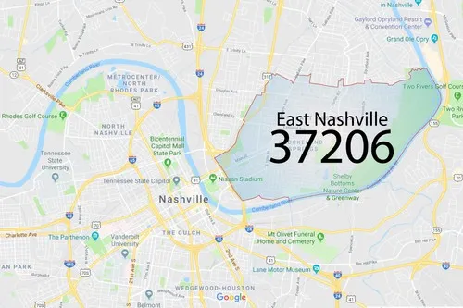
Best Graduation Rates
East Nashville Magnet High School

Slide 11
worst

Slide 12
Other stats

Slide 13
Does crime rate impact enrollment or graduation rates?

Slide 15
Further questions
Need more police data/better data with more info in order to explore more

Slide 16
end
Thanks!

