Slide 1

Metro Nashville public school data & Nashville crime rates
By erica henley

Slide 2
About the project
Explored graduation rates and how crime stats impact them
Used Excel & Python
PowerBI

Slide 3

Goals
To discover which public schools have the highest & lowest graduation rates
To discover if crime rates seem to impact these statistics
To see if any other factors found within the data could impact graduation rates

Slide 4



Data sources
Metro Nashville Public School Open Data: https://www.mnps.org/about/communications/opendata
Tennessee Dept. of Education https://www.tn.gov/education/districts/federal-programs-and-oversight/data/data-downloads.html
Nashville Open Data https://datanashvillegov-nashville.hub.arcgis.com/datasets/d747436243e9439e968fce056545016a_0/explore?location=35.885029%2C-86.948355%2C7.34

Slide 5
Issues encountered
Missing values
Formatting errors
Zip code info in police data

Slide 6
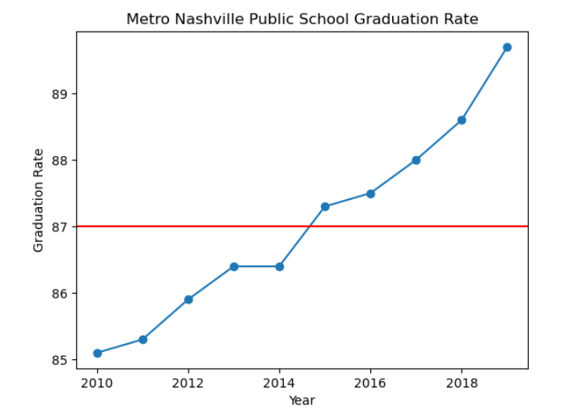
Graduation rates

Slide 7
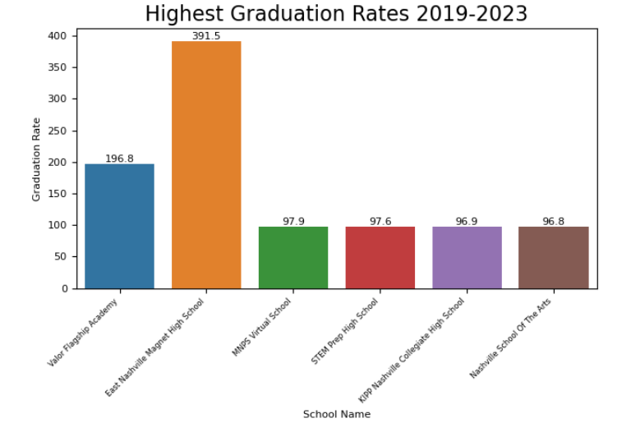
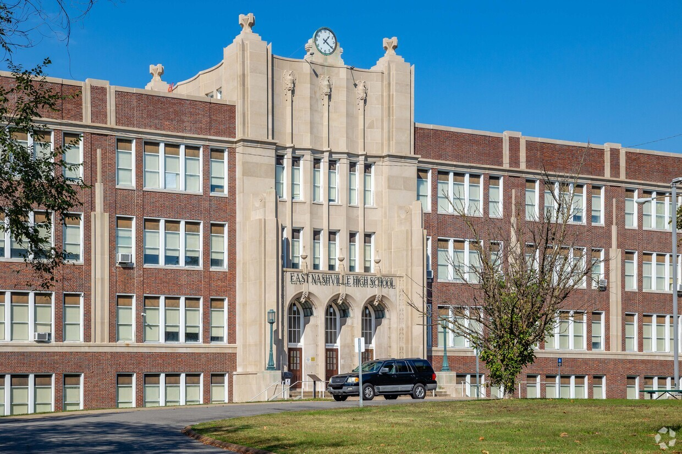
Best Graduation Rates
East Nashville Magnet High School

Slide 8
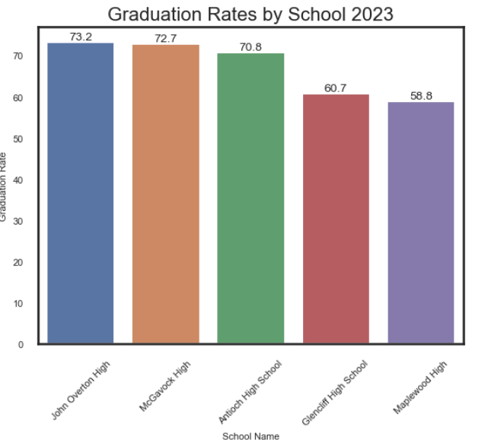
Lowest Graduation rates in 2023
Maplewood High – 37216
Glencliff High – 37211
Antioch High – 37013
McGavock High – 37214
John Overton High – 37220

Slide 9
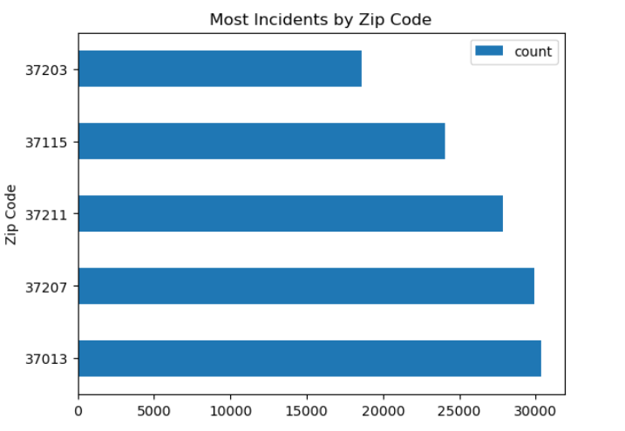
Does crime rate impact enrollment or graduation rates?

Slide 10
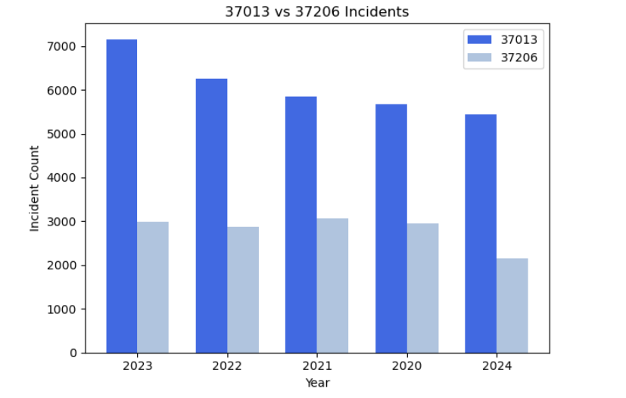
Crime rates in 37013 vs 37206
Highest graduation rate zip code vs lowest graduation rate zip code

Slide 11
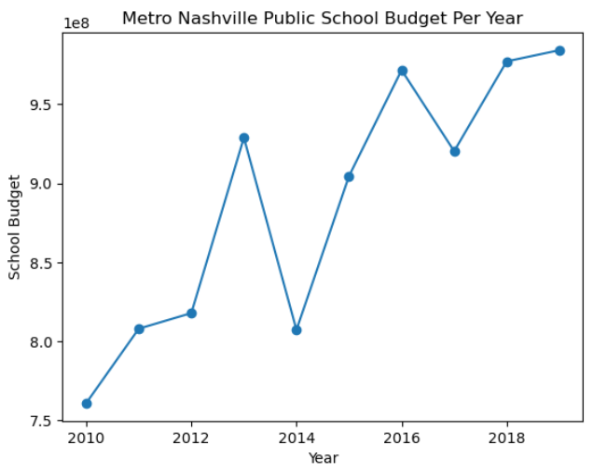
Metro Nashville public school budget

Slide 12
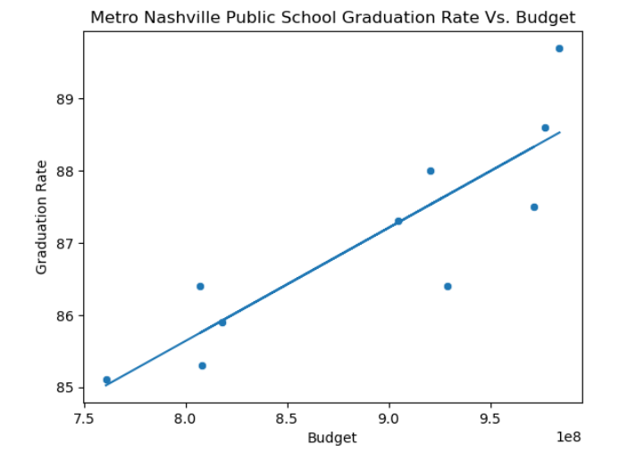
MNPS Budget vs graduation rates
The higher the budget, the better the graduation rate?

Slide 13

Insights
High crime rates seem to impact everyday factors, such as graduation rates
School budgets and graduation rates have a correlation

Slide 14

Questions?
Thank you for your time!
Please feel free to reach out with any follow-up questions
Contact Info:
Erica Henley
henley.er@gmail.com
870-560-8192

