Slide 1
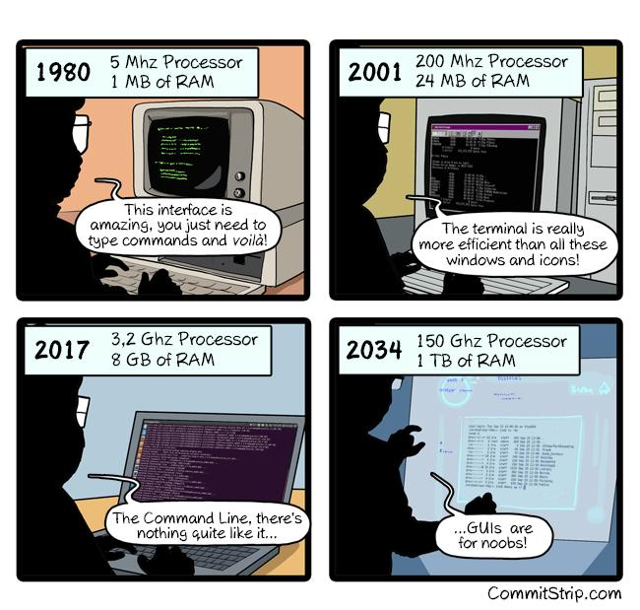
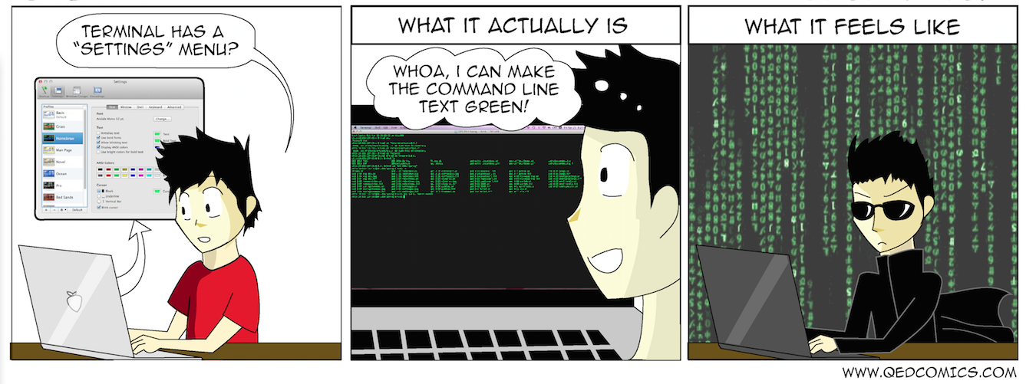
Interacting with the Shell
Spring 2025
PCfB Class 2
January 24, 2025

Slide 2
Outline
Intro to Unix shell
Configuration files
Useful commands
Assignment

Slide 3
Intro to unix shell

Slide 4
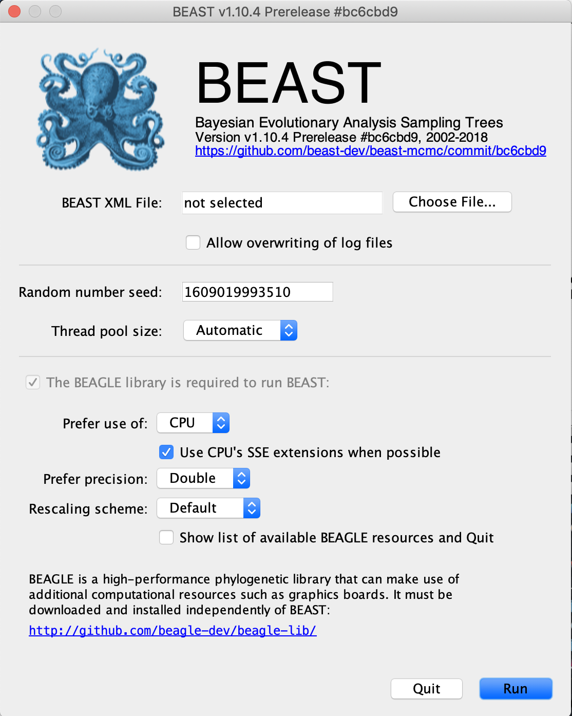
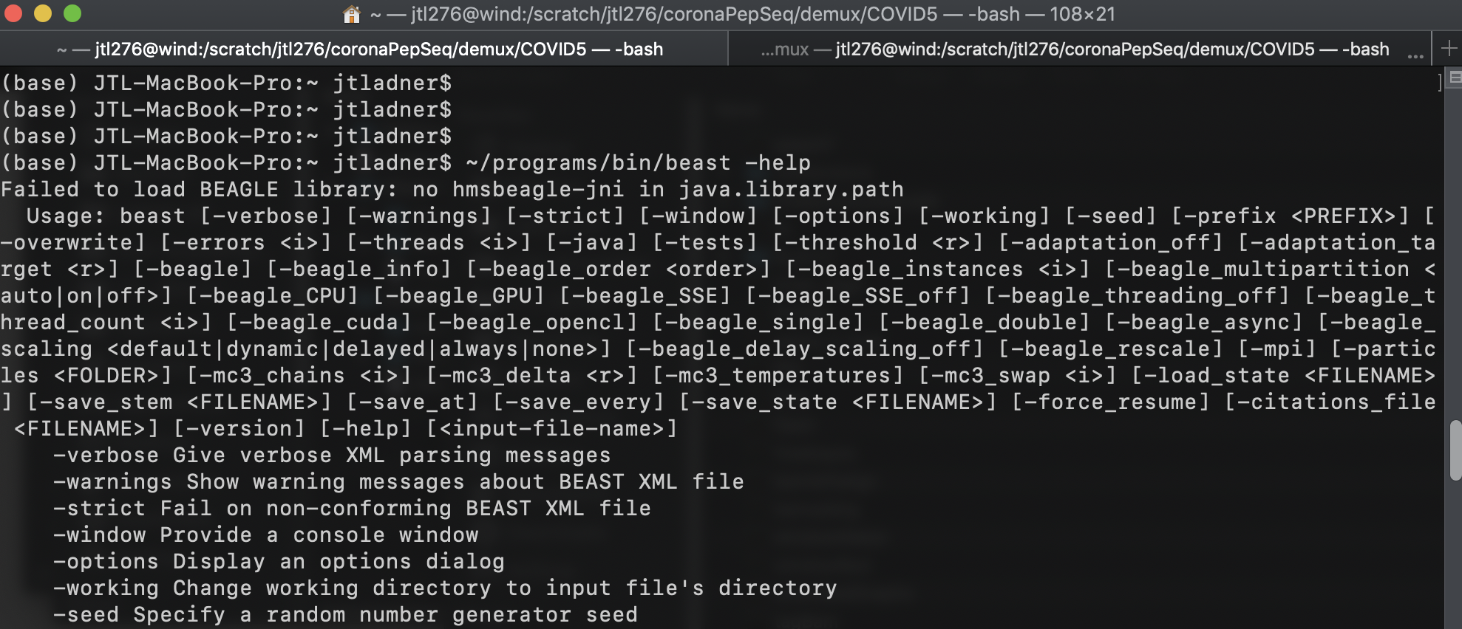
GUI vs. Command line
Graphical user interface
Command line/Terminal

Slide 5
Unix Shell
Command-line interpreter
A programming language
Commands can be entered by a user or read from a file

Slide 6
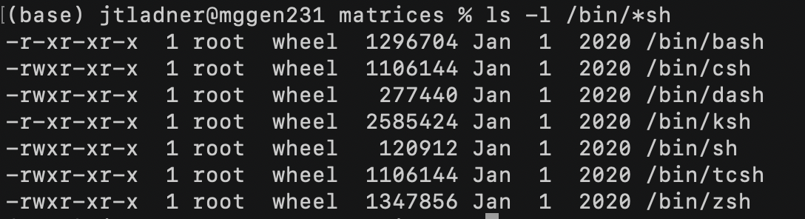
Available shells on my computer

Slide 7

Be careful!
The shell will not ask for confirmation before permanently deleting files from your computer
Deleted files are NOT moved to the trash
No Undo (ctrl-z)

Slide 8
Filesystem structure

Slide 9
/
Users
Volumes
Library
bin
Guest
efa38
zsh
mkdir
programs
.zshrc
directory
file

Slide 10
Types of paths
Absolute – always begins at the root
Relative – starts at working directory

Slide 11
/
Users
Volumes
Library
bin
Guest
efa38
zsh
mkdir
programs
.zshrc

Slide 12
/
Users
Volumes
Library
bin
Guest
efa38
zsh
mkdir
programs
.zshrc

Slide 13
/
Users
Volumes
Library
bin
Guest
efa38
zsh
mkdir
programs
.zshrc
(..) move backwards

Slide 14
/
Users
Volumes
Library
bin
Guest
efa38
zsh
mkdir
programs
.zshrc
tilda (“~”)

Slide 15
Configuration files

Slide 16
Bash:
Zsh:
.bash_profile
.bashrc
.zshrc

Slide 17
Practically speaking…
For Mac OSX:
You only need .bash_profile or .zshrc
Terminal.app runs login shell for each new window, by default
For Linux:
Use .bashrc for most settings
Execute .bashrc within .bash_profile (instructions on GitHub)

Slide 18

set -o noclobber
Protects you from accidentally overwriting files that already exist

Slide 19
Subtle change to behavior of up and down arrow keys
Still scroll through command history…
but now if you start typing a command, you will only scroll through commands that match what you have started typing

Slide 20
Bash:
bind '"\e[A": history-search-backward'
bind '"\e[B": history-search-forward'
Zsh:
bindkey '\eOA' history-beginning-search-backward
bindkey '\e[A' history-beginning-search-backward
bindkey '\eOB' history-beginning-search-forward
bindkey '\e[B' history-beginning-search-forward

Slide 21
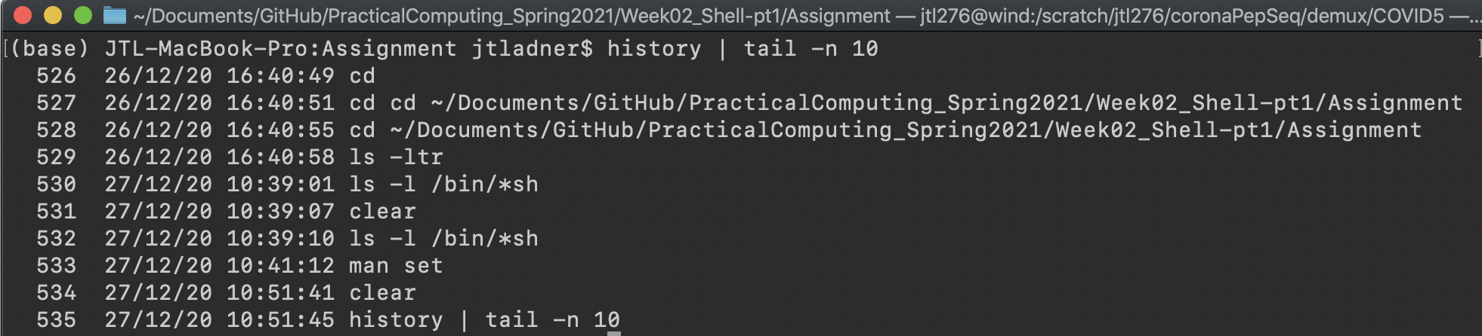
HISTTIMEFORMAT="%d/%m/%y %T "
Add time stamp to each command from history

Slide 22
fc -li
Alternative to history for zsh
history -i -#

Slide 23
source command
Changes to your .bash_profile/.bashrc/.zshrc will not automatically take effect within your current session
2 options:
Open a new terminal window
source ~/.bashrc

Slide 24
Useful commands

Slide 25
Getting around
pwd
ls
cd
Print working directory
List –l long, –t time, –a all, –r reverse
Change directory

Slide 26
Create/modify/delete files
cp
mv
rm
Copy
Move (rename)
Remove

Slide 27
Create/delete directories
mkdir
rmdir
Make directory
Remove directory

Slide 28
history
history -i -#
history | tail -n # >>commands.txt
fc –li | tail –n # >>! commands.txt

Slide 29
Commands covered in reading
Getting around
Creating/deleting files
Other
cd
pwd
cp
mv
rm
mkdir
rmdir
grep
cat
curl
man (-k)
history
ls
View/edit text
less
nano/pico
Data flow
>
>>
|

Slide 30
Other useful commands

Slide 31
Extracting parts of files
head
tail
Grab lines from beginning of file
Grab lines from end of file

Slide 32
Quantify file contents
wc
grep -c
word count
returns matching lines from a file
returns the number of matching lines

Slide 33
rename
Rename multiple files at the same time
Foil1.txt
Foil2.txt
Foil3.txt
rename –s foil file *txt

Slide 34
Keyboard shortcuts
ctrl-a
ctrl-e
ctrl-u
ctrl-k
Move cursor to start of command
Move cursor to end of command
Delete everything to left
Delete everything to right

Slide 35
Configuration and terminal demos

