Slide 1
OUTLINE
Weekly Overview
Paper Presentation
NAS and Ftrace Related
Data Movement Related
Discussion

Slide 2
OUTLINE
Weekly Overview
Paper Presentation
NAS and Ftrace Related
Data Movement Related
Discussion

Slide 3
Weekly Overview
This week:
NAS Architecture and Components
FAST’09 Capture, conversion, and analysis of an intense NFS workload; Eric Anderson, HP Labs
ATC’08 Measurement and Analysis of Large-Scale Network File System Workloads; Andrew W. Leung, Shankar Pasupathy, Garth Goodson, Ethan L. Miller; University of California, Santa Cruz, NetApp Inc
Data Movement
SIGOPS’19 Learned OS: “Learned” Operating Systems; Yiying Zhang, Yutong Huang; Purdue University

Slide 4
OUTLINE
Weekly Overview
Paper Presentation
NAS and Ftrace Related
Data Movement Related
Discussion

Slide 5
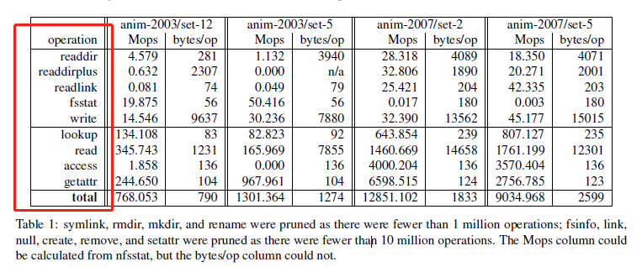
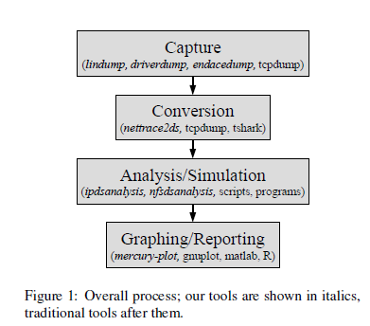
NFS
FAST’09 Capture, conversion, and analysis of an intense NFS workload; Eric Anderson, HP Labs
(1) Issues:
Problem Kernel: Introduce methods to capture, convert, store and analyze NFS workloads and propose a standard procedure for workload tracing.
Working Scenario: Storage system and tracing.
Shining point: A series process to capture, conversion, analysis and reporting.
(2) NFS tracing procedures:
Raw packet capture, usually as some type of trace. Better to capture network.
Main challenge is the underlying data rate: → To parse NFS packets, must capture the complete packet.
Captured host is not interacting with clients, it has no way to throttle incoming packets, so it should capture at the full sustained rate or risk packet loss. (Write to disk can handle such issue, while another challenge may incur I/O overhead.)
Propose Lindump based on tcpdump, a memory-mapped, shared ring buffer with compressed disk persistence.
Conversion, from some raw format into a format designed for analysis.
decides logical structure of converted data → picks physical structure for the converted data → run conversion quickly → Trace anonymization
Analysis to reduce the huge amount of converted data to Sth manageable, which a simulation or replay to explore some new system architecture.
Challenge: bounded memory. → Approximate quantiles for statistic. → Data cube for query matching. → Hash table based memory management
Generate graphs or textual reports from the output of the analysis or simulation.
(3) Evaluation：NFS workload is read-heavy
The tools described in this paper are available as open source from http://tesla.hpl.hp.com/opensource/ , and the traces are available from http://apotheca.hpl.hp.com/pub/datasets/animation-bear/. (Invalid now)

Slide 6
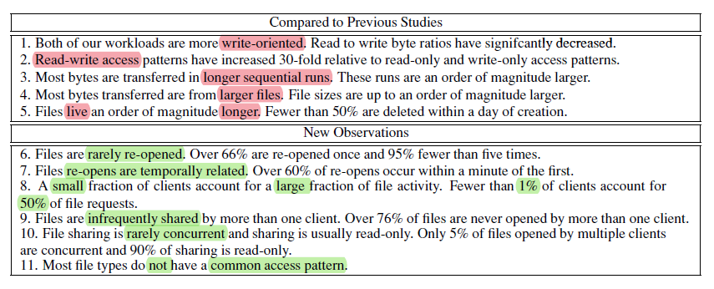
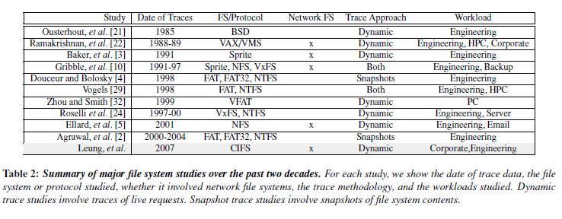
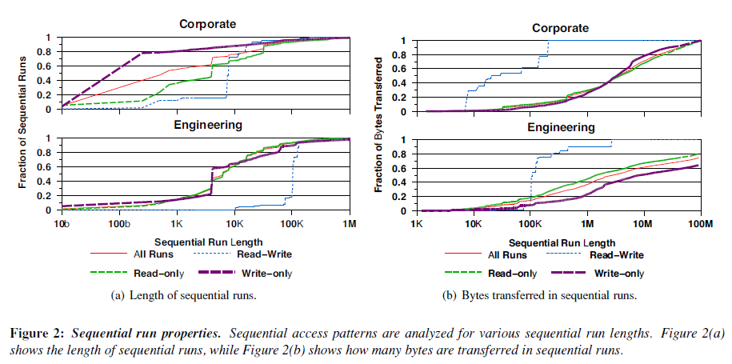
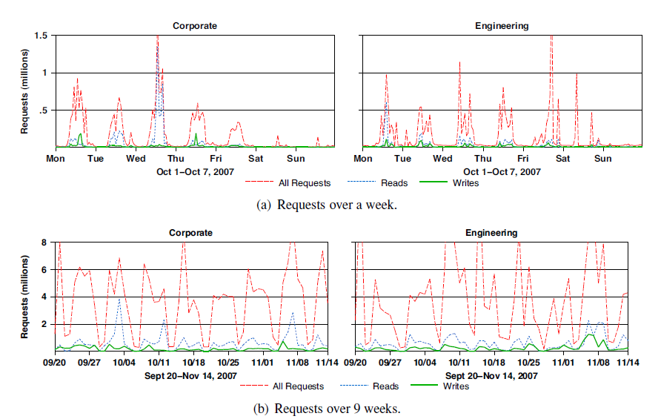
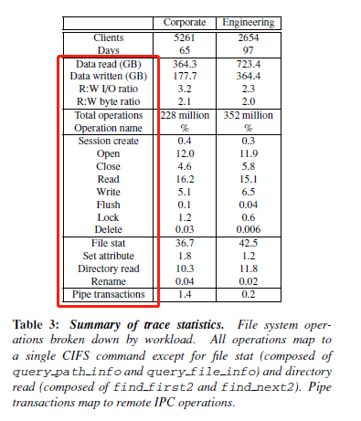
NFS
ATC’08 Measurement and Analysis of Large-Scale Network File System Workloads; Andrew W. Leung, Shankar Pasupathy, Garth Goodson, Ethan L. Miller; University of California, Santa Cruz, NetApp Inc
(1) Issues:
Problem Kernel: Difference of network file system workloads compared to previous file system trace, in terms of access, usage, and sharing patterns.
Working Scenario: Network storage system and tracing.
Shining point: mainly focus on write operations.
(2) NFS trace features :
Current Works do not target to NFS.
In this paper:
Changes in file access patterns and lifetimes:
Read-write file access patterns, which are highly random, are much more common relative to read-only and write-only access patterns;
Current workloads tend to be more write-oriented than before, with only about twice as many bytes read as written.
(2) Properties of file I/O and file sharing.
(3) Relationship between file type and client access patterns.
(3) Evaluation：
(4) Conclusion:
An insight: we can summarize the workload pattern by some features/parameters mentioned in this paper. I.e., redraw the access pattern based on sequential/ random writes

Slide 7
OUTLINE
Weekly Overview
Paper Presentation
NAS and Ftrace Related
Data Movement Related
Discussion

Slide 8
Data Movement
SIGOPS’19 Learned OS: “Learned” Operating Systems; Yiying Zhang, Yutong Huang; Purdue University
(1) Issues:
Problem Kernel: Discussion about the potential possibilities and corresponding challenges for adopting ML for OS.
Working Scenario: General OS like Linux and Windows.
Shining point: specify several potential issues that can be solved by ML in OS.
(2) Limitations (Challenges) for adopting ML in OS:
Difficult to develop/implement ML in integrated OS. Manually development needs non-trivial efforts.
Cannot efficiently tune the OS: i.e., Linux V5.1 holds 17K kernel configs, so that manual config is neither efficient nor achievable.
OS is always running, adaptiveness must be satisfied. Previous solutions may not be useful for current situations.
General OS shows weak support for professional hardware/apps.
(3) Potential Fields:
Learning Configurations. Memory management (89); file system (351); network system (729). Standard Scenarios: Scheduling/irq; Threshold config
Learning Policies. Make decisions based on big data and powerful computing. Space allocation (allocate virtual memory space mmp())
Learning mechanisms. Mapping :Virtual memory addresses to physical memory addresses; file name and offset to disk logical block address
(4) Evaluation：
(5) Conclusion:
A general overview summarizing potential fields that can adopt ML

