Slide 1
FAST’04 → A Trace Collection Tool for File System
Tracefs: A File System to Trace Them All
Akshat Aranya, Charles P. Wright, and Erez Zadok; Stony Brook University
A better tracing tool is really needed since the current (2004) tools is not efficient and versatile.
File system traces have been used to analyze user behavior and system software behavior, leading to advances in file system and storage technologies. Existing traces, however, are difficult to use because they:
were captured for a specific use and cannot be changed (often ad-hoc manner and only supports specific features),
often miss vital information for others to use (not well-documented),
become stale as time goes by (not extendable),
cannot be easily distributed due to user privacy concerns.
It is not uncommon: much time is wasted because available traces are unsuitable for the tasks at hand.
An ideal tracing tool:
Flexibility. most important since current tracing tool are cumbersome to store and parse or were focused on specific areas of study that make them less useful to other studies.
Performance. Tracing is inherently expensive, since it requires disk or network I/O. When designing tracing mechanisms, tradeoffs have to be made between performance and functionality.
Convenience of Analysis, Security and Privacy.

Slide 2
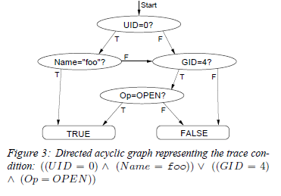
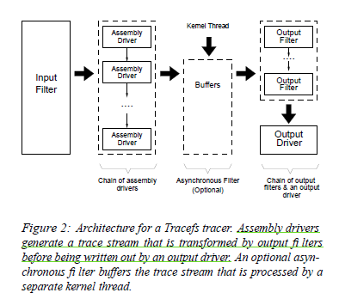
FAST’04 → A Trace Collection Tool for File System
Tracefs: A File System to Trace Them All
Akshat Aranya, Charles P. Wright, and Erez Zadok; Stony Brook University
Tracefs, a thin stackable file system for capturing file system traces in a portable manner, which can capture uniform traces for any file system/various degrees of granularity, without modifying the file systems being traced.
It can transform trace data into aggregate counters, compressed, checksummed, encrypted, or anonymized streams; and it can buffer and direct the resulting data to various destinations (e.g., sockets, disks, etc.).
Components of Tracefs:
Input Filters. to specify an expression that determine what operations are traced, then user can specify arbitrary boolean expressions built from a set of basic predicates, such as UID, GID, PID, session ID, process name, file name, VFS operation type, system call name, etc.
Assembly Drivers. Once the input filter has determined that a certain operation should be traced, the filter passes the corresponding VFS objects to a series of assembly drivers that determine the content of generated traces.
Stream driver. converts the fields of VFS objects into a stream format. The stream driver generates one message for each logged file system operation.
Aggregate driver. collect statistical distributions of operations, instead of actually logging each operation, which has been traditionally performed by post-processing. An aggregate driver that keeps track of the number of calls made during a tracing session and records the values at the end of the session.
Output Filters. provide added functionality such as encryption, compression, and checksum calculation.
Compression filter. Traces often contain repeated information. For example, the meta-data of the traces, like message identifiers and argument identifiers, is often repeated, which is well to compression. It compresses trace data on-the fly while introduces additional overheads. (traditional zlib method and so on)

Slide 3
LISA’14 → Trace Modeling and Replay
ParaSwift: File I/O trace modeling for the future
Rukma Talwadker, Kaladhar Voruganti; NetApp Inc.
Traces are used for designing and testing systems but are large and difficult to store and manage. Thus, creating models based on traces is gaining traction.
Prior works only target to model block trace, instead of file trace like that generated by NFS, NAS etc.
Modeling file traces is difficult because of the presence of meta-data operations and the statefulness NFS operation semantics
Backgrounds:
To get representation of app, one needs to capture a trace for hours, which usually leads to storing of multiple terabytes of data.
Traces have been leveraged to create workload models that can, in turn, be used to generate I/O patterns.
Benefits of modeling traces:
trace models are easier to copy and handle than large trace files;
using the trace model one can scale the I/O patterns present in the original trace in both temporal and spatial domains;
easier to simultaneously, selectively replay portions of trace across respective server mount points using a trace model.
Current works focus on block trace modeling like SAN workloads, while the attention towards NAS workloads are limit.
Current NAS workload does not present challenges inherent to the file I/O traces like metadata and I/O operation mixes, hierarchical file namespaces etc. Hence, modeling these virtualized file workloads is same as modeling SAN workloads.

Slide 4
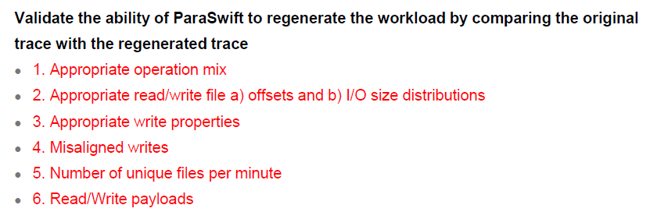
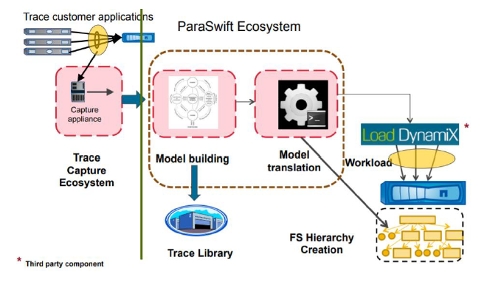
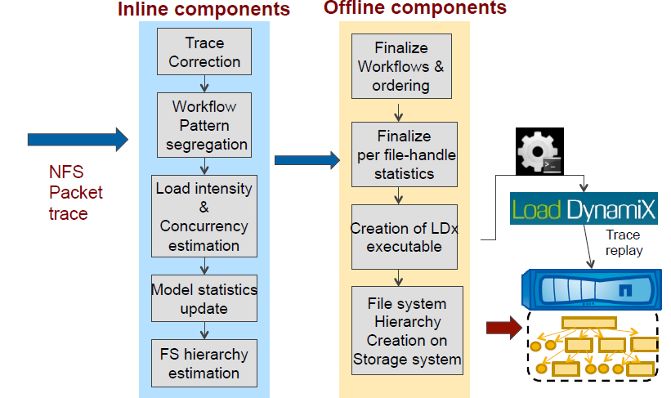
LISA’14 → Trace Modeling and Replay
ParaSwift: File I/O trace modeling for the future
Rukma Talwadker, Kaladhar Voruganti; NetApp Inc.
ParaSwift, algorithms and a framework for modeling and replaying NFS (also SAN, NAS) workloads that addresses the open problems:
the previous NAS trace modeling and replay research efforts
the limitations of current file system benchmarking tools
some new challenges in trace modeling due to the increased intensity in new types of workloads.
System Overview: need to build models for very large traces in a resource efficient manner, so that process is divided into 5 distinct phases:
Trace parsing. parser extracts and presents NFS request by stream (client-host) in the order of the request arrival to sampling component.
Inline trace sampling. The streamed way in ParaSwift requires model building data structures are updated in memory. After memory is full, it will spill over to the disk.
Inline trace model building. make efficient use of host memory; eliminate the need for doing multiple passes through the trace for model building; represent the workload characteristics in a very compact way without much information loss.
Batch trace processing. the in-memory data structures constructed by ParaSwift cannot be directly fed to a load regenerator, which requires batched way on the data structures for extracting the necessary model parameters.
Trace model translation for replay. use a commercial load generator (Load DynamiX), which achieves a high-fidelity translation of the ParaSwift trace model to an equivalent workload profile, and also provides the ability to seamlessly scale the trace workloads to over a million clients per NFS server mount point.
Notes:
Effort 1: Operations like creation and deletion of symbolic links, renaming of files/directories can change the underlying file system (FS) image.

Slide 5
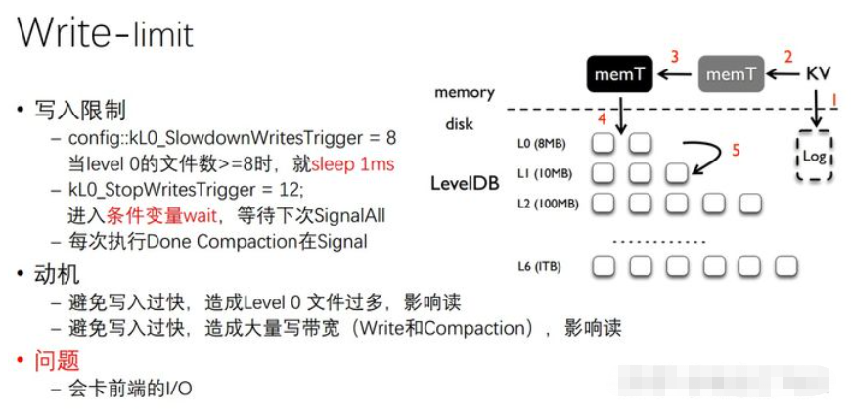
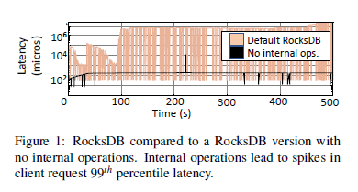
ATC’19 Tail Latency solved by Configuration and Scheduling
-config::kL0_SlowdownWritesTrigger = 8
Client threads sleep 1 sec;
-config::kL0_StopWritesTrigger = 12
→ Clients wait (locked) for compaction done
SILK: Preventing Latency Spikes in Log-Structured Merge Key-Value Stores
Oana Balmau, Florin Dinu, and Willy Zwaenepoel, University of Sydney; Karan Gupta and Ravishankar Chandhiramoorthi, Nutanix Inc.; Diego Didona, IBM Research–Zurich
Motivation: The read performance may be hurt if too many SSTables in L0
Consequence: the bandwidth for in-coming requests are restricted.
The tail latency in LSM-tree-based KV store is a tough issue but can be eased by tuning and rescheduling of upper-level compaction.
The contradiction between In-coming I/O requests and internal operations are responsible for tail latency.
Internal operations (flush+L0 compaction, lower-level compaction) should be rescheduled to digest the incoming request more efficiently. The trade-off between read/write requires compaction to be more sensitive, especially Flush + L0 compaction.
Background
Compactions severely hamper throughput. Various optimizations have dealt with this problem, while it is still pending to solve the latency, especially tail latency by optimizing I/O caused by compaction.
Current solutions that alleviate the tail latency:
TRIAD, reduces internal operations overhead by
keeping frequently updated keys in Memtable, decreasing internal operation overhead in skewed workloads.
providing an improvement to the flush by leveraging data already written in WAL.
at the disk level, employing a cost-based approach to trigger compaction from L0 to L1.
PebblesDB, avoids most of compaction overhead of merging and rewriting SSTables by allowing overlapping key-ranges on all but the highest tree level through Fragmented LSM trees.
compaction

Slide 6
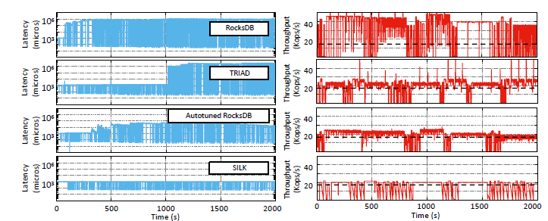
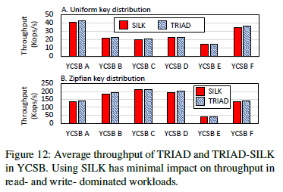
ATC’19 Tail Latency solved by Configuration and Scheduling
SILK: Preventing Latency Spikes in Log-Structured Merge Key-Value Stores
Oana Balmau, Florin Dinu, and Willy Zwaenepoel, University of Sydney; Karan Gupta and Ravishankar Chandhiramoorthi, Nutanix Inc.; Diego Didona, IBM Research–Zurich
Key Insight: techniques proposed for optimizing throughput do not address tail latency issue, and in fact in some cases exacerbate it.
The root cause of these high tail latencies is interference between client writes, flushes and compactions.
SILK, a new open-source KV store, incorporates the notion of an I/O scheduler to reduce this interference.
Main Ideas:
Dynamic bandwidth allocation. opportunistically allocates more bandwidth to internal operations during periods of low load.
Separate SILK thread continuously monitors the bandwidth used by client operations and allocates the available leftover I/O bandwidth to internal operations.
Prioritizing and preempting internal operations. Internal work is handled by a pool of worker threads. Once a flush or a compaction is completed, the system checks whether more internal work is needed by assessing the size of the levels and the state of the memory component.
a high-priority one for flushing, and a low-priority one for compactions where L0 adopts preempting compaction.
Higher-level compactions. Compactions on levels higher than L1 are scheduled in the low priority pool, which make use of the I/O bandwidth available by a dynamic rate limiter.
SILK can pause and resume these larger compactions, either individually (because of L0 to L1 compaction preemption) or at the level of the thread pool (because of high user load).

Slide 7
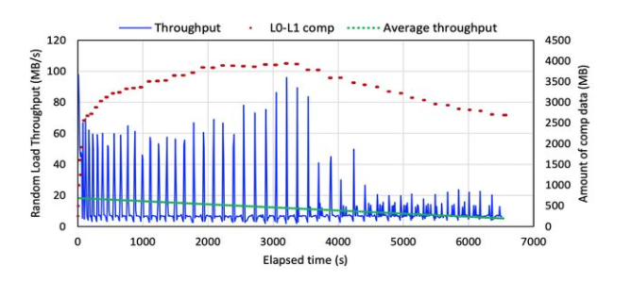
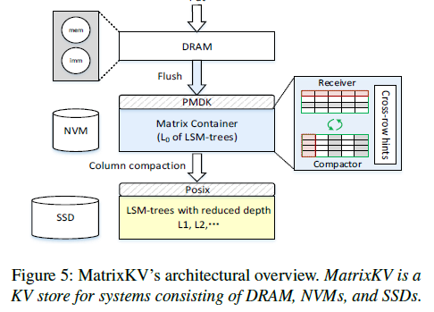
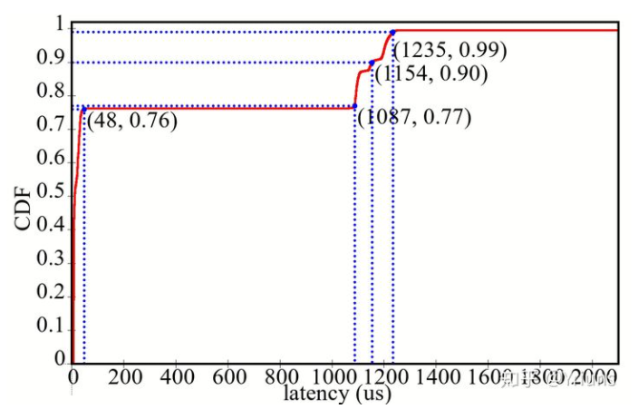
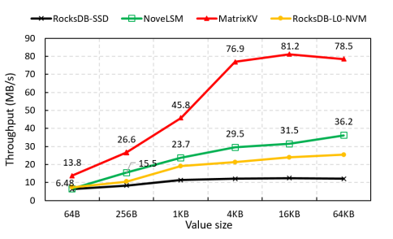
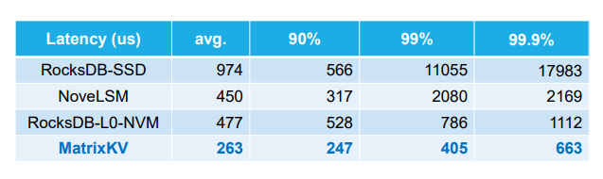
ATC’20 Tail Latency Solved by PM and Configuration
MatrixKV: Reducing Write Stalls in LSM-Tree
Ting Yao, Yiwen Zhang, and Jiguang Wan, Huazhong University of Science and Technology; Qiu Cui and Liu Tang, PingCAP; Hong Jiang, UT Arlington; Changsheng Xie, Huazhong University of Science and Technology; Xubin He, Temple University
The Write stall (tail latency) and Write amplification can be handled by adopting the NVM devices, with considering:
CPU and SSD bandwidth consumption by L0-L1 compaction; (quite like that proposed by SILK)
too much LSM-tree levels; (only adopts SILK methods can not fundamentally solve the tail latency since the shape of the tree may become unbalanced if the deeper level compactions are always delayed.)
MatrixKV, a KV store that uses PM for persisting SSTables in L0, and decrease the LSM-tree based on configuration.
Matrix Container, remove the SSTable format restriction of block unit, embedded index, and organize SSTable in L0 as matrix
Column compaction, compact more L0 SSTables to L1 in parallel;
Reducing LSM-Tree Depth based on configuration and matrix container.

Slide 8
ATC’20 Tail Latency Solved by PM and Configuration
MatrixKV: Reducing Write Stalls in LSM-Tree
Ting Yao, Yiwen Zhang, and Jiguang Wan, Huazhong University of Science and Technology; Qiu Cui and Liu Tang, PingCAP; Hong Jiang, UT Arlington; Changsheng Xie, Huazhong University of Science and Technology; Xubin He, Temple University
(1) Issues:
Problem kernel: Write stall (tail latency) and Write amplification
→ CPU and SSD bandwidth consumption by L0 compaction; → too much LSM-tree levels
Working scenario: LSM-tree based key-value stores that can be deployed in datacenters or embedded devices.
Shining point: shows write stalls in the architecture view, solving the problem by combining system design and new devices, not only focus on tail latency.
(2) Contributions:
Current solutions: system level redesign; new devices; configuration; parallelism; and etc
This paper:
Matrix Container, remove the SSTable format restriction of block unit, embedded index, and organize SSTable in L0 as matrix
Column compaction, compact more L0 SSTables in L0 in parallel;
Reducing LSM-Tree Depth based on configuration and matrix container.
(3) Evaluation (in figure)
(4) Conclusion:
Another work targets to tail latency while the global performance is also enhanced by NVM and less tree depth.

