Slide 1
SIGMOD’21
Nova-LSM: A Distributed, Component-based LSM-tree Key-value Store, Haoyu Huang, Shahram Ghandeharizadeh, University of Southern California Los Angeles.
Based on the trend of disaggregation storage from computation, it is time to rethink whether the centralized storage system design still works efficiently.
Background.
The cloud infrastructure motivates disaggregation of monolithic data stores into components based on an application’s workload.
Persistent multi-node key-value stores (KVSs) are widely used. And LSM-tree are preferable for write-intensive workloads.
Fast networking hardware (e.g., RDMA), potentially provides connectivity between components that constitute a data store
Motivation. To improve resource utilization, cloud-native data stores leverage the cloud infrastructure with hardware-software co-design to enable elasticity. This motivates disaggregation of monolithic data stores into components.
→ Physically, a component utilizes the appropriate hardware and scales independent of the others.
Challenges after Disaggregation:
Write stall caused by either all Memtables are full or the size of SSTables at Level exceeds a threshold. (to best use memory capacity)
More Memtables slows down scans and gets by searching a larger number of Memtables and SSTables at Level0.
Temporary bottlenecks may form due to random collision of many writes to a few, potentially one storage node, which slows down requests due to queuing delays.

Slide 2
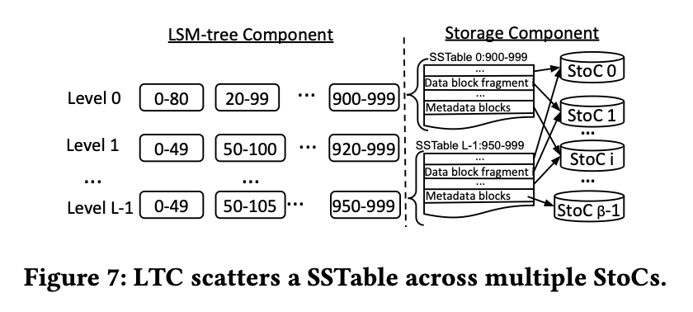
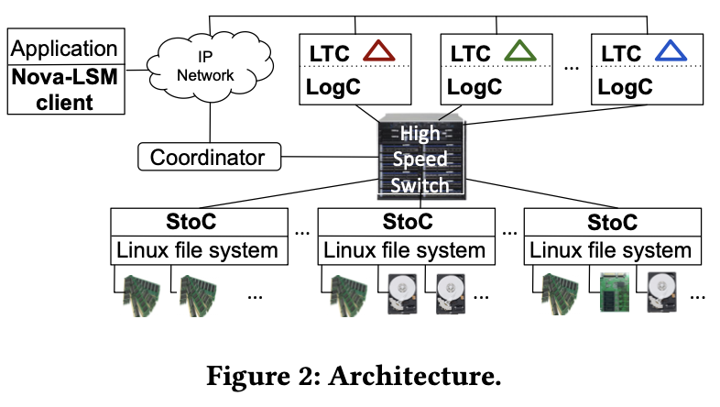
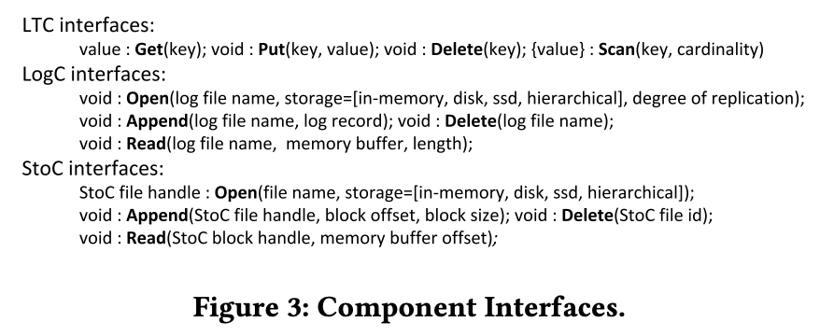
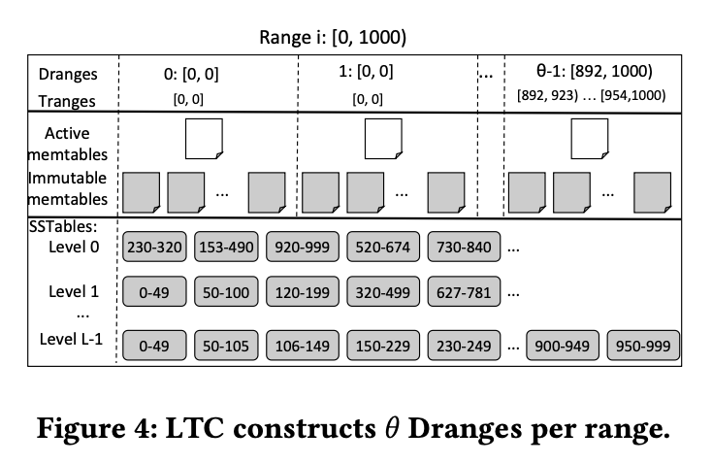
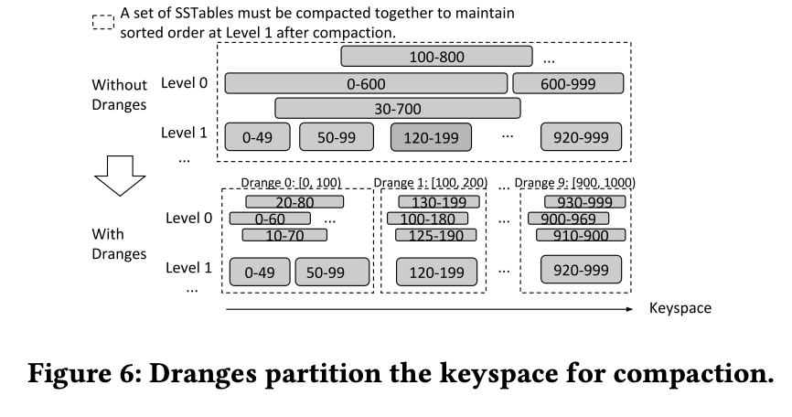
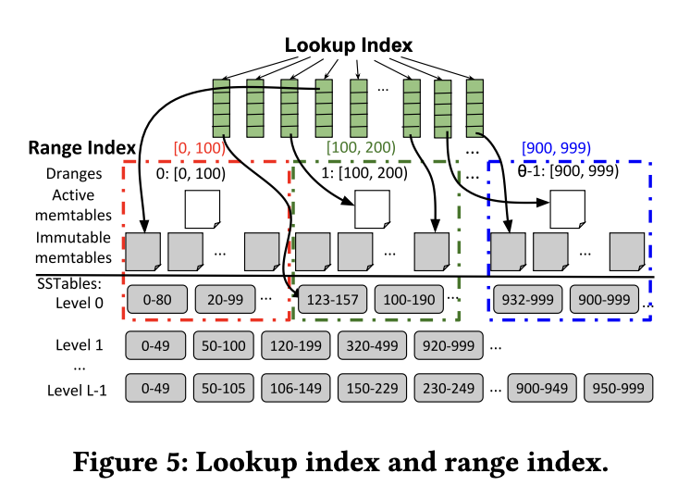
SIGMOD’21
Nova-LSM: A Distributed, Component-based LSM-tree Key-value Store, Haoyu Huang, Shahram Ghandeharizadeh, University of Southern California Los Angeles.
Main idea. Disaggregation of an LSM-tree key-value store into components that communicate using RDMA, by which storage is separated from processing, enabling processing components to share storage bandwidth and space.
→ Nova-LSM consists of LSM- tree components (LTCs), logging components (LogCs), and storage components (StoCs).
An LTC consists of 𝜔 ranges, for which LTC constructs an LSM-tree. Application’s requests are handled by these trees.
A LogC is a library integrated into an LTC and is responsible for generating log records to StoCs during normal mode of operation and fetching log records during recovery mode.
A StoC stores, retrieves, and manages variable-sized blocks using alternative storage mediums, e.g., HDD, SSD, or a storage hierarchy.
The coordinator maintains a configuration that contains the partitioning information and the assignment of ranges to n LTCs. Nova-LSM clients use this configuration information to direct a request to an LTC with relevant data.
These components are interconnected using RDMA.
To make full use of bandwidths of multiple storage nodes, the number of Memtables will be more than coupled LSM-tree storage engine.
For massive memtables: Drange that allows parallel compaction, which is transparent to application.
For poor read: Pointer-based Range index for each tree; In memory bloom filter; Parallel Search for each range; Parallel Compaction;
For Load balancing: By scattering blocks of a SSTable across multiple StoCs based on power-of-d to assigning writes to StoCs.

Slide 3
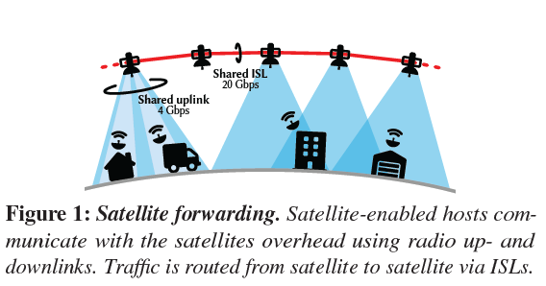
ATC’21 → Please Don’t Chain Me Up: Blockchain and Security
ICARUS: Attacking low Earth orbit satellite networks. Giacomo Giuliari, Tommaso Ciussani, Adrian Perrig, Ankit Singla Department of Computer Science, ETH Zürich
Internet service based on low Earth orbit satellites is excitement in the networking community due to its potential for global low-latency connectivity. However, the security of operation has been neglected.
Background
Low Earth Orbit (LEO) Satellite Networks (LSNs). SpaceX Starlink issued x1000s satellites will be arranged in equally-spaced orbital planes, each containing the same number of satellites, which connect to terminal units (TUs) on the ground with radio links, and to each other by laser (inter-satellite links, ISLs). Each orbit has a fixed height (relatively low) above sea level to guarantee better communication latency.
Communication.
Satellite–ground connectivity. TUs are installed at the clients on the ground. Each satellite can simultaneously connect with multiple TUs. Based on multibeam antennas, a satellite has 4 Gbps capacities for uplink and downlink respectively.
Inter-satellite connectivity. There are 4 ISLs per satellite, two connected to fore and aft satellites in the same orbital plane, and two to satellites in adjacent orbital planes. Traffic can be forwarded from a TU to a satellite in view through an uplink, then across multiple ISLs, and finally to the destination via a downlink.
Benefits: (1) Global low-latency broadband: Based on the multi-gigabit connectivity, LSNs can blanket the globe with broadband Internet and reduce latency for long-distance routes by more than 2 compared to today’s Internet: the speed of light in a vacuum is 50% higher than the speed of light in the glass medium of optical fiber; (2) ISLs provides more direct path between TUs than what fiber can achieve on the ground.
Denial of service. It is a new field to analyze to encompasses a large class of attacks. (e.g, DDoS)

Slide 4
ATC’21 → Please Don’t Chain Me Up: Blockchain and Security
ICARUS: Attacking low Earth orbit satellite networks. Giacomo Giuliari, Tommaso Ciussani, Adrian Perrig, Ankit Singla Department of Computer Science, ETH Zürich
Propose ICARUS, a DDoS attack on LSNs, with the objective of congesting (try to block) a target link or set of target links. It do so at low cost (attack traffic volume), and with low detectability (change in the ingress (entrance) bandwidth at individual satellites).
ICARUS Model.
The ICARUS adversary controls a botnet of compromised hosts equipped with TUs that connect to the LSN. These bots are exploited by the adversary to send traffic over the LSN to congest links and disrupt communications between other TUs controlled by benign users.
→ Botnet: a network of private odes infected with malicious software and controlled as a group without the owners' knowledge.
DDoS Attack. When the botnet targets the victim's server or network, each bot will send a request to the target's IP address overwhelmly, lead to a denial of service to normal traffic. Since each robot is a legitimate node and difficult to distinguish between attack traffic and normal traffic.
Main Works
Draw out the unique features of LSNs that introduce a vulnerability to DDoS.
Different from traditional network, the topology and routing latency of LSN are known by everyone, which makes it easy to attack.
LSNs is global coverage, thus providing diverse locations for potential bots. Even if terminals are secure, it suffices to compromise the user devices connected through them, and therefore exploits used today to create botnets directly apply in the case of a satellite-enabled botnet
By ICARUS, exploits these features to successfully congest target links in an LSN, which addresses the new challenges the LSN setting poses for the adversary of cost and detectability.
Use simple single shortest-path routing setting to show how connectivity between large regions may be hampered by ICARUS.
Use randomized multipath routing scenario showing that the attack still succeeds with high probability.

Slide 5
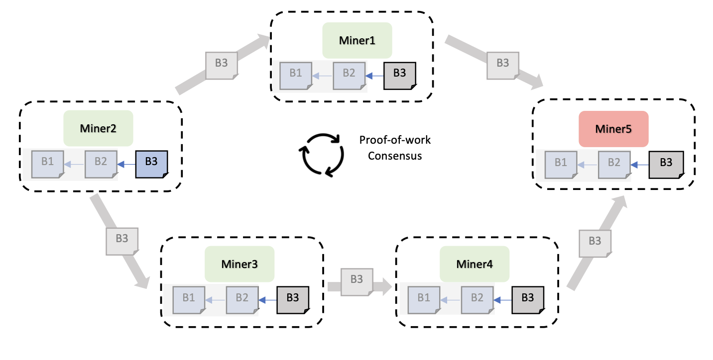
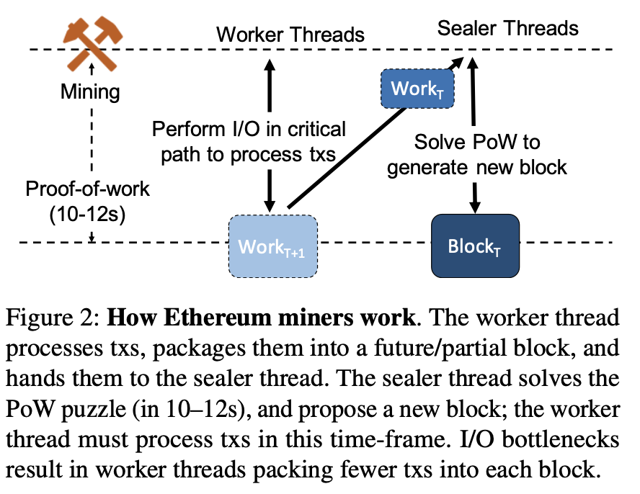
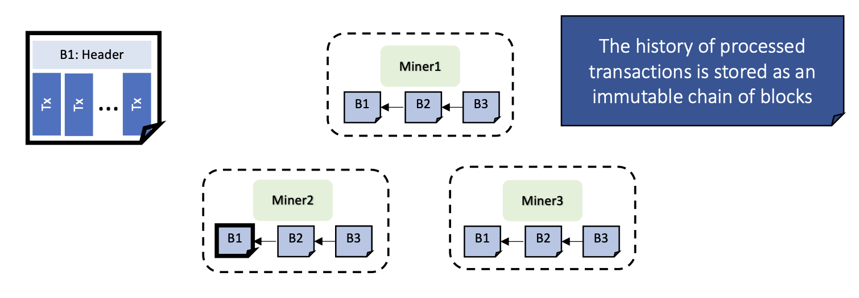
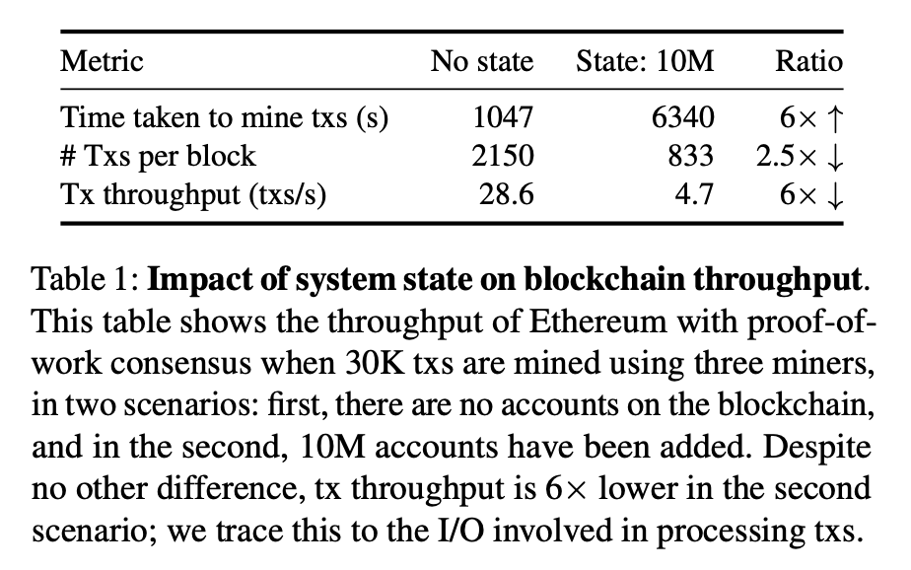
ATC’21 → Please Don’t Chain Me Up: Blockchain and Security
RainBlock: Faster Transaction Processing in Public Blockchains. Soujanya Ponnapalli, Aashaka Shah, and Souvik Banerjee, University of Texas at Austin; Dahlia Malkhi, Diem Association and Novi Financial; Amy Tai, VMware Research; Vijay Chidambaram, University of Texas at Austin and VMware Research; Michael Wei, VMware Research
Ethereum and other public blockchains suffer from low throughput: only tens of txs are added to the blockchain per second.
Background
Blockchains in a system view → a decentralized database. It maintains the history of transactions as an immutable chain of blocks; each block has an ordered list of transactions and is processed after its parent or previous block. It can be public, allowing untrusted servers to process transactions, or private, allowing only a few specific servers.
PoW of Public Blockchains. (1) Miners receive txs submitted by users, process these txs (executing txs and grouping into a block). (2) Several miners compete to add a block to the blockchain. Each miner tries to solve a PoW puzzle; the miner that solves the puzzle attaches the solution and broadcasts its block to other miners. (3) Other miners verify the PoW solution and the txs in the block, and build on top of the block. (4) A tx is confirmed or finalized once ten blocks are built on top of the block containing the tx.
Problems: Low throughput
(1) The sealer threads needs 10-12s to handle the Pow puzzle.
(2) While sealer thread is working on one block, worker thread tries to get the next block ready. Thus, the worker has about 10–12s to process txs; if it can process txs faster, it can pack more txs into the partial block that it passes to the sealer.
For Worker, accessing and authenticating data becomes more expensive as the total size of the data (system state) increases.
→ How about increasing block size and corresponding processing performance per PoW?

Slide 6
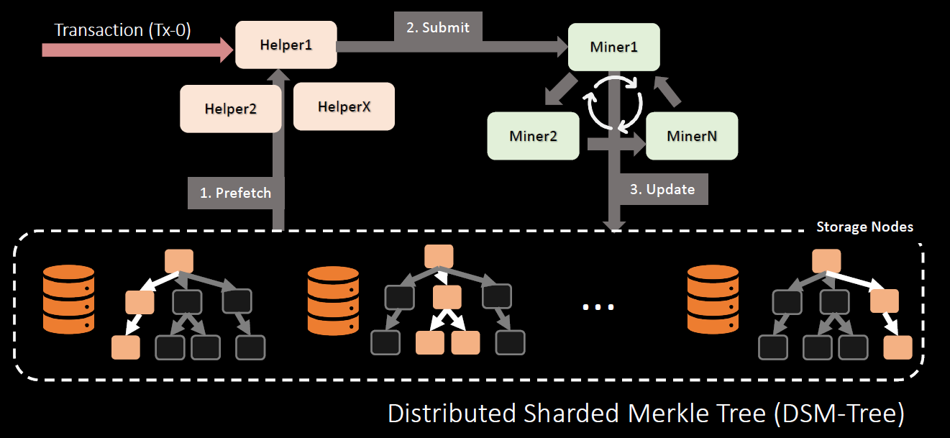
ATC’21 → Please Don’t Chain Me Up: Blockchain and Security
RainBlock: Faster Transaction Processing in Public Blockchains. Soujanya Ponnapalli, Aashaka Shah, and Souvik Banerjee, University of Texas at Austin; Dahlia Malkhi, Diem Association and Novi Financial; Amy Tai, VMware Research; Vijay Chidambaram, University of Texas at Austin and VMware Research; Michael Wei, VMware Research
Propose Rain-Block, a public blockchain that achieves high transaction throughput without modifying the proof-of- work consensus.
Key Insight: while PoW limits the block creation rate, it does not limit the block size (number of transactions in each block). The block size is limited by the rate at which miners can process transactions.
→ If we could increase the rate at which transactions are processed, we could increase the block size safely, without modifying the PoW consensus.
Previous Obstacle to increase block size: the time taken to propagate the block increased marginally, while the time taken to process transactions saw a significant increase. → Handle this issue in this paper.
→ Fundamental Inefficiency for tx processing → inefficient read derived from the RocksDB KV engine, optimize which can overcome the bottleneck.
(1) Merkle tree is serialized and stored in a RocksDB, traversing the Merkle tree requires multiple, expensive RocksDB reads
(2) miners process txs one by one in the critical path; this reduces parallelism and allows I/O bottlenecks to limit the tx throughput.
Solution:
(1) Deconstructing miners into three entities: storage nodes that store data, miners that process txs, and I/O-Helpers that fetch data and proofs from storage nodes and provide them to miners.
(2) Distributed, Sharded Merkle Tree (DSM-TREE), which stores data in a multi-versioned fashion across shards and allows concurrent reads and writes, eliminating the inherent serialization from using key-value stores like RocksDB.

Slide 7
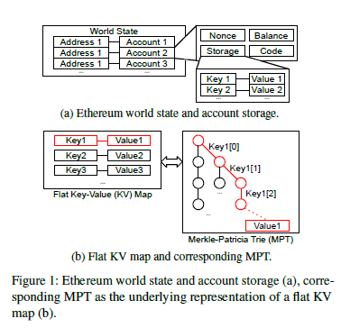
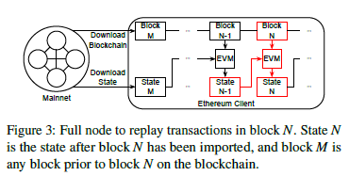
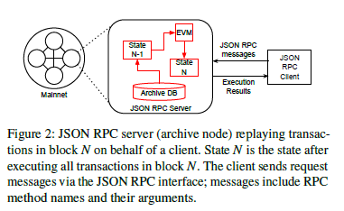
ATC’21 → Please Don’t Chain Me Up: Blockchain and Security
An Off-The-Chain Execution Environment for Scalable Testing and Profiling of Smart Contracts. Yeonsoo Kim and Seongho Jeong, Yonsei University; Kamil Jezek, The University of Sydney; Bernd Burgstaller, Yonsei University; Bernhard Scholz, The University of Sydney
Testing and profiling of Ethereum transactions at scale are difficult, with huge space occupation and performance inefficiency.
Background
Blockchain Client & Smart Contracts.
Data volume becomes huge. The number of unique Ethereum accounts soared from 20M in 2018 to more than 131M by January 2021.
Urgent demand for building tools that improve the correctness, efficiency, and security of their smart contracts.
Ethereum Client. It function as peers on the Ethereum network; the history of all state changes of a smart contract is kept by client.
Ethereum World State. The Ethereum world state is the global state information of Ethereum that maps between account addresses and the data associated with an account.
→For state verification, clients are required to maintain a local copy of the entire global state after processing a particular block.
Current Testing and Transaction Replay Method.
Overview. Testing smart contracts requires an Ethereum world state and a transaction execution environment
A process modeled as Transaction replay: the execution of a tx at the historical Ethereum state that the transaction was originally executed on at a given block height on the blockchain.
Tx Replay Delegation. Clients are configured as Ethereum archive nodes to keep the entire history of world states in their database and be used to retrieve historical state information → inefficient since the challenges from (1), (2) and (3).
Full node replay. When clients are configured as full nodes, they replay transactions for verification and synchronization with peers on the network.
→ Even the pending blocks are trimmed, it still follow the sequential process and cause massive space occupation. Worse if M is very “early”.

Slide 8
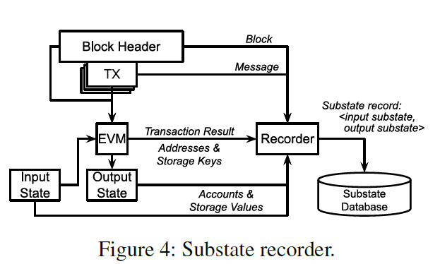
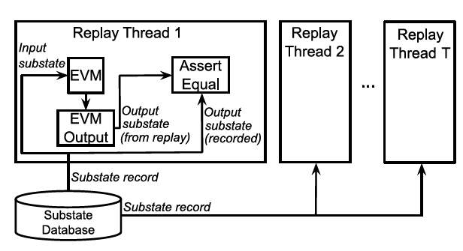
ATC’21 → Please Don’t Chain Me Up: Blockchain and Security
An Off-The-Chain Execution Environment for Scalable Testing and Profiling of Smart Contracts. Yeonsoo Kim and Seongho Jeong, Yonsei University; Kamil Jezek, The University of Sydney; Bernd Burgstaller, Yonsei University; Bernhard Scholz, The University of Sydney
Fundamental Issue:
(1) Needs to be isolated towards main chain so that the replay can be parallel.
(2) Needs fine-grained discrimination of state so that the data should be retrieved can be further trimmed.
Techniques
Off-the-chain Testing by recording and replaying.
Defining Substate. It contain only relevant parts of the world-state and environment parameters that contain enough information to replay a transaction with no dependency on earlier transactions.
Recorder. It records historical state from before and after a transaction on the chain.
→ Main idea: an augmented Ethereum client that produces the historical state as a side effect while importing blocks from the blockchain. For a transaction, it captures and store substates in the substate database, which is a flat key-value map.
Replayer. It mocks the Ethereum protocol of a client such that transactions can be executed without the peer-to-peer network of Ethereum and the cryptographic verification tasks of a client.
Main idea: It operates directly on the substate database. It executes transactions off-the-chain, in parallel, and in isolation achieving unprecedented scalability for testing smart contracts.
Implementation based on Ethereum virtual machine (EVM).
Developers write smart contracts in the Solidity language that translates smart contracts into an immutable bytecode representation for the EVM. Bytecode is persistently deployed on the blockchain where it can be invoked for execution on the EVM in a transaction.

