Slide 1
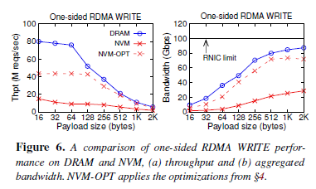
ATC’21 → Peeking over the Fence: RDMA
Characterizing and Optimizing Remote Persistent Memory with RDMA and NVM; Xingda Wei, Xiating Xie, Rong Chen, Haibo Chen, Binyu Zang；Institute of Parallel and Distributed Systems, Shanghai Jiao Tong University, Shanghai Artificial Intelligence Laboratory Engineering Research Center for Domain-specific Operating Systems, Ministry of Education, China
NVM becomes popular with high performance, persistence, and byte-addressability; The acceptance of building remote memory systems with RDMA have produced interest in combining them for fast and persistent remote memory systems. However, many prior systems are either based on emulated NVM or have failed to fully exploit NVM characteristics, leading to suboptimal performance.
Background:
RPM (Remote Persistent Memory) becomes the key building block in modern datacenter.
Distributed File System, e.g., Octopus, uses a distributed NVM pool to store file system metadata and file data blocks. It achieves high throughput and bandwidth for reading/write file data through Client-Active Data I/O: the client directly read/write a file’s data block using one-sided RDMA READ/WRITE. It also leverages RDMA-enabled distributed transactions to update the filesystem metadata.
Distributed Database, e.g., DrTM+H, a distributed transactional system designed for RDMA and NVM, leverages the power of one-sided and two-sided RDMA to boost transaction execution, which adopts optimistic concurrency control (OCC) to ensure serializability. It organizes NVM as a distributed shared memory pool to store the database records and transaction logs.
Opportunities appears in building efficient RPM since RDMA are widely adopted in modern datacenters and NVM are accepted as “disk storage’’.
Challenges: how to integrate RDMA with NVM?
Even RDMA can directly access NVM as DRAM, the performance is poor without proper optimizations, which leads to inefficiency in existing RDMA-NVM systems.
RDMA access NVM in a complex way. Many inter/inner call involved with the way not considering NVM device.

Slide 2
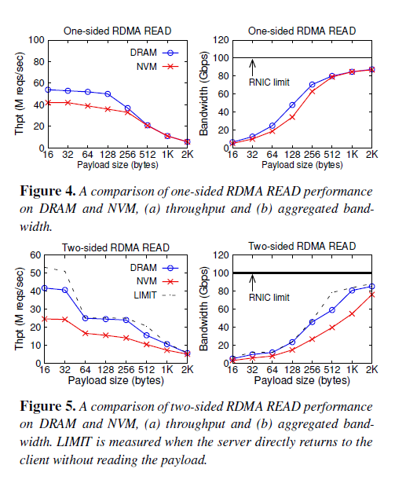
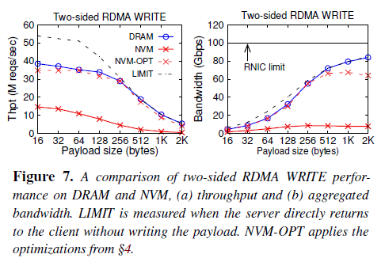
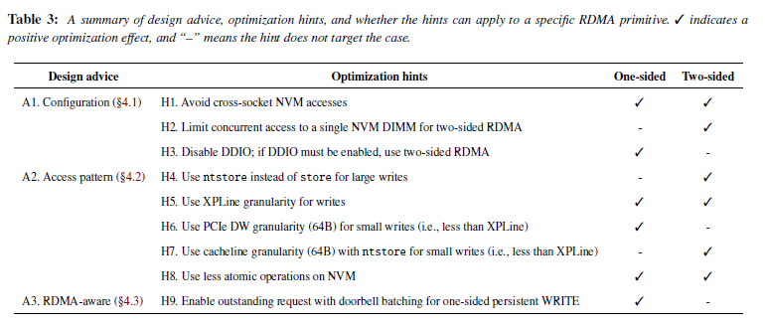
ATC’21 → Peeking over the Fence: RDMA
Characterizing and Optimizing Remote Persistent Memory with RDMA and NVM; Xingda Wei, Xiating Xie, Rong Chen, Haibo Chen, Binyu Zang；Institute of Parallel and Distributed Systems, Shanghai Jiao Tong University, Shanghai Artificial Intelligence Laboratory Engineering Research Center for Domain-specific Operating Systems, Ministry of Education, China
Conducts a systematic study to summarize optimization hints that the system designer can use to exploit NVM with RDMA better.
→ How system configurations, NVM access patterns, and RDMA-aware optimizations affect the efficacy of RDMA-NVM systems.
→ Based on hints, empirically study the design of two RDMA-NVM systems: distributed database (DrTM+H) and a distributed file system (Octopus).
Main works:
Performance analysis (Evaluation).
Remote write, i.e., the client issues write requests to the server NVM using either one-sided or two-sided RDMA.
→ much slower than that of DRAM.
Remote read, it has close performance to that of DRAM due to the asymmetric read/write performance feature (§2.1) of NVM.
Optimization Hints.
One-sided RDMA communicate with Optane PM
through PCIe read/write transactions, while
Two-sided RDMA uses server CPU to read/write PM.
Focus on Configurations (1-3), Access pattern (4-8),
and RDMA-aware setup.

Slide 3
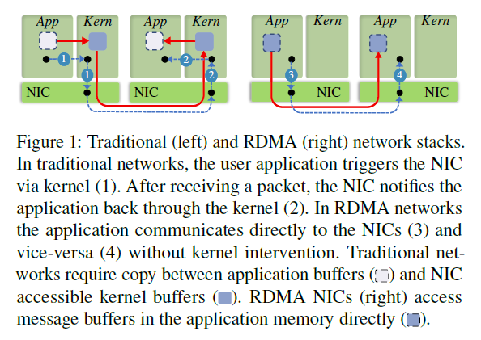
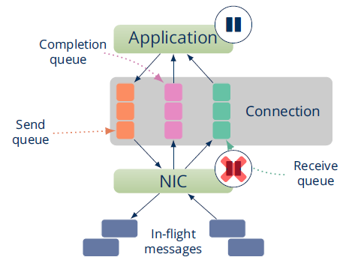
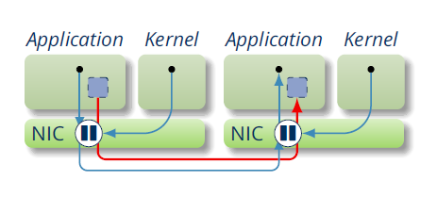
ATC’21 → Peeking over the Fence: RDMA
MigrOS: Transparent Live-Migration Support for Containerized RDMA Applications; Maksym Planeta, Jan Bierbaum, Leo Sahaya Daphne Antony, Torsten Hoefler, Hermann Härtig; TU Dresden, AMOLF, ETH Zürich
As RDMA offload packet-processing onto specialized APIs by special hardware (NICs) and bypass the OS to improve network latency and bandwidth, OS loses control over active RDMA connections and loses the possibility to migrate RDMA applications transparently.
Background & Motivation：
Current situation for RDMA and container in cloud environments:
RDMA is widely used because of its better performance; containers have become a popular tool for lightweight virtualization. Containerised apps, being independent of the host’s user space (libraries, apps, config files), simplify distributed app deployment and administration.
RDMA networks and containers follow contradicting architectural principles: Containerisation enforces stricter isolation between apps and host, whereas RDMA networks try to bring apps and underlying hardware “closer” to each other.
Live migration are expected to be conducted quickly, while Direct device access complicates live migration since it breaks the isolation.
It moves app state (between containers) transparently and imposes no additional requirements for the application by checkpoint, state transfer and restart. The state of RDMA communication is not recoverable by existing systems, hence RDMA apps cannot be checkpointed or migrated.
Consistent Checkpointing, involves send, receive and completion queues, which shares the connection state. Under such scenarios, OS can stop the app while it can not control the NIC, so that some updates (in-flight messages) may lost.
CRIU cannot save/restore RDMA verbs/objects.
It is a software enabling live migration by transparent checkpointing and restoring of Linux processes. To extract the user-space app state, CRIU uses conventional debugging mechanisms; to extract the state of process-specific kernel objects, CRIU depends on special Linux kernel interfaces.
During recovery, CRIU runs inside the target process and recreates all OS objects on behalf of the target.

Slide 4
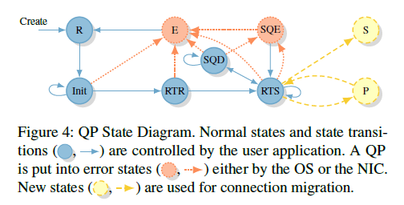
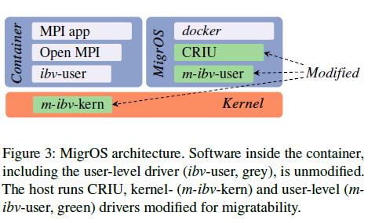
ATC’21 → Peeking over the Fence: RDMA
MigrOS: Transparent Live-Migration Support for Containerized RDMA Applications; Maksym Planeta, Jan Bierbaum, Leo Sahaya Daphne Antony, Torsten Hoefler, Hermann Härtig; TU Dresden, AMOLF, ETH Zürich
Proposes MigrOS, an OS-level architecture for transparent live migration of containerized RDMA applications. It is sufficient to only extend CRIU with IB verbs support, existing container runtimes use CRIU for their checkpoint/restore functionality
A set of minimal changes to the RDMA communication protocol reenables live migration without interposing the critical path operations.
Requires no changes to the user applications and maintains backwards compatibility at all levels of the network stack.
General ideas and design: live migration with no application modifications and no performance overhead.
Two new QP states to enable the creation of consistent checkpoints for Queue Pair states migration.
Before: Each newly-created QP is in the Reset (R) state. To send and receive messages, a QP must reach its final Ready-to-Send (RTS) state. Before reaching RTS, the QP traverses the Init and Ready-to-Receive (RTR) states. In case of an error, the QP goes into one of the error states; Error (E) or Send Queue Error (SQE).
Newly added: When the kernel checkpoints a process, all of QPs go into the Stopped (S) state. A stopped QP does not send or receive any messages. A QP becomes Paused (P) when it learns that its destination QP has transitioned to the Stopped state. A paused QP does not send messages, but also has no other QP to receive messages from.
Connection Migration Protocol: by which, the communication partner of the migrating container not confuse migration with a network failure; once the migration is complete, all partners of the migrated container need to learn its new address modifications to the packet-level RoCEv2 protocol.
Protocol Changes
Checkpoint/Restore API

Slide 5
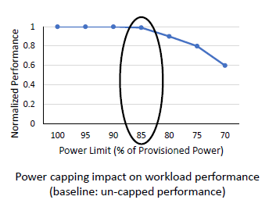
ATC’21 → Dogs Never Get Tired: Power and Edge Computing
Prediction-Based Power Oversubscription in Cloud Platforms; Alok Kumbhare, Reza Azimi, Ioannis Manousakis, Anand Bonde, Felipe Frujeri, Nithish Mahalingam, Pulkit A. Misra, Seyyed Ahmad Javadi, Bianca Schroeder, Marcus Fontoura, and Ricardo Bianchini, Microsoft Research and Microsoft Azure
Prior work has used power capping (upper-bound) to shave rare power peaks and add more servers to a datacenter, thereby oversubscribing its resources and lowering capital costs (money-paid), which requires when the workloads and their server placements are known.
→These factors are unknown in public clouds, forcing providers to limit the oversubscription and thus the potential performance loss from power capping.
Motivations:
Soaring demand for datacenter capacity. 200B+ spent worldwide on datacenter systems.
Efficient resource utilization is key. Lower costs and fewer datacenters build better sustainability if the efficiencies are guaranteed.
Power is typically a bottleneck resource. Massive underutilization due to providing peak power for each server: each sever are equipped with the peak power, while many of them remain unused.
Power Capping and Oversubscription (Prior Work) cannot handle the issue efficiently and automatically.
Harvest unutilized power for adding more servers and use power capping (upper-bound) for safety.
Hardware-based capping on servers to throttle CPU (all cores) and memory to honor cap.
Focus on profile impact of capping on workloads and oversubscribe power while protecting performance
Suffers performance degradation when the available provided power are limited stricter.
Oversubscription Challenges for Cloud Providers: it is limited by performance impact of capping.
Workloads on Virtual Machines (VMs) are Opaque: it remains unknown which ones are critical (e.g., latency-sensitive or user-facing).
Dynamic system (VM arrivals/departures) prevents pre-defined grouping: difficult to harvest power while protecting performance of critical workloads.
Multiple VMs with differing performance requirements per server: if there is impact that full-server throttling can restrict critical VMs?

Slide 6
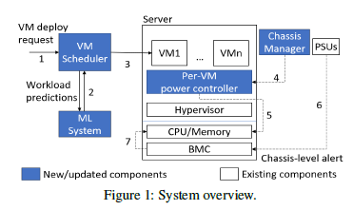
ATC’21 → Dogs Never Get Tired: Power and Edge Computing
Prediction-Based Power Oversubscription in Cloud Platforms; Alok Kumbhare, Reza Azimi, Ioannis Manousakis, Anand Bonde, Felipe Frujeri, Nithish Mahalingam, Pulkit A. Misra, Seyyed Ahmad Javadi, Bianca Schroeder, Marcus Fontoura, and Ricardo Bianchini, Microsoft Research and Microsoft Azure
Fine-grained Power Capping for Oversubscription, by which providers can use predictions of workload performance criticality and virtual machine (VM) resource utilization to increase oversubscription.
Insights:
Not all VMs are performance-critical (e.g., non-production, batch), the ML Predictions can be used to identify performance criticality of opaque VMs.
Fine-grained is better: Per-core dynamic voltage and frequency scaling (DVFS) for throttling (energy-saved) VMs Solution.
Solutions: Criticality-aware per-VM power capping and oversubscription, which provide power safety while protecting performance of critical VMs, and also supports strategy for criticality-aware oversubscription.
System Overview:
Machine Learning (ML) and prediction serving system. It adds algorithms and models to predict VM criticality and resource demand.
They use Resource Central, the existing ML and prediction serving system in Azure, which provides query for predictions, receiving input features (e.g., user, VM size, guest OS) that are known at deployment time from the scheduler, executes ML models (criticality or CPU utilization) and respond with the prediction and a confidence score.
Since user-facing workloads exhibit diurnal load pattern, algorithm can be adopted to identify periodicity in CPU utilization. And finally classify always-throttle and Do-not-throttle VMs.
VM placement with rules to tightly pack VMs on servers. It adds rules for distributing power via criticality and utilization-aware VM placement.
Criticality-aware capping for safety while protecting performance of critical VMs.

