Slide 1
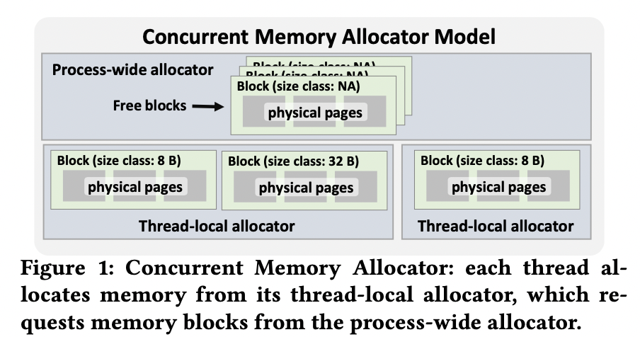
SIGMOD’21
CoRM: Compactable Remote Memory over RDMA; Konstantin Taranov, Salvatore Di Girolamo, Torsten Hoefler, ETH Zurich
Distributed memory systems, with RDMA becomes important since they provide a system-scale abstraction where physically separated memories can be addressed as a single logical one (in- memory databases, caching services). However, since RDMA is involved:
Network controllers and CPUs concurrently access memory, leading to inconsistencies if memory management operations are not synchronized.
→ To ensure consistency, most distributed memory systems do not provide memory compaction and are exposed to memory fragmentation.
Background & Issues
Distributed Shared Memory Systems (DSM). It provides abstractions where the memory of multiple physical nodes is viewed as a single unified memory space. Applications running in it randomly access their local memory or the memory of remote nodes.
Concurrent Memory Allocators (CMAs). Each thread is served by a thread-local allocator, in which memory allocation requests are served from this heap without the need for global synchronization. If a thread-local allocator runs out of memory, it requests new memory from the process-wide allocator.
Trade-off between synchronization overhead and memory efficiency: the larger the block size, the less the number of accesses to the process-wide allocator, the better the scalability; larger blocks can lead to memory inefficiency if the allocated blocks are not fully utilized by the allocating thread.
Memory Fragmentation. An allocator experiences a high volume of allocations followed by only a partial set of deallocations.
Memory Compaction. It takes a set of scarcely utilized blocks and merging them into one, releasing the others.
Involving too much network requests hence hurt the performance (2x throughput degradation.)
Current RDMA-accelerated DSM do not support memory compaction. Memory compaction requires to move allocated data in memory, changing the virtual-to-physical mapping and potentially changing the virtual addresses themselves. When this happens, remote peers cannot access that data via RDMA anymore because the virtual addresses they hold may become invalid.

Slide 2
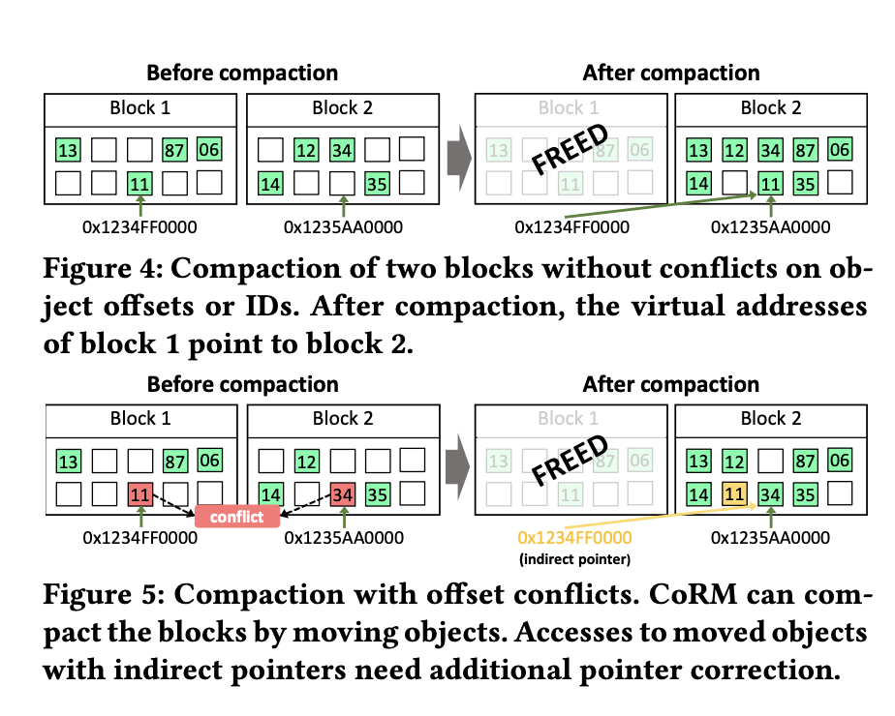
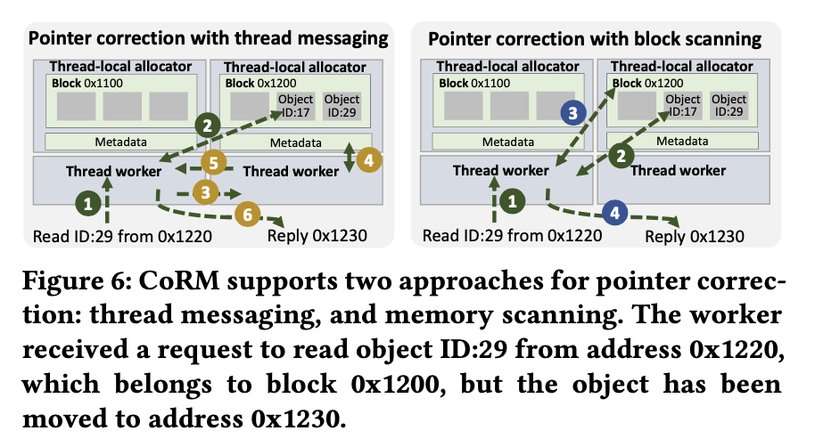
SIGMOD’21
CoRM: Compactable Remote Memory over RDMA; Konstantin Taranov, Salvatore Di Girolamo, Torsten Hoefler, ETH Zurich
Propose CoRM, a shared memory system that exploits RDMA for fast remote accesses and supports memory compaction.
It is RDMA-safe: objects are still accessible via RDMA, and user is guaranteed to observe their consistent state even if they are relocated by the compaction.
Techniques
Memory allocation and compaction.
RDMA-aware memory remapping to silently move objects across physical memory blocks while preserving their virtual addresses and RDMA access keys.
It allocate a physical page using the memfd_create system call; then the allocated physical page is mapped to virtual space using mmap. The process-wide allocator keeps track of all virtual-to-physical mappings. The memfd_create call creates an anonymous (changeable) file that lives in RAM.
For compaction, copy, merge and remap the virtual pointers to the new blocks. (remapping is guaranteed by RNIC.)
Based on the IDs for each object in the block, modifying the physical-logical mapping is enabled. (RNIC needs to update the mapping itself.)
Pointer correction
CoRM always optimistically accesses the object at the hinted offset and then checks its ID. If the ID of the accessed object does not match the one in the used pointer, then CoRM performs a search to find the requested object. Once the object is found, the hint inside the object pointer is updated to the new offset, making the pointer direct.
Pointer release
CoRM stores the address of the virtual block where the object has been initially allocated in the header of each object. This allows us to keep track of how many objects that have been moved out from an old virtual address are still valid and can still be accessed.
Once there are no more of such objects, i.e., they have been deallocated with Free calls, then CoRM can safely assume that the virtual address can be reused.

Slide 3

ATC’21 → Barking up the Wrong Tree: Correctness and Debugging
Argus: Debugging Performance Issues in Modern Desktop Applications with Annotated Causal Tracing; Lingmei Weng, Columbia University Peng Huang, Johns Hopkins University Jason Nieh, Columbia University Junfeng Yang, Columbia University
Modern desktop applications involve many asynchronous, con- current interactions that make performance issues difficult to diagnose.
Although prior work used causal tracing for debugging performance issues, these techniques suffer from high inaccuracies for desktop applications.
Background
For modern desktop apps, performance diagnosis can be very difficult. Such apps are built with complicated frameworks and libraries.
For responsiveness, they divide handling of user interface (UI) events into many small execution segments that run concurrently on multi-core hardware.
→ i.e., macOS apps handle UI events by sending messages to delegate objects that contain code to react to these events asynchronously, which in turn interacts with the OS, daemons, and other libraries. The asynchronous, predominantly concurrent interactions obscure the true cause of an anomaly.
Current Solutions
System Debugger. They excel at analyzing system state at a specific point in time in an individual component. They are not to analyze concurrent execution flows over time whose interactions may cause performance issues.
Causal tracing in distributed system. It debugs cross-component performance issues, utilizes a trace graph to help developers understand performance issues that involve complex interactions. It consists of vertices and edges, where vertices are execution segments (operation, system event, message, etc.,) and edges indicate causal relationships between vertices.
→ Cannot handle desktop issues, since frameworks and libraries used by desktop apps have diverse programming idioms and are often closed-source, making deep instrumentation difficult.

Slide 4
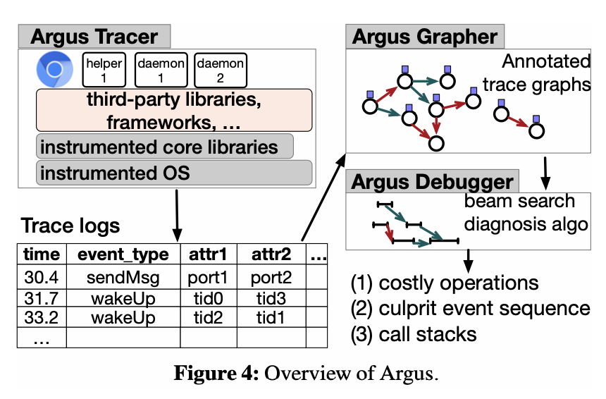
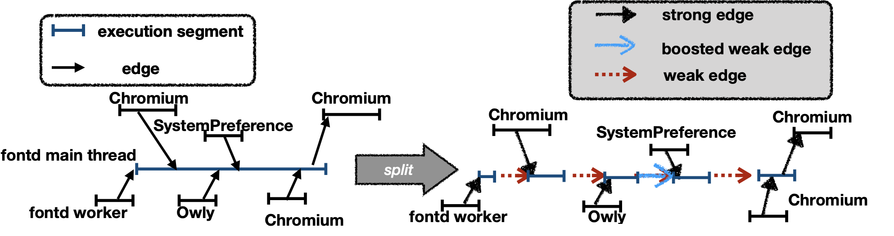
ATC’21 → Barking up the Wrong Tree: Correctness and Debugging
Argus: Debugging Performance Issues in Modern Desktop Applications with Annotated Causal Tracing; Lingmei Weng, Columbia University Peng Huang, Johns Hopkins University Jason Nieh, Columbia University Junfeng Yang, Columbia University
Address the issue by Argus, a causal tracing tool specially designed to help users diagnose performance anomalies in desktop applications.
Key Insight. Tracing inaccuracies are inherently unavoidable in real desktop systems, so instead of trying to eliminate all inaccuracies, we should design tracing solutions that can accommodate some inaccuracies.
Main Idea
Argus introduces a new notion of annotated trace graphs, in which edges are explicitly annotated as strong and weak edges.
Strong edges represent connections among segments based on typical programming case that must be causal (like send and receive an IPC message).
Weak edges represent ambiguous relationships among segments.
→ i.e., when one thread wakes up another thread, it could be a causal relation, e.g., lock/unlock, or just an artifact of regular OS scheduling.
Argus further boosts or prunes unnecessary weak edges by leveraging operation semantics and call stacks.
Techniques
Beam search diagnosis algorithm. Based on edge strength and comparing trace subgraphs across normal and abnormal executions of an application.
→ Observation: prior critical path analysis is ineffective due to inaccuracies inherent in trace graphs.
Beam search selects likely causal paths in the massive trace graph and tolerates noises.
Comparing trace subgraphs across normal and abnormal executions to handle problem that is due to missing operations in the abnormal execution.

Slide 5
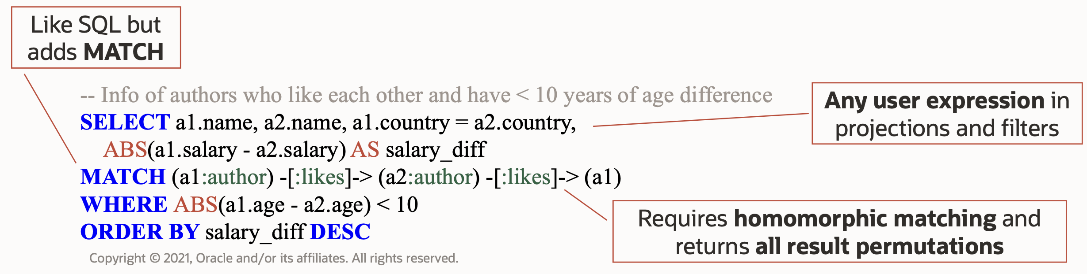
ATC’21 → Searching for Tracks: Graphs
aDFS: An Almost Depth-First-Search Distributed Graph-Querying System; Vasileios Trigonakis, Jean-Pierre Lozi, Tomas Faltin, Nicholas P. Roth, Iraklis Psaroudakis, Arnaud Delamare, Vlad Haprian, Calin Iorgulescu, Petr Koupy, Jinsu Lee, Sungpack Hong, Hassan Chafi. Oracle Labs
Graph-Querying allows flexible exploration of graphs, which looks like SQL query for RDBMs in terms of format and basic principle, while it is much more complicated and often suffers query explosion.
→ even seemingly trivial queries can easily produce billions of intermediate results and irregular data access patterns.
Backgrounds:
Graph queries are a key tool for graph analysis, as indicated by the large number of existing systems and graph-query languages. Graph queries provide an expressive interface for interactive graph exploration with rich dynamic projection and filtering support.
The dynamic user-defined patterns, filters, and projections, the focus on edges, and the homomorphic matching make it challenging since it needs to handle very large intermediate and final result sets, with a combinatorial explosion effect.
i.e., Twitter graph, the single-edge query (a)->(b) matches the whole graph, amounting to 1.4 billion results, and the two-edge query (a)->(b)->(c) amounts to 9.3 trillion matches. This means matching the (a)->(b)->(c)->(a) cycle needs to consider 9.3 trillion intermediate results.
Demands for Graph query. (i) keep the computation in main memory to guarantee low latency, (ii) scale out to multiple machines in a distributed manner to handle graphs and queries that exceed the capacity of a single machine, and (iii) control their memory usage at the machine level.
Current Solutions: Breadth-first search (BFS) and depth-first search (DFS).
BFS traversals are easier to parallelize but, as with distributed joins, suffer from explosion in the size of intermediate results, cannot be easily pipelined, and stress the network bandwidth to shuffle data across levels of pattern matching.
DFS traversals reduce the size of intermediate results but are challenging to parallelize and result in random data access patterns, wasting locality when iterating over neighbors.

Slide 6
ATC’21 → Searching for Tracks: Graphs
aDFS: An Almost Depth-First-Search Distributed Graph-Querying System; Vasileios Trigonakis, Jean-Pierre Lozi, Tomas Faltin, Nicholas P. Roth, Iraklis Psaroudakis, Arnaud Delamare, Vlad Haprian, Calin Iorgulescu, Petr Koupy, Jinsu Lee, Sungpack Hong, Hassan Chafi. Oracle Labs
aDFS (almost-DFS): A distributed graph-querying system that brings the best of both DFS/BFS worlds.
Main idea:
It processes graphs partitioned across multiple machines fully in memory, combining BFS and DFS traversals to bound the maximum amount of memory required for query execution, while achieving a high degree of parallelism.
DFS, together with a distributed flow-control mechanism, guarantee that the amount of runtime memory remains within limits.
BFS exploration allows for better locality and parallelization during execution
Techniques
DFS-first and Asynchronous Communication. Workers operate independently on traversals where there is work. Workers buffer and forget remote traversals allows workers to not block due to remote communication.
Strict DFS would be inefficient when matching a remote edge, i.e., an edge that leads to a remote machine, for which worker threads do not block when encountering a remote edge but place the intermediate result in a message buffer and continue with other local work instead.
Buffers batch intermediate results: once full, a buffer’s contents are asynchronously sent to the remote machine for further processing. Threads only need to block if flow control dictates so. This buffering results in essentially BFS exploration of the remote edges of a vertex.
Flow control for cross-machine. It caps the number of in-flight intermediate result buffers. The finite nature of these message buffers allows strictly configuring the amount of runtime memory that aDFS requires, while the flow-control mechanism guarantees query termination and deadlock freedom.
Dynamic local DFS/BFS. a dynamic approach for deciding whether to go DFS or expand with BFS for local matches in order to improve parallelism, locality, and work sharing across threads.

