Slide 1
FAST’21 → Advanced File Systems
Rethinking File Mapping in Persistent Memory
Ian Neal, Gefei Zuo, Eric Shiple, and Tanvir Ahmed Khan, University of Michigan; Youngjin Kwon, School of Computing, KAIST; Simon Peter, University of Texas at Austin; Baris Kasikci, University of Michigan.
Persistent Memory (PM, or NVM) are 30−40x faster than SSDs, while file system IO performance cannot keep up with PM performance. The rigorous analysis of IO path performance is important. (an Evaluation paper.)
→ Not all aspects of the IO path have been examined in detail, especially file mapping process.
What is file mapping? is the operation of mapping a logical offset (a file and offset) in a file to a physical location ((a device offset) ) on the underlying device at a fixed granularity; contains per-file mapping and global mapping.
Current challenges:
(1) Fragmentation. occurs when a file is spread across non-contiguous physical locations on device (like B-tree case). (1) Overhead: It causes locations to become non-contiguous and the mapping structure to become larger, increasing search and insert; (2) Reduction in sequential accesses. causes additional, random IO.
(2) Locality of reference. Optimizing file mapping can yield further benefits for reference locality. (we can hide part of the file mapping traversal overhead for accesses with locality by remembering the meta-data location of a prior lookup and prefetching the location of the next lookup.)
(3) Mapping structure size. Ideally, a fm structure consumes a small fraction of available space, leaving room for actual file data storage.
(4) Concurrency. Can be easy handled in per-file fm but difficult in flogal fm structure.

Slide 2
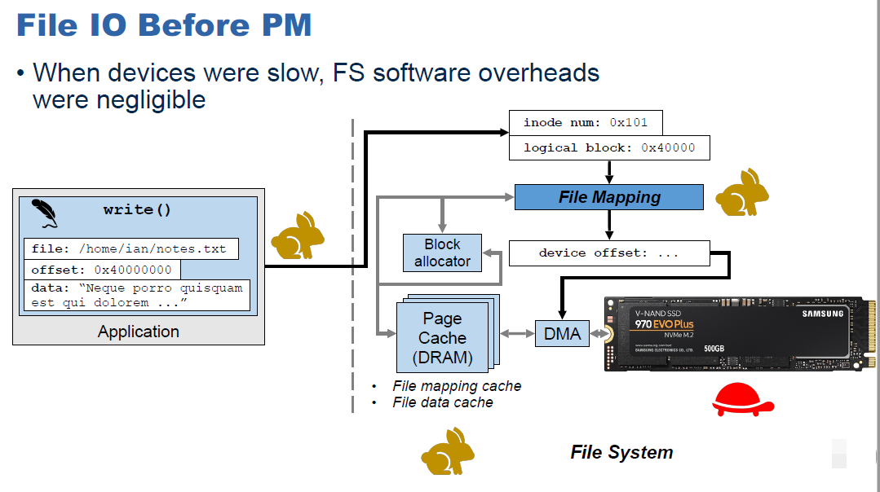
FAST’21 → Advanced File Systems
Rethinking File Mapping in Persistent Memory
Ian Neal, Gefei Zuo, Eric Shiple, and Tanvir Ahmed Khan, University of Michigan; Youngjin Kwon, School of Computing, KAIST; Simon Peter, University of Texas at Austin; Baris Kasikci, University of Michigan.
Persistent Memory (PM, or NVM) are 30−40x faster than SSDs, while file system IO performance cannot keep up with PM performance. The rigorous analysis of IO path performance is important. (an Evaluation paper.)
→ Not all aspects of the IO path have been examined in detail, especially file mapping process.
What is file mapping? is the operation of mapping a logical offset (a file and offset) in a file to a physical location ((a device offset) ) on the underlying device at a fixed granularity; contains per-file mapping and global mapping.
Current challenges:
(1) Fragmentation. occurs when a file is spread across non-contiguous physical locations on device (like B-tree case). (1) Overhead: It causes locations to become non-contiguous and the mapping structure to become larger, increasing search and insert; (2) Reduction in sequential accesses. causes additional, random IO.
(2) Locality of reference. Optimizing file mapping can yield further benefits for reference locality. (we can hide part of the file mapping traversal overhead for accesses with locality by remembering the meta-data location of a prior lookup and prefetching the location of the next lookup.)
(3) Mapping structure size. Ideally, a fm structure consumes a small fraction of available space, leaving room for actual file data storage.
(4) Concurrency. Can be easy handled in per-file fm but difficult in global fm structure.
Notes:
(2) Locality of reference when accessing a file can be used to reduce file mapping overhead. Accesses with locality are typically accelerated by caching prior accesses and prefetching adjacent ones.

Slide 3
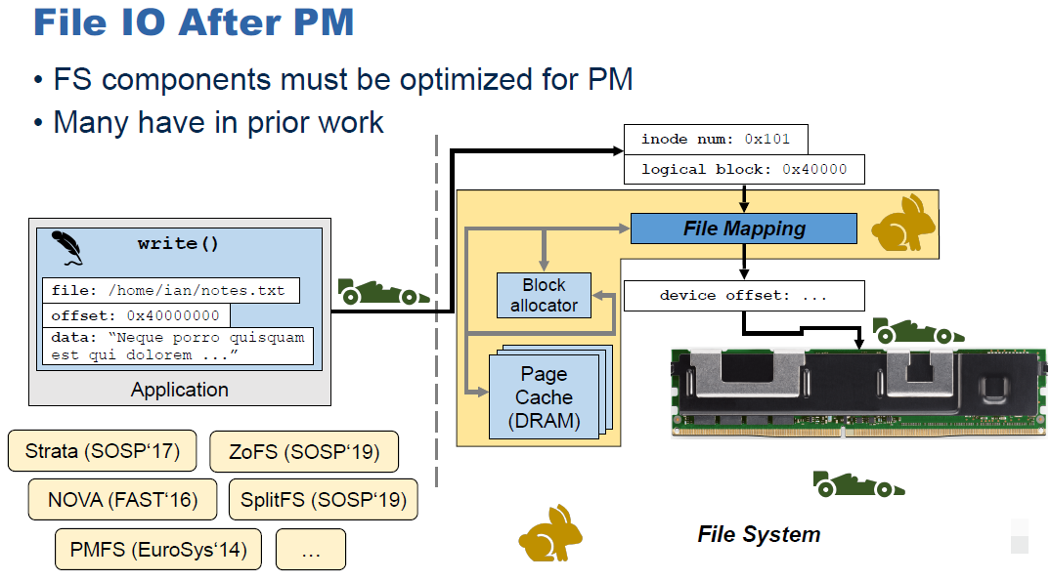
FAST’21 → Advanced File Systems
Can comprise up to 70% of the IO path overhead!
Rethinking File Mapping in Persistent Memory
Ian Neal, Gefei Zuo, Eric Shiple, and Tanvir Ahmed Khan, University of Michigan; Youngjin Kwon, School of Computing, KAIST; Simon Peter, University of Texas at Austin; Baris Kasikci, University of Michigan.
Persistent Memory (PM, or NVM) are 30−40x faster than SSDs, while file system IO performance cannot keep up with PM performance. The rigorous analysis of IO path performance is important. (an Evaluation paper.)
→ Not all aspects of the IO path have been examined in detail, especially file mapping process.
What is file mapping? is the operation of mapping a logical offset (a file and offset) in a file to a physical location ((a device offset) ) on the underlying device at a fixed granularity; contains per-file mapping and global mapping.
Current challenges:
(1) Fragmentation. occurs when a file is spread across non-contiguous physical locations on device (like B-tree case). (1) Overhead: It causes locations to become non-contiguous and the mapping structure to become larger, increasing search and insert; (2) Reduction in sequential accesses. causes additional, random IO.
(2) Locality of reference. Optimizing file mapping can yield further benefits for reference locality. (we can hide part of the file mapping traversal overhead for accesses with locality by remembering the meta-data location of a prior lookup and prefetching the location of the next lookup.)
(3) Mapping structure size. Ideally, a fm structure consumes a small fraction of available space, leaving room for actual file data storage.
(4) Concurrency. Can be easy handled in per-file fm but difficult in global fm structure.
Notes:
(2) Locality of reference when accessing a file can be used to reduce file mapping overhead. Accesses with locality are typically accelerated by caching prior accesses and prefetching adjacent ones.

Slide 4
FAST’21 → Advanced File Systems
Rethinking File Mapping in Persistent Memory
Ian Neal, Gefei Zuo, Eric Shiple, and Tanvir Ahmed Khan, University of Michigan; Youngjin Kwon, School of Computing, KAIST; Simon Peter, University of Texas at Austin; Baris Kasikci, University of Michigan.
• Main work of this paper: Analysis and Evaluation for optimized fm structure; design for two global file mapping structures.
Analysis and evolutions:
evaluate the real-world end-to-end performance based on current file mapping structures and self-implemented prototype.
Is page caching necessary? No, using the page cache impacts file mapping structure design, and copying mappings to DRAM is costly.
Are file mapping optimization impactful? Yes, HashFS provides +10–45% throughput.
Specialize for different file size? Legacy structures suffered performance degradation on large files, update operations expensive
Newly-designed (Optimized) Hash-based global file mapping structure. (Simple prototype)
→Cuckoo Hash method: To reduce the small number of memory accesses required by the hash table structure, to avoid the complexity of resizing per-file mapping structures as files grow and shrink. The fragmentation is avoided. (Also need an in-memory translation cache and poor locality)
→ HashFS (linear probing): a simple one-time hash model combines block-allocation and file-mapping scheme, specifically reduces the cost of the insert operation. Insert into hash table implicitly allocates block at corresponding offset; Bypasses expensive block allocator management. (also has very low spatial locality, but improves sequential access.) (conflict is expensive when fs will full.)

Slide 5
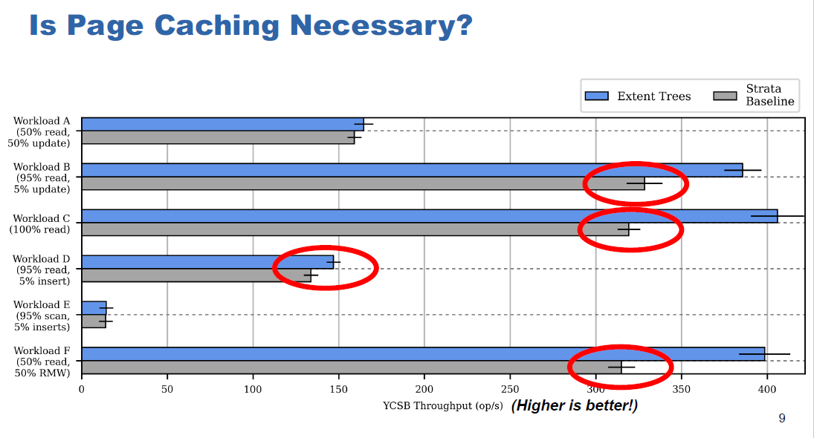
FAST’21 → Advanced File Systems
Rethinking File Mapping in Persistent Memory
Ian Neal, Gefei Zuo, Eric Shiple, and Tanvir Ahmed Khan, University of Michigan; Youngjin Kwon, School of Computing, KAIST; Simon Peter, University of Texas at Austin; Baris Kasikci, University of Michigan.
• Main work of this paper: Analysis and Evaluation for optimized fm structure; design for two global file mapping structures.
Analysis and evolutions:
evaluate the real-world end-to-end performance based on current file mapping structures and self-implemented prototype.
Is page caching necessary? No, using the page cache impacts file mapping structure design, and copying mappings to DRAM is costly.
Are file mapping optimization impactful? Yes, HashFS provides +10–45% throughput.
Specialize for different file size? Legacy structures suffered performance degradation on large files, update operations expensive
Newly-designed (Optimized) Hash-based global file mapping structure. (Simple prototype)
→Cuckoo Hash method: To reduce the small number of memory accesses required by the hash table structure, to avoid the complexity of resizing per-file mapping structures as files grow and shrink. The fragmentation is avoided. (Also need an in-memory translation cache and poor locality)
→ HashFS (linear probing): a simple one-time hash model combines block-allocation and file-mapping scheme, specifically reduces the cost of the insert operation. Insert into hash table implicitly allocates block at corresponding offset; Bypasses expensive block allocator management. (also has very low spatial locality, but improves sequential access.) (conflict is expensive when fs will full.)

Slide 6
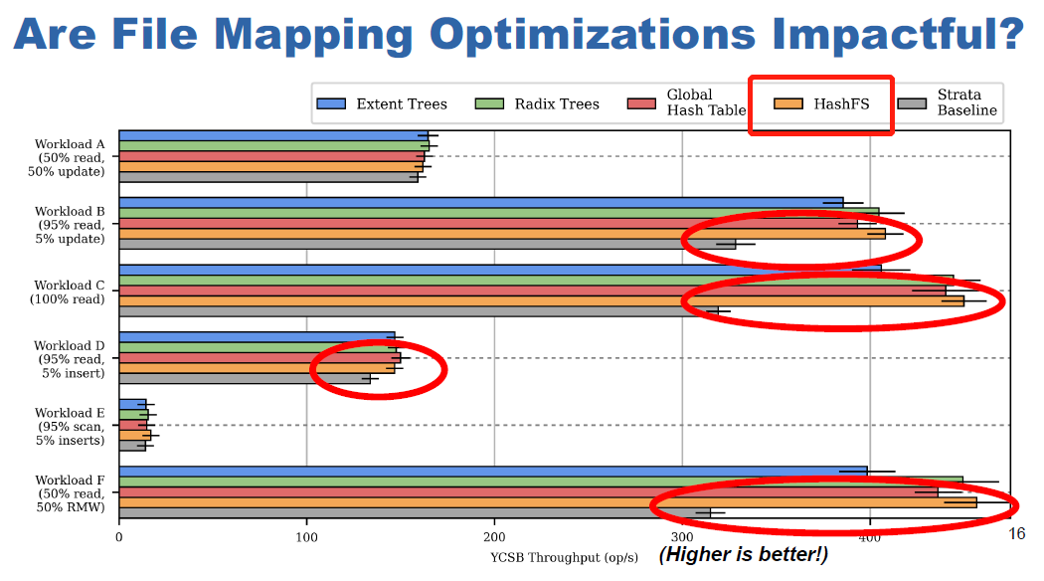
FAST’21 → Advanced File Systems
Rethinking File Mapping in Persistent Memory
Ian Neal, Gefei Zuo, Eric Shiple, and Tanvir Ahmed Khan, University of Michigan; Youngjin Kwon, School of Computing, KAIST; Simon Peter, University of Texas at Austin; Baris Kasikci, University of Michigan.
• Main work of this paper: Analysis and Evaluation for optimized fm structure; design for two global file mapping structures.
Analysis and evolutions:
evaluate the real-world end-to-end performance based on current file mapping structures and self-implemented prototype.
Is page caching necessary? No, using the page cache impacts file mapping structure design, and copying mappings to DRAM is costly.
Are file mapping optimization impactful? Yes, HashFS provides +10–45% throughput.
Specialize for different file size? Legacy structures suffered performance degradation on large files, update operations expensive
Newly-designed (Optimized) Hash-based global file mapping structure. (Simple prototype)
→Cuckoo Hash method: To reduce the small number of memory accesses required by the hash table structure, to avoid the complexity of resizing per-file mapping structures as files grow and shrink. The fragmentation is avoided. (Also need an in-memory translation cache and poor locality)
→ HashFS (linear probing): a simple one-time hash model combines block-allocation and file-mapping scheme, specifically reduces the cost of the insert operation. Insert into hash table implicitly allocates block at corresponding offset; Bypasses expensive block allocator management. (also has very low spatial locality, but improves sequential access.) (conflict is expensive when fs will full.)

Slide 7
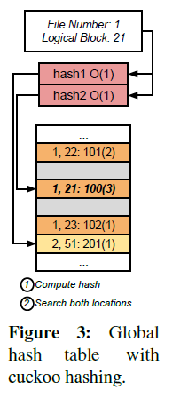
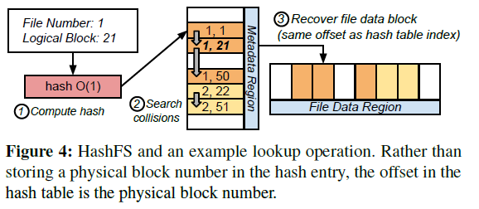
FAST’21 → Advanced File Systems
Rethinking File Mapping in Persistent Memory
Ian Neal, Gefei Zuo, Eric Shiple, and Tanvir Ahmed Khan, University of Michigan; Youngjin Kwon, School of Computing, KAIST; Simon Peter, University of Texas at Austin; Baris Kasikci, University of Michigan.
• Main work of this paper: Analysis and Evaluation for optimized fm structure; design for two global file mapping structures.
Analysis and evolutions:
evaluate the real-world end-to-end performance based on current file mapping structures and self-implemented prototype.
Is page caching necessary? No, using the page cache impacts file mapping structure design, and copying mappings to DRAM is costly.
Are file mapping optimization impactful? Yes, HashFS provides +10–45% throughput.
Specialize for different file size? Legacy structures suffered performance degradation on large files, update operations expensive
Newly-designed (Optimized) Hash-based global file mapping structure. (Simple prototype)
→Cuckoo Hash method: <inum>, <logical block>: <physical block>(<# of blocks>).To reduce the small number of memory accesses required by the hash table structure, to avoid the complexity of resizing per-file mapping structures as files grow and shrink. The fragmentation is avoided. (Also need an in-memory translation cache and poor locality)
→ HashFS (linear probing): a simple one-time hash model combines block-allocation and file-mapping scheme, specifically reduces the cost of the insert operation. Insert into hash table implicitly allocates block at corresponding offset; Bypasses expensive block allocator management. (also has very low spatial locality, but improves sequential access.) (conflict is expensive when fs will full.)
Notes:
Cuckoo: For lookups, at most two locations have to be consulted. For insertions, if both potential slots are full, the insertion algorithm picks one of the existing entries and evicts it by moving it to its alternate location, continuing transitively until there are no more conflicts.
HashFS: (physical follows the hash by logical) Physical blocks are stored in the file data region, which starts at fileDataStart. A lookup resolves first to the metadata region. The corresponding physical block location is calculated from the offset of the entry in the metadata region.
For example, if the hash of <inum=1, lblk=21> resolves to offset i in the metadata region, the location of the corresponding physical block is ( fileDataStart +iblockSize), with blockSize = 4KB.

Slide 8
FAST’21 → Advanced File Systems
Pattern-Guided File Compression with User-Experience Enhancement for Log-Structured File System on Mobile Devices
Cheng Ji, Nanjing University of Science and Technology; Li-Pin Chang, National Chiao Tung University, National Yang Ming Chiao Tung University; Riwei Pan and Chao Wu, City University of Hong Kong; Congming Gao, Tsinghua University; Liang Shi, East China Normal University; Tei-Wei Kuo and Chun Jason Xue, City University of Hong Kong.
• While the performance of mobile processors is improving drastically, the improvement of mobile storage performance is slow.
I/O operations on mobile storage are write-dominant, and the write pattern is highly random and synchronous, which are closely related to user-perceived latencies.
Key Insight: mobile apps heavily rely on SQLite for transactional data management, and Android packs resources and compiled into large executable files, which are highly compressible but ignored.
Background & Motivation:
I/O and Storage of Mobile Devices. Log-structured file system outperforms in-place file system in mobile scenarios (random file writes), while LFS still suffers write stress caused by logging, inefficient defragmentation. (lifespan suffered) → (compression needed)
Pitfalls of File Compression. It may not efficient for mobile storage because of the highly random nature of file reads and writes of mobile applications and usually the trace are small and write-intensive. (Current way are not efficient.)
Benefits of File Compression with LFS. Compared with conventional in-place updating fs like Ext4, LFS is highly friendly to file compression since of out-of-place updating and reverse (physical-to-logical) mapping. (there are potentials in LFS)

Slide 9
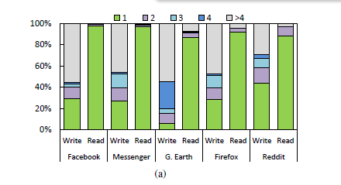
FAST’21 → Advanced File Systems
Pattern-Guided File Compression with User-Experience Enhancement for Log-Structured File System on Mobile Devices
Cheng Ji, Nanjing University of Science and Technology; Li-Pin Chang, National Chiao Tung University, National Yang Ming Chiao Tung University; Riwei Pan and Chao Wu, City University of Hong Kong; Congming Gao, Tsinghua University; Liang Shi, East China Normal University; Tei-Wei Kuo and Chun Jason Xue, City University of Hong Kong.
• While the performance of mobile processors is improving drastically, the improvement of mobile storage performance is slow.
I/O operations on mobile storage are write-dominant, and the write pattern is highly random and synchronous, which are closely related to user-perceived latencies.
Key Insight: mobile apps heavily rely on SQLite for transactional data management, and Android packs resources and compiled into large executable files, which are highly compressible but ignored.
Background & Motivation:
I/O and Storage of Mobile Devices. Log-structured file system outperforms in-place file system in mobile scenarios (random file writes), while LFS still suffers write stress caused by logging, inefficient defragmentation. (lifespan suffered) → (compression needed)
Pitfalls of File Compression. It may not efficient for mobile storage because of the highly random nature of file reads and writes of mobile applications and usually the trace are small and write-intensive. (Current way are not efficient.)
Benefits of File Compression with LFS. Compared with conventional in-place updating fs like Ext4, LFS is highly friendly to file compression since of out-of-place updating and reverse (physical-to-logical) mapping. (there are potentials in LFS)
Notes:
This figure is for the workload pattern featured in mobile devices

Slide 10
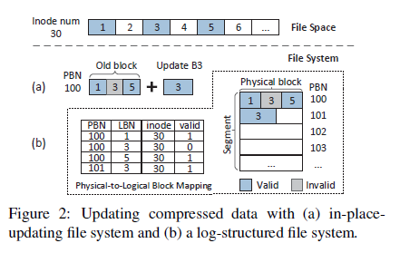
FAST’21 → Advanced File Systems
Pattern-Guided File Compression with User-Experience Enhancement for Log-Structured File System on Mobile Devices
Cheng Ji, Nanjing University of Science and Technology; Li-Pin Chang, National Chiao Tung University, National Yang Ming Chiao Tung University; Riwei Pan and Chao Wu, City University of Hong Kong; Congming Gao, Tsinghua University; Liang Shi, East China Normal University; Tei-Wei Kuo and Chun Jason Xue, City University of Hong Kong.
• While the performance of mobile processors is improving drastically, the improvement of mobile storage performance is slow.
I/O operations on mobile storage are write-dominant, and the write pattern is highly random and synchronous, which are closely related to user-perceived latencies.
Key Insight: mobile apps heavily rely on SQLite for transactional data management, and Android packs resources and compiled into large executable files, which are highly compressible but ignored.
Background & Motivation:
I/O and Storage of Mobile Devices. Log-structured file system outperforms in-place file system in mobile scenarios (random file writes), while LFS still suffers write stress caused by logging, inefficient defragmentation. (lifespan suffered) → (compression needed)
Pitfalls of File Compression. It may not efficient for mobile storage because of the highly random nature of file reads and writes of mobile applications and usually the trace are small and write-intensive. (Current way are not efficient.)
Benefits of File Compression with LFS. Compared with conventional in-place updating fs like Ext4, LFS is highly friendly to file compression since of out-of-place updating and reverse (physical-to-logical) mapping. (there are potentials in LFS)
Notes:
3 a case for update compressed data
One solution is to re-write B1, B3, and B5 and repack them tightly in another free space. Another option is to align compressed data to predefined boundaries to allow future size changes of compressed data. However, with both options above, file compression suffers, from either amplified write traffic or internal fragmentation;
LFS appends the compressed B3 to a new block, avoiding rewriting of existing data and wasting of free space.

Slide 11
FAST’21 → Advanced File Systems
Pattern-Guided File Compression with User-Experience Enhancement for Log-Structured File System on Mobile Devices
Cheng Ji, Nanjing University of Science and Technology; Li-Pin Chang, National Chiao Tung University, National Yang Ming Chiao Tung University; Riwei Pan and Chao Wu, City University of Hong Kong; Congming Gao, Tsinghua University; Liang Shi, East China Normal University; Tei-Wei Kuo and Chun Jason Xue, City University of Hong Kong.
• Propose FPC, file access pattern guided compression based on the log-structured file system, optimized for the random-writes and fragmented-reads of mobile applications.
Main idea: file compression should be judiciously applied to files based on their access patterns.
Dual-mode compression, where Foreground compression handles write-mostly files for write stress reduction, while background compression packs random-reading file blocks for boosted read performance.
File Access Behaviors Pattern: (1)Write-hot, read-cold files like SQLite database files and WAL; (2) Write-cold, read-hot files like executable files (when launching the app, it needs be read, which affects the user experience);
Foreground compression: is applied only on the write-intensive, highly compressible SQLite files (barely read WAL and never read roll-back log). It adopts deep compression by packing fs metadata with user data by larger compression window. The previous sequential compression is dropped. (physical block can only store compressed logical blocks of contiguous file offsets.)
Background compression: is applied on executable files (also highly compressible but subject to small, random reads upon application launching). It adopts infrequent background compression to re-organize read-critical blocks of executable files

Slide 12
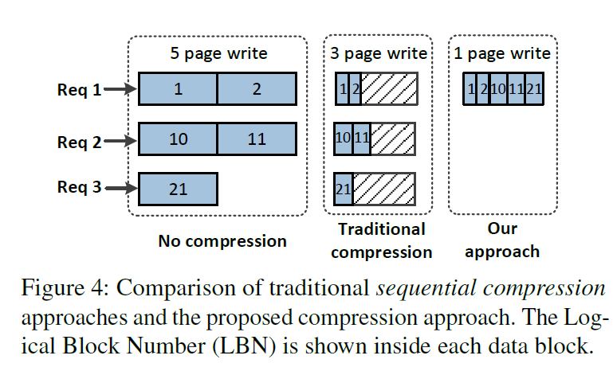
FAST’21 → Advanced File Systems
Pattern-Guided File Compression with User-Experience Enhancement for Log-Structured File System on Mobile Devices
Cheng Ji, Nanjing University of Science and Technology; Li-Pin Chang, National Chiao Tung University, National Yang Ming Chiao Tung University; Riwei Pan and Chao Wu, City University of Hong Kong; Congming Gao, Tsinghua University; Liang Shi, East China Normal University; Tei-Wei Kuo and Chun Jason Xue, City University of Hong Kong.
• Propose FPC, file access pattern guided compression based on the log-structured file system, optimized for the random-writes and fragmented-reads of mobile applications.
Main idea: file compression should be judiciously applied to files based on their access patterns.
Dual-mode compression, where Foreground compression handles write-mostly files for write stress reduction, while background compression packs random-reading file blocks for boosted read performance.
File Access Behaviors Pattern: (1)Write-hot, read-cold files like SQLite database files and WAL; (2) Write-cold, read-hot files like executable files (when launching the app, it needs be read, which affects the user experience);
Foreground compression: is applied only on the write-intensive, highly compressible SQLite files (barely read WAL and never read roll-back log). It adopts deep compression by packing fs metadata with user data by larger compression window. The previous sequential compression is dropped. (physical block can only store compressed logical blocks of contiguous file offsets.)
Background compression: is applied on executable files (also highly compressible but subject to small, random reads upon application launching). It adopts infrequent background compression to re-organize read-critical blocks of executable files

Slide 13
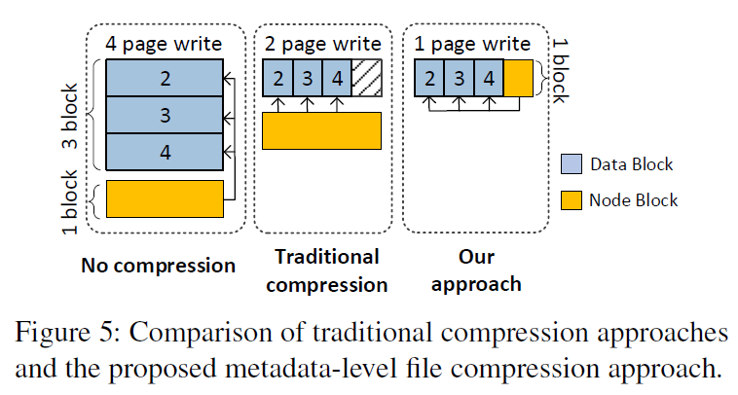
FAST’21 → Advanced File Systems
Pattern-Guided File Compression with User-Experience Enhancement for Log-Structured File System on Mobile Devices
Cheng Ji, Nanjing University of Science and Technology; Li-Pin Chang, National Chiao Tung University, National Yang Ming Chiao Tung University; Riwei Pan and Chao Wu, City University of Hong Kong; Congming Gao, Tsinghua University; Liang Shi, East China Normal University; Tei-Wei Kuo and Chun Jason Xue, City University of Hong Kong.
• Propose FPC, file access pattern guided compression based on the log-structured file system, optimized for the random-writes and fragmented-reads of mobile applications.
Main idea: file compression should be judiciously applied to files based on their access patterns.
Dual-mode compression, where Foreground compression handles write-mostly files for write stress reduction, while background compression packs random-reading file blocks for boosted read performance.
File Access Behaviors Pattern: (1)Write-hot, read-cold files like SQLite database files and WAL; (2) Write-cold, read-hot files like executable files (when launching the app, it needs be read, which affects the user experience);
Foreground compression: is applied only on the write-intensive, highly compressible SQLite files (barely read WAL and never read roll-back log). It adopts deep compression by packing fs metadata with user data by larger compression window. The previous sequential compression is dropped. (physical block can only store compressed logical blocks of contiguous file offsets.)
Background compression: is applied on executable files (also highly compressible but subject to small, random reads upon application launching). It adopts infrequent background compression to re-organize read-critical blocks of executable files

Slide 14
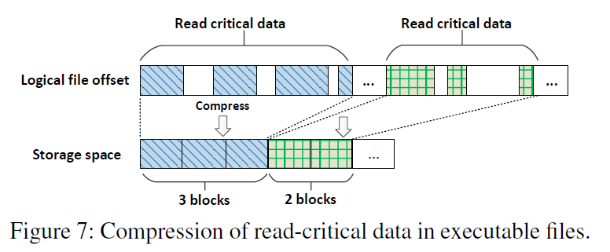
FAST’21 → Advanced File Systems
Pattern-Guided File Compression with User-Experience Enhancement for Log-Structured File System on Mobile Devices
Cheng Ji, Nanjing University of Science and Technology; Li-Pin Chang, National Chiao Tung University, National Yang Ming Chiao Tung University; Riwei Pan and Chao Wu, City University of Hong Kong; Congming Gao, Tsinghua University; Liang Shi, East China Normal University; Tei-Wei Kuo and Chun Jason Xue, City University of Hong Kong.
• Propose FPC, file access pattern guided compression based on the log-structured file system, optimized for the random-writes and fragmented-reads of mobile applications.
Main idea: file compression should be judiciously applied to files based on their access patterns.
Dual-mode compression, where Foreground compression handles write-mostly files for write stress reduction, while background compression packs random-reading file blocks for boosted read performance.
File Access Behaviors Pattern: (1)Write-hot, read-cold files like SQLite database files and WAL; (2) Write-cold, read-hot files like executable files (when launching the app, it needs be read, which affects the user experience);
Foreground compression: is applied only on the write-intensive, highly compressible SQLite files (barely read WAL and never read roll-back log). It adopts deep compression by packing fs metadata with user data by larger compression window. The previous sequential compression is dropped. (physical block can only store compressed logical blocks of contiguous file offsets.)
Background compression: is applied on executable files (also highly compressible but subject to small, random reads upon application launching). It adopts infrequent background compression to re-organize read-critical blocks of executable files
Notes:
The mixture of data read-critical and non-read-critical amplifies application launching time because non-read-critical data are loaded and decompressed.
The upper half of Figure 7 illustrates that critical data are scattered in an executable file.
We propose monitoring the read-critical data set during application launching.
Later on, upon requests, the file system compacts these critical data and compresses them into file blocks, as shown in the bottom half of Figure 7
Notice that the compaction changes the storage layout of file blocks but not the logical order of file blocks.
compressing read-critical data avoids to load and decompress non-read-critical data and thus prevents decompression from degrading application launching time.

Slide 15
FAST’21 → Advanced File Systems
pFSCK: Accelerating File System Checking and Repair for Modern Storage
David Domingo, Sudarsun Kannan; Rutgers University
Issues: it is not a coincidence that the file system checker is slow even with utilizing faster modern storage and better CPU.
E.g., the system won’t boot after a reboot due to update, restart, crash caused by fs checking/recovery (C/R).
Background: file system checking is necessary while the current solutions are less efficient.
File system checking: works by identifying and fixing the structural inconsistencies of fs metadata. The inconsistencies could be in inodes, data and inode bitmaps, links, or directory entry structures.
Current solutions: e2fsck (fsck for Ext4) divide C/R across multiple stages (passes), with each pass responsible for checking a file system structure like inode, which is too slow; new C/Rs increase parallelism in a coarse-grained way but can’t handle data imbalance.
Targets that want to achieve: Less C/R time with fined-grained parallelism. But Challenges are:
Certain consistency checks must be ordered for correctness. i.e., directory cannot be certified to be error-free by the directory checking until all its files are verified as consistent by the inode checking.
Static partitioning of CPU threads across different C/R steps is suboptimal since the time to process different metadata. (in figure).
I/O optimizations (I/O caching and read-ahead mechanisms) in current C/Rs are not designed for multi-threaded parallelism.
Affect the performance of other co-running applications that share CPUs or access the same disks checked by C/R.
Notes:
Data imbalance means that the different cases by data scales: file dominant / directory dominant behaves differently in terms of runtime latency. (coarse-grained way cannot figure out the imbalance caused by specific data structure like files or dirs);
Form the figure, we know that:
(1) Majority of time is spent checking inodes and directory metadata;
(2) Directory-intensive file systems take significantly longer than a file-intensive file system;
(3) Runtime scales linearly with file system utilization
Actually, we cannot handle such detailed latency even we know which parts suffer the major pressure, since such info are ignored with current coarse-grained parallelism.

Slide 16
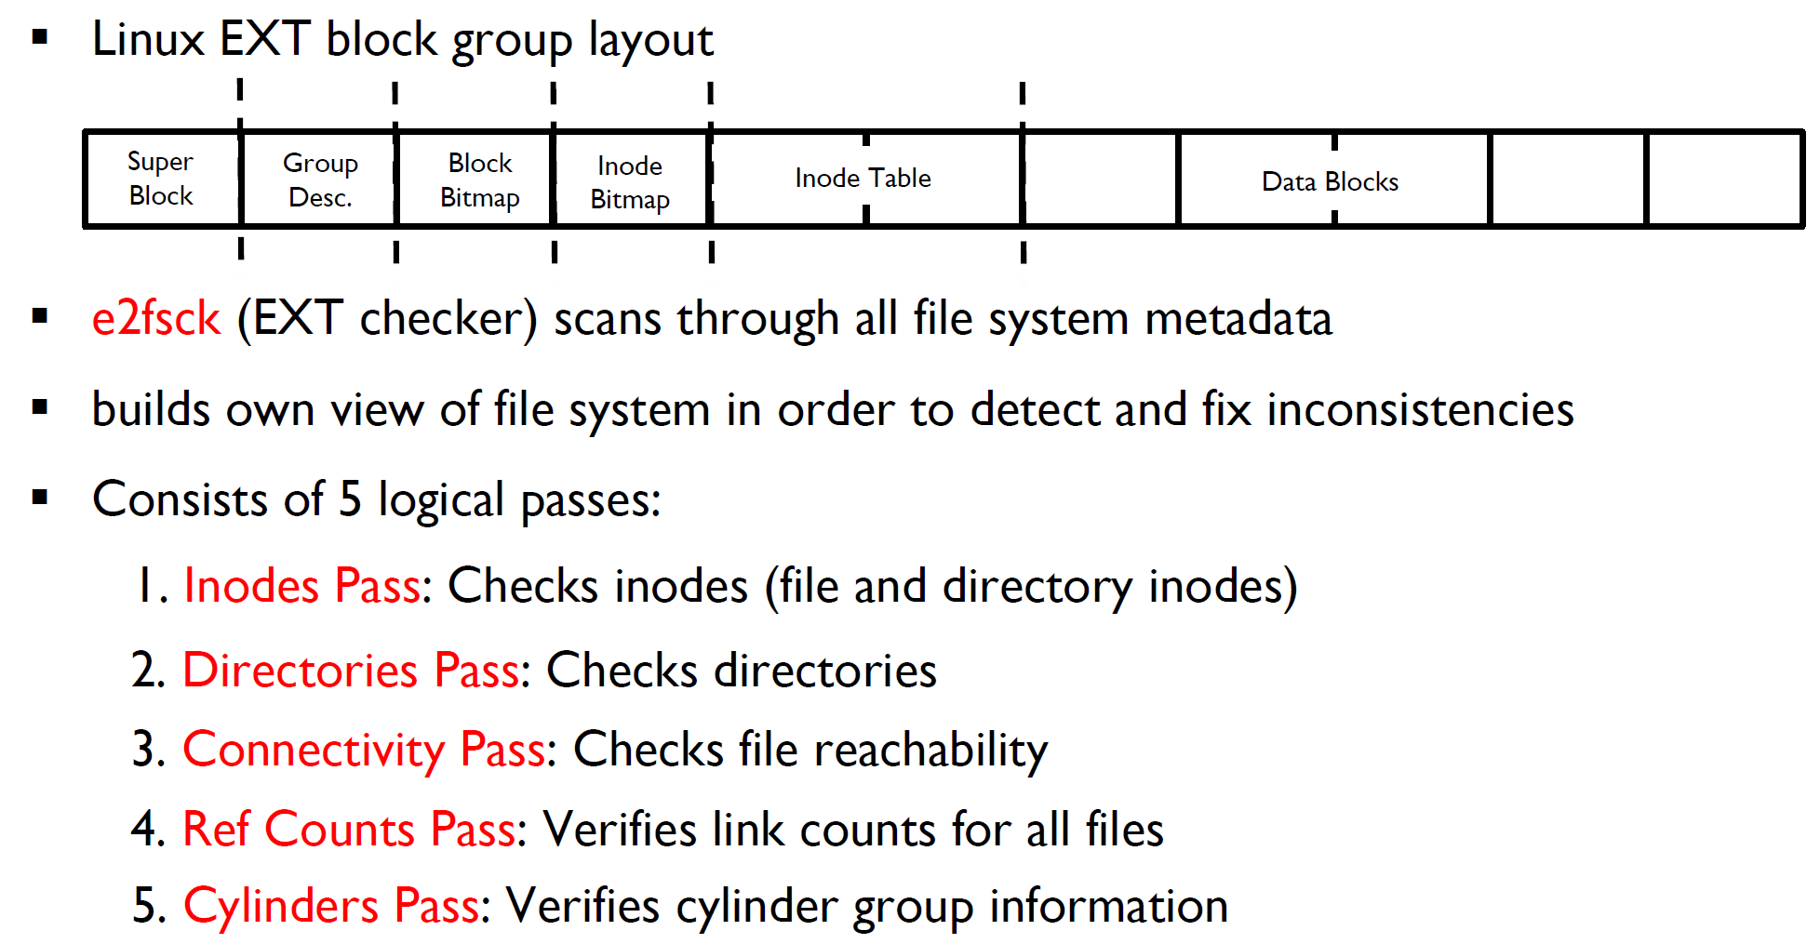
FAST’21 → Advanced File Systems
pFSCK: Accelerating File System Checking and Repair for Modern Storage
David Domingo, Sudarsun Kannan; Rutgers University
Issues: it is not a coincidence that the file system checker is slow even with utilizing faster modern storage and better CPU.
E.g., the system won’t boot after a reboot due to update, restart, crash caused by fs checking/recovery (C/R).
Background: file system checking is necessary while the current solutions are less efficient.
File system checking: works by identifying and fixing the structural inconsistencies of fs metadata. The inconsistencies could be in inodes, data and inode bitmaps, links, or directory entry structures.
Current solutions: e2fsck (fsck for Ext4) divide C/R across multiple stages (passes), with each pass responsible for checking a file system structure like inode, which is too slow; new C/Rs increase parallelism in a coarse-grained way but can’t handle data imbalance.
Targets that want to achieve: Less C/R time with fined-grained parallelism. But Challenges are:
Certain consistency checks must be ordered for correctness. i.e., directory cannot be certified to be error-free by the directory checking until all its files are verified as consistent by the inode checking.
Static partitioning of CPU threads across different C/R steps is suboptimal since the time to process different metadata. (in figure).
I/O optimizations (I/O caching and read-ahead mechanisms) in current C/Rs are not designed for multi-threaded parallelism.
Affect the performance of other co-running applications that share CPUs or access the same disks checked by C/R.
Notes:
Data imbalance means that the different cases by data scales: file dominant / directory dominant behaves differently in terms of runtime latency. (coarse-grained way cannot figure out the imbalance caused by specific data structure like files or dirs);
Form the figure, we know that:
(1) Majority of time is spent checking inodes and directory metadata;
(2) Directory-intensive file systems take significantly longer than a file-intensive file system;
(3) Runtime scales linearly with file system utilization
Actually, we cannot handle such detailed latency even we know which parts suffer the major pressure, since such info are ignored with current coarse-grained parallelism.

Slide 17
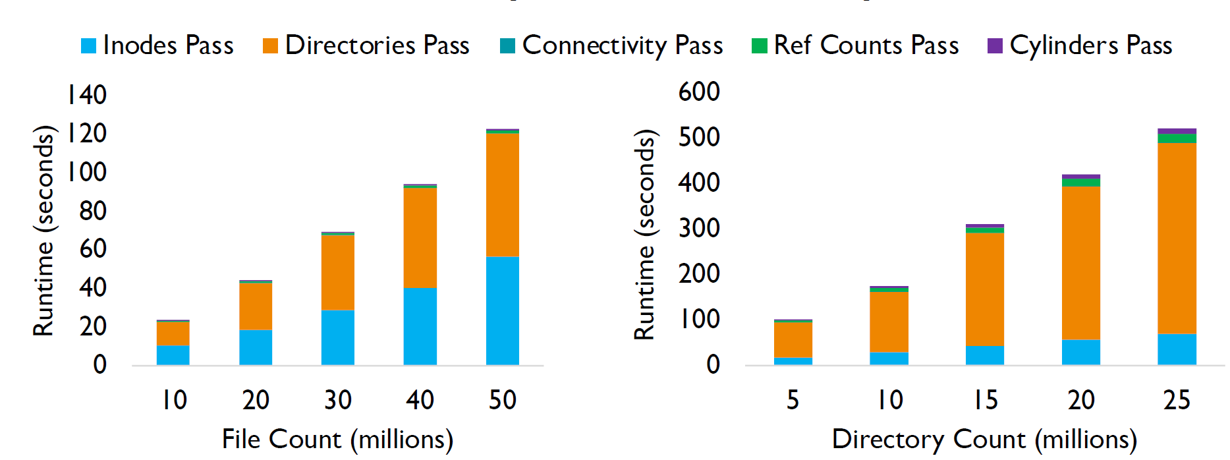
FAST’21 → Advanced File Systems
pFSCK: Accelerating File System Checking and Repair for Modern Storage
David Domingo, Sudarsun Kannan; Rutgers University
Issues: it is not a coincidence that the file system checker is slow even with utilizing faster modern storage and better CPU.
E.g., the system won’t boot after a reboot due to update, restart, crash caused by fs checking/recovery (C/R).
Background: file system checking is necessary while the current solutions are less efficient.
File system checking: works by identifying and fixing the structural inconsistencies of fs metadata. The inconsistencies could be in inodes, data and inode bitmaps, links, or directory entry structures.
Current solutions: e2fsck (fsck for Ext4) divide C/R across multiple stages (passes), with each pass responsible for checking a file system structure like inode, which is too slow; new C/Rs increase parallelism in a coarse-grained way but can’t handle data imbalance.
Targets that want to achieve: Less C/R time with fined-grained parallelism. But Challenges are:
Certain consistency checks must be ordered for correctness. i.e., directory cannot be certified to be error-free by the directory checking until all its files are verified as consistent by the inode checking.
Static partitioning of CPU threads across different C/R steps is suboptimal since the time to process different metadata. (in figure).
I/O optimizations (I/O caching and read-ahead mechanisms) in current C/Rs are not designed for multi-threaded parallelism.
Affect the performance of other co-running applications that share CPUs or access the same disks checked by C/R.
Notes:
Data imbalance means that the different cases by data scales: file dominant / directory dominant behaves differently in terms of runtime latency. (coarse-grained way cannot figure out the imbalance caused by specific data structure like files or dirs);
Form the figure, we know that:
(1) Majority of time is spent checking inodes and directory metadata;
(2) Directory-intensive file systems take significantly longer than a file-intensive file system;
(3) Runtime scales linearly with file system utilization
Actually, we cannot handle such detailed latency even we know which parts suffer the major pressure, since such info are ignored with current coarse-grained parallelism.

Slide 18
FAST’21 → Advanced File Systems
pFSCK: Accelerating File System Checking and Repair for Modern Storage
David Domingo, Sudarsun Kannan; Rutgers University
Propose pFSCK, a parallel C/R tool that exploits CPU parallelism and modern storage’s high bandwidth to accelerate file system C/R while reducing system downtime and improving data reliability and availability.
Main idea: using fine-grained approach (inodes and dir blocks, instead of the whole logical space) to do C/R, with relevant policies.
Data parallelism: break up the work done at each pass, redesign data structures, and allow multiple threads to perform checks in parallel.
Pipeline parallelism: to parallelize C/R along with the logical flow, since critical structure like updating global bitmaps within each stage need to be serial. It adopts out-of-order execution but with in-order instruction commit by isolating the global data structures and perform all necessary operations in parallel but certify correctness only when the results are merged. (like db txn processing)
pFSCK scheduler: dynamically monitors progress across different stages of pFSCK and uses the pending work ratio for thread assignment, by which the data imbalance can be solved by dynamically allocate/withdraw active threads for each process. It achieves adapting to different fs configurations, regardless of file system size, utilization, or configurations, such as a file-intensive or directory-intensive fs.
Resource-aware pFSCK scheduler: scales the C/R threads across passes by monitoring the total CPU utilization of the system. It achieves supporting efficient C/R for both on/offline and can be adapted to varying system resource utilization to reduce the performance impact on any concurrently running applications.

Slide 19
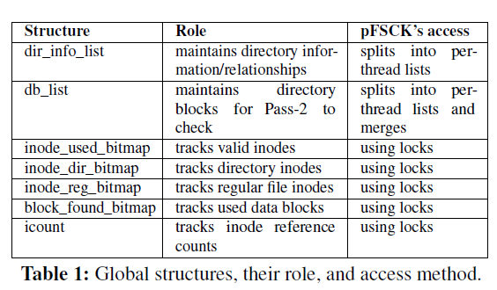
FAST’21 → Advanced File Systems
pFSCK: Accelerating File System Checking and Repair for Modern Storage
David Domingo, Sudarsun Kannan; Rutgers University
Propose pFSCK, a parallel C/R tool that exploits CPU parallelism and modern storage’s high bandwidth to accelerate file system C/R while reducing system downtime and improving data reliability and availability.
Main idea: using fine-grained approach (inodes and dir blocks, instead of the whole logical space) to do C/R, with relevant policies.
Data parallelism: break up the work done at each pass, redesign data structures, and allow multiple threads to perform checks in parallel.
Pipeline parallelism: to parallelize C/R along with the logical flow, since critical structure like updating global bitmaps within each stage need to be serial. It adopts out-of-order execution but with in-order instruction commit by isolating the global data structures and perform all necessary operations in parallel but certify correctness only when the results are merged. (like db txn processing)
pFSCK scheduler: dynamically monitors progress across different stages of pFSCK and uses the pending work ratio for thread assignment, by which the data imbalance can be solved by dynamically allocate/withdraw active threads for each process. It achieves adapting to different fs configurations, regardless of file system size, utilization, or configurations, such as a file-intensive or directory-intensive fs.
Resource-aware pFSCK scheduler: scales the C/R threads across passes by monitoring the total CPU utilization of the system. It achieves supporting efficient C/R for both on/offline and can be adapted to varying system resource utilization to reduce the performance impact on any concurrently running applications.

Slide 20
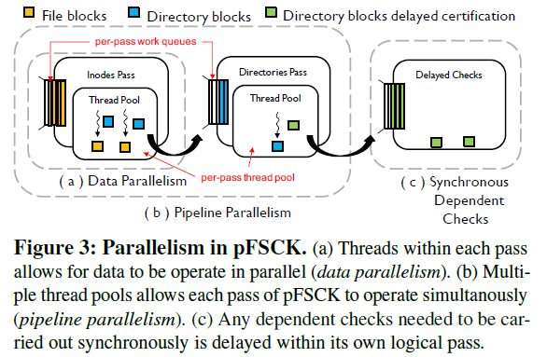
FAST’21 → Advanced File Systems
pFSCK: Accelerating File System Checking and Repair for Modern Storage
David Domingo, Sudarsun Kannan; Rutgers University
Propose pFSCK, a parallel C/R tool that exploits CPU parallelism and modern storage’s high bandwidth to accelerate file system C/R while reducing system downtime and improving data reliability and availability.
Main idea: using fine-grained approach (inodes and dir blocks, instead of the whole logical space) to do C/R, with relevant policies.
Data parallelism: break up the work done at each pass, redesign data structures, and allow multiple threads to perform checks in parallel.
Pipeline parallelism: to parallelize C/R along with the logical flow, since critical structure like updating global bitmaps within each stage need to be serial. It adopts out-of-order execution but with in-order instruction commit by isolating the global data structures and perform all necessary operations in parallel but certify correctness only when the results are merged. (like db txn processing)
pFSCK scheduler: dynamically monitors progress across different stages of pFSCK and uses the pending work ratio for thread assignment, by which the data imbalance can be solved by dynamically allocate/withdraw active threads for each process. It achieves adapting to different fs configurations, regardless of file system size, utilization, or configurations, such as a file-intensive or directory-intensive fs.
Resource-aware pFSCK scheduler: scales the C/R threads across passes by monitoring the total CPU utilization of the system. It achieves supporting efficient C/R for both on/offline and can be adapted to varying system resource utilization to reduce the performance impact on any concurrently running applications.

Slide 21
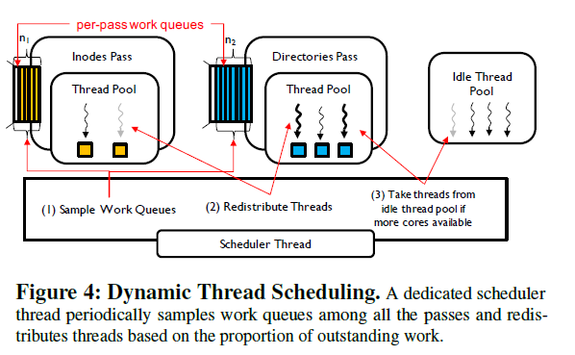
FAST’21 → Advanced File Systems
pFSCK: Accelerating File System Checking and Repair for Modern Storage
David Domingo, Sudarsun Kannan; Rutgers University
Propose pFSCK, a parallel C/R tool that exploits CPU parallelism and modern storage’s high bandwidth to accelerate file system C/R while reducing system downtime and improving data reliability and availability.
Main idea: using fine-grained approach (inodes and dir blocks, instead of the whole logical space) to do C/R, with relevant policies.
Data parallelism: break up the work done at each pass, redesign data structures, and allow multiple threads to perform checks in parallel.
Pipeline parallelism: to parallelize C/R along with the logical flow, since critical structure like updating global bitmaps within each stage need to be serial. It adopts out-of-order execution but with in-order instruction commit by isolating the global data structures and perform all necessary operations in parallel but certify correctness only when the results are merged. (like db txn processing)
pFSCK scheduler: dynamically monitors progress across different stages of pFSCK and uses the pending work ratio for thread assignment, by which the data imbalance can be solved by dynamically allocate/withdraw active threads for each process. It achieves adapting to different fs configurations, regardless of file system size, utilization, or configurations, such as a file-intensive or directory-intensive fs.
Resource-aware pFSCK scheduler: scales the C/R threads across passes by monitoring the total CPU utilization of the system. It achieves supporting efficient C/R for both on/offline and can be adapted to varying system resource utilization to reduce the performance impact on any concurrently running applications.

