Slide 1
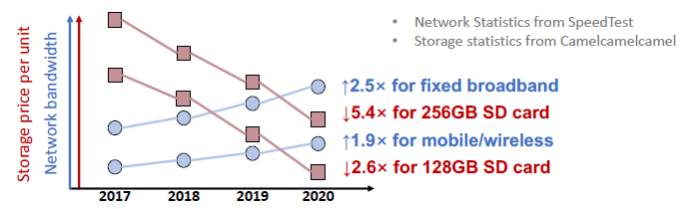
ATC’21 → Dogs Never Get Tired: Power and Edge Computing
Video Analytics with Zero-streaming Cameras; Mengwei Xu, Peking University/Beijing University of Posts and Telecommunications; Tiantu Xu, Purdue ECE; Yunxin Liu, Institute for AI Industry Research (AIR), Tsinghua University; Felix Xiaozhu Lin, University of Virginia
Low-cost cameras enable powerful analytics. An unexploited opportunity is that most captured videos remain “cold” without being queried. It is better to capturing videos to local storage and communicating with the cloud only when analytics is requested.
Background:
Low-cost, wireless cameras are growing exponentially and enabling ubiquitous intelligence. A typical scenarios is deploying massive cameras within a fixed physical region, and using stream way remotely query for returning all frames last time period that contains specific objects.
(i.e., collect all frames containing bus last week.) (i.e., real-time uploading frames from sensors (camera) to edge compute nodes.)
Most videos are cold, even some frames never used till deletion.
Case analysis: as for retrospective query, a campus spanning around 1 mile square equipped more than 1000 cameras, and Analysis over 6-month 3,000,000 hours of videos (around 5.4PB) show that: Only <2% cameras were used; and Only <0.005% video data was used.
Transmitting cold videos wastes precious wireless bandwidth, where Network 𝑈𝑠𝑎𝑔𝑒 = 𝐵𝑖𝑡𝑟𝑎𝑡𝑒 ∗ 𝐶𝑎𝑚𝑒𝑟𝑎𝑠 ∗ 𝑇𝑖𝑚𝑒
Bitrate = 1-2Mbps for 720P@30FPS; Cameras is Densely-deployed, large-scale; Time always 24*7
Currently, cheap camera storage can retain videos long enough (weeks to months). Therefore, local-stored cameras may be a better choice, like:
Cameras store videos locally during capture time and respond to servers during query time. Hence, Network/compute resource are provisioned
on-demand, which is good for resource efficiency.
Challenges: how can query be fast since now the local camera should handle the query.
Cameras holds limit resources (RaspberryPi-like) and have no powerful computation from GPU
Query are sensitive to network limit since it should be conducted as a synchronized way. And users are always waiting.

Slide 2
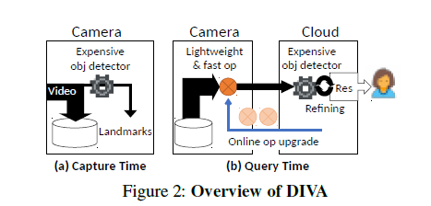
ATC’21 → Dogs Never Get Tired: Power and Edge Computing
Video Analytics with Zero-streaming Cameras; Mengwei Xu, Peking University/Beijing University of Posts and Telecommunications; Tiantu Xu, Purdue ECE; Yunxin Liu, Institute for AI Industry Research (AIR), Tsinghua University; Felix Xiaozhu Lin, University of Virginia
DIVA, a camera/cloud runtime system that support efficient zero-streaming frames capturing and query.
Zero Streaming Use Cases:
(1) Cameras continuously capture videos to their local storage without uploading any.
(2) Only in response to a retrospective query, the cloud reaches out to the queried camera and coordinates with it to process the queried video.
(3) While the video is being processed, the system presents users with inexact yet useful results; it continuously refines the results until query completion.
User explores videos through interactive queries, e.g., aborting an ongoing query based on inexact results and issuing a new query with revised parameters.
i.e., to trace the cause of recent frequent congestion on a highway, one queries cameras on nearby local roads, requesting car counts seen on these local roads.
i.e., to understand how recent visitors impact animal activities, a ranger queries all the park’s cameras, requesting time ranges where the cameras capture animals.
Techniques: When capturing videos, cameras require no network or external compute resources. Only to process a query, the cameras require networks such as long-range wireless and cloud resources such as GPU.
A camera captures video to local storage; it deletes videos after their maximum retention period.
For query, camera works with the cloud: the camera runs operators, implemented as lightweight neural nets (NNs), to rank or filter frames; the cloud runs object detection to validate results uploaded from the camera, not sacrifices query accuracy, ensuring it as high as that of object detection by the cloud.
To best use limited camera resource during video capture. Accurate knowledge on sparse sample is much useful than inaccurate knowledge on all frames: When capturing videos, a camera builds sparse (1 of 30s) yet accurate landmark frames as training sample, from which it learns reliable knowledge for accelerating future queries.
To rapidly explore massive videos during query execution. When executing a query, a camera processes frames in multiple passes with increasingly more expensive operators, producing useful results during query execution, enabling users to explore effectively.
The early operators quickly explore the frames for inexact answers while later operators slowly exploit for more exact answers.

Slide 3
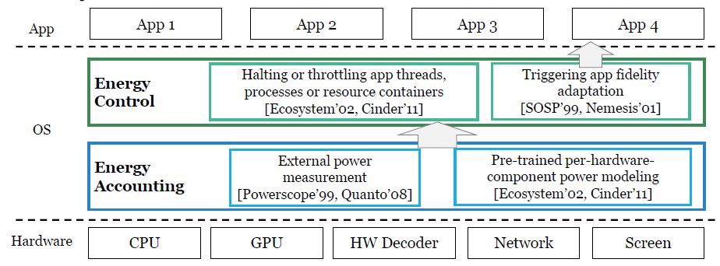
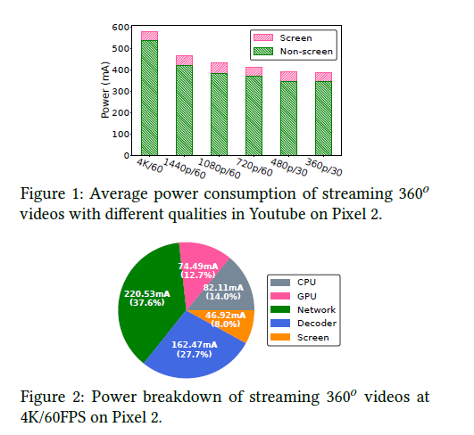
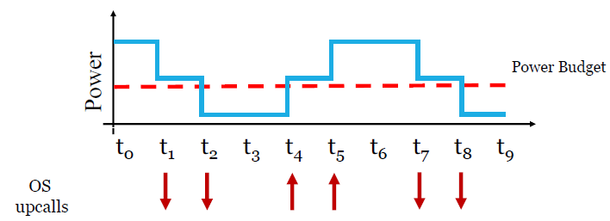
ATC’21 → Dogs Never Get Tired: Power and Edge Computing
Proactive Energy-Aware Adaptive Video Streaming on Mobile Devices; Jiayi Meng, Qiang Xu, and Y. Charlie Hu, Purdue University
Energy-aware app adaptation (EAA) enables mobile apps to dynamically adjust data fidelity (i.e., streaming video quality) to meet user-specified battery duration. However, it is less efficient and reactive.
Background:
Power-hungry APPs. For enriched user-experience, apps utilize many power-hungry hardware (CPU, GPU, WiFi, 4G, hardware decoder). Hence, user-experience of them is often limited by the shortened battery life from increased power draw.
Energy-aware App Adaptation (EAA). Many apps can reduce their power draw by reducing their data fidelity and enables apps to dynamically adjust their data fidelity to meet a user-specified goal for battery duration. (e.g., low power mode for a four-hour plane ride)
Limit data fidelity: Decrease size, quality of a video in video streaming apps; reduce the filtering level of a map in navigation apps.
EAA components: an energy accounting subsystem to monitor energy drain during app execution and detect deviations (e.g., exceeding a threshold, from the user-specified energy budget; control subsys conduct adaptation logic to stay within energy drain budget or correct energy drain deviation.
Traditional EAA is black-boxed and reactive but simple: OS monitors app energy drain and signals app to adapt upon detecting energy drain deviation from the pre-specified energy budget, which causes high oscillation (fluctuation) and poor quality-of-experience (QoE).
Modern apps have Proactive Built-in Adaptation. Apps proactively adapt data fidelity to network dynamics or other system constraints to optimize QoE.
Key insight: The energy-drain budget can be seamlessly integrated into the built-in proactive QoE adaptation of the app, which is pre-effect and better for QoE.
Challenges
App needs to predict power consumption for each adaptation candidate beforehand
App needs to incorporate the energy budget into its QoE own optimization logic.

Slide 4
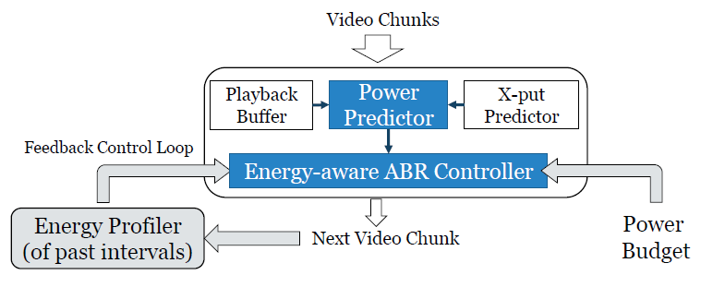
ATC’21 → Dogs Never Get Tired: Power and Edge Computing
Proactive Energy-Aware Adaptive Video Streaming on Mobile Devices; Jiayi Meng, Qiang Xu, and Y. Charlie Hu, Purdue University
Design Energy-aware ABR (adaptive bitrate), an energy-aware ABR video streaming system (a Proactive Built-in Adaptation) to demonstrate how to address the two challenges in designing proactive energy-aware app adaptation.
Design:
As with original ABR, Energy-aware ABR derives the client-side playback buffer status and estimated network throughput from two generic modules of ABR, the playback buffer module and throughput predictor module. The energy profiler module estimates the energy drain in past intervals which is used to maintain the energy surplus/deficit.
For power consumption prediction. Propose a function-level power modeling methodology that accurately predicts app energy drain in the next interval.
that can predict the average power draw of the streaming app in the next time interval in fetching a chunk of any candidate chunk quality.
The hardware component usage is logged during app execution and afterwards fed into the power model as input to estimate the component-wise power draw that happened during the app execution.
Cluster the hardware components according to the common video chunk they process at each time interval, so that the components within each cluster will have synchronous power behavior.
User-specified energy budget: total energy budget 𝐸b over a fixed amount of time Td: power budget 𝑃b = 𝐸b / 𝑇d.
𝐸b : 50% battery level drop; 𝑇d : 4-hour plane ride
For power controlling. Propose Energy-aware QoE Maximization to integrating an energy budget into the app adaptation logic. The challenge is:
→Unlike other constraints such as network throughput in the QoE optimization problem, app energy drain is cumulative and hence elastic over time.
Controller accumulates the energy surplus/deficit as in the reactive approach, which is then exploited by the QoE maximization module to maximize the QoE of future video chunks.

Slide 5
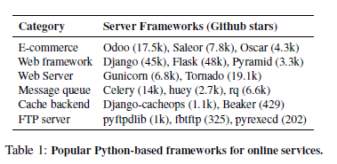
ATC’21 → Barking up the Wrong Tree: Correctness and Debugging
PYLIVE: On-the-Fly Code Change for Python-based Online Services; Haochen Huang, Chengcheng Xiang, Li Zhong, and Yuanyuan Zhou, University of California, San Diego
Python is widely adopted in online services that have high requirements on availability, which means Code changes are necessary for online services. It is crucial to dynamically change Python programs in production without restarting them.
Background:
Meta-object protocol. Python is designed with a full support of it. A meta-object is an object that contains a program’s metadata, including types, interfaces, classes and methods, etc. The meta-object protocol provides programming interfaces for programs to manipulate these metadata at runtime.
A new method A can be dynamically added to class C; Once it is changed, the new “A” is called when A is invoked.
An existing function’s code body can also be changed at runtime.
Dynamic typing. Python defines and checks variable types at running time, which makes it easy to dynamically change them.
→ i.e, variable a can be changed from a string to a bool. at running time each time before a is used, type check is performed by throwing a runtime exception.
Python bytecode. A Python interpreter stores and interprets programs in bytecode, providing an opportunity for dynamically instrumenting code. Compared to machine code, bytecode is much easier to analyze and change with automatic tools.
→ It is architecture-independent; has fewer instructions than machine instructions; retains more type information than machine code.
Motivations: Rollout is not the best choice for dynamic logging and profiling.
It still requires a restart of each service instance, which can clear the key program states for diagnosis. These states (e.g., resource leaks) may only be reproduced after a long production run, which is undesirable to be cleared by rollout.
Its deployment is heavy-weight and an overkill for just collecting logging/profiling information. (wait for a few hours or even a few days)
Sometimes only a few servers exhibit abnormal behaviors because of their unique memory states. If engineers want to diagnose the issue by rolling out a patch with new logging statements, this patch needs to be batched together with many other patches and will not be applied until the next deployment

Slide 6
ATC’21 → Barking up the Wrong Tree: Correctness and Debugging
PYLIVE: On-the-Fly Code Change for Python-based Online Services; Haochen Huang, Chengcheng Xiang, Li Zhong, and Yuanyuan Zhou, University of California, San Diego
Propose PYLIVE, it leverages the unique language features of Python, meta-object protocol and dynamic typing, to support dynamic logging, profiling and bug-fixing without restarting online services.
The metaobject protocol enables programs to dynamically modify metadata, including function bodies/interfaces/class-attributes, while dynamic typing allows changing variable types during running. The feature of Python (interpreted languages) makes dynamic code change easier than for compiled languages.
No modification to the underlying runtime systems (i.e., Python interpreters), making it easy to be adopted by online services with little portability concern.
Design Purposes and Use Cases:
(1) On-the-fly logging for diagnosing production-run errors. When an online service exhibits abnormal behaviors, engineers can use PYLIVE to dynamically add logs at certain locations to collect debugging information from production-run, which are hard to reproduce in a testing environment.
(2) On-the-fly profiling for diagnosing production-run performance issues. When an online service has performance issues, engineers can use PYLIVE to dynamically profile a set of functions to collect production-run timing information to troubleshoot the issues, which contains (1) dynamically start/stop profiling during runs and (2) only profile a small set of specified functions with less overhead.
(3) Urgent dynamic patching (bug-fixing or security patch). PYLIVE allows dynamically applying urgent patches to fix some critical bugs or security issues without stopping and restarting an online service. These bugs and issues can either cause major failures or open up vulnerabilities to attackers.
Contributions:
It realizes safe and portable dynamic code change by leveraging Python’s language features. Safe: requires no low-level transformations of machine code or memory layout; Portable: it relies only on the interfaces provided by standard Python interpreters and can be easily adopted by existing Python-based systems.
It enables instrumentation-based code changes for dynamic logging and profiling. It provides convenient interfaces to flexibly instrument customized code to specific functions at running time. This is useful for collecting diagnostic information in production-run systems without causing performance degradation.

