Slide 1
OUTLINE
Weekly Overview
Paper Presentation
CMU, ML4DB related
Discussion

Slide 2
OUTLINE
Weekly Overview
Paper Presentation
CMU, ML4DB related
Discussion

Slide 3
Weekly Overview
This week:
Background Learning for Workload Compression
Trace replay → Tracefs: A File System to Trace Them All. FAST’04
Trace modeling → ParaSwift: File I/O trace modeling for the future. LISA’14
Preliminary work → SMAUG: SMArt caching Using Global frequency and reuse distance
Survey for ML4DB
2017’Self-Driving Database Management Systems; Andrew Pavlo, Gustavo Angulo, Joy Arulraj, Haibin Lin, Jiexi Lin, Lin Ma, Prashanth Menon Todd C. Mowry, Matthew Perron, Ian Quah, Siddharth Santurkar, Anthony Tomasic Skye Toor, Dana Van Aken, Ziqi Wang, Yingjun WuF, Ran Xian, Tieying Zhang Carnegie Mellon University, National University of Singapore
2018’Query-based Workload Forecasting for Self-Driving Database Management Systems; Lin Ma, Dana Van Aken, Ahmed Hefny, Gustavo Mezerhane, Andrew Pavlo, Geoffrey J. Gordon; Carnegie Mellon University
2019’ Advanced Database Systems (Spring 2019) → 25 Self-Driving Databases
Next week:
Survey following the steps of ML4DB
Another CMU work targets to train model with less labeled data
Notes:
Smaug: (1) not AI (2) how to handle overhead (not clear about this flow, may be minimal benefits still efficient)
Is it related to workload compression?

Slide 4
OUTLINE
Weekly Overview
Paper Presentation
CMU, ML4DB related
Discussion

Slide 5
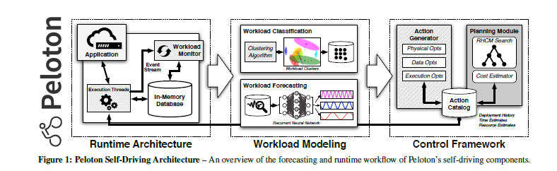
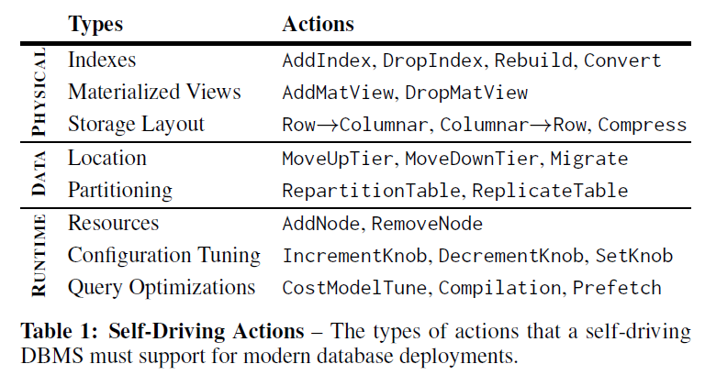
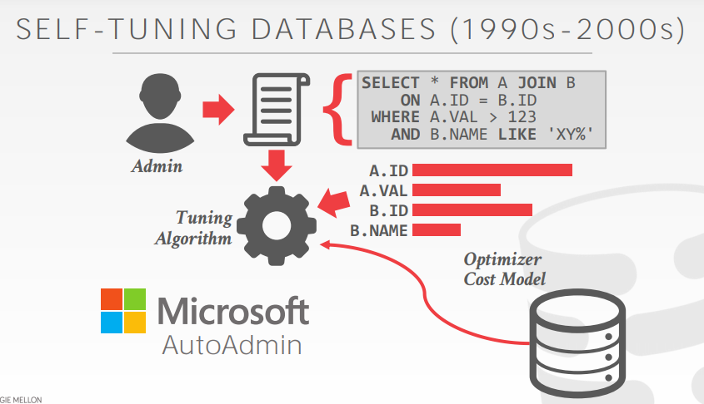
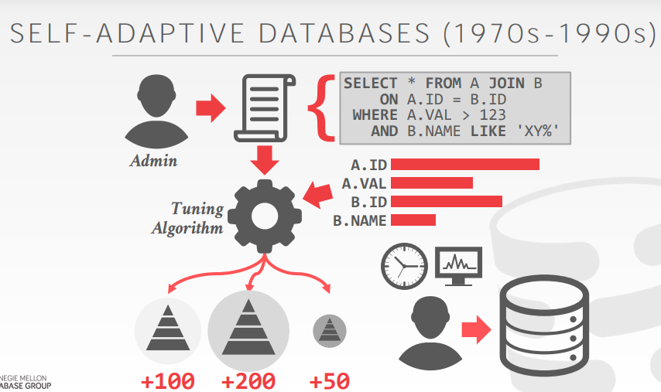
ML4DB → CMU Survey
Self-Driving Database Management Systems Andrew Pavlo, Gustavo Angulo, Joy Arulraj, Haibin Lin, Jiexi Lin, Lin Ma, Prashanth Menon Todd C. Mowry, Matthew Perron, Ian Quah, Siddharth Santurkar, Anthony Tomasic Skye Toor, Dana Van Aken, Ziqi Wang, Yingjun WuF, Ran Xian, Tieying Zhang Carnegie Mellon University, National University of Singapore
(1) Issues:
Problem Kernel: The self-driving DBMS is a very ambitious goal, which is so ambitious that the existing DBMS cannot support it at all.
Self-driving is no longer, like the plug-in model for MySQL, but is deeply integrated into the design of the DBMS.
Working Scenario: a flexible, in-memory DBMS architecture with sufficient resource and computation (separated GPU is better)
Shining point: more like a survey to summarize what necessary features a self-driving database needed. With a relatively simple prototype
(2) Contributions:
Previous solutions: (1) external to the DBMS; (2) reactionary; (3) isolated; (4) not take a holistic view that considers more than one problem at a time.
self-adaptive databases: (1) Human-beings are responsible for whether the tools/algorithms are correct/useful or not; (2) The best index/tuning for today are not the best for tomorrow.
Self-tuning (cloud-managed) database: (1) Focus on standalone tools (logical/physical design, parameters tuning) that target only a single aspect of the database; (2) DBA provides it with a sample database/trace that guides a search process to find an optimal or near-optimal configuration.
Now, self-driving databases, which must satisfy:
understand an application’s workload → Workload Classification. Select actions to improve some objective function (e.g., throughput, latency, cost).
unsupervised learning to group the app’s queries that have similar characteristics (DBSCAN for query’s logical semantics)
forecast resource utilization trends → Workload Forecasting, identifies potential actions that tune and optimize the database for the expected workload.
Neither RNN nor LSTM are efficient enough (trade-off between accuracy vs. computation cost)
choose which action to employ, and determine the best time to enact
The benefits of having a tight coupling of the autonomous components and DBMS architecture emerges. (Better feedback with less interfering)
For employment: Action generation (use more resource when load is low); for timing: Action Planning (self-driving vehicles & RL)

Slide 6
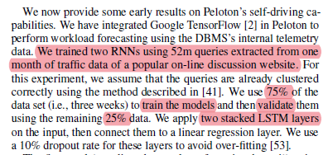
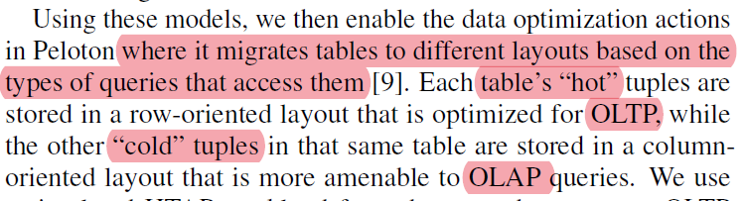
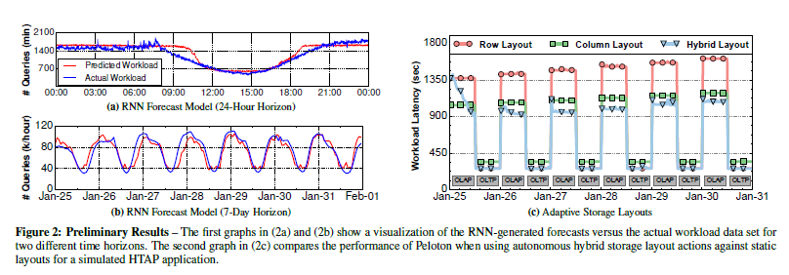
ML4DB → CMU Survey
Self-Driving Database Management Systems Andrew Pavlo, Gustavo Angulo, Joy Arulraj, Haibin Lin, Jiexi Lin, Lin Ma, Prashanth Menon Todd C. Mowry, Matthew Perron, Ian Quah, Siddharth Santurkar, Anthony Tomasic Skye Toor, Dana Van Aken, Ziqi Wang, Yingjun WuF, Ran Xian, Tieying Zhang Carnegie Mellon University, National University of Singapore
(1) Issues:
Problem Kernel: The self-driving DBMS is a very ambitious goal, which is so ambitious that the existing DBMS cannot support it at all.
Self-driving is no longer, like the plug-in model for MySQL, but is deeply integrated into the design of the DBMS.
Working Scenario: a flexible, in-memory DBMS architecture with sufficient resource and computation (separated GPU is better)
Shining point: more like a survey to summarize what necessary features a self-driving database needed. With a relatively simple prototype
(2) Contributions: self-driving databases,
Workload Classification → unsupervised learning
Workload Forecasting → RNN or LSTM
choose which action to employ, and determine the best time to enact → RHCM&RL
(3) Evaluation:
(4) Conclusion:
Conduct ML with an integrated, system’s view is promising
We can figure out the trend of new-style of advanced DB can be achieved by ML
The ML4DB can be attached with resource issue, like enough computation left for DB to achieve compute-intensive work when idle (indicated by FAST’21 RocksDB’s last 8 years overview)
Using separated resource, like GPU/ NPU is a better choice

Slide 7
ML4DB → Summary (temporary)
2019’ Advanced Database Systems → Self-Driving Databases
(1) Potential benefits of workload forecast:
Hot-cold separation (classification and prediction) , allocating data to corresponding storage level based on temperature.
Cloud Auto-Scheduling & Load balance (RL-based), distributing data to different nodes among clusters based on inner/inter nodes load status.
(2) A general view of ML4DB (self-driving DB):
Automatic optimization for specific components like parameters tuning; (support previous demands)
Automatically determine when to apply action according results from ML; (no need of human-beings)
Learn from applied actions and make future decisions. (RL)
(3) Detailed procedures:
Phase 1: modeling (input: the history of the app’s workload and internal runtime profiling metrics of DB; output: model)
forecast models that predict the application’s future workload and database state
predict how the DBMS’s internal sub-systems will respond to configuration changes made by actions
Challenge: not expose information about underlying hardware so the system can reuse training data across operating environments
Phase 2: planning
use models to select actions that provide the best reward. (RL-related method)
Phase 3: deployment
how to expose useful information of DBMS, which includes app’s workload, metrics about DBMS’s internals, and how to control its behavior.
each action completes quickly and with little impact on performance
(4) Current works:
Oracle self-driving DBMS; Peloton; IBM DB2; etc.

