Slide 1
OUTLINE
Weekly Overview
Paper Presentation
Works done by Stony Brook University
Discussion

Slide 2
OUTLINE
Weekly Overview
Paper Presentation
Works done by Stony Brook University
Discussion

Slide 3
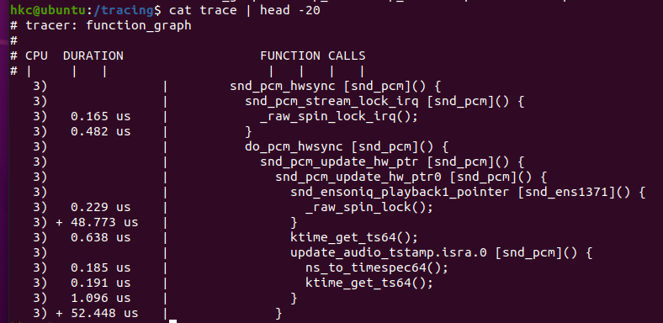
Weekly Overview
This week:
Tracefs exploration for Workload Compression
Ftrace, a tracing framework for Linux kernel, records the running track of the kernel function with several tracers.
track dynamic kernel functions, call stacks of functions, and the stack usage.
track delays, such as interrupts blocked, preemption prohibited time, and how long it takes to start execution after waking up a process.
Survey for ML4sys (mainly Stony Brook University)
FAST’20 Carver: Finding Important Parameters for Storage System Tuning; Zhen Cao, Geoff Kuenning, and Erez Zadok; Stony Brook University and Harvey Mudd College
FAST’20 Poster KMLIB: TOWARDS MACHINE LEARNING FOR OPERATING SYSTEMS; Ibrahim Umit Akgun, Ali Selman Aydin, Erez Zadok; Stony Brook University
ATC’18 Towards Better Understanding of Black-box Auto-Tuning: A Comparative Analysis for Storage Systems; Zhen Cao, Vasily Tarasov, Sachin Tiwari, and Erez Zadok; Stony Brook University and IBM Research—Almaden
Next week:
Learned OS: “Learned” Operating Systems; Yiying Zhang, Yutong Huang; Purdue University
ML4KV: Design Continuums and the Path Toward Self-Designing Key-Value Stores that Know and Learn; Stratos Idreos, Niv Dayan, Wilson Qin, Mali Akmanalp, Sophie Hilgard, Andrew Ross, James Lennon, Varun Jain, Harshita Gupta, David Li, Zichen Zhu; Harvard University

Slide 4
OUTLINE
Weekly Overview
Paper Presentation
Works done by Stony Brook University
Discussion

Slide 5
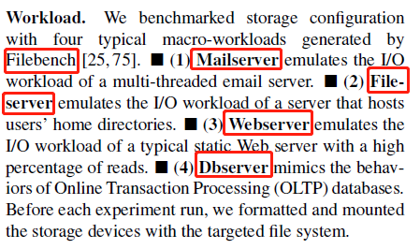
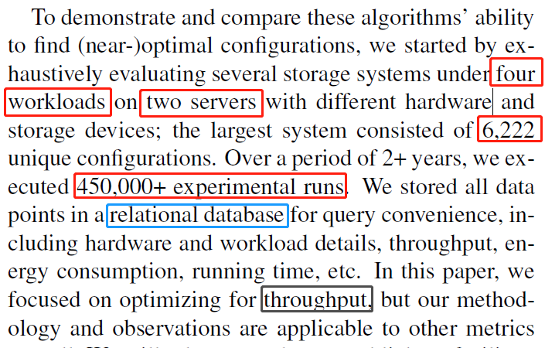
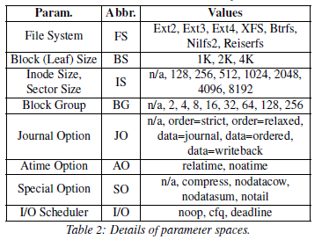
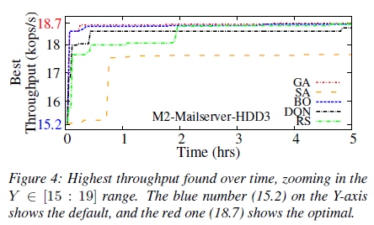
ML4sys → Parameters Selection (ATC’18 )
Towards Better Understanding of Black-box Auto-Tuning: A Comparative Analysis for Storage Systems; Zhen Cao, Vasily Tarasov, Sachin Tiwari, and Erez Zadok; Stony Brook University and IBM Research—Almaden
(*) black-box auto-tuning:
iteratively try different configurations, measure an objective function’s value; (thrpt, energy consumption, purchase cost, formula combining metrics…)
based on the previously learned information, select the next configurations to try.
(1) Issues:
Problem Kernel: there is no deep understanding how exactly these methods work; evaluated only one or few algorithms at a time.
Working Scenario: apply and analytically compare multiple black-box optimization techniques on storage systems.
Shining point: it is an overview discussing several tuning method.
(2) Contributions:
Evaluate and analyze several current methods: Simulated Annealing; Genetic Algorithms; Reinforcement Learning; Bayesian Optimization (BO); Control Theory; Supervised Machine Learning
(3) Evaluation:
Notes:
(SA) is inspired by the annealing process in metallurgy. A state corresponds to one configuration. Neighbors of a state refer to new configurations achieved by altering only one parameter value of the current state
(GA) is inspired by natural selection. It maintains a population of configurations and applies several genetic operators to them. Crossover takes two parent configs and generates new ones. Better configs will have a higher probability to “survive”.
(RL) explores how software agents take actions in an environment to maximize the defined cumulative rewards
BO可以用非常少的步数（每一步可以想成用一组超参数来训练你的神经网络）就能找到比较好的超参数组合。另一个原因是BO不需要求导数（gradient），而正好一般情况下神经网络超参的导数是求不出来的。这两个原因导致BO成为了如今世界上最好的调超参的方法

Slide 6
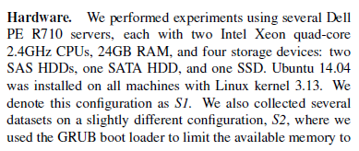
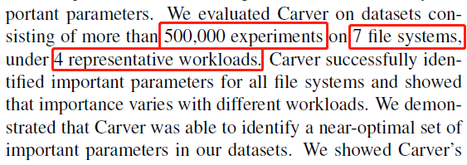

ML4sys → Parameters Selection (FAST’20 )
Carver: Finding Important Parameters for Storage System Tuning; Zhen Cao, Geoff Kuenning, and Erez Zadok; Stony Brook University and Harvey Mudd College
(1) Issues:
Problem Kernel: Storage systems have massive parameters, tuning which provide significant gains in performance, while both manual and automatic tuning methods struggle due to the large number of them and exponential possible configurations. (i.e., Linux’s Ext4 offers about 60 parameters, representing over 1037 potential configuration states.)
Previous research shows that some parameters have greater impact than others, focusing on them can speed up auto-tuning systems.
→ How to figure out which paras are more important?
Working Scenario: can be used for several file systems to figure out the importance of their parameters in the system’s view
Shining point: touches a special but critical field when deploying ML for system
(2) Contributions:
Current works: can not scale well if the complexity/number-of-paras becomes huge.
Experts use domain expertise to tune a few but well-studied paras, which does not scale well with increasing complexity.
auto-tune storage systems: black-box way have difficulty scaling to high dimensions and take a long time to converge on good solutions
This work: Adapting ML’s dimensionality reduction to storage-parameter selection.
By eliminating the less important parameters and ordering parameters by importance.
a variance-based metric to quantify storage parameters’ importance;
Latin Hypercube Sampling to sample huge parameter spaces;
a greedy but efficient parameter-selection algorithm that can identify important parameters.
(3) Evaluation:

Slide 7

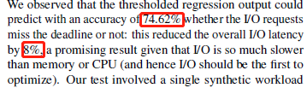
ML4sys → OS’s configuration (FAST’20 Poster)
KMLIB: TOWARDS MACHINE LEARNING FOR OPERATING SYSTEMS; Ibrahim Umit Akgun, Ali Selman Aydin, Erez Zadok; Stony Brook University
(1) Issues:
Problem Kernel: Most OS are developed decades ago cannot support dynamic workloads, it is beneficial to develop adaptive systems that learn from data patterns and OS events. However, user-level ML engines are often too costly (CPU and memory footprint) to be used inside a tightly controlled, resource constrained OS. Need a lightweight yet efficient ML engine targeting kernel space components, OS I/O scheduler.
Working Scenario: In kernel ML model, which contains all procedures for prediction, for OS components auto-tuning.
Shining point: depict an integrated picture for potential fields, challenges and discussion, while lacking implementation.
(2) Contributions:
Current Solutions: Similar problems can be found in OSs. Mainly about caching, indexing and scheduling.
Efforts in DB: learned structures to improve performance and adaptability; optimized for workloads and underlying system specifications.
Efforts in computer architecture: predicting memory access patterns is an ML problem, (cache-replacement models) to improve the performance.
This paper: try to illustrate the in-kernel ML for OSs with a simple attempt: a parameter configuration → mq_deadline for I/O scheduling.
→ Linear Regression model to predict whether the I/O request will meet the deadline or not
(i) In the dd_init queue function, set the learning rate, batch size, Initial weights, momentum, and number of features to learn.
(ii) In the dd_dispatch request function, CALL functions that collect Xt and Yt and perform the training steps.
(iii) In the dd_insert request function, CALL inference function; and based on the prediction to decide whether to early-reject the I/O request or not.
(3) Evaluation:

Slide 8
OUTLINE
Weekly Overview
Paper Presentation
Works done by Stony Brook University
Discussion

Slide 9
Current Summary for ML4sys
Adopting ML for specific field in systems (detail)
→ For some specific scenario, it is better to use ML rather than traditional method.
(1) Tuning for specific parameters
HotStorage’21→ read ahead case; FAST’20 → I/O scheduling; Caching, scheduling, indexing, and etc.
(2) System general configuration (massive tuning)
Black-boxed → ATC’18+FAST’20 carver case and related;
Capturing workload features: CMU Malin’s; Learned Index; Learned KV
Migrating ML to System (general)
Try to create an environment where user themselves can design ML method to solve different kind of issues.
(1) Try to find the system scenario which can be integrated regarded as a ML model
Self-driving DB; workload-oriented multi-indexing;
(2) Deep migration (kernel level, inner-system)
HotStorage’21 architecture; system and algorithm co-design (AutoSys)
What we want to do
Workload features → learn from real-world demands.
Not only one parameter, but a series of Inter-related actions/paras → inner the storage system
Challenges:
Architecture Design (more dynamic and flexible policy for dataflow);
ML overhead control and system flow interference;
Scalability & real-time detection and feedback

