Slide 1
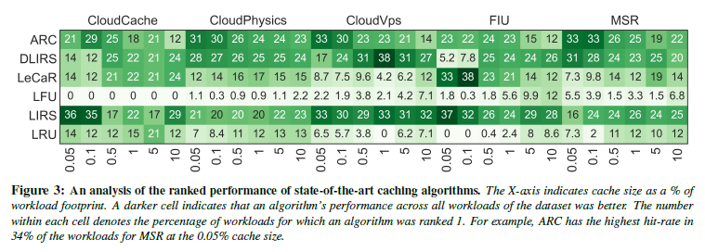
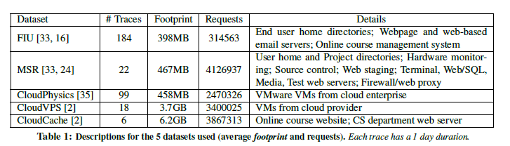
FAST’21 → Caching Everywhere
Learning Cache Replacement with Cacheus; Liana V. Rodriguez, Farzana Yusuf, Steven Lyons, Eysler Paz, Raju Rangaswami, and Jason Liu, Florida International University; Ming Zhao, Arizona State University; Giri Narasimhan, Florida International University
Recent advances in machine learning open up new approaches for solving classic problems in computing systems. For storage systems, cache replacement is one such issue because of its enormous impact on performance.
Cache management + ML = Improved performance
Basic Observation:
state-of-the-art caching algorithms continue to leave room for improvement:
(1) caching algorithms that do well for certain workloads do not perform well for others;
(2) caching algorithms that do well for certain cache sizes do not necessarily perform well for other cache sizes.
Motivation:
Understanding Workloads. Based on the analysis of production storage workloads, there are 4 representative types. (analyzed over 329 production storage traces sourced from 5 different production collections)
There is no algorithm is a clear winner.
Adaptive Replacement Cache (ARC), an adaptive method to recognize both recency and frequency of access, which divides cache into two LRU lists, T1 and T2. T1 holds items accessed once while T2 keeps items accessed more than once since admission. It is unable to capture the full frequency distribution of the workload and perform well for LFU-friendly workloads.
Low Interference Recency Set (LIRS), based on reuse distance. It handles scan workloads well by routing one-time accesses via its short filtering list Q. Its ability to adapt is bad since its use of a fixed-length Q.
Learning Cache Replacement (LeCaR), a ML technique that uses reinforcement learning and regret minimization to control its dynamic use of two cache replacement policies, LRU and LFU upon a cache miss. It is not bad but still has potential to be optimized, in terms of adaptiveness, overhead, and churn-friendliness → (Incremental work for LeCaR)

Slide 2
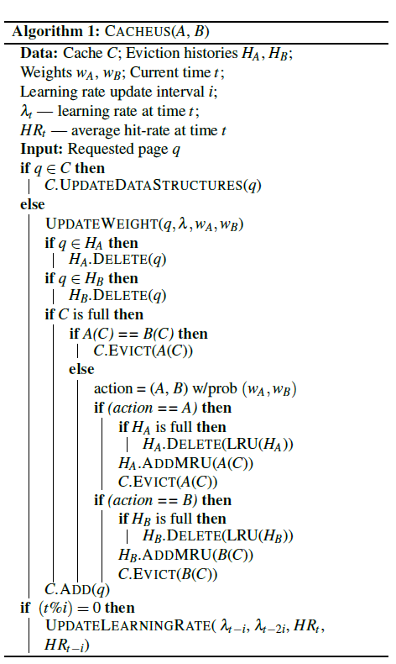
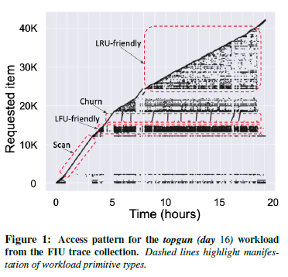
FAST’21 → Caching Everywhere
Learning Cache Replacement with Cacheus; Liana V. Rodriguez, Farzana Yusuf, Steven Lyons, Eysler Paz, Raju Rangaswami, and Jason Liu, Florida International University; Ming Zhao, Arizona State University; Giri Narasimhan, Florida International University
Main works of this paper:
Inform workload primitive types. LRU-friendly, LFU-friendly, scan, and churn. The workload primitive types vary across workloads, within a single workload over time, and as cache size changes. time, and as cache size changes.
LRU-friendly, defined by an access sequence that is best handled by LRU caching algorithm.
LFU-friendly, defined by an access sequence that is best handled by the LFU caching algorithm.
Scan, defined by an access sequence where a subset of stored items are accessed exactly once.
Churn, defined by repeated accesses to a subset of stored items with each item being accessed with equal probability.
CACHEUS, is inspired by LeCaR but overcomes an important shortcoming by being completely adaptive, with the elimination of all statically chosen hyper-parameters, thus ensuring high flexibility.
→simplifying and adapting LeCaR by a gradient-based stochastic hill climbing approach with random restart.
at the end of every N requests (cache size), the gradient of the performance (average hit-rate) with learning rate over the previous two windows is calculated. → If the gradient is positive (negative, resp.), then the direction of change of the learning rate is sustained (reversed, resp.). The amount of change of learning rate in the previous window determines the magnitude of the change in learning rate for the next window.
If the performance increases (decreases, resp.) by increasing the learning rate, we will increase (decrease, resp.) the learning rate multiplying it by the amount of learning rate change from the previous window, and vice versa.
Upon cache hits, CACHEUS updates the internal data structures which includes moving the item to the Most Recently Used position of cache and updating its frequency. Upon cache miss, it checks the eviction histories for the requested item, removes it from said histories, and updates the weights.

Slide 3
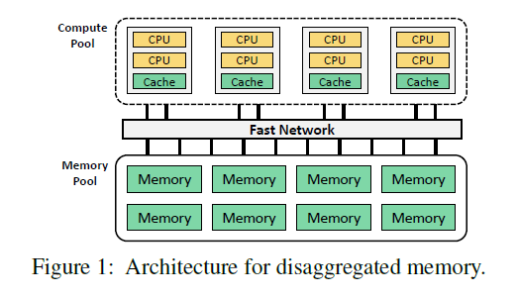
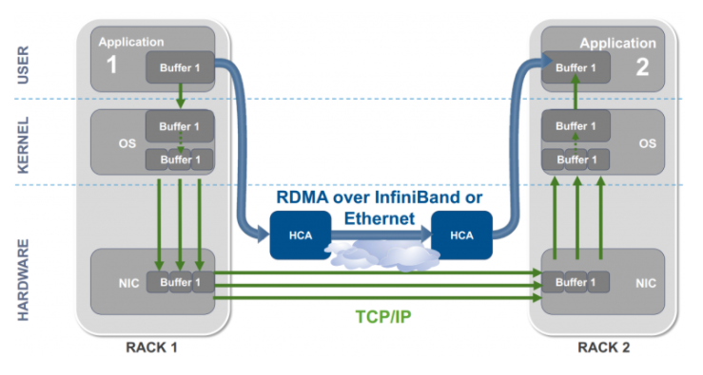
ATC’21 → Peeking over the Fence: RDMA
One-sided RDMA-Conscious Extendible Hashing for Disaggregated Memory; Pengfei Zuo, Jiazhao Sun, Liu Yang, Shuangwu Zhang, Yu Hua; Huawei Cloud, Huazhong University of Science and Technology
Memory disaggregation enjoys the benefits of improved resource utilization, failure isolation, and elasticity. Hashing indexes have been widely used to provide fast lookup services in distributed memory systems.
Traditional hash index is inefficient for disaggregated memory since the computing power in memory pool is too weak to execute complex index requests.
Background:
RDMA (Remote Direct Memory Access), uses DMA when two or more computers are communicating, and directly access the memory of another host from the memory of one host.
Zero-copy: app directly perform data transmission without involving the network software stack, data can be sent directly to the buffer or can be received directly from the buffer without being copied to the network layer.
Kernel-bypass: app directly perform data transmission in user mode, without context switching between kernel mode and user mode.
No-CPU Involvement: app access the memory of the remote host without consuming any CPU in the remote host. The memory of the remote host can be read without the involvement of the process (or CPU) on the remote host. The remote host's CPU cache will not be filled with the accessed content.
One-sided RDMA: a mode also called Memory Verbs, including RDMA Reads/Writes/Atomic where RDMA access does not require confirmation from the remote machine.
Disaggregated Memory Architecture, achieves resource pooling and independent hardware.
Compute pool consists of many CPU blades, each of which retains a small amount of memory as the local cache for the memory pool.
Memory pool includes memory blades that can be DRAM or PM DIMMs, and controllers (low-power processing units used only for interconnection).
The communication between compute and memory pools is based on one-sided RDMA.
Memory Verbs (memory operation/function) involved in this paper: RDMA Read (Pull data from remote mem to local mem); RDMA Write (Push data from local mem to remote mem); RDMA Atomic (the atomic operation for controlling)

Slide 4
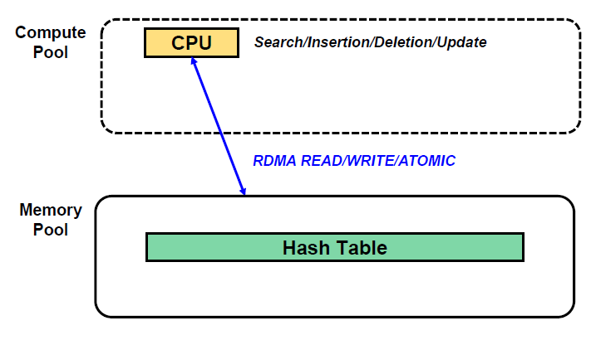
ATC’21 → Peeking over the Fence: RDMA
One-sided RDMA-Conscious Extendible Hashing for Disaggregated Memory; Pengfei Zuo, Jiazhao Sun, Liu Yang, Shuangwu Zhang, Yu Hua; Huawei Cloud, Huazhong University of Science and Technology
Memory disaggregation enjoys the benefits of improved resource utilization, failure isolation, and elasticity. Hashing indexes have been widely used to provide fast lookup services in distributed memory systems.
Traditional hash index is inefficient for disaggregated memory since the computing power in memory pool is too weak to execute complex index requests.
Issues: RDMA-search-friendly (RSF) hashing Indexes becomes less efficient when facing new disaggregated memory architecture
RSF indexes execute search requests by using one-sided RDMA READs to fetch data from remote memory without involving remote CPUs. Insertion, deletion, and update (IDU) requests are sent to the remote CPUs, which locally execute them. This mechanism fails to work in DM design since the computing power in the memory pool is too weak to execute the complex IDU requests.
even IDU can be executed in compute blades by using one-sided RDMA WRITE and ATOMIC verbs to operate on remote data. Executing IDU requests using one-sided RDMA verbs in existing RSF incurs performance degradation due to massive network round-trips and concurrent access conflicts.
Challenges:
Many remote reads & writes for handling hash collisions. Current RSF incur data movement overheads to make room for newly inserted items which involves remote reads and writes, decreasing hash performance since each remote read or write produces one RDMA network round-trip.
Concurrency control for remote access. lock-based techniques are required for that, which have low overhead for local hashing indexes, but in DM scenarios, remote locking has to be implemented using RDMA ATOMIC verbs with microsecond-level latency.
Tricky remote resizing of hash tables. Extendible/full-table resizing needs to move several/all KV items from old hash table to new one, which is costly. and during resizing, it is challenging to concurrently access the hash table.

Slide 5
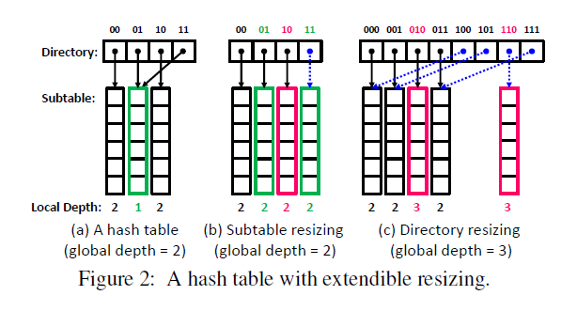
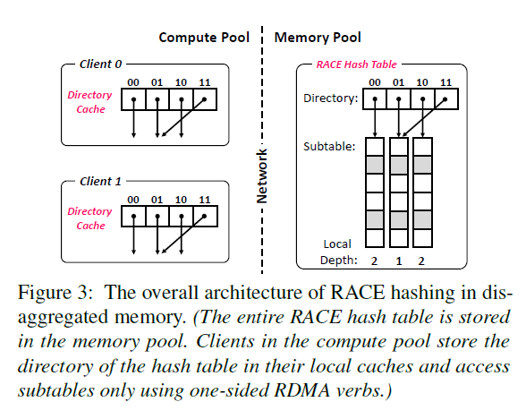
ATC’21 → Peeking over the Fence: RDMA
One-sided RDMA-Conscious Extendible Hashing for Disaggregated Memory; Pengfei Zuo, Jiazhao Sun, Liu Yang, Shuangwu Zhang, Yu Hua; Huawei Cloud, Huazhong University of Science and Technology
Propose RACE hashing, which fully relies on one-sided RDMA verbs to efficiently execute all index requests, which is both RDMA-search-friendly and RDMA-IDU-friendly.
Technique foundation: Based on extendible resizing, and hence a RACE hash table consists of multiple sub-tables and a directory (indexing sub-tables).
For a 64-bit hash value, M bits is for directory to locate a sub-table and the (64-M) bits are used to locate target buckets within the sub-table.
General ideas and design:
The sub-table structure is designed to be one-sided RDMA-conscious (RAC), achieving that all index requests can be executed using only one-sided RDMA verbs while having a constant-scale time complexity in the worst case, and therefore delivering high performance.
To handle remote concurrency for multi-clients accessing, RACE hashing leverages a lock-free remote concurrency control scheme for the RAC hash sub-table, which achieves that all index requests except failed insertions are concurrently executed in a lock-free manner.
To reduce the penalty from extendible resizing, RACE hashing caches the directory at the client side (a client is a CPU blade), and therefore eliminates the RDMA access to the directory.
To handle that a stale directory cache may obtain incorrect or inconsistent results. RACE hashing presents a stale-read scheme to guarantee the correctness of accessed data and allow current request execution during resizing.

Slide 6
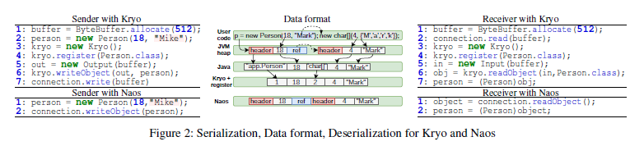
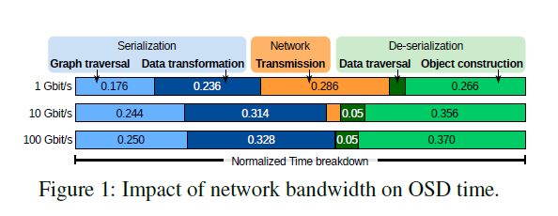
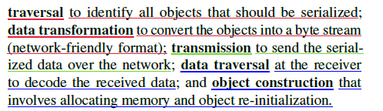
ATC’21 → Peeking over the Fence: RDMA
Naos: Serialization-free RDMA networking in Java; Konstantin Taranov, ETH Zurich; Rodrigo Bruno, INESC-ID / Técnico, ULisboa; Gustavo Alonso and Torsten Hoefler, ETH Zurich
Managed languages is not allowed to directly access heap objects. To send data over the network, it must be explicitly converted to byte streams before sending and converted back to objects after receiving, to serialize data structures into well-defined messages that can be exchanged using any network protocol.
It is expensive and limits performance of JVM-based distributed systems as it induces additional memory copies and requires data transformation resulting in high CPU and memory bandwidth consumption, especially worse in distributed big-data applications.
The network is not a bottleneck anymore. (Serialization already accounts for 6% of total CPU cycles at Google datacenters.)
Background:
JVM heap. For most apps, it is shared by threads and store object instances and arrays, which is divided into thread local allocation buffers (TLAB) that can be located in a physically discontinuous space but must logically be continuous for its thread.
Object Serialization. All Java objects start with a JVM-specific header followed by primitive or reference fields.
Person has one primitive (int) field followed by a reference field to a char[] that starts with the length of the array followed by all characters.
Serializing an object involves traversing the object graph starting from that object and, upon visiting each reachable object, copying all primitive fields into the pre-allocated byte buffer; Deserialization follows a similar but reversed logic: upon visiting serialized object, a new object must be allocated, and all primitive fields are copied out of the buffer into the allocated object.
Kryo, a JAVA library, addresses limitations of native Java serialization by requiring manual registration to achieve a more compact representation of the serialized data, by which it can represent all primitive types and classes using integer identifiers, thereby reducing space needed for storing type names.
→ It is still cumbersome for applications with hundreds of data types.

Slide 7
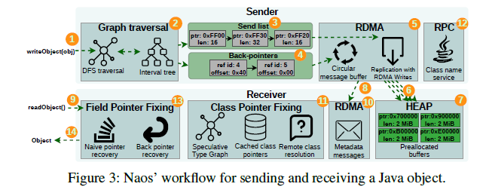
ATC’21 → Peeking over the Fence: RDMA
Naos: Serialization-free RDMA networking in Java; Konstantin Taranov, ETH Zurich; Rodrigo Bruno, INESC-ID / Técnico, ULisboa; Gustavo Alonso and Torsten Hoefler, ETH Zurich
Naos, a native runtime support for serialization-free networking that avoids extra memory copies and data transformation by sending objects directly from the source heap into the remote heap, which allows Java apps to send/receive objects directly through RDMA or TCP connections.
Sending and receiving data without data trimming enables the use of zero-copy RDMA networking, and bypassing not only serialization, by which objects are sent in their uncompressed memory format, reducing the pressure on the CPU at the cost of higher data volumes to be transferred
Overview:
An object transfer starts with a writeObject triggering a DFS graph traversal, during which, pointers to already visited objects are detected by an interval tree.
After traversal, both the objects and metadata are sent over the network using RDMA, in which Naos uses a circular message buffer to send metadata and writes objects directly to the remote heap.
Upon reception of the data and metadata, the receiver starts recovering the object graph by fixing class pointers and field pointers. Once pointers are fixed, the head (indicate the object for receiving) of the object graph is returned to the caller of readObject.
Techniques:
Object Graph Traversal: objects contain reference fields pointing to others and therefore, when an object is passed through writeObject , all objects reachable from it need to be sent. Naos adopts DFS and Internal Tree (that keeps tracks of all visited memory intervals during DFS traversal) to traverse such pointers.
Network exchange of on-Heap Objects: adds native RDMA to JVM without compromising JVM’s memory safety; not expose explicit RDMA access to remote/local heap. Instead, its API allows only sending/receiving Java objects by relying on one-sided RDMA communication to avoid redundant data copies.
Object Graph Recovery: Naos sends unmodified memory segments from one heap to another, so that objects are sent containing pointers that are valid only on the sender address space, but not on the receiver’s. This algorithm overwrites these pointers making them valid on the receiver’s address space.

