Slide 1
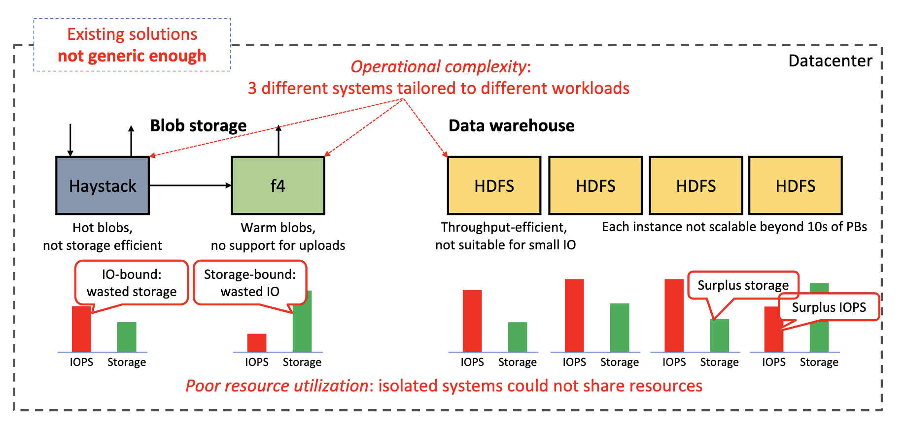
FAST ’21 Cloud and Distributed Systems Track
Facebook's Tectonic Filesystem: Efficiency from Exascale
Satadru Pan, Facebook, Inc.; Theano Stavrinos, Facebook, Inc. and Princeton University; Yunqiao Zhang, Atul Sikaria, Pavel Zakharov, Abhinav Sharma, Shiva Shankar P, Mike Shuey, Richard Wareing, ......
Facebook’s original storage infrastructure consisted of a constellation of smaller, specialized storage systems, all of which store exabytes of data.
Blob storage stores and serves binary large objects and was spread across Haystack (hot data) and f4 (warm data). Latency Sensitive
Data warehouse provides storage for data analytics and was spread across many HDFS instances. Throughput Sensitive
The constellation approach was operationally complex, requiring many different systems to be developed, optimized, and managed.
It was also inefficient, stranding resources in the specialized storage systems that could have been reallocated for other parts of the storage workload.
For blob storage, separating hot and warm blobs resulted in poor resource utilization, a problem exacerbated by hardware and blob storage usage trends. Since Haystack and f4 were separate systems, each stranded resources that could not be shared with other systems.
Haystack overprovisioned storage to accommodate peak IOPS, whereas f4 had an abundance of IOPS from storing a large volume of less frequently-accessed data.
HDFS for data warehouse storage. HDFS clusters are limited in size because they use a single machine to store and serve metadata.
As a result, we needed tens of HDFS clusters per datacenter to store analytics data. This was operationally inefficient; every service had to be aware of data placement and movement among clusters.

Slide 2
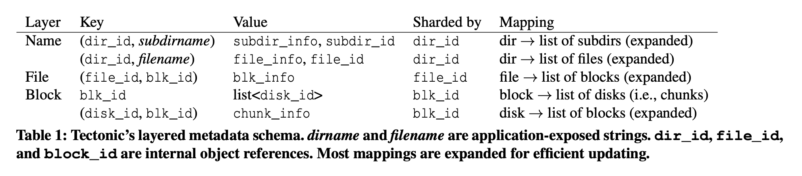
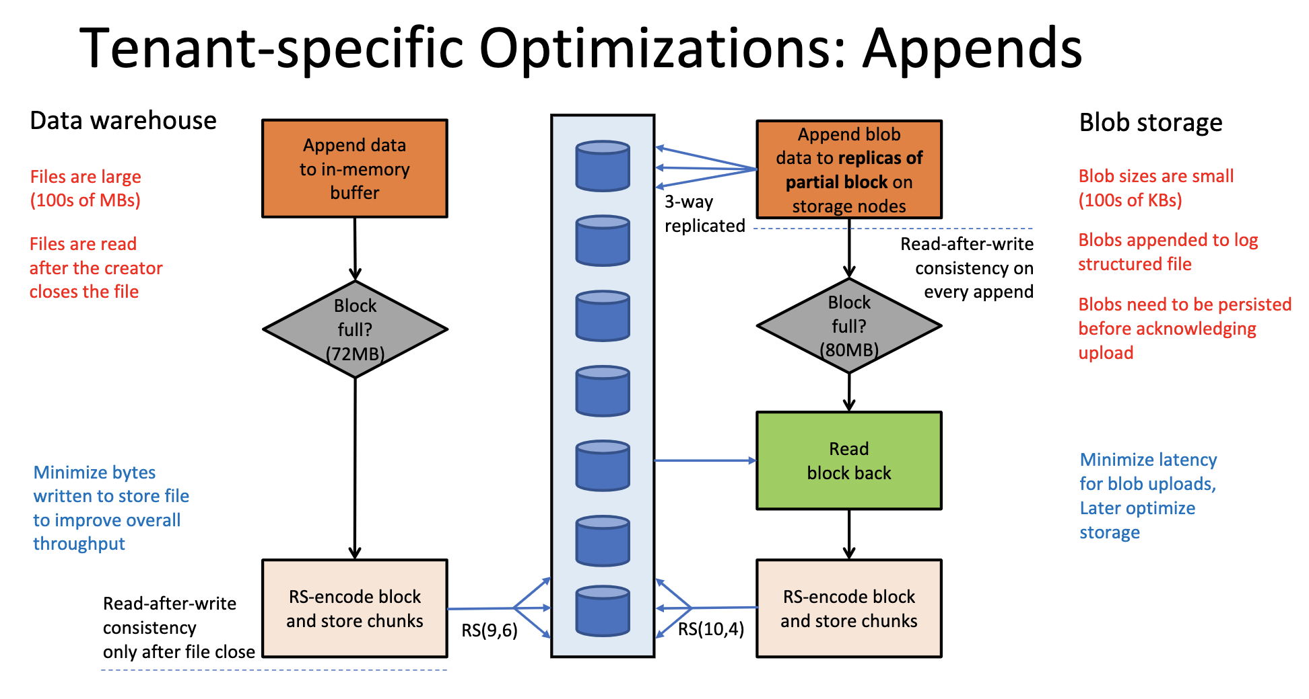
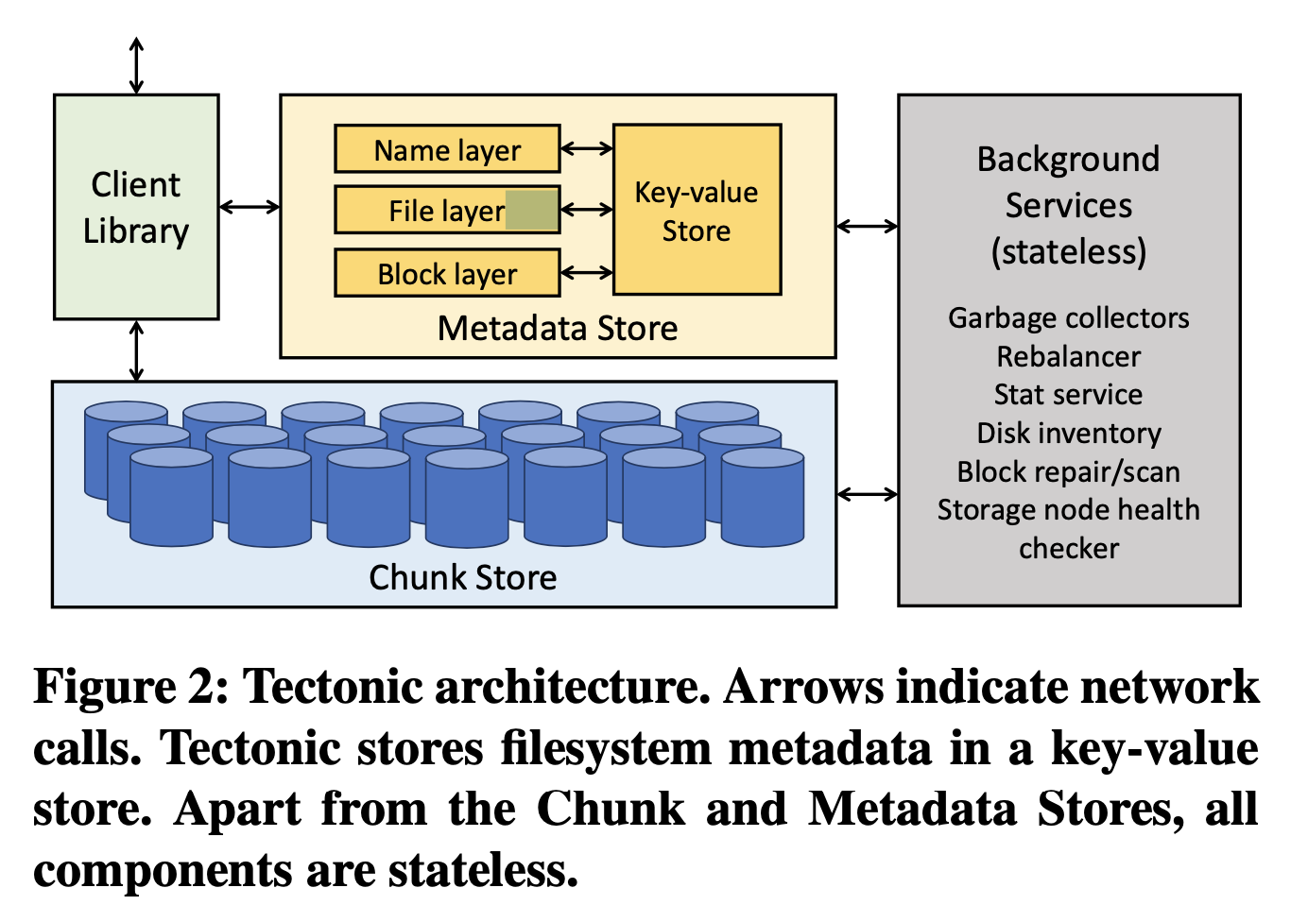
FAST ’21 Cloud and Distributed Systems Track
Facebook's Tectonic Filesystem: Efficiency from Exascale
Satadru Pan, Facebook, Inc.; Theano Stavrinos, Facebook, Inc. and Princeton University; Yunqiao Zhang, Atul Sikaria, Pavel Zakharov, Abhinav Sharma, Shiva Shankar P, Mike Shuey, Richard Wareing, ......
Challenges to build Tectonic:
Scaling to exabyte-scale: important for operational simplicity and resource sharing.
Providing performance isolation between tenants and Enabling tenant-specific optimizations: match the performance of specialized storage systems.
Propose Tectonic to act as distributed filesystem which currently serves around ten tenants, including blob storage and data warehouse.
Chunk Store is a flat, distributed object store for chunks. Chunks make up blocks, which in turn make up Tectonic files. The number of chunks stored grows linearly with the number of storage nodes and it is oblivious to higher-level abstractions like blocks or files. Blocks as the unit of durable storage.
Tectonic’s Metadata Store stores the filesystem hierarchy and the mapping of blocks to chunks. To scale metadata, Tectonic disaggregates the filesystem metadata into independently-scalable layers. Storing metadata in a key-value store for scalability and operational simplicity.
Tectonic Client Library orchestrates the Chunk and Metadata Store services to expose a filesystem abstraction to applications, which gives applications per-operation control over how to configure reads and writes.
Sharing Resources Effectively: Distributing ephemeral resources among and within tenants. Ephemeral resources are managed within each tenant at the granularity of groups of applications (TrafficGroups), reducing the cardinality of the resource sharing problem, reducing the overhead of managing multitenancy. Each TrafficGroup is in turn assigned a TrafficClass.

Slide 3
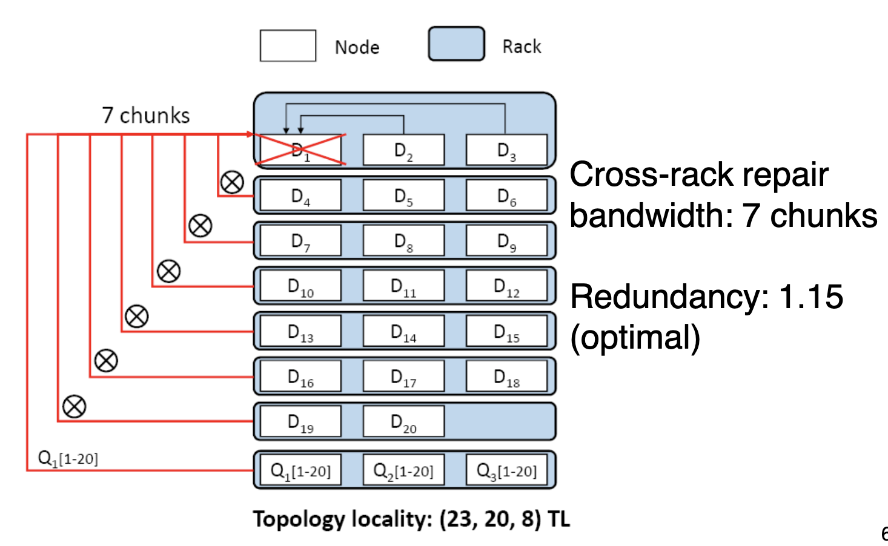
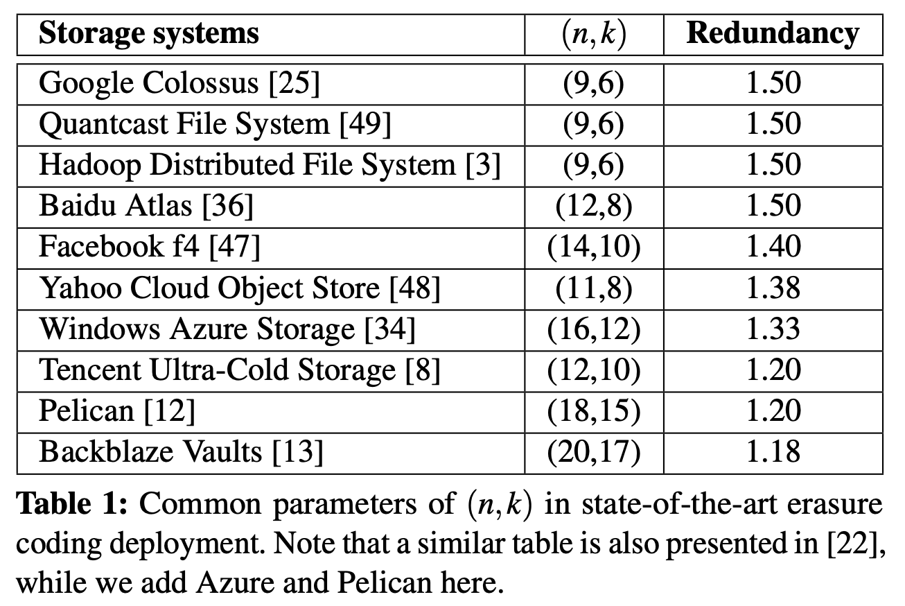
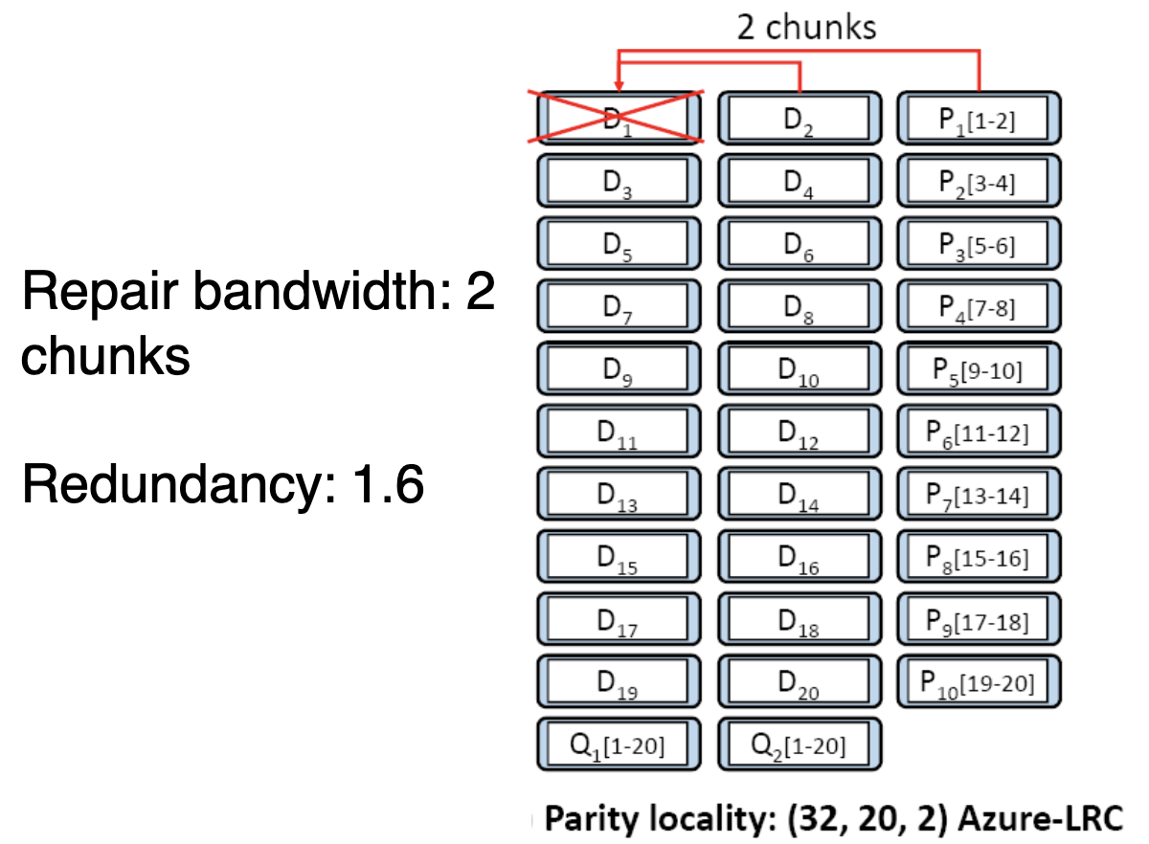
FAST ’21 Cloud and Distributed Systems Track
Exploiting Combined Locality for Wide-Stripe Erasure Coding in Distributed Storage
Yuchong Hu, Liangfeng Cheng, and Qiaori Yao, Huazhong University of Science & Technology; Patrick P. C. Lee, The Chinese University of Hong Kong; Weichun Wang and Wei Chen, HIKVISION
Erasure coding is a low-cost redundancy mechanism for dis- tributed storage systems by storing stripes of data and parity chunks.
Erasure coding parameters should be configured in a medium range to limit the repair penalty.
Explore further redundancy reduction under erasure coding to achieve extreme storage saving.
Wide stripes are recently proposed to suppress the fraction of parity chunks in a stripe to achieve extreme storage savings. For example, VAST considers a setting of (n, k) = (154, 150), thereby incurring only a redundancy of 1.027×.
The significant storage efficiency of wide stripes is attractive for both cold (backup system to reduce cost) and hot (in-memory kv stores to reduce expensive hardware footprints) distributed storage systems.
Challenges: (1) Expensive repair: (n,k) RS code repairs a chunk by retrieving k chunks, Large k in wide stripes means more bandwidth and I/O; (2) Expensive encoding: Limited CPU cache: as k increases, more difficult to fit wide stripes in cache; (3) Expensive updates: Same as in traditional stripes: any updated data chunk causes all n-k parity chunks to be updated.
The main challenge of wide-stripe erasure coding is the repair problem. Existing methods use locality to reduce the repair bandwidth.
Parity locality: Locally repairable codes (LRCs): (n,k,r) Azure-LRC. Reducing repair penalty: encodes every r data chunks into a parity chunk, so repairing a lost chunk only accesses r local chunks (r < k)
Topology locality: (n,k) RS-coded chunks placed in z racks: (n,k,z) TL. Reducing cross-rack repair bandwidth: splits a repair operation into local inner-rack repair and cross-rack repair sub-operations
Notes:
Parity locality: It also has two global parity chunks Q1[1-20] and Q2[1-20]. The (32, 20, 2) Azure- LRC has a single-chunk repair bandwidth of two chunks.
In contrast, the (23, 20) RS code also has 20 data chunks and is tolerable against any three node failures. Its single-chunk repair bandwidth is 20 chunks, yet its redundancy is only 1.15×.
Topology locality: localizing the repair operations within racks. They store the chunks of a stripe in multiple nodes within a rack, and split a repair operation into inner-rack and cross-rack repair sub-operations. The cross-rack repair bandwidth is provably minimized

Slide 4
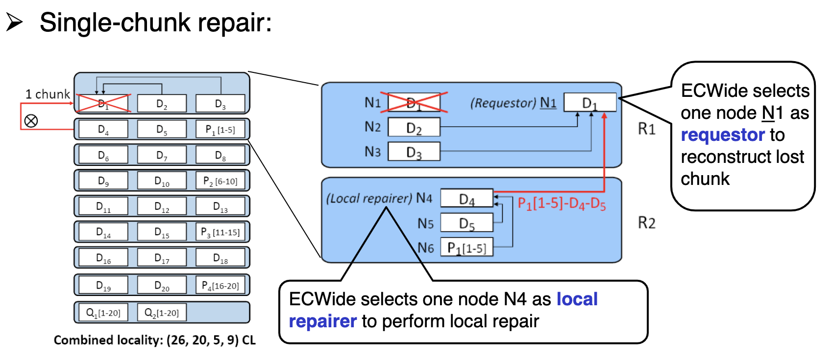
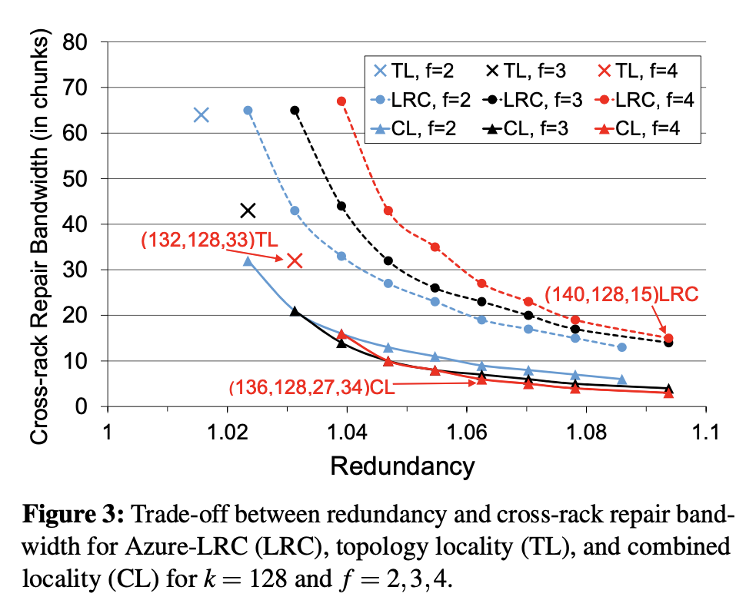
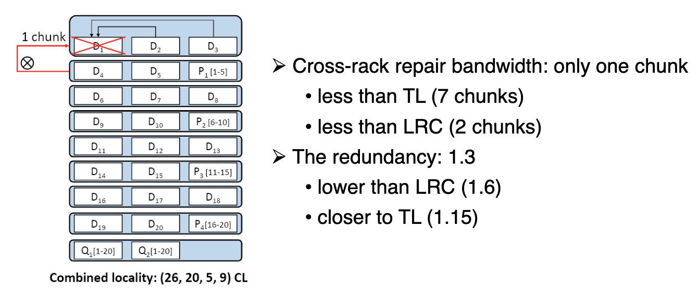
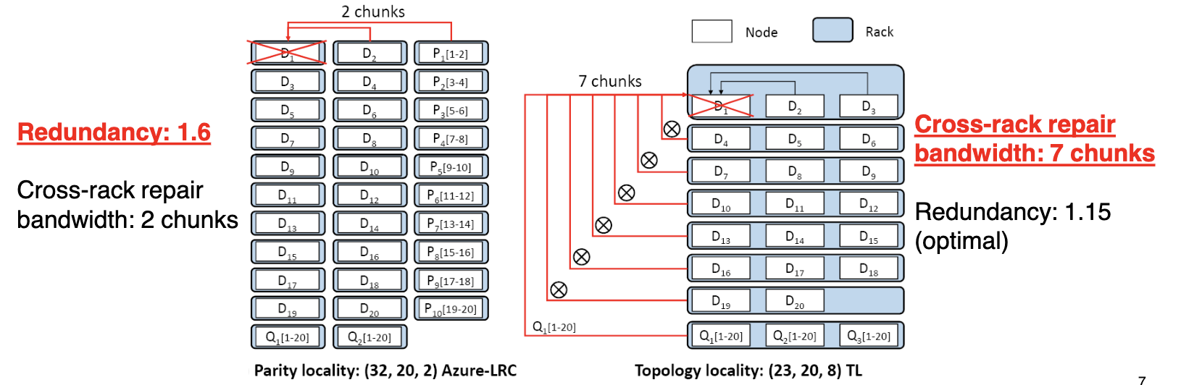
FAST ’21 Cloud and Distributed Systems Track
Exploiting Combined Locality for Wide-Stripe Erasure Coding in Distributed Storage
Yuchong Hu, Liangfeng Cheng, and Qiaori Yao, Huazhong University of Science & Technology; Patrick P. C. Lee, The Chinese University of Hong Kong; Weichun Wang and Wei Chen, HIKVISION
Motivation: Trade-off between redundancy and repair penalty
Parity locality incurs high redundancy
Topology locality incurs high cross-rack repair bandwidth
Combined Locality: (n,k,r,z) CL:
c: number of chunks of a stripe in a rack; f: number of tolerable node failures of a stripe
Requirement: c ≤ f; otherwise, a rack failure leads to data loss
Idea: If c increases, a local inner-rack repair covers more chunks →reducing more cross-rack repair bandwidth; Minimum cross-rack repair bandwidth: when c = f
Example: (26,20,5,9) CL = (26,20,5) Azure-LRC placed in 9 racks
Trade-off Analysis: CL outperforms TL and LRC in terms of trade-off of redundancy and cross-rack repair bandwidth
ECWide: a wide-stripe erasure-coded storage system
Minimum cross-rack repair bandwidth: realizes combined locality; Efficient encoding: proposes a multi-node encoding design; Efficient parity updates: proposes an inner-rack parity update design
Full-node repair: Multiple single-chunk repairs in parallel
Always select least-recently-selected (LRS) nodes as requestors or local repairers to avoid them to choose identical nodes, which may degrade parallel performance.

Slide 5
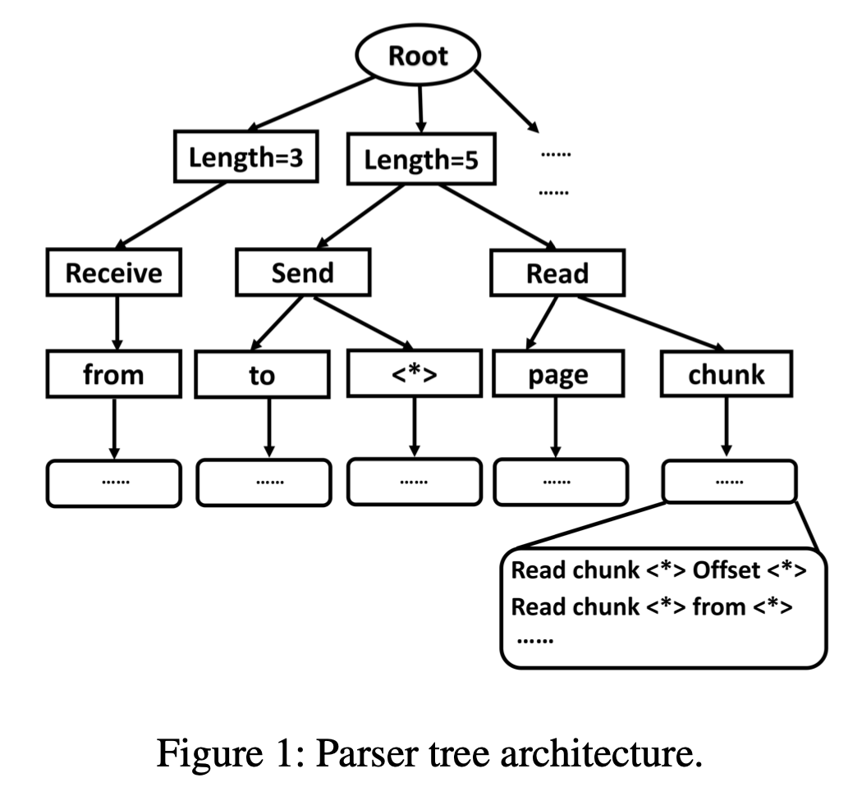
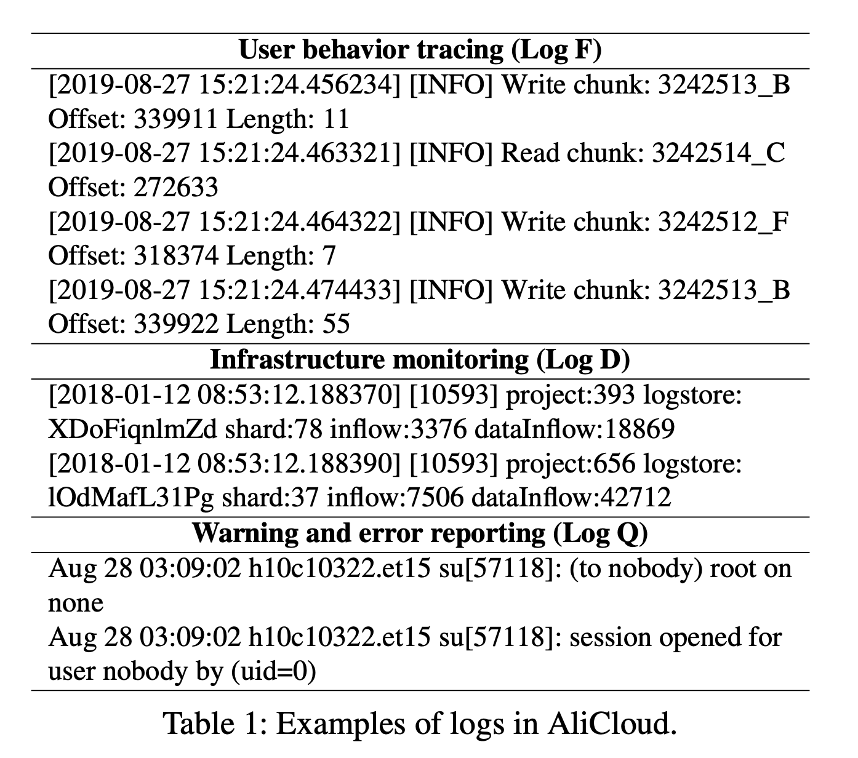
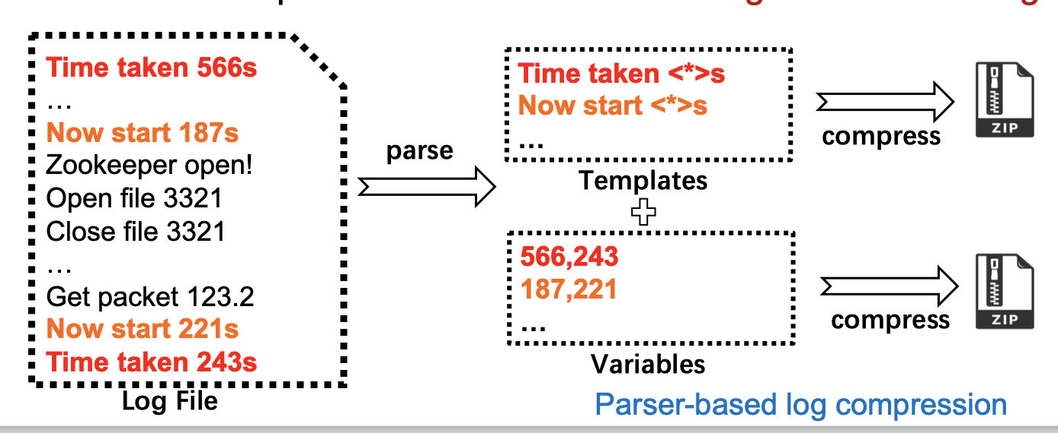
FAST ’21 Cloud and Distributed Systems Track
On the Feasibility of Parser-based Log Compression in Large-Scale Cloud Systems
Junyu Wei and Guangyan Zhang, Tsinghua University; Yang Wang, The Ohio State University; Zhiwei Liu, China University of Geosciences; Zhanyang Zhu and Junchao Chen, Tsinghua University; Tingtao Sun and Qi Zhou, Alibaba Cloud
Most systems log internal events and the size of such logs can grow large.
AliCloud, a major cloud provider, can generate several PBs of logs per day.
To reduce log size, a classic solution is to compress these logs. General-purpose lossless compression methods, such as LZMA, gzip, and bzip, can compress a file by identifying and replacing duplicate bytes.
A number of recent works observe that most system logs are generated by adding variables to a string template (e.g. printf(“value=%d”, v)), and thus by separating them, they only need to store the variables. We call these approaches parser-based log compression in this paper, such Logzip.
The compressor will first utilize the parser tree to try to match each log entry to a template. If a match is found, the log entry will be converted to the template ID and the variables. Afterward the compressor will group log entries according to their template IDs and store their variables in a column manner.
Structure of Cloud Logs
The basic structure of these logs contains three parts: header, template and variable. A header includes the timestamp and the corresponding log level. Templates are the formalized output statements of logs. Variables refer to the part which varies in each instance of the same template.
In eight types of logs, timestamps account for more than 20% of space; Numerical data are often correlated; Most numerical values are small and using fixed-length coding (e.g. 32 bits for an integer) will generate many 0 bits at the beginning.

Slide 6
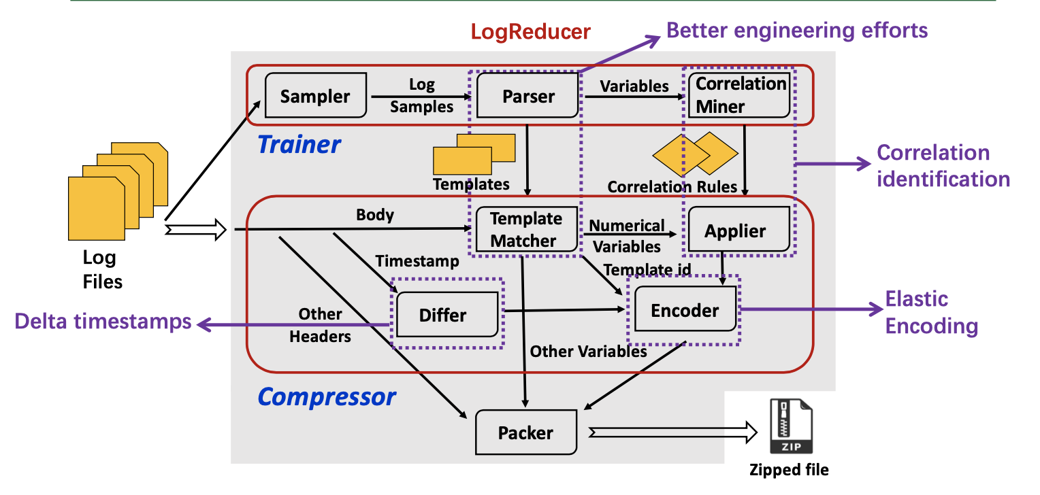
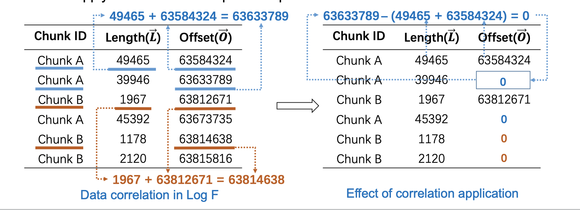
FAST ’21 Cloud and Distributed Systems Track
On the Feasibility of Parser-based Log Compression in Large-Scale Cloud Systems
Junyu Wei and Guangyan Zhang, Tsinghua University; Yang Wang, The Ohio State University; Zhiwei Liu, China University of Geosciences; Zhanyang Zhu and Junchao Chen, Tsinghua University; Tingtao Sun and Qi Zhou, Alibaba Cloud
Existing methods do not work well
While these works report promising results, we observe less intriguing performance when applying this method to production logs from AliCloud: we find Logzip is seven times slower than LZMA, a general-purpose compression method targeting a high compression ratio, and Logzip’s compression ratio is worse than LZMA on 13 out of the 18 types of the logs.
Analysis: (1) The python implementation is not efficient, re-implement in C/C++. (2) Fewer templates but more variables per template: cut the parser tree into only one layer in the compression phase: only take length into consideration; (3) Take a batch of log files as inputs and compress them together to speedup the compression procedure.
Further Compressing Numerical Variables
Compressing Timestamps: Differential encoding of time stamps
Correlation Identification and Utilization: Identify correlation in training phase; Apply correlation in compression phase
Elastic Encoder: Use elastic encoding to save space. We cut the 32-bit integer into 7-bit segments and add one bit to each segment, indicating whether the segment is the last segment (1 means it is the last).
Build LogReducer, a parser-based log compressor
Training phase is done over sampled data. It uses a parser to extract templates and a correlation miner to find possible correlations.
Compression: LogReducer first extracts the headers and matches logs’ bodies to templates. Then compute the difference of adjacent timestamps and utilize correlations over numerical variables. Finally LogReducer encodes all numerical results using elastic encoder.

Slide 7
FAST ’21 Cloud and Distributed Systems Track
CNSBench: A Cloud Native Storage Benchmark
Alex Merenstein, Stony Brook University; Vasily Tarasov, Ali Anwar, and Deepavali Bhagwat, IBM Research–Almaden; Julie Lee, Stony Brook University; Lukas Rupprecht and Dimitris Skourtis, IBM Research–Almaden; ......
Modern hybrid cloud infrastructures require software to be easily portable between heterogeneous clusters.
Software containerization and the larger cloud native ecosystem is considered to be the enabler for providing seamless application portability. An essential step for reliably moving an application from one location to another is validating its performance on the destination infrastructure.
One way to perform such validation is to replicate the application on the target site and run an application-level benchmark.
Though reliable, such an approach requires a custom benchmark for every application. To avoid this extra effort, organizations typically resort to using component-specific benchmarks.
A fundamental requirement for such a benchmark is the ability to generate realistic workloads. However, existing storage benchmarks are inadequate to generate workloads characteristic of modern cloud native environments.
New Workload Properties:
More Storage Control Operations. Creating volumes, attaching volumes, snapshotting. On one platform, 54% of containers ran for ≤5 minutes and hosts ran a median of 30 containers.
Diversity and Specialization. Projects such as Docker make cloud native computing widely available. Workloads on hosts and clusters more diverse.
Elasticity and Dynamicity. Deployment rate increased from rolling out a new version 2–3 times per week to over 150 times in a single day.
Notes:
Hybrid: running certain workloads on-premises, and employing multiple cloud vendors

Slide 8
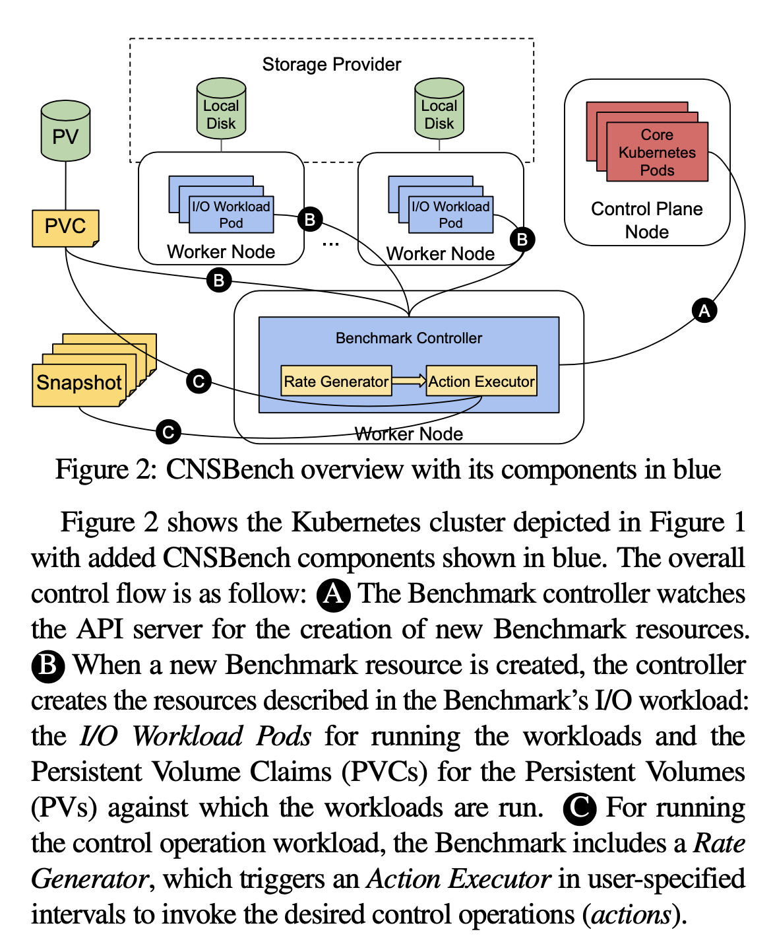
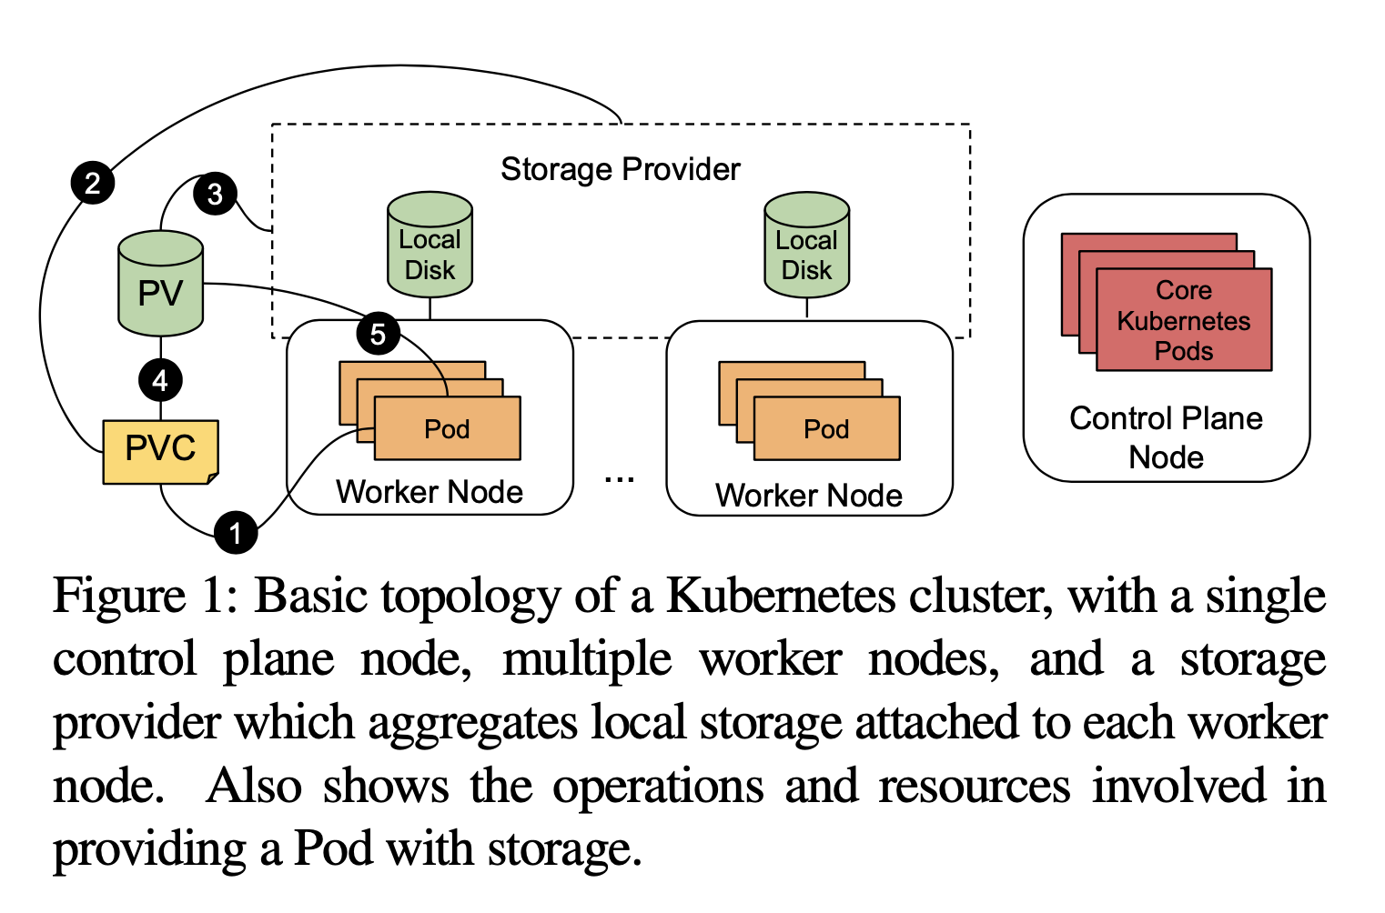
FAST ’21 Cloud and Distributed Systems Track
CNSBench: A Cloud Native Storage Benchmark
Alex Merenstein, Stony Brook University; Vasily Tarasov, Ali Anwar, and Deepavali Bhagwat, IBM Research–Almaden; Julie Lee, Stony Brook University; Lukas Rupprecht and Dimitris Skourtis, IBM Research–Almaden; ......
Benchmark Design Requirements:
Separate I/O workloads and control workloads. I/O workloads should be specified and created independently from control workloads
Use existing tools to generate I/O workloads.
Specify and create realistic control workloads. Orchestrate I/O and control workloads to emulate a dynamic environment.
Easy to define and run benchmarks
To address the current gap in benchmarking capabilities in cloud native storage, implement the Cloud Native Storage Benchmark—CNSBench based on Kubernets.
Defined a custom Benchmark resource and implemented a corresponding Benchmark Controller. The Benchmark resource specifies the I/O and control workloads, which the controller is then responsible for running.
Control workloads are specified using a combination of actions and rates. Rates trigger associated actions at some interval.
The I/O workload specification is defined using a ConfigMap—a core Kubernetes resource for storing configuration files and other free-form text. These files contain the specifications for the Pods that will run the I/O workloads, as well as specifications for supporting resources such as PVCs.
While developing CNSBench, we have also been building out a library of pre-defined workloads. If the administrator instead wanted to instantiate a workload not found in our library, it is easy to package an existing application into a workload that can be used by CNSBench.
Notes:
A basic Kubernetes cluster is shown in Figure 1. It consists of control plane nodes, worker nodes, and a storage provider (among other components). Worker and control plane nodes run Pods, the smallest unit of workload in Kubernetes that consist of one or more containers. User workloads run on the worker nodes, whereas core Kubernetes components run on the control plane nodes. Core components include (1) the API server, which manages the state of the Kubernetes cluster and exposes HTTP endpoints for accessing the state, and (2) the scheduler, which assigns Pods to nodes.

