Slide 1
NSDI’14
FaRM: Fast Remote Memory; Aleksandar Dragojević, Dushyanth Narayanan, Orion Hodson, and Miguel Castro, Microsoft Research
Currently, the total amount of memory in the cluster continues to increase since the price decreases, which can include the memory footprint of most applications, or at least provide sufficient memory buffering.
However, if the cluster memory is to be used uniformly, the network between physical machines, namely the TCP/IP network, becomes the bottleneck.
Backgrounds & Motivation.
New Bottleneck. Decreasing DRAM prices have made it cost effective to build commodity servers with hundreds of gigabytes of DRAM.
Cluster (x100 machines) holds 10x TB DRAM → big enough for data of app (at least cache) → better performance since no need for disk I/O
This has potential to enable apps that perform small random data accesses (no need of disk or flash), but network communication remains a bottleneck.
Still atop of TCP/IP. Emerging fast networks are not going to solve this problem while systems continue to use traditional TCP/IP networking. For example, a state-of-the-art key-value store performing 7x worse in a client-server setup using TCP/IP than in a single-machine setup.
Emerging RDMA. RDMA provides reliable user-level reads and writes of remote memory. It achieves low latency and high throughput because it bypasses the kernel, avoids the overheads of complex protocol stacks, and performs remote memory accesses using only the remote NIC without involving the remote CPU.
RoCE. RDMA has long been supported by Infiniband but it has not seen widespread use in data centers because it has traditionally been expensive, and it is not compatible with Ethernet. Today, RoCE becomes available by supporting RDMA over Ethernet with data center bridging at competitive prices.
Key Insight: Overcome the network bottleneck of traditional TCP/IP by RoCE-based RDMA, achieving the transparent, uniform memory allocation for distributed storage system.

Slide 2
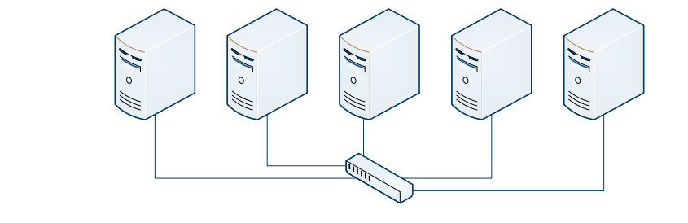
NSDI’14
FaRM: Fast Remote Memory; Aleksandar Dragojević, Dushyanth Narayanan, Orion Hodson, and Miguel Castro, Microsoft Research
FaRM, exposes the memory of machines in the cluster as a shared address space. Applications can use transactions to allocate, read, write, and free objects in the address space with location transparency.
Design Principles.
Using RDMA for data transmission among memory of all machines in the cluster, by forming a unified address space to support transactional implementation, which integrates the 2-phase transaction commit protocol with original reliable transmission of RDMA .
Although RDMA reduces the lock-holding time, the performance of this protocol is still very poor in the storage’s view. Therefore, performance should be improved by: 1) lock-free reads, 2) execute objects and corresponding calculations in one machine and replace distributed txns with local txns.
Implementation. A common KV store interface is implemented.
→ Hopscotch hashing Based KV interface guarantees that a key-value pair is located in a small contiguous region of memory that may be read with a single RDMA.
Use One-sided RDMA vrebs to provide message passing primitives.
For Write. FaRM uses RDMA writes to implement a fast message passing primitive that achieves an order-of-magnitude improvement in message rate and latency relative to TCP/IP on the same Ethernet network. Collocate related data on the same machine.
For Read. It uses one-sided RDMA reads to achieve an additional two-fold improvement for read-only operations that dominate most workloads. The performance are improved by up to 8x with careful tuning and changes to the operating system and the NIC driver.
The shared address space is composed of multiple memory areas with a size of 2GB. Each memory area is the basic unit of address mapping, data recovery, and RDMA registration to the NIC.
It provide lock-free read (Version-based) that can be serialized with transactions on the shared address space. Transactions use optimistic concurrency control with an optimized two-phase commit protocol that takes advantage of RDMA.
A series of works published to enhance FaRM: https://www.microsoft.com/en-us/research/project/farm/

Slide 3
ATC’21 → Barking up the Wrong Tree: Correctness and Debugging
MLEE: Effective Detection of Memory Leaks on Early-Exit Paths in OS Kernels; Wenwen Wang, University of Georgia
Memory leaks in operating system (OS) kernels can cause critical performance and security issues. However, it is quite challenging to detect memory leaks due to the inherent complexity and large-scale code base of real-world OS kernels.
Memory leak: the dynamically allocated heap memory in the program is not released or cannot be released for some reason, which causes a waste of system memory, slows down the program running speed, or even crashes the system.
Backgrounds: Memory leaks can cause serious system issues.
Performance issues ➔ Increased system response time due to reduced memory resources;
Reliability issues ➔ Unavoidable system reboots when leaked objects exhaust memory resources;
Security issues ➔ Exploited to launch security attacks.
Current Work: Many memory leak detectors have been developed, which are designed based on the structures and features of user-level applications thus cannot be applied directly to OS kernels. Compared to user applications, OS kernels are much more complicated in terms of program logic and semantic, as they need to handle various exceptional statuses, respond to arbitrary interrupts from peripheral devices, perform security checks on untrusted data sources, and etc.
I.e., Compiler-based code instrumentation; Binary instrumentation with the need of source code; Dynamic garbage collection-based algorithm.
Detecting leaks in OS kernels is still challenging → Focus Issues of memory leaks on early-exit (EE) paths
The Linux kernel memory leak detector is a dynamic detection tool, which cannot cover kernel code that is not executed at runtime.
Existing static detection techniques are mainly developed for user applications, which cannot be directly applied to OS kernels, and are much more complicated: 25 million source lines in Linux.
Handled specifically in this paper: E-E path is to exit from a kernel routine earlier than normal program paths, by skipping some of the program code in the routine without execution. Hence, an E-E path generally has less program statements than a normal program path.

Slide 4
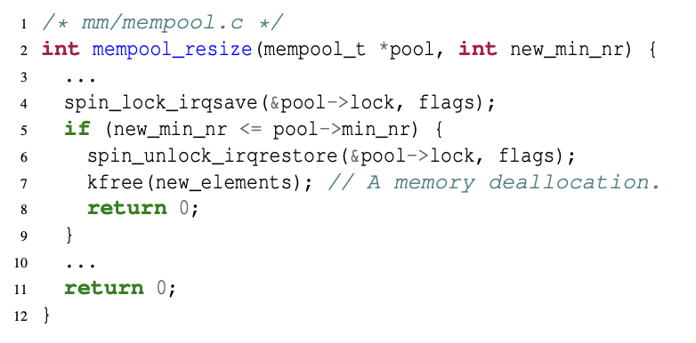
ATC’21 → Barking up the Wrong Tree: Correctness and Debugging
MLEE: Effective Detection of Memory Leaks on Early-Exit Paths in OS Kernels; Wenwen Wang, University of Georgia
Propose MLEE: detecting memory leaks on early-exit (E-E) paths. The main idea is by inconsistent presences of memory deallocations on different early-exit paths and normal paths, so that the potential memory leaks can be detected.
Approach: Cross-checking presences of memory deallocations on different early-exit paths and normal paths
Key Observation:
Software bugs often lurk (hide) in rarely-tested program paths. In general, an E-E path is designed to exit from a kernel routine as early as possible. But, before the routine is exited from the E-E path, some extra work usually needs to be completed, e.g., deallocating a memory object.
→ If a memory deallocation is required but missed on the E-E path, it constitutes a memory leak.
Techniques:
(1) To identify early-exit paths: the diverse semantics and usage scenarios of early-exit paths in OS kernels make it difficult to precisely identify early-exit paths . The solution is by identifying the unique program statements of an early-exit path.
Early-exit branch: a particular conditional branch that leads to an early-exit path. In which the program paths starting from:
(1) one target always reach to a return statement that has a successor statement under the program orders of the routine
(2) another target always have a possibility to reach to a return statement that has no successor statement under the program orders of the routine.
(2) To analyze memory deallocations: a missed memory deallocation may be not needed on a specific early-exit path. The solution is by creating effective static analyses to ensure that the freed object is live, valid and not used on the early-exit path; and heuristically inferring whether the missed memory deallocation is necessary.

Slide 5
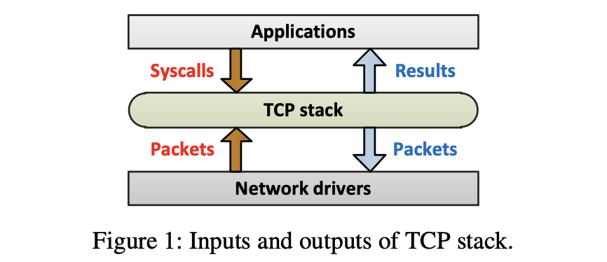
ATC’21 → Barking up the Wrong Tree: Correctness and Debugging
TCP-Fuzz: Detecting Memory and Semantic Bugs in TCP Stacks with Fuzzing; Yong-Hao Zou and Jia-Ju Bai, Tsinghua University; Jielong Zhou, Jianfeng Tan, and Chenggang Qin, Ant Group; Shi-Min Hu, Tsinghua University
TCP stacks provide reliable data transmission in network, and thus they should be correctly implemented and well tested to ensure reliability and security. However, testing TCP stacks is difficult.
Backgrounds:
TCP stack. TCP protocol is a transport-layer network protocol that receives system calls and packets to provide reliable data transmission. It carries over 85% of network traffic nowadays. In practice, the TCP protocol has different implementations forming different TCP stacks. Each modern OS (Linux) has its own kernel-level TCP stack to provide fundamental network support for user-level applications. Besides, to achieve better performance and reduce impact on OS kernels, many user-level TCP stacks have been developed and widely-used in telecom systems and network nodes, to transfer data without OS involvement.
Correctly implementing is difficult. As a TCP stack has rich functionalities (such as reliable transmission and congestion control), complex state model and various possible exceptions to handle. Developers may unintentionally make mistakes when implementing TCP stacks, introducing bugs that can cause serious problems.
Challenges: TCP stacks are tough to debug.
A TCP stack accepts packets and system calls that have dependencies between each other, and thus generating effective test cases is challenging.
A TCP stack has various complex state transitions, but existing testing approaches target covering states instead of covering state transitions, and thus their testing coverage is limited.
Study of TCP stack commits shows that 87% of bug-fixing commits are related to semantic bugs, but existing bug sanitizers can detect only memory bugs not semantic bugs.

Slide 6
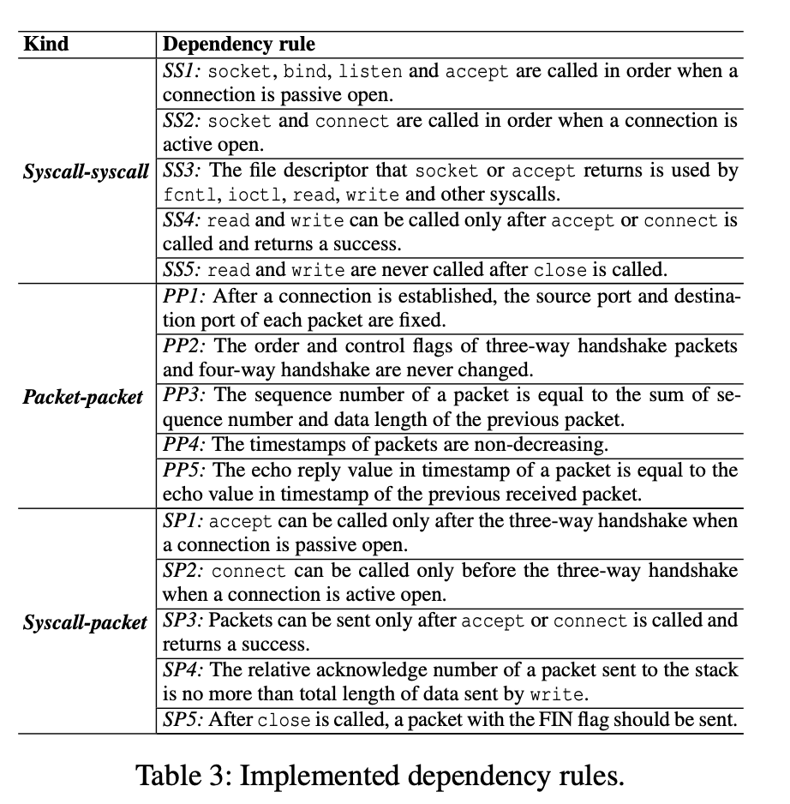
ATC’21 → Barking up the Wrong Tree: Correctness and Debugging
TCP-Fuzz: Detecting Memory and Semantic Bugs in TCP Stacks with Fuzzing; Yong-Hao Zou and Jia-Ju Bai, Tsinghua University; Jielong Zhou, Jianfeng Tan, and Chenggang Qin, Ant Group; Shi-Min Hu, Tsinghua University
Propose a novel fuzzing framework named TCP-Fuzz, to effectively test TCP stacks and detect bugs.
Fuzz Test: a software testing technology, is to input automatically or semi-automatically generated random data into a program, and monitor program exceptions, such as crashes, assertion failures, to find possible program errors, such as memory leaks. Fuzzing testing is often used to detect security vulnerabilities in software or computer systems.
Techniques.
To generate effective test cases. It uses a dependency-based strategy that can generate the sequences of syscalls and packets by considering dependencies between them. It considers three dependencies to generate effective test cases, including syscall-syscall, packet-packet and syscall-packet dependencies.
I.e., a typical packet-packet dependency is that the sequence number of a new packet should be equal to the sum of the sequence number and data length of the previous packet;
To effectively cover state transitions. It uses a transition-guided fuzzing approach that exploits a new coverage metric named branch transition as program feedback to replace code coverage. In which the branch transition is represented as a vector that stores both branch coverage for the current input item (packet or syscall) and the change of branch coverage between the current and previous input items.
Branch transition can describe not only states but also state transitions of two adjacent input items.
To detect semantic bugs. TCP-Fuzz uses a differential checker that compares the outputs of multiple TCP stacks for the same inputs. Hence, different TCP stacks should obey many identical semantic rules (most of these rules are defined in RFC documents), and thus they should produce identical or similar outputs for the same inputs. Otherwise, these TCP stacks have implementation inconsistencies, indicating some of them possibly have semantic bugs. This checker is scalable and does not introduce runtime overhead for TCP stacks.

