Slide 1
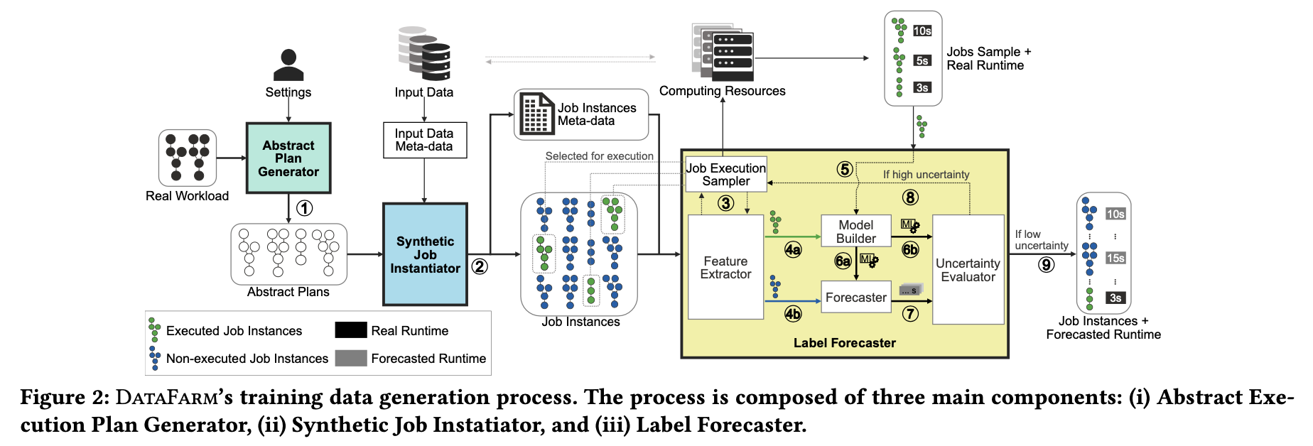
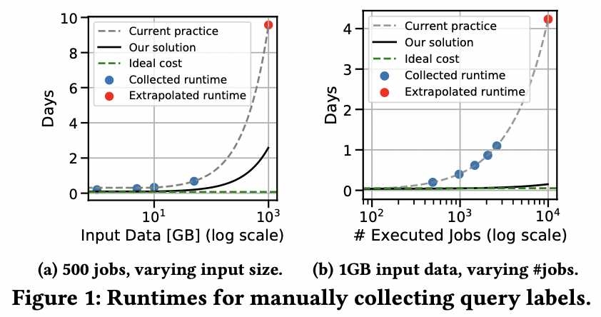
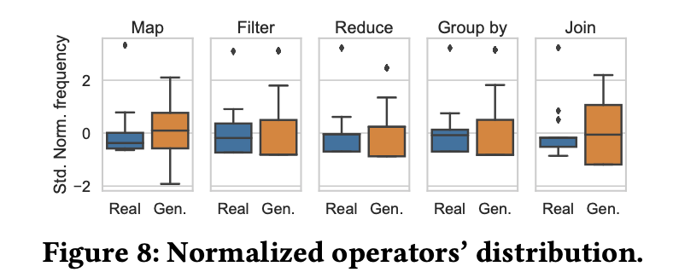
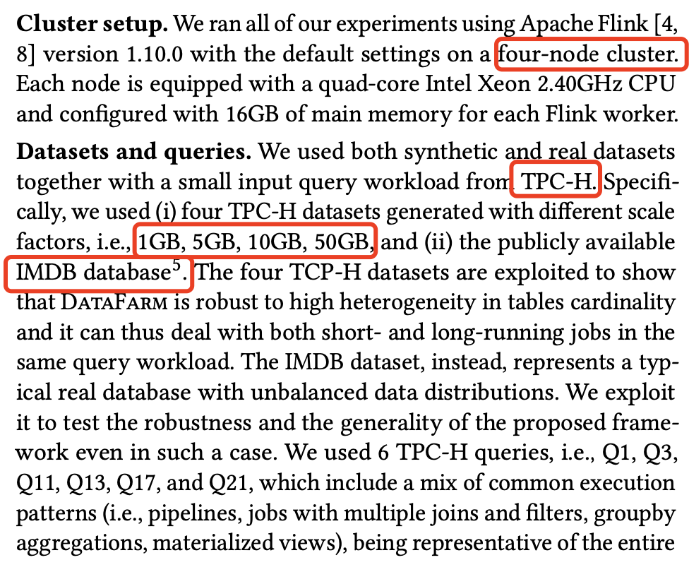
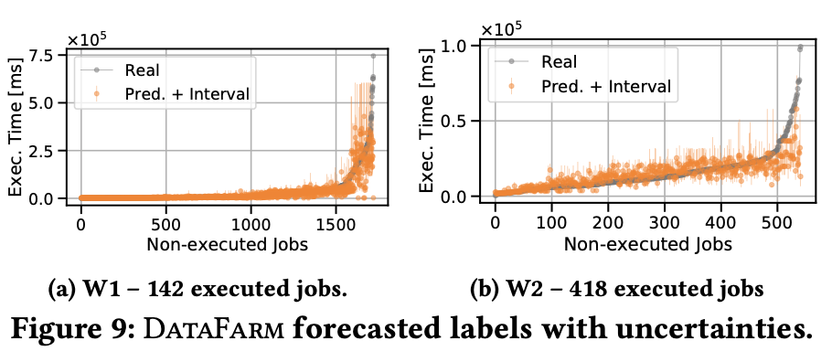
Workload Generation
Expand your Training Limits! Generating Training Data for ML-based Data Management, Francesco Ventura, Zoi Kaoudi, Jorge-Arnulfo, Volker Markl, Politecnico di Torino, TU Berlin & DFKI GmbH
(1) Issues:
Problem Kernel: ML becomes prominent method in data management components (query optimizers). However, training data is hard to get: Collecting a labeled query workload has high cost in terms of time and money. (i.e., large query workloads with execution time or output volume as labels)
Working Scenario: data management scheme with ML-based query optimizer.
Shining point: techniques are useful for workload feature collection.
(2) NFS Tracing:
Related Works.
ML for query data management optimization: cardinality estimation, join ordering enumeration, cost model learning, execution time estimation, and for learning the entire query optimizer itself.
Valuable data is needed to train the models on, while such data are limit. (time-consuming) Currently less work target to this issue.
DATAFARM, to generate and label large query workloads, following a data-driven white-box approach to learn from pre-existing small workload patterns, input data, and computational resources.
Abstract Plan Generator takes as input the pre-existing (small) real workload, learns the relations between operators, generates new heterogeneous abstract plans. (based on Markov Chain and DAG)
Based on an active learning approach, characterizes jobs with features, actively improving forecasting performance by executing the smallest number possible of jobs. (based on quantile regression forests)
(3) Evaluation：

Slide 2
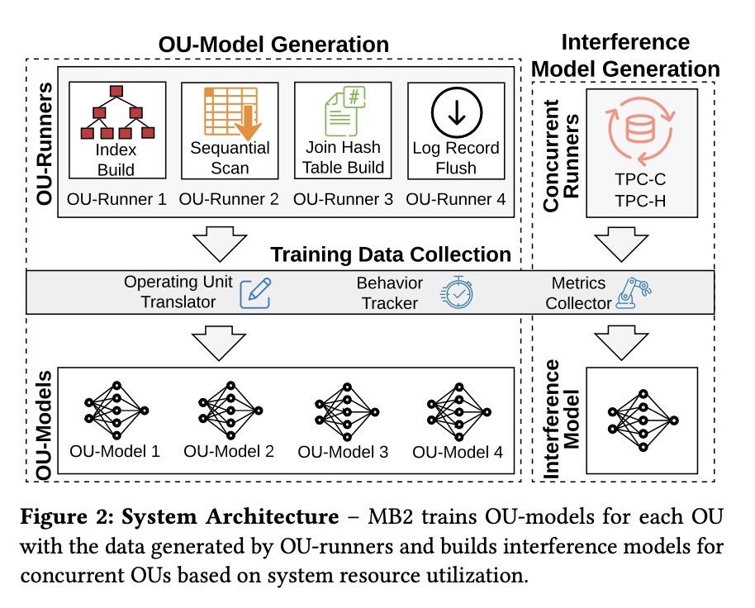
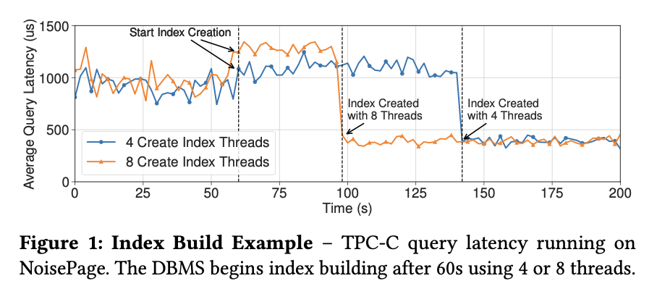
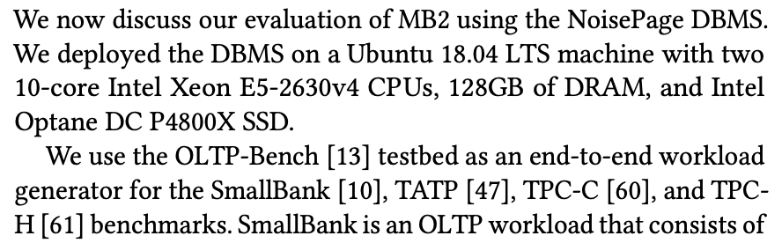
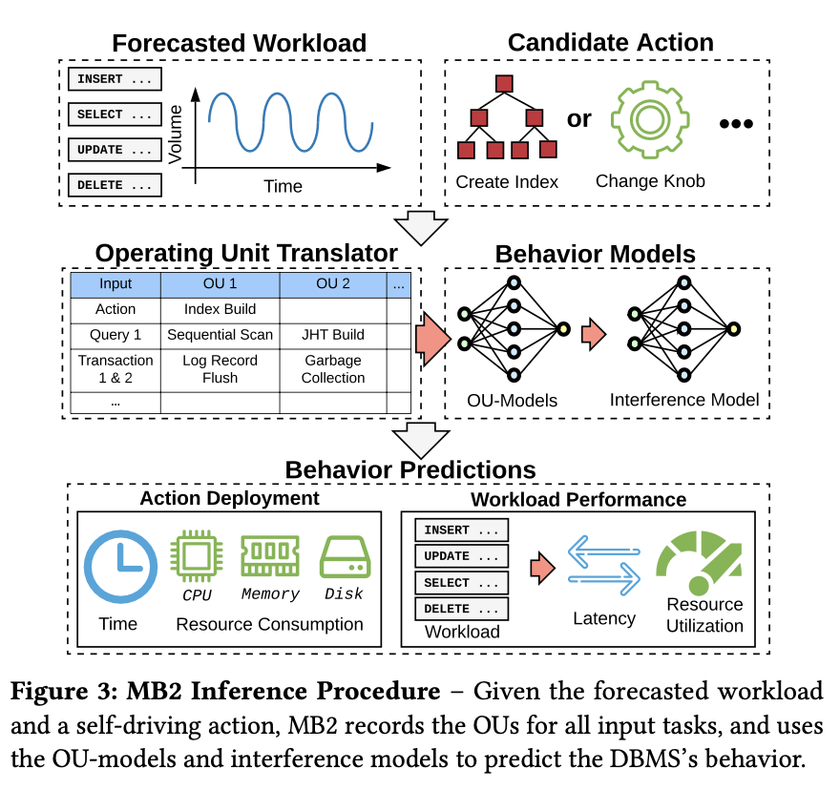
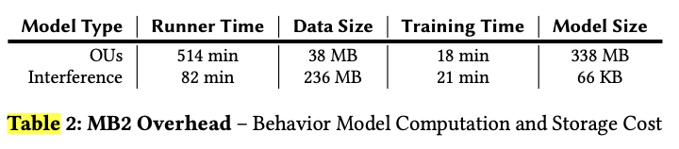
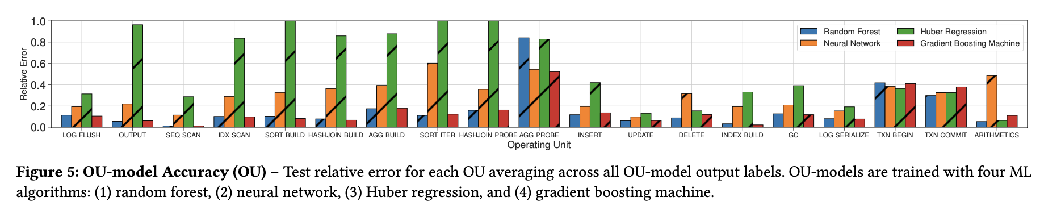
Data Movement
MB2: Decomposed Behavior Modeling for Self-Driving Database Management Systems, Lin Ma, William Zhang, Jie Jiao, Wuwen Wang, Matthew Butrovich, Wan Shen Lim, Prashanth Menon, Andrew Pavlo; Carnegie Mellon University
(1) Issues:
Problem Kernel: Self-driving DBMS, by managing itself automatically, removes the impediments where DBMS are difficult to deploy and administer before. However, an issue in achieving full autonomy is how to predict the DBMS’s runtime behavior and resource consumption.
Working Scenario: suppose the self-driving DBMS plans to create a new index. In that case, MB2’s models can answer how long the index creation is, how the index creation impacts the system performance, and how the new index accelerates the workload’s queries. (Not pre-defined)
(2) MB2: decompose a DBMS’s internal architecture into small, independent operating units (OUs) (e.g., building a hash table, flushing log records). MB2 then uses ML methods to train an OU-model for each OU that predicts its runtime and resource consumption. (But still offline)
With trained OU-models, a self-driving DBMS can use them as a simulator to approximate its runtime behavior: The inputs for MB2 are the forecasted workload and a potential action. (support linear regression, Huber regression, vector machine, deep neural network and etc.
(1) extracts the OUs from the inputs and generates their model features.
(2) uses OU-models to predict the behavior of each OU
(3) sums OU’s prediction to derive information that guides the DBMS’s planning system
For the working scenario, before a self-driving DBMS chooses the action to build the index, it can use MB2’s models to estimate the time and consumed resources (e.g., CPU, memory)
Limitation: The workload forecasting system cannot predict ad-hoc queries it has never seen before. Thus, we assume the DBMS executes queries with a cached query plan except for the initial invocation.
(3) Evaluation：
(4) Conclusion:

Slide 3
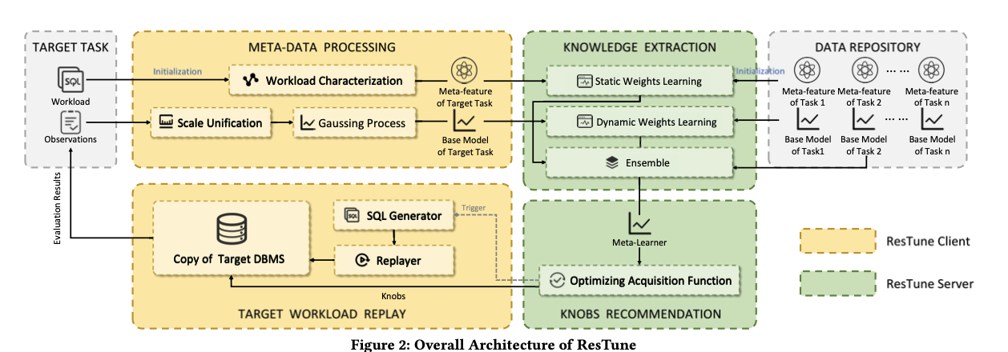
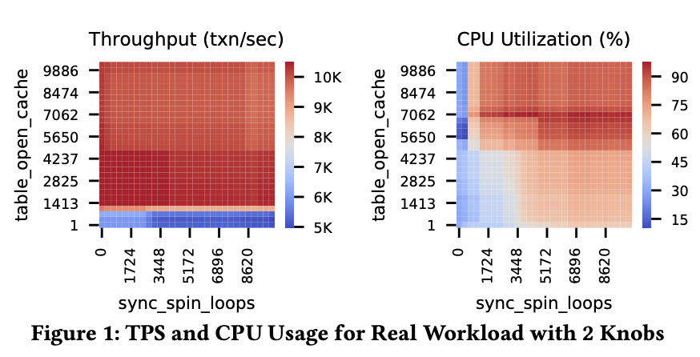
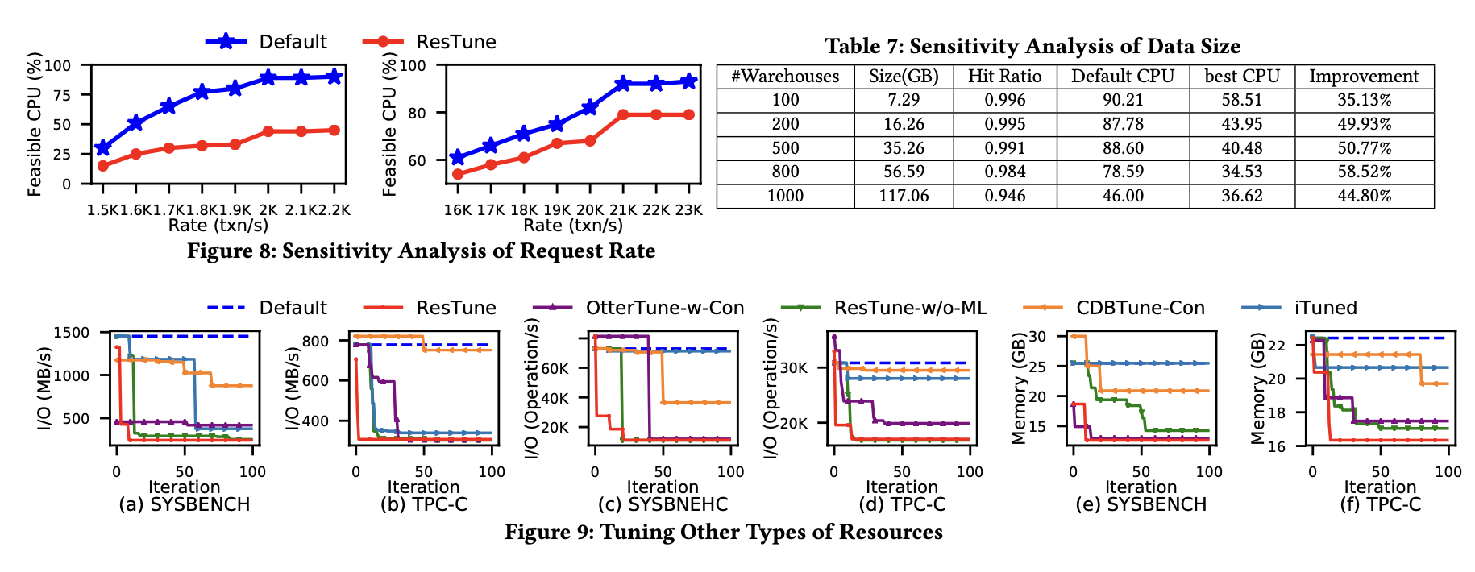
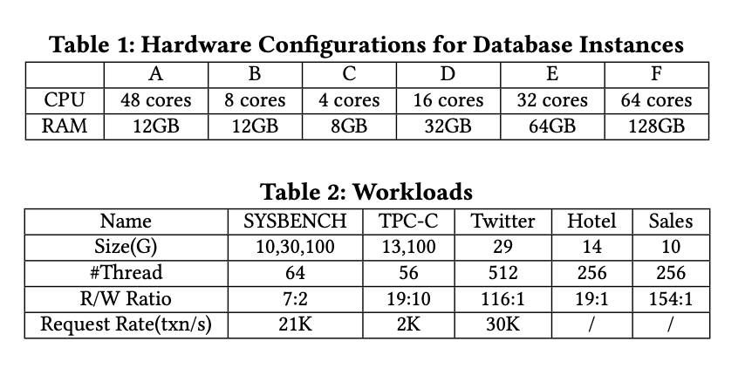
Data Movement
ResTune: Resource Oriented Tuning Boosted by Meta-Learning for Cloud Databases, Zhang, Xinyi and Wu, Hong and Chang, Zhuo and Jin, Shuowei and Tan, Jian and Li, Feifei and Zhang, Tieying and Cui, Bin; Alibaba Group
(1) Issues:
Problem Kernel: Parameters/Configuration Tuning in cloud data management is critical and necessary. Fill in the ML4sys scope.
Working Scenario: target to OLTP workload and DBMS (MySQL and etc) parameter tuning related to performance.
Shining Point: tuning considering both performance and resource utilization.
(2) ResTune:
Current solution.
Knob tuning: Search-based, Bayesian Optimization based and Reinforcement Learning based; Only consider the performance
Hyper-Parameters Optimize (HPO) utilize meta-learning to borrow strength from metadata
This work: boost constrained Bayesian Optimization with meta-learning
Using the least-satisfied resource for pursing best performance. (transaction per second)
Client runs in user-side and is responsible for the preprocessing of target tasks and the execution of recommended parameter configurations
Server runs in the back-end tuning cluster and is responsible for recommending parameter configuration in each training iteration.
For tuning a para: copy/collect workload for a DB → get meta-feature & base model → dynamic/statistic weights learning → get/verify paras
(3) Evaluation：

