Slide 1
ASPLOS’20
Hailstorm: Disaggregated Compute and Storage for Distributed LSM-based Databases, Laurent Bindschaedler, Ashvin Goel, Willy Zwaenepoel, EPFL, University of Toronto, University of Sydney.
Issues. Distributed LSM-based databases face throughput and latency issues due to load imbalance across instances and interference from background tasks such as flushing, compaction, and data migration.
Background.
Skew in Distributed Databases: Because some keys are more popular than others, sharding inevitably leads to data imbalance across nodes, which makes it worse in distributed database system where data are held by separated (physical) components and each component is created equal whereas specific components need to serve more requests.
→ Component A is responsible for serving a hot key range but has the same resources compared to B that serves cold range.
Compaction in LSM KV Stores: high CPU and I/O consumption.
Trade-off between the resource consumed by compaction and resource for in-coming requests.
Skewness hurts nodes with higher load from user requests, in which background operations become more intensive since these nodes manage more data.

Slide 2
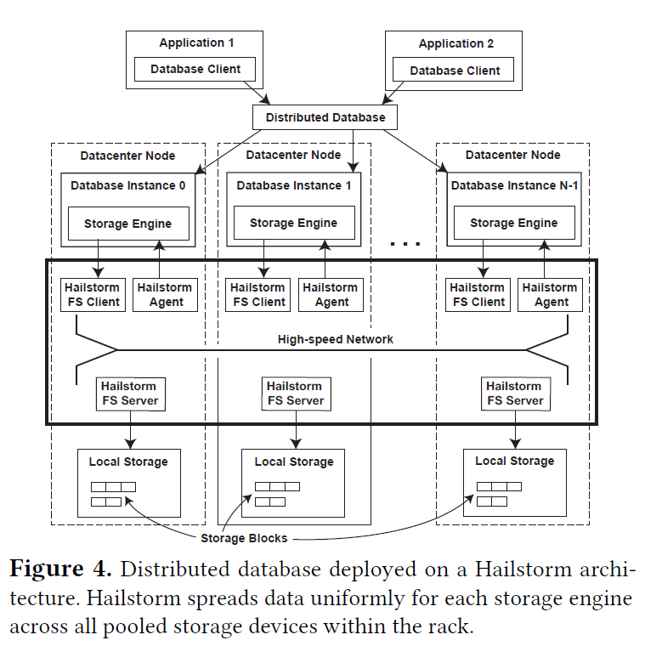
ASPLOS’20
Hailstorm: Disaggregated Compute and Storage for Distributed LSM-based Databases, Laurent Bindschaedler, Ashvin Goel, Willy Zwaenepoel, EPFL, University of Toronto, University of Sydney.
Hailstorm: Each node runs the distributed Hailstorm filesystem, consisting of:
A client that provides a filesystem interface to storage engines,
A server that stores data,
A Hailstorm agent schedules/outsources compaction tasks on behalf of local storage engine.
Clients and servers are provisioned independently and can run on separate,
possibly dedicated nodes.
Main Techniques: load-balancing for compaction:
Storage Pooling. Client stores data at block granularity on all storage devices. Decrease the chances of imbalancing.
➔ It splits all files into small blocks (1 MB, consider network latency).
➔ It spreads blocks uniformly in a pseudorandom cyclic order across servers.
➔ It maintains Global Metadata Awareness by uuid;
Compaction Offloading. By monitoring CPU consumption of each instance, offload highest to the lowest.
➔ AgentA monitors its resources consumed by compaction; so as for AgentB….
➔ The FS offloads compaction task from busiest instance to the idlest instance.

Slide 3
ATC’21 → I’m Old But I Learned a New Trick: Machine Learning
Palleon: A Runtime System for Efficient Video Processing toward Dynamic Class Skew. Boyuan Feng, Yuke Wang, Gushu Li, Yuan Xie, and Yufei Ding, University of California, Santa Barbara.
Issue: Convolutional neural networks (CNNs) have been widely deployed by video processing systems on cloud-backed mobile platforms (e.g., cell phones and robotics). However, these systems often face a tension between intensive energy consumption from CNNs and limited resources on mobile platforms.
Background for cloud-backed mobile platform: Mainly the inference work on mobile devices with high power consumption by intensive inputs and high demand of accuracy and latency.
i.e., Smart glasses continuously recognize the surrounding environment with CNNs and help the blind person with ordinary tasks (e.g., reading a handwritten note, navigating the grocery store).
Challenges caused by the limit resource budget towards high energy consumption and latency of CNNs.
A popular CNN, VggNet, can easily consume 3.6W and introduce 1.4 second latency, which makes a large smartphone battery (e.g., 2.7 Ah battery in iPhone X) out of power within 2 hours on continuous image classification.
Current Solution always make compromise.
To improve the execution efficiency, techniques have been proposed such as pruning and quantization to reduce the size of CNN models. But fail to exploit the special characteristics of video streams; furthermore, the compromised model accuracy also limits the overall pruning or quantization ratio.

Slide 4
ATC’21 → I’m Old But I Learned a New Trick: Machine Learning
Palleon: A Runtime System for Efficient Video Processing toward Dynamic Class Skew. Boyuan Feng, Yuke Wang, Gushu Li, Yuan Xie, and Yufei Ding, University of California, Santa Barbara.
Key Insight: Explicit locality exists but be neglected.
→ Since video stream collected from a continuous camera feed, it is common that only a small number of classes keep appearing in consecutive frames.
i.e., in a film scenario, only a small number of people would come to the master shots frequently, generally lasting for a few minutes, and another group of
people will not appear until the scenario has changed.
A study on Youtube videos of day-to-day life shows more than 90% frames are comprised of less than 10 classes.
Main techniques:
Class skew to accelerate video processing with runtime input-level information.
→ It is an unbalanced class distribution that flexibly and effectively extracts the scenario information of both class cardinality and visual separability.
Class cardinality captures the number of classes in a class skew. By which to tailor a CNN (trained to recognize thousands of classes) into a specialized model, only recognize a small number of classes in the current class skew.
Visual separability under the same class cardinality. (i.e., a class skew with two classes is easier to recognize compared to that with two subtle classes.) By which to use a more compact model for computation and energy saving without loss of accuracy compared with a full model.
Palleon, a runtime system that adapts and selects a CNN with the least energy consumption based on the detected class skews.
ABLE, a detector to abstract class skews from video streams, which comes with the static profiling and the dynamic class-skew switch detection.
Bayesian Filter to adapt CNNs toward the detected class skew during runtime by enhancing accuracy.
Separability-Aware Model Selection to squeeze system energy consumption by identifying CNN with the least resource consumption and scheduling the runtime workload between the edge and the cloud.

Slide 5
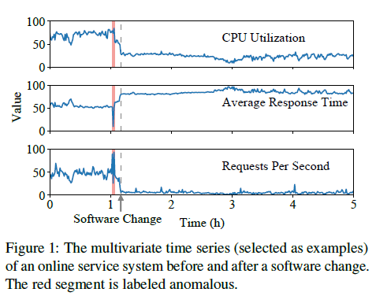
ATC’21 → I’m Old But I Learned a New Trick: Machine Learning
Jump-Starting Multivariate Time Series Anomaly Detection for Online Service Systems. Minghua Ma; Shenglin Zhang; Junjie Chen; Jim Xu; Haozhe Li and Yongliang Lin, Xiaohui Nie, Bo Zhou and Yong Wang, Dan Pei. Nankai University, Tianjin University, Georgia Tech, CNCERT/CC; Tsinghua University, BNRist
With the booming of online service systems, anomaly detection on multivariate time series is important for system reliability.
→ Although learning-based approaches are adopted, they suffer from long initialization time for sufficient training data.
Background.
Time-series Analysis. To closely monitor the quality of service, providers continuously collect the monitoring data of each performance metric (e.g., CPU utilization, average response time, and requests per second) at equally spaced intervals, which form a multivariate time series (each is a univariate).
Traditional multivariate time series anomaly detection approaches: univariate way. Operators concern about the status of the overall service rather than that of a specific metric. Because the univariate way cannot capture the complex temporal relationships among different univariate time series.
Recent learning-based works: use deep learning to build learning models for multivariate time series anomaly detection.
→ i.e., OmniAnomaly, utilizes a stochastic recurrent neural network model to learn the temporal relationships of multivariate time series.
Challenges.
Learning-based approaches are hardly applicable in practice because they usually require a long period of training data.
Online service systems are deployed or changed very frequently to deploy new features, fix bugs, etc.
→ Google and Baidu report that thousands of software changes are deployed every day.
→ Due to these software changes, the data distribution of multivariate time series can change dramatically, it invalidates models trained based on the data
before the change, so that these learning-based approaches have to be retrained (hundreds of days) before reaching steady state.

Slide 6
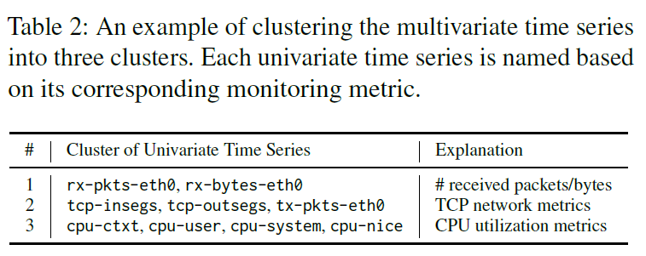
ATC’21 → I’m Old But I Learned a New Trick: Machine Learning
Jump-Starting Multivariate Time Series Anomaly Detection for Online Service Systems. Minghua Ma; Shenglin Zhang; Junjie Chen; Jim Xu; Haozhe Li and Yongliang Lin, Xiaohui Nie, Bo Zhou and Yong Wang, Dan Pei. Nankai University, Tianjin University, Georgia Tech, CNCERT/CC; Tsinghua University, BNRist
Propose JumpStarter, a multivariate time series anomaly detection approach with small initialization time based on Compressed sensing.
(1) Initialization time: how long to “initialize” a model: the time lag between when the model is launched and when it becomes well trained.
(2) CS: a signal processing technique where high-energy components in a matrix of multivariate time series are sparse (i.e., have few high-energy components).
→ The difference between original and reconstructed matrix, should resemble white noise (only low-energy), when original time series contains no anomaly.
→ Whether a time series contains anomalies ➔ whether difference between original and reconstructed in a sliding window is very differently from white noise.
Techniques of FTPipe:
To handle the large number of time series: A shape-based clustering algorithm. Since the time series in the same group exhibit a similar shape within a sliding window, they can be reconstructed efficiently without losing temporal relationships.
Correlation is defined based on shape-based distance between univariate;
Hierarchical clustering to cluster the univariate into not-previously-defined clusters.
To handle issues caused by sampling: An outlier-resistant sampling algorithm. It samples from normal time series segments rather than anomalous ones. Gaussian distribution to sample from the original time series may inevitably generate reconstructed time series sampled from some long-lasting anomalous segments, which can cause some false positives / false negatives.
If an anomaly lasts longer than the window size, it can be captured from the beginning since it is significantly different from the normal pattern.
Obtain the sampling confidence of each data point. The higher a data point is likely to be an outlier, the lower its sampling confidence is, and the less likely it will be selected.

Slide 7
ATC’21 → Can I Come In? It’s Raining!: Cloud Computing
FaaSNet: Scalable and Fast Provisioning of Custom Serverless Container Runtimes at Alibaba Cloud Function Compute. Ao Wang, Shuai Chang, Huangshi Tian, Hongqi Wang, Haoran Yang, Huiba Li, and Rui Du; Hong Kong University of Science and Technology, Alibaba Group; Yue Cheng, George Mason University.
Function-as-a-Service (FaaS), enables to build and scale apps by allowing users to deploy fine-grained functions. Custom FaaS container enables better control over OSs, versioning, and tooling for modernizing FaaS applications.
→ However, rapid container provisioning introduces challenges, since container provisioning is costly, and real-world FaaS workloads
exhibit highly dynamic patterns. ➔ better elasticity.
Background.
Serverless computing: allow developers to break monolithic server-based applications into finer-grained cloud functions. Developers write function logic while the service provider performs tasks of provisioning, scaling, and managing the backend servers that the functions run on.
Custom container images. (1) Allow cloud functions to be deployed as custom container runtimes, (ML, video processing) with no limit on function package sizes. (2) Container tooling (same as Docker-mannered container) simplifies software development and testing procedures; (3) Enable new DevOps features such as incremental update (Kubernetes).
Current solutions are not applicable:
It (centralized system with root nodes) would require extra, dedicated, centralized components, thus increasing the total cost of ownership (TCO) for the provider while introducing a performance bottleneck.
Their FaaS infrastructure uses a dynamic pool of resource-constrained VMs to host containerized cloud functions for strong isolation; VM can join and leave the pool at any time. This dynamicity requires a highly adaptive solution, which existing solutions fail to support.

Slide 8
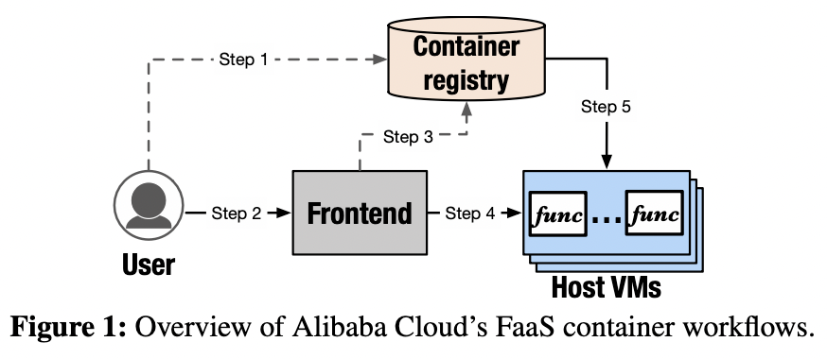
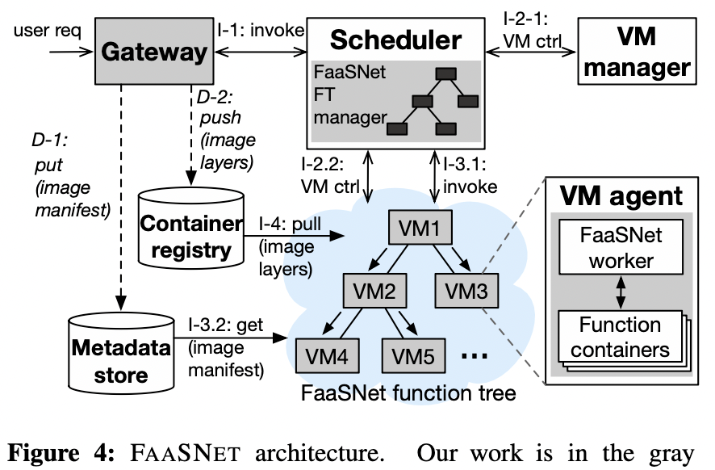
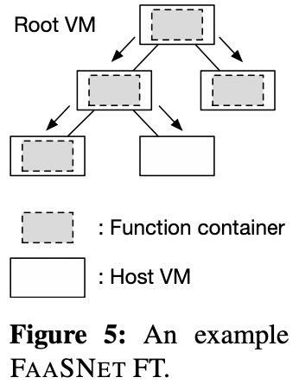
ATC’21 → Can I Come In? It’s Raining!: Cloud Computing
FaaSNet: Scalable and Fast Provisioning of Custom Serverless Container Runtimes at Alibaba Cloud Function Compute. Ao Wang, Shuai Chang, Huangshi Tian, Hongqi Wang, Haoran Yang, Huiba Li, and Rui Du; Hong Kong University of Science and Technology, Alibaba Group; Yue Cheng, George Mason University.
Propose FaaSNET, a highly-scalable middleware system for accelerating FaaS container provisioning.
➔ It enables high scalability by decentralizing the container provisioning process across host VMs.
Architecture.
Gateway. (1) tenant identity access management authentication, (2) forwarding the function invocation requests to the FaaS scheduler, (3) converting regular container images to the I/O efficient data format.
Scheduler. serves function invocation requests by integrating FT manager into it to manage function trees through FT’s insert and delete APIs.
Each VM runs a VM agent, which is for VM-local function management, in which the worker is integrated for container provisioning tasks.
Workflow.
Scheduler communicates with a VM manager, if there are not enough VMs, the scheduler queries its local FT metadata and sends RPC requests to workers of the FT to start the container provisioning process.
The scheduler sits off the critical path while workers fetch function container layers on demand and creates the container runtime from the assigned peer VMs in parallel.
Techniques.
FT. (balanced binary tree) VMs are organized in function-based tree (FT). A FT consists of multiple host VMs and allows provisioning of container runtimes or code packages to be decentralized across all VMs in a scalable manner.
Tree balancing algorithm. It enables high adaptivity by dynamically adapting FT topology to accommodate VM joining and leaving.

