Slide 1
OUTLINE
Weekly Overview
Paper Presentation
FAST’21
Smart Storage
Discussion

Slide 2
OUTLINE
Weekly Overview
Paper Presentation
FAST’21
Smart Storage
Discussion

Slide 3
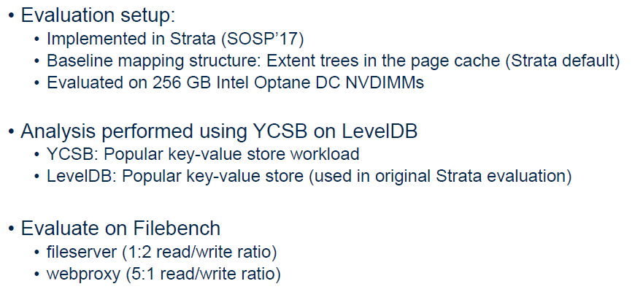
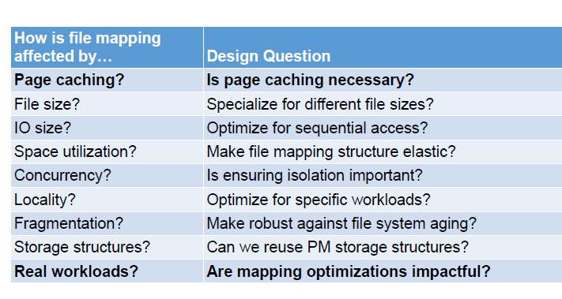
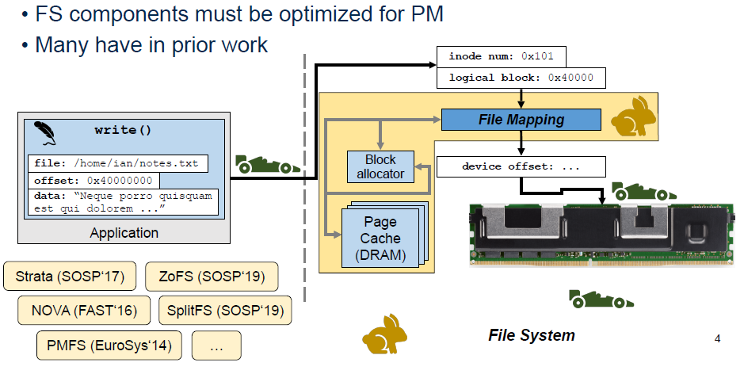
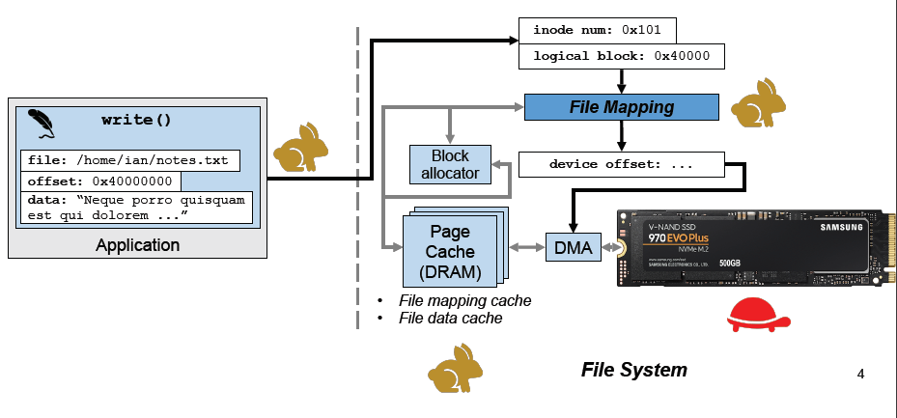
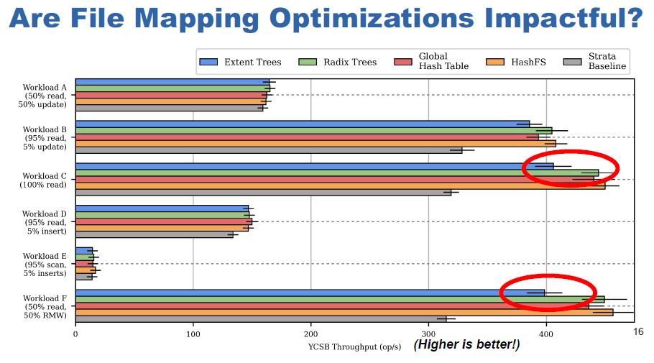
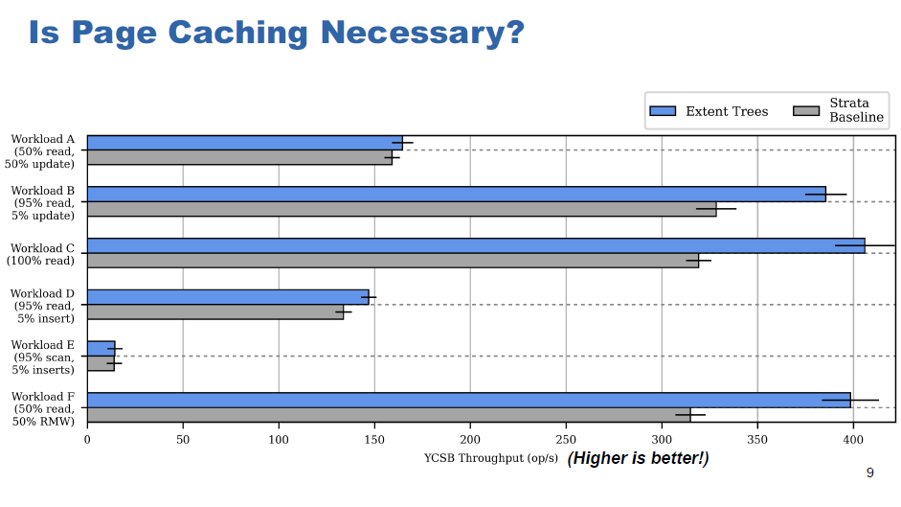
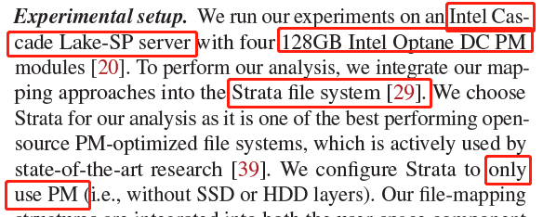
FAST’21 → Advanced File Systems
Rethinking File Mapping in Persistent Memory
Ian Neal, Gefei Zuo, Eric Shiple, and Tanvir Ahmed Khan, University of Michigan; Youngjin Kwon, School of Computing, KAIST; Simon Peter, University of Texas at Austin; Baris Kasikci, University of Michigan.
(1) Issues:
Problem kernel: Persistent Memory (PM, or NVM) are 30−40x faster than SSDs, while file system IO performance cannot keep up with PM performance. The rigorous analysis of IO path performance is important.
Working scenario: file mapping structure (logical → physical) from general file systems that support PM device.
Shining point: an evaluation paper summarizing several critical issues.
(2) Contributions:
Current solutions:
Fragmentation like B-tree case; Overhead caused by non-contiguous location and oversize mapping structure;
Reduction in sequential accesses.
This paper:
Analyze I/O performance; propose simple implementation.
(3) Evaluation: (shown in figure)
(4) Conclusion:
File mapping is significant of the IO path overhead on PM file systems that can no longer be mitigated by a page cache.
Evaluate 4 different PM-optimized mapping structures to explore the different challenges associated with file mapping on PM.
It is not open-sourced but can be reproduced based on Strata (PM fs); Knowledge for file system exploration especially PM fs.

Slide 4
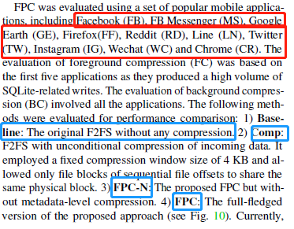
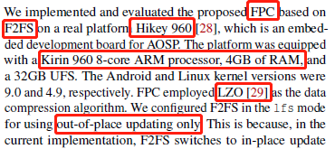
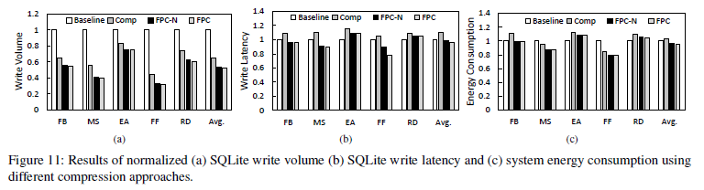
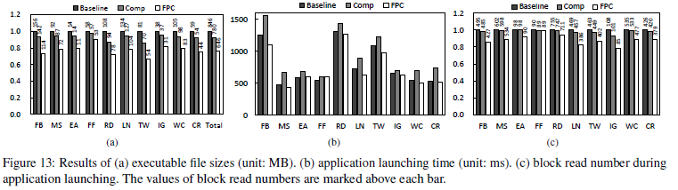
FAST’21 → Advanced File Systems
Pattern Guided File Compression with User Experience Enhancement for Log Structured File System on Mobile Devices
Cheng Ji, Li Pin Chang, Riwei Pan, Chao Wu Congming Gao, Liang Shi, Tei Wei Kuo ,Chun Jason Xue; Nanjing University of Science and Technology National Chiao Tung University, City University of Hong Kong, Tsinghua University, East China Normal University
(1) Issues:
Problem kernel: While the performance of mobile processors is improving drastically, the improvement of mobile storage performance is slow. I/O operations on mobile storage are write-dominant, and the write pattern is highly random and synchronous, which are closely related to user-perceived latencies, and can be compressed.
Working scenario: Mobile devices (executable files (xx.apk) → SQLite → File system (ext4, F2FS) → block devices)
Shining point: selectively compressing based on workload patterns.
(2) Contributions:
Current solutions:
SQLite compression; ext4 logical compression; Regardless of access-pattern.
This paper:
divide access into write-dominant (WAL) and read-sensitive (executable file);
foreground deep compression for write-dominant; background alternative compression (rearrangement) for read-intensive;
(3) Evaluation: (shown in figure)
(4) Conclusion:
to reduce write stress and save storage space for mobile devices by compression.
implemented on real mobile device and experimental results showed both the write traffic and the executable file size was substantially reduced.
Maybe AI-based access pattern recognition also works, the main workflow of this paper is instructive for us.

Slide 5
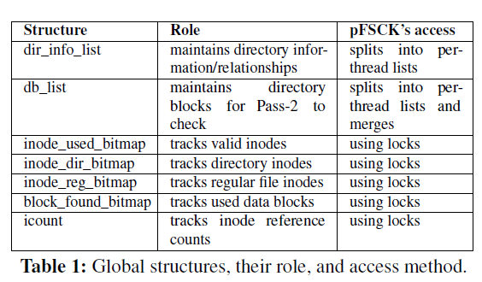
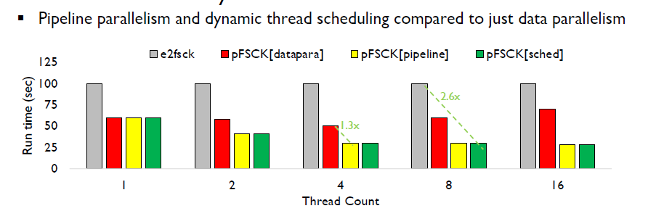
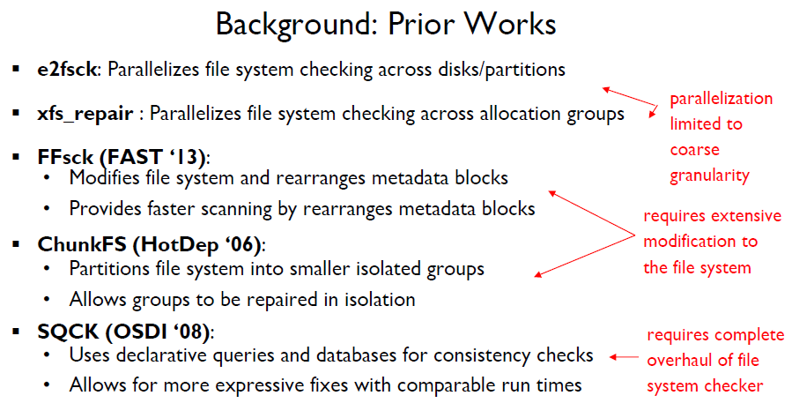
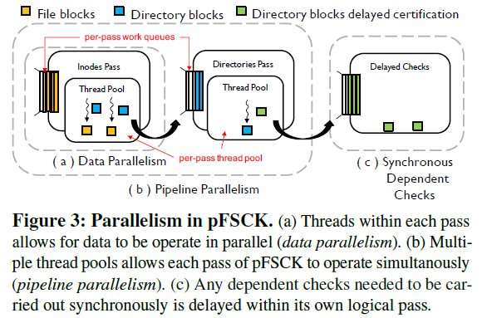
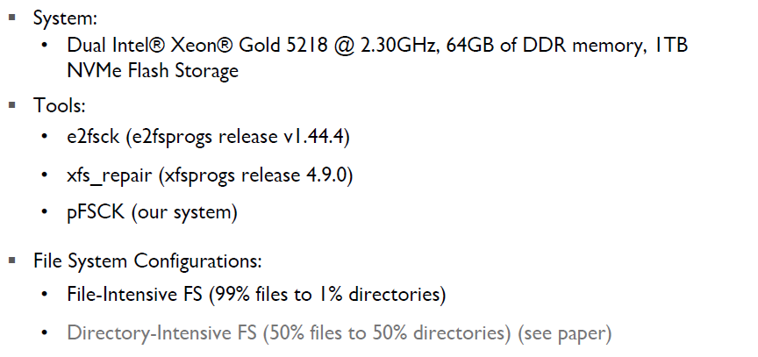
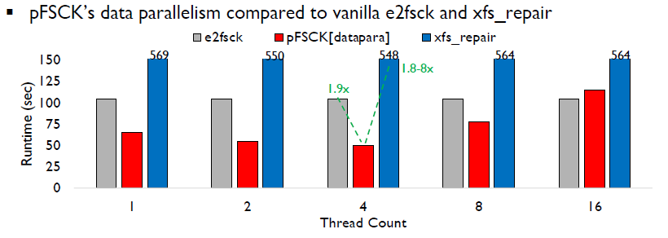
FAST’21 → Advanced File Systems
pFSCK: Accelerating File System Checking and Repair for Modern Storage
David Domingo, Sudarsun Kannan; Rutgers University
(1) Issues:
Problem kernel: it is not a coincidence that the file system checker is slow even with utilizing faster modern storage and better CPU.
E.g., the system won’t boot after a reboot due to update, restart, crash caused by fs checking/recovery (C/R).
Working scenario: file system checking/recovery tool for PC/Server
Shining point: optimize C/R checker by parallelism.
(2) Contributions:
Current solutions: shown in figure
This paper: Parallelize file system checking at finer granularity (ex. inodes, directories)
Data parallel: Overlap as much independent logical checks within each pass; Pipeline parallel: Overlap as much logical checks across passes;
(3) Evaluation: (shown in figure)
(4) Conclusion:
It is a sometimes-neglected field but non-trivial .
The parallelism is adopted in fine-grained, which looks not new but still efficient.

Slide 6
OUTLINE
Weekly Overview
Paper Presentation
FAST’21
Smart Storage
Discussion

Slide 7
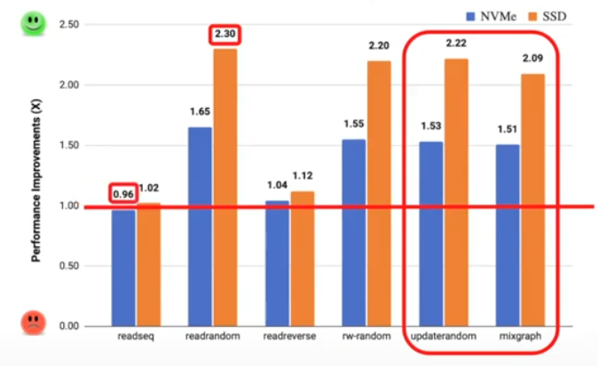
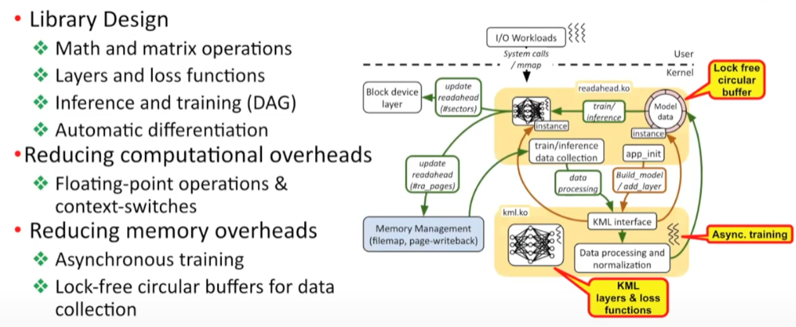
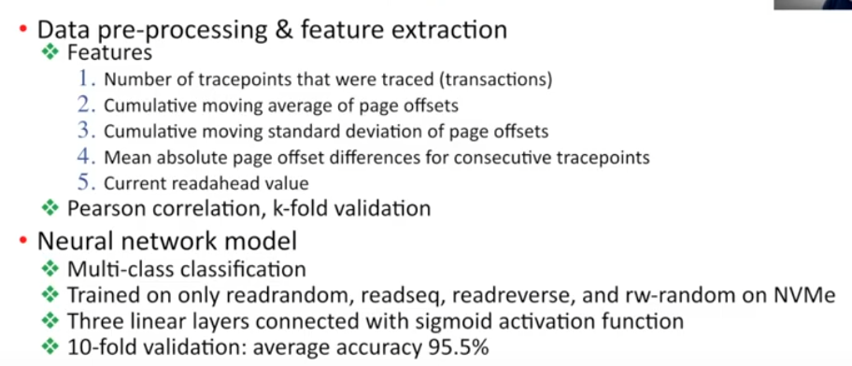
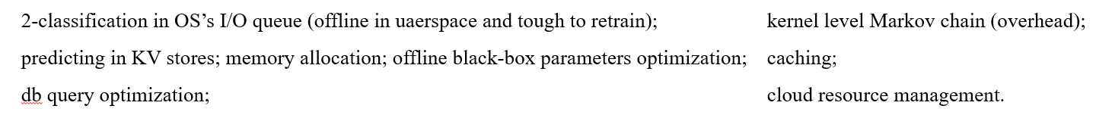
HotStorage‘21
A Machine Learning Framework to Improve Storage System Performance
Ibrahim Umit Akgun, Ali SelmanAydin,Aadil Shaikh, LukasVelikov, and Erez Zadok Stony Brook University
(1) Issues:
Problem kernel: Storage systems and their OS components are designed to accommodate apps and dynamic workloads, where Storage components inside the OS contain various heuristic algorithms (tunable via parameters → heuristics) to provide high performance and adaptability for different workloads. Parameters tuned based on experiments with limited applications and hardware (suboptimal values and manual is impractical).
→ An adaptive, intelligent system to handle dynamic and complex workloads is critical.
Working scenario: user-space/kernel-space training/inference of OSs in storage systems → less ML overhead; less system interference; versatile
Shining point: A user-defined ML platform that can achieve several ML tasks like classification, prediction…
(2) Contributions:
Current solutions
This paper:
General model for kernel level ML platform architecture that supports several working scenarios
target to the readahead mechanism, which is to improve I/O by caching “future” storage data based on tunable per-disk and per-file readahead values.
(3) Evaluation
(4) Conclusion:
Very guided and correlate with the data movement work.
The lightweight kernel level ML looks accepted now, while pitifully this work is not open-sourced yet.

Slide 8
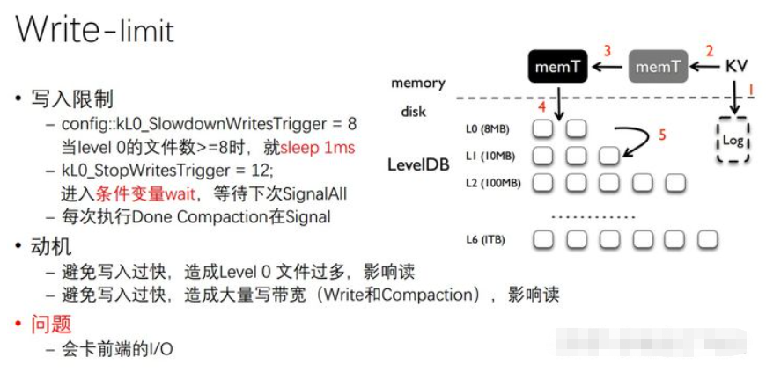
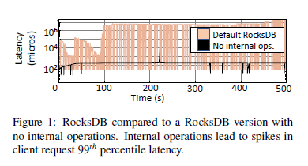
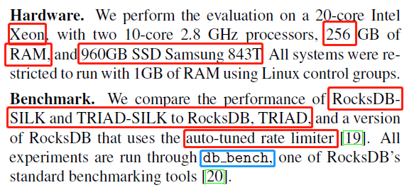
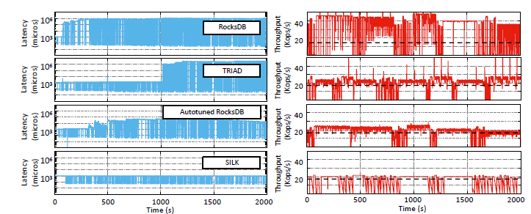
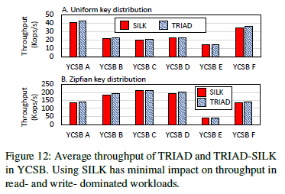
ATC‘19
SILK: Preventing Latency Spikes in Log-Structured Merge Key-Value Stores
Oana Balmau, Florin Dinu, and Willy Zwaenepoel, University of Sydney; Karan Gupta and Ravishankar Chandhiramoorthi, Nutanix Inc.; Diego Didona, IBM Research–Zurich
compaction
(1) Issues:
Problem kernel: The tail latency in LSM-tree-based KV store is a tough issue but can be eased by upper-level compaction tuning.
→ Both incoming I/O volume, flush+L0 compaction, global compaction are responsible for tail latency.
Working scenario: LSM-tree based key-value store s that can be deployed in datacenters or embedded devices.
Shining point: shows insights on the problem even it is still a tuning method. The issue values more than solution.
(2) Contributions:
Current solutions: TRIAD, PebblesDB, Monkey, MatrixDB…
This paper:
Flush & L0 compaction first →digests client I/O and clear L0;
Multi-thread Preempting Compactions. → L0 has highest priority.
Dynamic bandwidth allocation. Low load → for client;
(3) Evaluation
(4) Conclusion:
It seems reasonable while the situation get worse if all data are in the last level.
A promising configuration paper. Another example based on pattern-guided workloads (internal workloads)

Slide 9
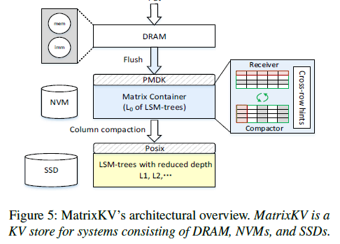
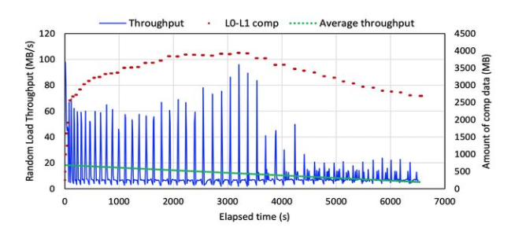
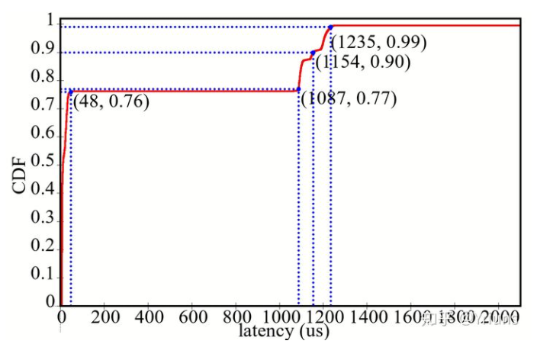
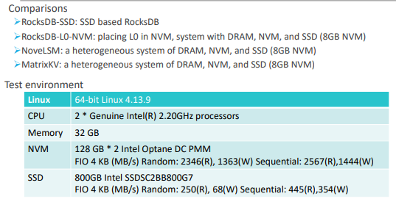
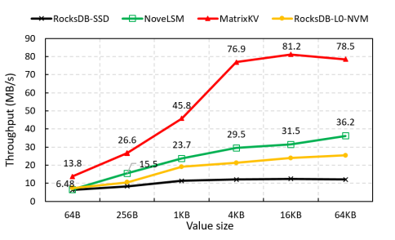
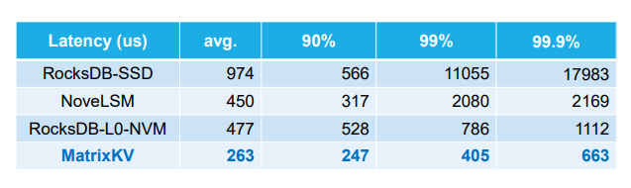
ATC‘20
MatrixKV: Reducing Write Stalls in LSM-Tree
Ting Yao, Yiwen Zhang, and Jiguang Wan, Huazhong University of Science and Technology; Qiu Cui and Liu Tang, PingCAP; Hong Jiang, UT Arlington; Changsheng Xie, Huazhong University of Science and Technology; Xubin He, Temple University
(1) Issues:
Problem kernel: Write stall (tail latency) and Write amplification
→ CPU and SSD bandwidth consumption by L0 compaction; → too much LSM-tree levels
Working scenario: LSM-tree based key-value stores that can be deployed in datacenters or embedded devices.
Shining point: shows write stalls in the architecture view, solving the problem by combining system design and new devices, not only focus on tail latency.
(2) Contributions:
Current solutions: system level redesign; new devices; configuration; parallelism; and etc
This paper:
Matrix Container, remove the SSTable format restriction of block unit, embedded index, and organize SSTable in L0 as matrix
Column compaction, compact more L0 SSTables in L0 in parallel;
Reducing LSM-Tree Depth based on configuration and matrix container.
(3) Evaluation (in figure)
(4) Conclusion:
Another work targets to tail latency while the global performance is also enhanced by NVM and less tree depth.

