Slide 1
VLDB’20
TiDB: A Raft-based HTAP Database, Dongxu Huang, Qi Liu, Qiu Cui, Zhuhe Fang∗, Xiaoyu Ma, Fei Xu, Li Shen, Liu Tang, Yuxing Zhou, Menglong Huang, Wan Wei, Cong Liu, Jian Zhang, Jianjun Li, Xuelian Wu, Lingyu Song, Ruoxi Sun, Shuaipeng Yu, Lei Zhao, Nicholas Cameron, Liquan Pei, Xin Tang
PingCAP .
Issues:
Hybrid Transactional and Analytical Processing (HTAP) databases require processing transactional and analytical queries in isolation to remove the interference between them. It is necessary to maintain different replicas of data specified for the two types of queries.
→ It is challenging to provide a consistent view for distributed replicas within a storage system, where analytical requests can efficiently read consistent and fresh data from transactional workloads at scale and with high availability.
Comes from NewSQL: efficiently handle OLTP while still guarantee ACID for transaction.
Currently, “One size does not fit all”: use different data models and technologies for the different purposes of OLAP and OLTP.
What should HTAP database have:
Scalability. It is unavoidable, necessary to deploy the database into cloud environment, so that efficient sharding/partition is needed.
Availability. In distributed system, replication is required and must be satisfied.
Freshness and Isolation. OLAP should get data issued by OLTP a.s.a.p., their performance should be guaranteed.

Slide 2
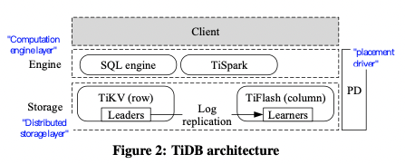
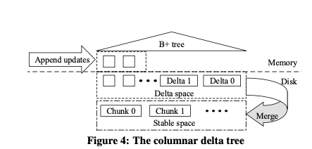
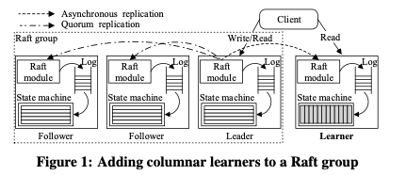
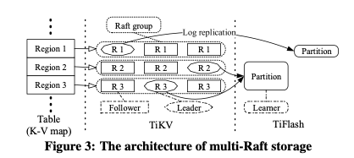
VLDB’20
TiDB: A Raft-based HTAP Database, Dongxu Huang, Qi Liu, Qiu Cui, Zhuhe Fang∗, Xiaoyu Ma, Fei Xu, Li Shen, Liu Tang, Yuxing Zhou, Menglong Huang, Wan Wei, Cong Liu, Jian Zhang, Jianjun Li, Xuelian Wu, Lingyu Song, Ruoxi Sun, Shuaipeng Yu, Lei Zhao, Nicholas Cameron, Liquan Pei, Xin Tang
PingCAP.
Raft-based Consensus for HTAP database.
Each group contains a leader receiving incoming request from SQL engine, which adopts a log-structured manner.
Each group contains several followers for replication, sync Log contents from leader for self-updating.
Learner requires Log contents from leaders among different groups, async updating itself based on Raft-Log.
TiDB:
SQL engine for OLTP transactions, TiSpark and etc for OLAP query.
TiKV servers are RocksDB engines handling data issued by SQL following row-format, which maintains replications based on Raft.
TiFlash are column-based servers for OLAP query's, which are updated asynchronizely based on the Raft-Log.
Placement Driver is a global manager for components management and rearranging data to different physical servers. Also support dynamic server merge and split.
Data structure:
In TiKV, each row is a KV with (table, index, rowID as key, row as key). All KVs are sharded by row-region (key-ranges).
In TiKV, Raft maintains the distributed shape, all requests direct to leaders.
In TiFlash, row-based KVs are converted into column-based format (table, columnID as key), which are partitioned by column.
In TiFlash, row-based KVs are first indexed by B-tree with a WAL manner, periodically updated to global columns.
Notes:
What is tidb:
A distributed cloud-native DB that support HTAP
For which, it fully depends on raft to maintain the distributed shape, in terms of replication, distributed management; to achieve OLTP
By the wal of raft, it bt-the-way maintain a column-based replication for read (OLAP), so that to support OLAP

Slide 3
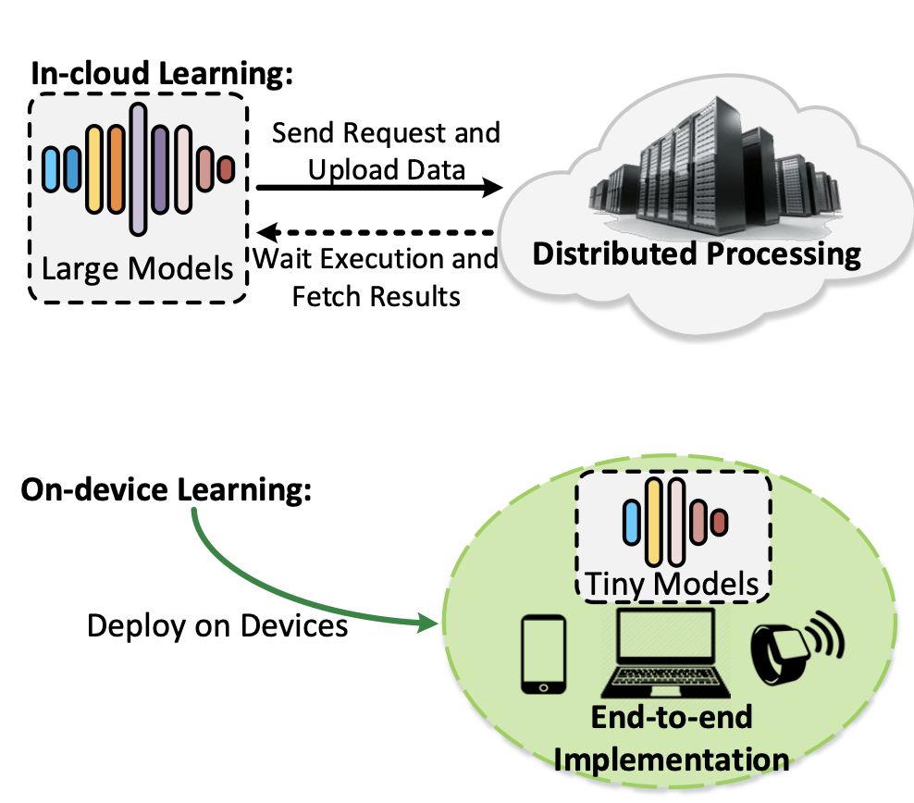
ATC’21 → I’m Old But I Learned a New Trick: Machine Learning
Octo: INT8 Training with Loss-aware Compensation and Backward Quantization for Tiny On-device Learning. Qihua Zhou1, Song Guo1, Zhihao Qu, Jingcai Guo1, Zhenda Xu1, Jiewei Zhang, Tao Guo1, Boyuan Luo1, Jingren Zhou. The Hong Kong Polytechnic University, Hohai University, Alibaba Group
In-could learning shows overhead and drawback. Even the emerging on-device learning is available, they still face the challenges from recourses and efficiency.
Background
Drawback of in-cloud learning.
→ It requires huge-cost, is hard to provide personalized models; and suffers from high latency and privacy leakage.
On-device learning needs improvement.
Definition: It eliminates in-cloud learning limitations by handling the end-to-end learning process totally on user devices. (i.e., mobile and IoT equipment.)
Issue: This edge environment makes it often subject to limited computational capacity and memory.
Current issues of on-devices learning: Mainstream learning models are designed for large-scale training tasks and cannot well match the characteristic of tiny on-device learning.
→ NNs are often implemented in a 32-bit floating-point (FP32) format and representing model parameters in such high precision is
not always necessary
Key Insight: It is feasible to represent parameters in lower bit precision while not downgrading the entire network quality.

Slide 4
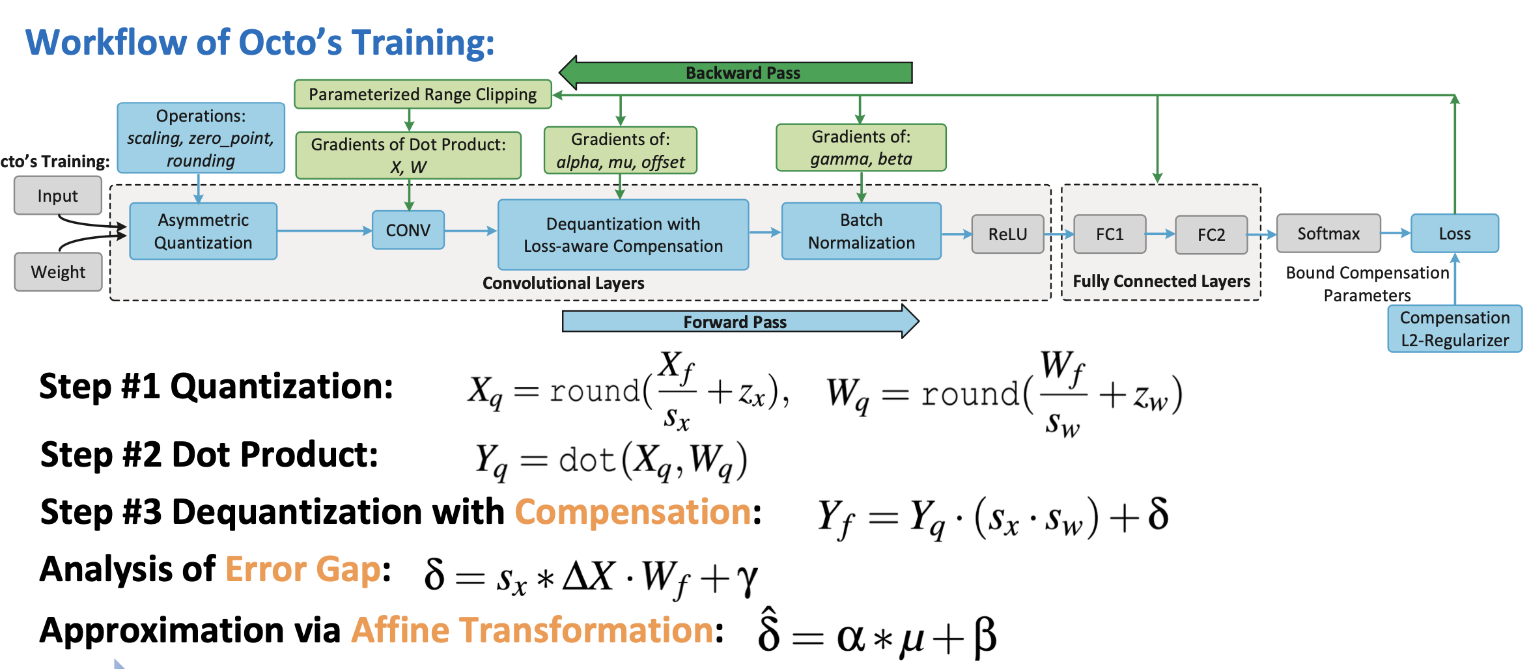
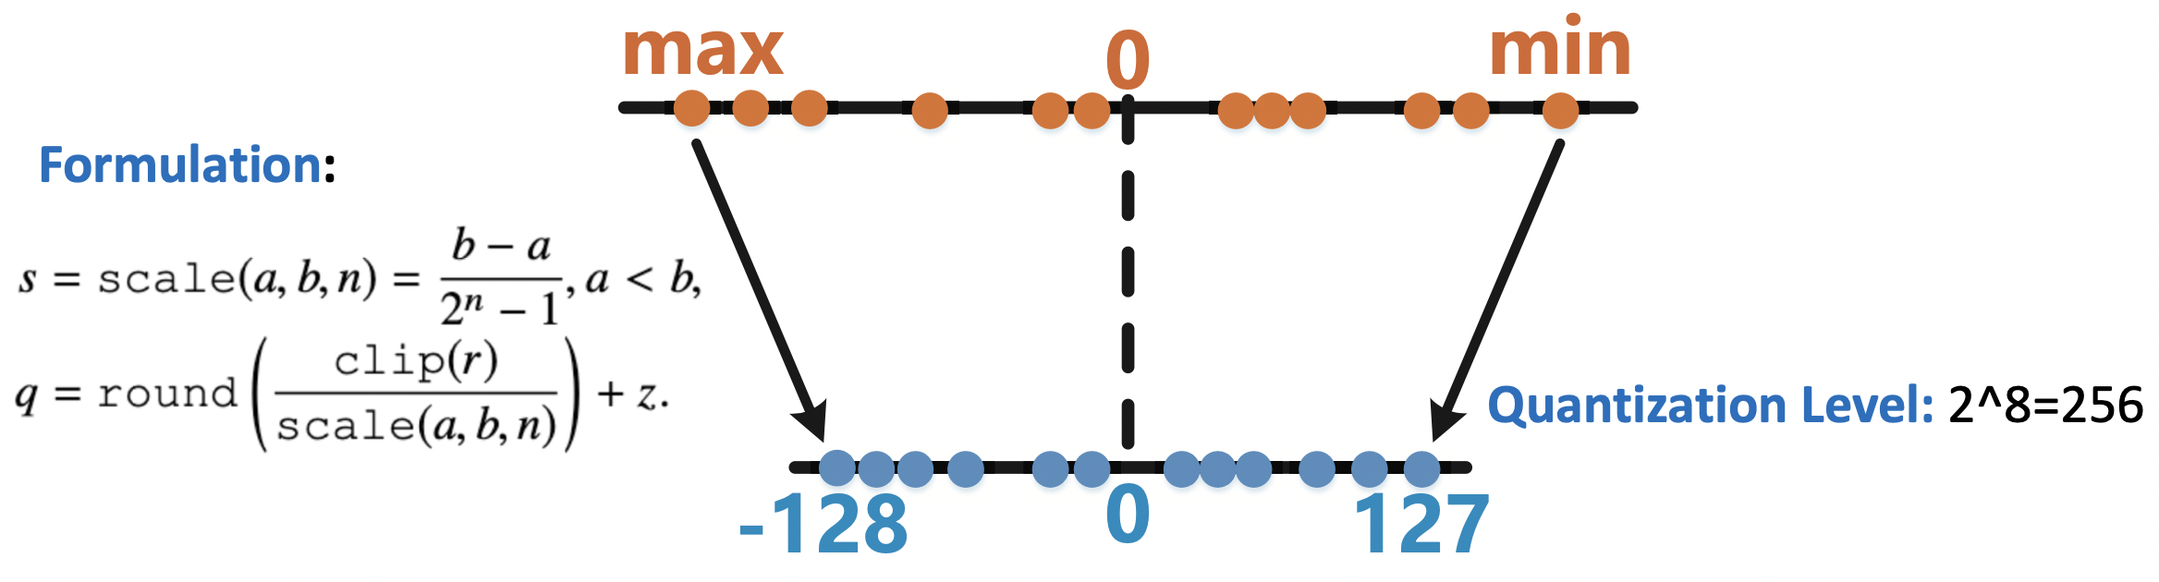
ATC’21 → I’m Old But I Learned a New Trick: Machine Learning
Octo: INT8 Training with Loss-aware Compensation and Backward Quantization for Tiny On-device Learning. Qihua Zhou1, Song Guo1, Zhihao Qu, Jingcai Guo1, Zhenda Xu1, Jiewei Zhang, Tao Guo1, Boyuan Luo1, Jingren Zhou. The Hong Kong Polytechnic University, Hohai University, Alibaba Group
The fundamental instructions dominating the computational cost
→ Tensor Dot Product based on FP32 format.
Propose Octo, to support hardware-level quantization-aware learning by representing a number via low bit width.
→ From 32-bit floating-point (FP32) to 8-bit fixed-point numbers (INT8);
→ Enable hardware-level INT8 training directly on devices.
Techniques: (could be regarded as a “mapping” method.)
#1. To fundamentally accelerate processing speed on devices:
→ Uniform 8-bit quantization for CONV, Affines, Activations and Gradients (potentially all the critical components).
#2. To maintain model quality when using INT8 quantization-aware training.
→ Loss-aware Compensation (LAC): fill the error gap from quantized tensor arithmetic.
→ Parameterized Range Clipping (PRC): bound the transformation domain of quantized gradients.
#3. To alleviate system overhead, especially reducing memory footprint.
→ Preserve all the parameters and intermediate derivatives in INT8 format with affine approximation.
#4. To make the system ease-of-use and compatible with multiple platforms.
→ Embed the hardware-level matrix instructions via C++ and Python hybrid implementation.

Slide 5
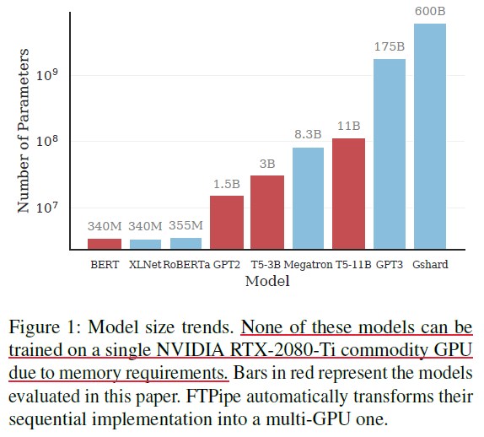
ATC’21 → I’m Old But I Learned a New Trick: Machine Learning
Fine-tuning giant neural networks on commodity hardware with automatic pipeline model parallelism. Saar Eliad, Ido Hakimi, Alon De Jager, Mark Silberstein; Assaf Schuster. Technion - Israel Institute of Technology
Fine-tuning holds the potential to make giant NN models pre-trained on high-end super-computing-grade systems readily available for users that lack access to such costly resources.
→ Still difficult to realize because the models often do not fit in the memory of a single commodity GPU.
Background of Fine-tuning DNN. Giant Model is not trained from scratch. Instead, a short training phase is performed on an already existing model, which has been pre-trained on large application-related datasets to obtain general domain knowledge.
→ By training on user-specific datasets, fine-tuning allows accommodating new inputs.
→ Provider-scale pre-training + short fine-tuning on user data, making the power of giant models broadly accessible
Challenge by low-cost commodity hardware. Small memory sizes and slow inter-GPU communications are the main characteristics that set apart commodity GPUs from high-end devices, affecting the training of giant models.
→ Small GPU memory (i.e., 40 GBs to train T5 with 3B paras, still larger than the memory size of any commodity GPU.
→ Slow PCIe Communication. Existing approaches to cope with GPU memory constraints (sharding/swapping) are ineffective, amplified
here because small batch sizes do not allow for overhead mitigation using communication and computation overlapping.
Single GPU/data-parallel-multi-GPU approach for fine-tuning giant models are not viable options.
Pipeline-based Approaches is promising, while current solution depends on coarse-grained scheduling, leading to bubble, data
overhead, or load-imbalance.

Slide 6
ATC’21 → I’m Old But I Learned a New Trick: Machine Learning
Fine-tuning giant neural networks on commodity hardware with automatic pipeline model parallelism. Saar Eliad, Ido Hakimi, Alon De Jager, Mark Silberstein; Assaf Schuster. Technion - Israel Institute of Technology
Propose FTPipe with Mixed-pipe, making multi-GPU exec of fine-tuning tasks for giant nn readily accessible on commodity hardware.
Observations:
Partitioning without DNN topology constraints, prefer the load-balancing instead of inter-communication.
Fine-tuning large models is less sensitive to staleness.
Key idea: model partitioning and task allocation.
Flexible partition: partitions model into arbitrary computational blocks rather than layers. → Mixed-pipe
Allocation: relaxes model topology constraints when assigning blocks to GPUs, allowing nonadjacent blocks to be executed on one GPU.
It affords better balance of the compute and memory-load on the GPUs without increasing the communication overheads.
Techniques of FTPipe:
Tracing: all computation ops and dependencies are represented by vertex and edge, a block is a computation op.
Profiling: each block is profiled with memory consumption and execution time and so on.
Model partitioning: to maximum throughput by minimizing the maximum stage period among all stages.
GPU assignment: several schemes (i.e., Greedy, space-first, load-balance-first, etc.)compete to select the best result.
Work scheduling: both sync and async (better). computes forward passes for different micro-batches, filling the pipeline, then moves into alternating between backward and forward passes, modifying the model parameters after each mini-batch.

Slide 7
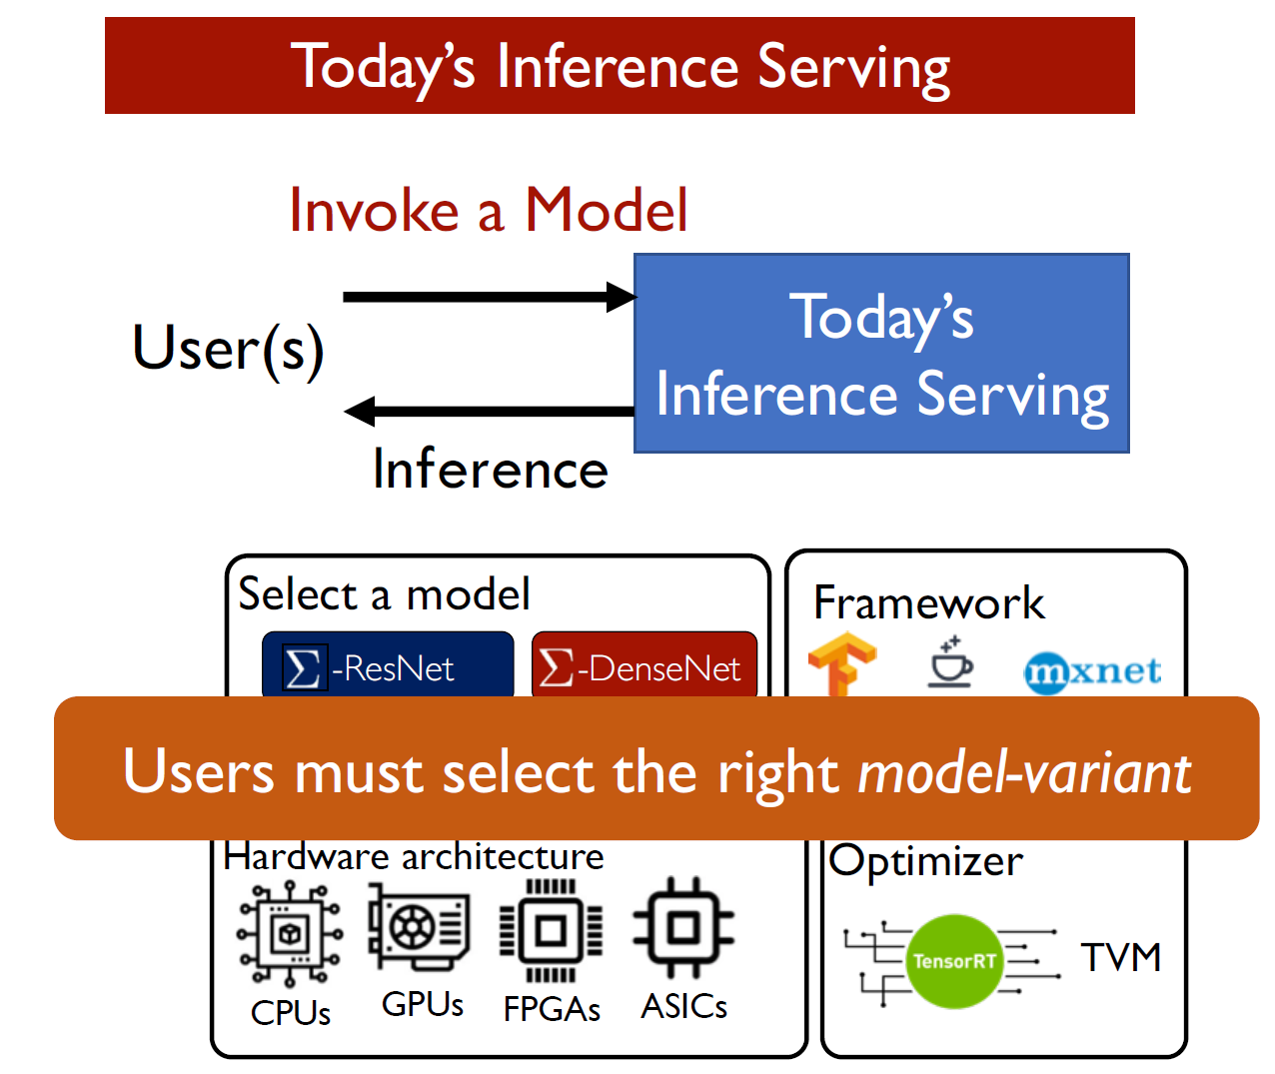
ATC’21 → I’m Old But I Learned a New Trick: Machine Learning
INFaaS: Automated Model-less Inference Serving. Francisco Romero, Qian Li, Neeraja J. Yadwadkar, Christos Kozyrakis, Stanford University，
Despite existing work in machine learning inference serving, ease-of-use and cost efficiency remain challenges at large scales.
→ Configuration is still manual. (x1000s of model-variants – versions of models that differ in hardware, resource footprints,
latencies, costs, and accuracies).
→ Worsely, decisions need to be made dynamically for each inference query to avoid excessive costs.
i.e., app evolves overtime, the performance penalty can be 100x, the trade-off between cost and accuracy/latency should be considered.
Background of current distributed inference services: Users must be Professionals.
Existing systems (TensorFlow Serving, AWS SageMaker, and etc.) require developers to select model-variants, batch sizes, instance/hardware types, and statically-defined autoscaling configurations, for meeting application requirements.
→ If these decisions are made without understanding the trade-offs offered by the variants, the impact could be significant (note
the wide cost, performance, and accuracy ranges spanned by the variants)
Challenges:
Selecting the right model-variant, including model architecture (ResNet…), programming framework (tensorFlow…), model graph optimizers, hyperparameters, hardware platforms. The performance, cost, and accuracy trade-off space offered by these variants is large.
Reducing cost as load varies. Currently, only VM-scaling based approaches. Query patterns and service level objectives of applications, (i.e., real-time translation and video analytics), can vary unpredictably. Provisioning for peak demand leads to high cost, hence distributed inference serving systems need to dynamically respond to changes

Slide 8
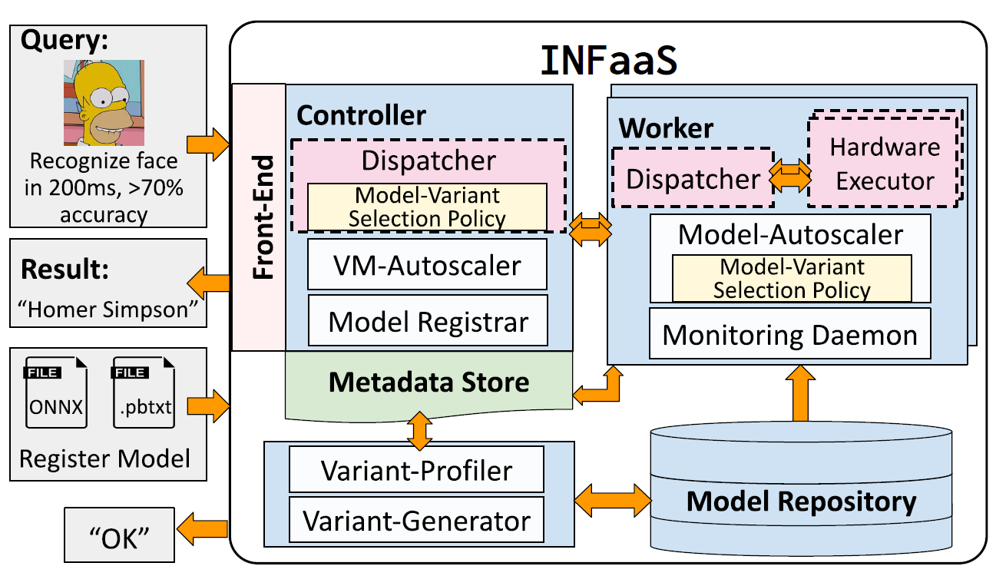
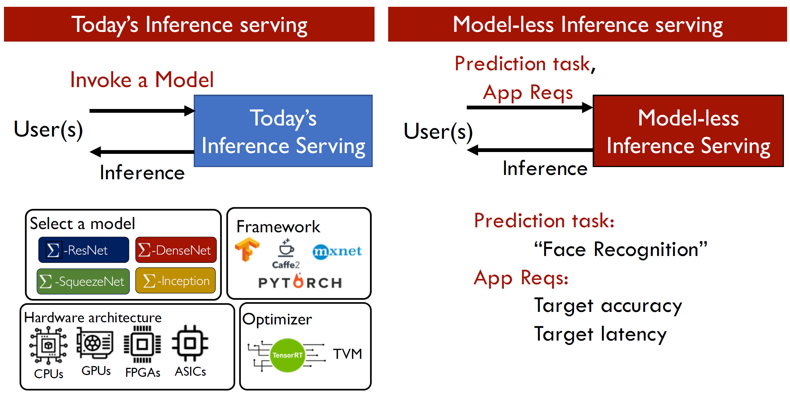
ATC’21 → I’m Old But I Learned a New Trick: Machine Learning
INFaaS: Automated Model-less Inference Serving. Francisco Romero, Qian Li, Neeraja J. Yadwadkar, Christos Kozyrakis, Stanford University，
Built INFaaS, an automated model-less system for distributed inference serving.
→ It introduces a model-less interface where after registering trained models, developers specify only the high-level performance,
cost, or accuracy requirements for each inference query.
(1) Easy-to-use: Automatically and efficiently select a model and hardware;
(2) Cost Efficient: Share the hardware as well as models across users.
Workflow of INFaaS:
User register models; user submit a query through the API; → generates model-variants and perform-cost profiles on different platforms.
(3) Controller selects a model variant, then selects a worker to process the query; → main contribution including policy of scaling.
(4) The query proceeds to run on the variant’s target hardware platform.
(5) Upon completion, the result is returned to the user.
Main techniques
Model-auto-scale based on user’s meta data and model variant selection policy.
→ min Cost(action) = Hardware Cost + 𝜆 Loading Latency
Current Model is good enough. Model-horizontal (VM-level) by provides more resources (adding/shrinking CPUs/GPUs)
Current Model needs to be polished. Model-vertical scaling (model-level) by upgrading the model by providing more variants, status, paras…

