Slide 1
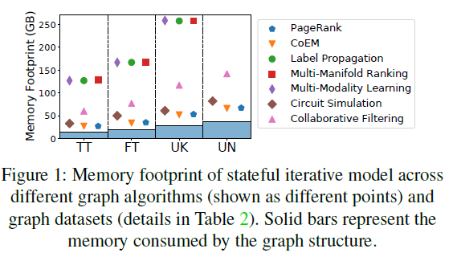
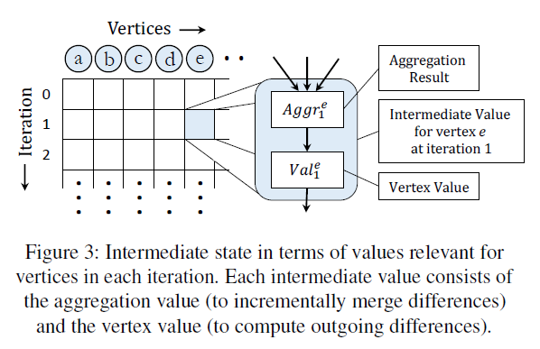
ATC’21 → Searching for Tracks: Graphs
Controlling Memory Footprint of Stateful Streaming Graph Processing. Pourya Vaziri and Keval Vora, Simon Fraser University
With interest in analyzing dynamic graphs, streaming graph processing systems rely on stateful iterative models where they track the intermediate state as execution progresses to incrementally adjust the results upon graph mutation.
The intermediate state tracked by models significantly increases the memory footprint of these systems, which limits their scalability on large graphs.
Background
Streaming Graph Processing Model. A streaming graph (SG) is a graph whose structure keeps on changing (mutation) via a continuous stream of graph updates (e.g., add and delete of vertices and edges). SG processing systems operate on SGs to produce results consistent with the latest graph structure.
Stateless iterative models. It performs iterative processing without capturing intermediate values that describe the execution history graph structure mutates. they either continue iterative computation without incorporating the impact of mutations on already computed or, they conservatively deduce the set of values that could be potentially affected due to mutation and recompute those values from scratch. (high-computation)
Stateful Iterative Processing Model. It reduce the amount of computation to be performed upon graph mutation using incremental processing.
The main idea is to track the intermediate state that captures the necessary details of execution history so that when the graph structure mutates, only the relevant parts of execution history are adjusted or recomputed.
Tracking Intermediate State in Memory. The intermediate state in stateful iterative models is in form of values relevant for vertices at each iteration.
Aggregation at each vertex that collects values from its incoming edges;
value computed for that vertex;
Iterative algorithms use selective scheduling mechanisms to suppress propagation of minor changes.
By explicitly tracking the two values, differences can be correctly computed and propagated based on values visible to the neighbors.
Tracking this intermediate state increases the memory footprint of such incremental processing techniques.

Slide 2
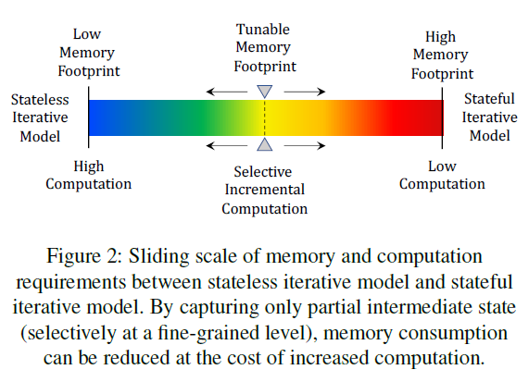
ATC’21 → Searching for Tracks: Graphs
Controlling Memory Footprint of Stateful Streaming Graph Processing. Pourya Vaziri and Keval Vora, Simon Fraser University
Develop novel memory-efficient stateful iterative models that demand much less memory capacity to efficiently process streaming graphs and provide the same guarantees as existing state-of-the-art streaming graph processing systems.
Techniques
Selective Stateful Iterative Model. By which memory footprint is controlled by selecting a small portion of intermediate state to be maintained during execution.
Insight-1: vertex computations within an iteration are independent of each other, and hence, incrementally recomputing the value of a vertex is only dependent on the intermediate state saved for that vertex (i.e., not dependent on the states saved for other vertices).
Insight-2: the usefulness of different portions of the intermediate state is different; this means, intermediate states for certain vertices would end up reducing more computation than those for other vertices.
Main idea: Tunes its memory footprint depending on the available main memory by selecting the intermediate vertex states to be captured at a fine-grained level.
Minimal Stateful Iterative Model. It specializes the incremental processing for certain graph algorithms (depending on their update functions) to drastically reduce the memory footprint.
Insight: The effects of mutations can be propagated iteration-by-iteration throughout the graph even without using the intermediate states for most of the vertices.
Main idea: only that get directly affected by graph mutation are needed to perform incremental processing over the entire graph.

Slide 3
ATC’21 → Please Don’t Chain Me Up: Blockchain and Security
Avocado: A Secure In-Memory Distributed Storage System. Maurice Bailleu, Dimitra Giantsidi, and Vasilis Gavrielatos, University of Edinburgh; Do Le Quoc, Huawei Research; Vijay Nagarajan, University of Edinburgh; Pramod Bhatotia, University of Edinburgh and TU Munich
Trusted execution environment (TEE) guarantees the authenticity, integrity and the security of their executing code, data and runtime states. Based on it, an efficient in-memory distributed KV system can be meaningful.
→ However, the TEEs are primarily designed to secure the limited in-memory state of a single-node system, and thus, the security properties of TEEs do not naturally extend to a distributed infrastructure.
Backgrounds:
In-memory distributed KV stores are adopted as storage system infrastructure in the cloud because (i) they support latency sensitive applications by keeping data in memory, and (ii) they accommodate large datasets beyond memory limits of a single server by a scale-out distributed design.
The increased risk of security violations in cloud-oriented storage systems. In untrusted environments, an attacker (malicious cloud operator) can compromise the security properties of the stored data and query operations, which pose a serious threat to storage systems.
Hardware-assisted trusted execution environments (TEEs) ( Intel SGX, ARM Trustzone) provide way to build secure systems.
→ It provide a hardware-protected secure memory region whose residing code and data are isolated from any layers in the software stack.
Challenges for secure in-memory distributed KV systems.
They are supposed to build on high-performance network stacks, while protected memory of TEEs cannot be directly accessed via the untrusted RDMA.
The fault-tolerance of such KV systems requires secure replication, which are expensive in practice.
The scalable attestation mechanism, that establish trust between the servers and clients, is a single node model.
They typically requires fast access to massive memory on each server for single-node KVS, while TEEs provide a limited secure physical memory.

Slide 4
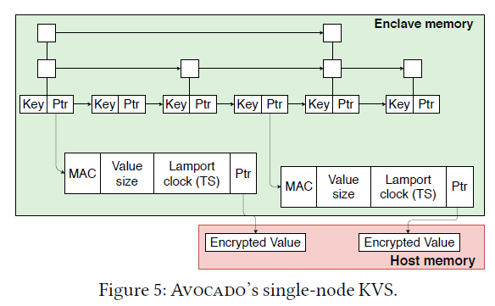
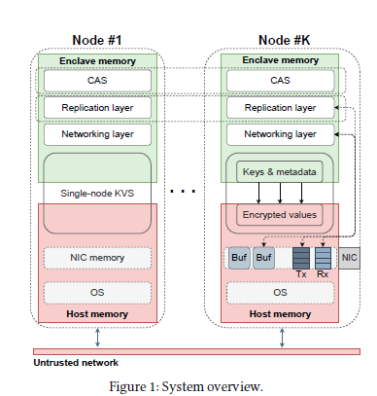
ATC’21 → Please Don’t Chain Me Up: Blockchain and Security
Avocado: A Secure In-Memory Distributed Storage System. Maurice Bailleu, Dimitra Giantsidi, and Vasilis Gavrielatos, University of Edinburgh; Do Le Quoc, Huawei Research; Vijay Nagarajan, University of Edinburgh; Pramod Bhatotia, University of Edinburgh and TU Munich
Propose Avocado, a secure in-memory distributed storage system that provides strong security, fault-tolerance, consistency (linearizability) and performance for untrusted cloud environments.
Main idea:
Key space are divides into shards, each of which is replicated over several nodes that are connected through high-speed network.
Based on enclave memory provided by TEE, integrating and reformatting the shielded execution mechanism to support distributed environment. The address space (Key, metadata) is limited to the enclave memory and interacts with untrusted memory (Host) through the asynchronous syscall interface.
Partitions the key and value space by placing the keys along with metadata inside the enclave memory, while storing the bulk of data encrypted and integrity and authenticity protected in the untrusted host memory.
Techniques :
Configuration and attestation service (CAS) provides and speeds up the trust establishment between the nodes and the clients.
Secure replication protocol. It leverages TEEs to preserve the integrity of protocol execution, which allows to model Byzantine behavior as a normal crash fault, and finally offering linearizable reads and writes.
High-performance network stack for TEEs based on eRPC, it supports the complete transport and session layers, while enabling direct I/O within the protected TEE domain.
Single-node KV storage based on a partitioned skip list data structure, which overcomes the memory limitations of TEEs, while supporting lock-free scalable concurrent updates

Slide 5
ATC’21 → Please Don’t Chain Me Up: Blockchain and Security
Accelerating Encrypted Deduplication via SGX. Yanjing Ren and Jingwei Li, University of Electronic Science and Technology of China; Zuoru Yang and Patrick P. C. Lee, The Chinese University of Hong Kong; Xiaosong Zhang, University of Electronic Science and Technology of China
Outsourcing data management to cloud is common in practice, (i.e., 22% business data are stored in the cloud), which should fulfill security and storage efficiency. Encrypted deduplication preserves the deduplication effectiveness on encrypted data and is attractive for outsourced storage.
→ However, existing encrypted deduplication approaches build on expensive cryptographic primitives that incur substantial performance slowdown.
Backgrounds:
Chunk-based Encrypted Deduplication. (CED)
Chunk-based Deduplication works by partitioning an input file into non-overlapping chunks. For each chunk, it computes the cryptographic (encoded) hash of the chunk content to get a fingerprint. It treats the chunk as a duplicate if the fingerprint has been tracked.
A client encrypts each plaintext chunk of the input file with symmetric secret key into a ciphertext chunk and stores in the cloud. To support file reconstruction, the client creates a file recipe (fingerprints, sizes, keys of the ciphertext chunks) and encrypts it with secret key and stores recipe cloud.
Rooted Reason for efficiency → Proof-of-ownership (PoW). CED removes duplicate ciphertext chunks on the client side without being uploaded to the cloud. The client sends fingerprints to cloud, which checks if corresponding ciphertext chunks have been stored. The client then uploads only the non-duplicate ciphertext chunks to the cloud. The cloud only responds to clients which satisfy the PoW verification.
Intel SGX, which is a suite of security-related instructions built into modern Intel CPUs. SGX shields the execution of code and data in a hardware-protected environment called an enclave, which resides in hardware-guarded memory region called the enclave page cache (EPC).
Critical Issue: How to accelerate encrypted deduplication while preserving security?
→ Current solutions require either isolated server (extra bandwidth) or extra computation proving client is trusted.
→ The advances of hardware-assisted trusted execution provide opportunities to improve performance of encrypted deduplication.

Slide 6
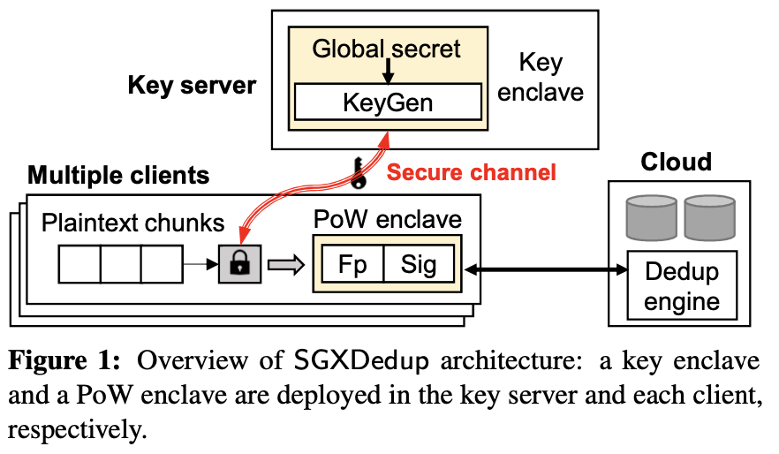
ATC’21 → Please Don’t Chain Me Up: Blockchain and Security
Accelerating Encrypted Deduplication via SGX. Yanjing Ren and Jingwei Li, University of Electronic Science and Technology of China; Zuoru Yang and Patrick P. C. Lee, The Chinese University of Hong Kong; Xiaosong Zhang, University of Electronic Science and Technology of China
SGXDedup: How about offloading the expensive cryptographic operations of encrypted deduplication by directly running sensitive operations in enclaves (within server and client), so as to improve the performance of encrypted deduplication, while maintaining its security, bandwidth efficiency, and storage efficiency.
Workflow
A key enclave in the key server to manage and protect the global secret of server-aided Message-Locked Encryption) against a compromised key server:
both the key enclave and a client first establish a secure channel based on a shared blinded key.
The client then submits the fingerprint of a plaintext chunk via the secure channel.
The key enclave computes the MLE key as the cryptographic hash of both the global secret and the fingerprint.
It returns the MLE key via the secure channel.
SGXDedup deploys a PoW enclave in each client to prove the authenticity of the ciphertext chunks in source-based deduplication.
The PoW enclave first sets up a shared PoW key with the cloud.
After MLE key generation, the client encrypts each plaintext chunk into a ciphertext chunk. The PoW enclave takes the ciphertext chunk as input, computes the corresponding fingerprint, and creates a signature of the fingerprint using the shared PoW key with the cloud.
The client then uploads both the fingerprint and the signature to the cloud. The cloud verifies the authenticity of the fingerprint based on the corresponding signature and the PoW key.
Only when the fingerprint is authenticated, the cloud proceeds to check if the fingerprint corresponds to any already stored duplicate ciphertext chunk.
By which, there is no need to upload duplicate ciphertext chunks, and will not incurs expensive cryptographic operations for proving that the client is the owner of the ciphertext chunks.

