Slide 1
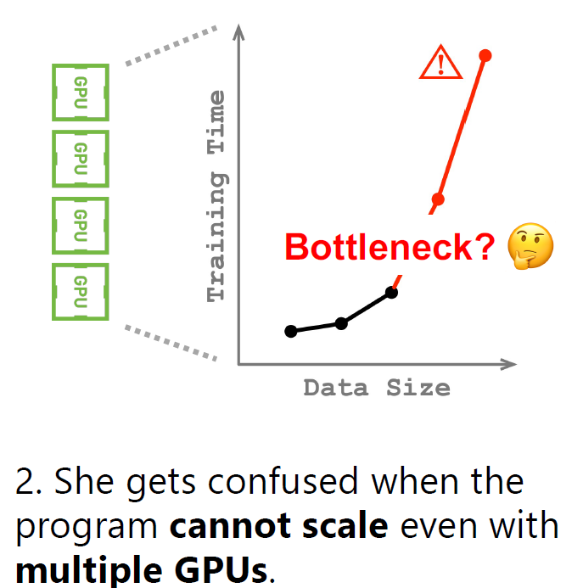
ATC’21 → Searching for Tracks: Graphs
CrystalPerf: Learning to Characterize the Performance of Dataflow Computation through Code Analysis. Huangshi Tian, HKUST; Minchen Yu, HKUST and Huawei Technologies Ltd.; Wei Wang, HKUST
Dataflow computation dominates big data processing where a program is structured as a directed acyclic graph (DAG) of operations. As dataflow computation consumes massive resources in clusters, its performance becomes important.
→ However, it can be difficult to figure out in practice due to the complexity of DAG execution.
Backgrounds:
Dataflow frameworks are deployed widely in the cloud for distributed machine learning (e.g., TensorFlow) and analyzing big data. Dataflow frameworks provide a library of built-in operations (e.g., map, reduce, and tensor operators), which programmers use to compose a data processing pipeline, structured as a directed acyclic graph (DAG) of operations.
The framework schedules DAG executions as parallel tasks on a cluster of machines.
Dataflow computation routinely faces various performance issues such as resource contention, inefficient configuration, and poor scalability.
Due to the complexity of DAG executions, troubleshooting performance issues in dataflow computation usually demands painstaking efforts even for skilled programmers.
Current Solutions & Challenges
Lack of handy toolchains that can provide useful performance-resource information with actionable advices.
Existing tools often generate an overwhelming amount of low-level execution traces, which inexperienced developers may find difficult to even
make sense of them.
Many system solutions simplify performance reasoning, but they either are designed for a specific framework or require modifying the framework’s source
code with intrusive instrumentation.

Slide 2
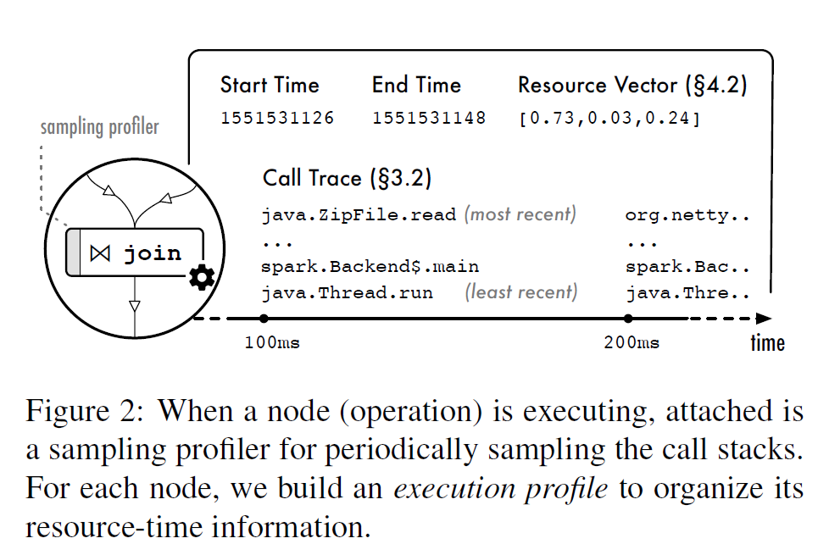
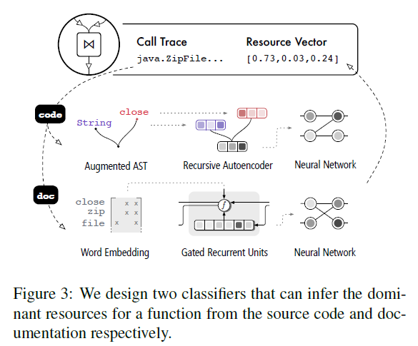
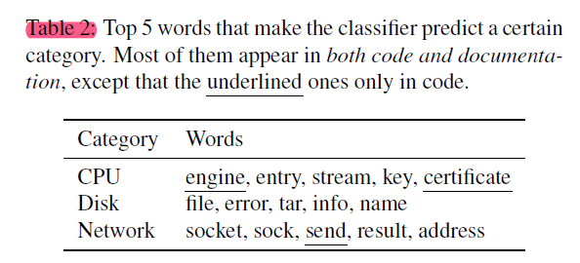
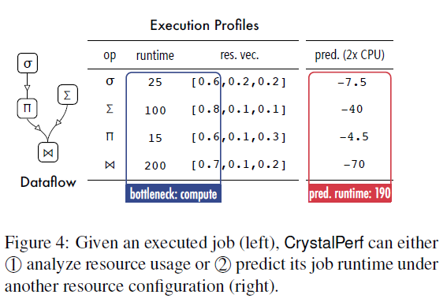
ATC’21 → Searching for Tracks: Graphs
CrystalPerf: Learning to Characterize the Performance of Dataflow Computation through Code Analysis. Huangshi Tian, HKUST; Minchen Yu, HKUST and Huawei Technologies Ltd.; Wei Wang, HKUST
Propose CrystalPerf, a new approach that learns to characterize the performance of dataflow computation (requirement) based on code analysis.
Major contribution
requires no code instrumentation
→ applies to a wide variety of dataflow frameworks.
Key insight: the source code of an operation contains learnable syntactic and semantic patterns that reveal how it uses resources.
Main idea: establish a performance-resource model that, given a dataflow program, then infers automatically how much time each operation has spent on each resource (e.g., CPU, network, disk) from past execution traces and the program source code, with machine learning techniques.
Workflow:
Mining Resource-Time from Traces. uses the sampling profilers built on utilities to collect the call traces of a dataflow job and its operation tasks periodically. (mainly records the start time and the duration of each operation.) Manual labeling
→ derive the resource-time information by analyzing how those functions use resources.
Profiling Resource Usage of Job. two neural network classifiers to infer the resource patterns from the code and documentation. Supervised learning
→ Use abstract syntax tree (AST) to maintain the DAG relationship and further summarize the performance-resource mapping from function→ usage to jobs (call several functions) → usage
Case Study. For debugging, CrystalPerf generates a detailed report of the time spent on each resource to help users understand the potential issues of the program. For prediction, we consider the scenario where a user profiles a job under a given configuration and wonders how the job completion time would change with a different configuration

Slide 3
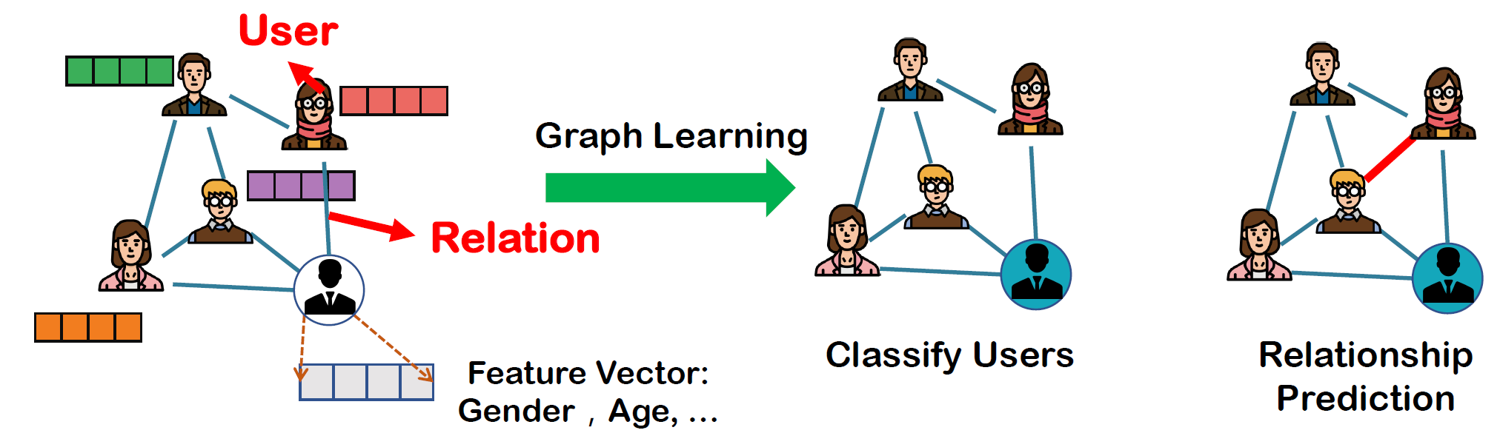
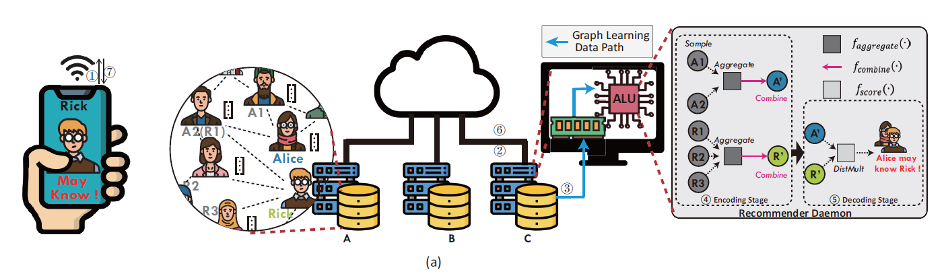
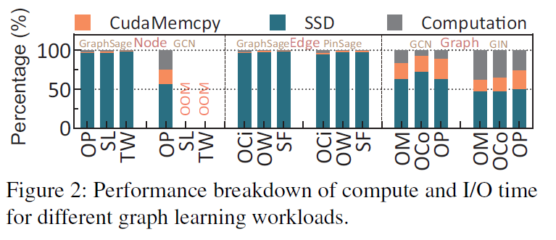
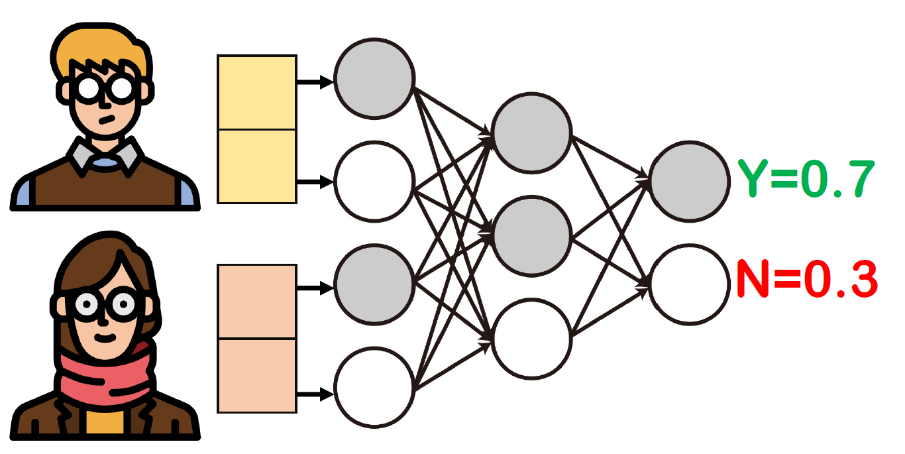
ATC’21 → Searching for Tracks: Graphs
GLIST: Towards In-Storage Graph Learning. Cangyuan Li, Ying Wang, Cheng Liu, and Shengwen Liang, SKLCA, Institute of Computing Technology, Chinese Academy of Sciences, Beijing, China; University of Chinese Academy of Sciences, Beijing, China; Huawei Li, SKLCA, Institute of Computing Technology, Chinese Academy of Sciences, Beijing, China; University of Chinese Academy of Sciences, Beijing, China; Peng Cheng Laboratory, Shenzhen, China; Xiaowei Li, SKLCA, Institute of Computing Technology, Chinese Academy of Sciences, Beijing, China; University of Chinese Academy of Sciences, Beijing, China
Graph learning is widely used in applications such as recommender system and medicine design. Real-world graph learning apps typically operate on large attributed graphs with rich information, which do not fit in the memory.
→ Graph learning requests must go across deep I/O stack and move massive data from storage to host memory, which incurs latency and power consumption.
Background:
Attributed graphs, such as social graph in Facebook, occupy a growing proportion of storage space in the datacenters of service.
Taobao manages attributed graphs that consist of one billion users and two billion items.
Graph Learning. as the machine learning advances, the question of how to make prediction, discover new patterns, and mine useful information from such rich attributed graphs, is important in cloud datacenters where the massive graph data can be ingested to learn the basic classification, clustering, visualization and prediction functionality.
I/O in GNN. The encoding function encodes the vertices in a graph into latent representation (also called embedding) that summarizes both the location and neighboring information. The decoding function decodes the embedding to the original vertex information, which is directly related to graph learning tasks, such as labeling a vertex in classification task.
Performance Issues caused by current architecture
(1) The storage-and-compute decoupled systems are bottlenecked by I/O operations, due to the costly data movement from the storage to CPUs/GPUs.
(2) Large-scale GL tasks exhibit poor data locality, which can hardly be exploited in the limited on/off-chip due to the large footprint of attributed graphs.
(3) Although GL tasks are complicated than plain-graph processing, they are solvable by graph neural networks (GNN), which means a compact specialized GL accelerator is a viable alternative to GPUs and CPUs in storage-centric GL systems

Slide 4
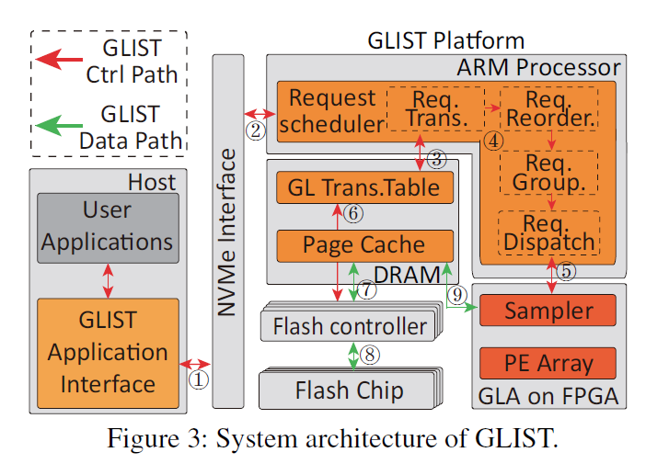
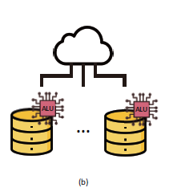
ATC’21 → Searching for Tracks: Graphs
GLIST: Towards In-Storage Graph Learning. Cangyuan Li, Ying Wang, Cheng Liu, and Shengwen Liang, SKLCA, Institute of Computing Technology, Chinese Academy of Sciences, Beijing, China; University of Chinese Academy of Sciences, Beijing, China; Huawei Li, SKLCA, Institute of Computing Technology, Chinese Academy of Sciences, Beijing, China; University of Chinese Academy of Sciences, Beijing, China; Peng Cheng Laboratory, Shenzhen, China; Xiaowei Li, SKLCA, Institute of Computing Technology, Chinese Academy of Sciences, Beijing, China; University of Chinese Academy of Sciences, Beijing, China
Propose Graph Learning In-STorage (GLIST), to replace the power-hungry CPU/GPU based solutions and eliminate the unnecessary power consumed by graph data movement.
→ It is a combination of in-SSD computing and customized graph learning accelerator architecture,
→ It enables the storage device to directly respond to attributed graph analysis requests and queries, making more energy efficiency.
Architecture:
To manage the incoming link prediction requests­. It translates each link prediction request to primitive analysis commands including a vertex embedding command that invokes the encoder function and a prediction command that executes the decoder function.
The link prediction can be obtained after the execution of the corresponding primitive analysis commands.
Techniques
(1) Reorder the primitive vertex analysis commands that generate flash accesses (i.e.vertex embedding requests) to explore the graph data reuse and fits the flash accesses to the flash channel-level parallelism.
(2) Groups the reordered primitive vertex analysis commands into small batches to increase the bandwidth utilization of ways and channels, instead of sequentially handling each graph analysis command with limited footprint.
(3) The instructions are served by the Sampler first, which fetches the feature vectors from the flash devices or the Page Cache directly from on-board DRAM.
(4) The newly assembled graph (based on feature vectors retrieved from flash) is further loaded to the on-chip buffers of GLA. When all the required data are ready, the processing element array is instructed by the commands to execute the invoked vertex analysis model.

Slide 5
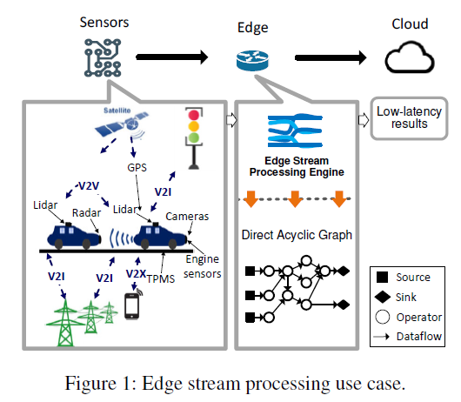
ATC’21 → Searching for Tracks: Graphs
DART: A Scalable and Adaptive Edge Stream Processing Engine. Pinchao Liu Florida International University Dilma Da Silva Texas A&M University Liting Hu Virginia Tech
IoT applications are time-critical and dynamically changing. However, traditional data processing are not well-suited for these IoT applications.
These systems do not scale well with massive concurrently running IoT applications, do not support low-latency processing under limited computing resources, and do not adapt to the heterogeneity and dynamicity at edge environments.
Background
Traditional IoT Applications adopt the server-client model: sensors send time-series observations to cloud for analysis.
Long-distance of processing makes it not appropriate or time-critical IoT application because: (1) the high latency may cause the results to be obsolete; and (2) the network infrastructure cannot afford the massive data streams
Edge stream processing applies the stream processing to edge computing architecture. Not rely on the cloud to process sensor data → it relies on distributed edge compute nodes (Gateways, powerful sensors, etc.) which are near the data sources to process data and trigger actuators.
Sensors generate data streams continuously. They are then consumed by the edge stream processing engine, which creates a logical topology of stream processing operators connected into a DAG, processes the tuples of streams from sources to sinks, and outputs the results in a very short time.
Source node is an IoT sensor. Inner node runs an operator or operators that can perform user-defined computation on data, (simple like join, filter; complex like ML-based classification). Each sink node is an IoT actuator or a message queue to the cloud.
Challenges & Issues: Current Edge stream processing is still not enough as IoT systems grow in number and complexity
Scale to numerous concurrently running IoT stream applications. Modern stream processing engines still inherit a centralized architecture, in which the monolithic master is responsible for all scheduling activities.
Adapt to the edge dynamics and recover from failures to ensure system reliability. Mainly due to workload variability, failures, and stragglers.

Slide 6
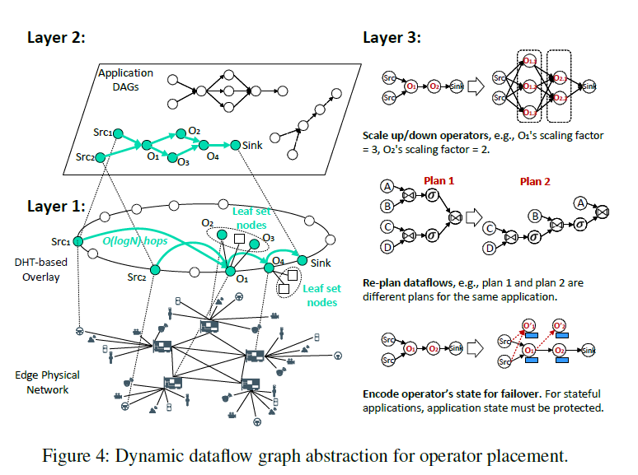
ATC’21 → Searching for Tracks: Graphs
DART: A Scalable and Adaptive Edge Stream Processing Engine. Pinchao Liu Florida International University Dilma Da Silva Texas A&M University Liting Hu Virginia Tech
Propose DART, a scalable and adaptive edge stream processing engine by re-architecting the stream processing system runtime design.
→ There is no monolithic master. Instead, DART involves all peer nodes to participate in operator placement, dataflow path planning, and operator scaling, thereby improving scalability and adaptivity.
Architecture
Layer 1: DHT-based consistent ring overlay. All distributed edge “nodes“ (with id) are self-organized into a DHT-based overlay. It is guaranteed data can be routed to any destination node within O(logN) hops.
→ P2P Principle. All nodes are created equal. (DHT-based overlay (hash-based mapping) has been commonly used Bitcoin and BitTorrent.)
→ Each node is randomly assigned a unique “NodeId" in a large circular NodeId space.
→ Routing table to build dynamic dataflows, which records the nodes that current node link to when processing happens.
→ Leaf set for scaling and failure recovery, which records physically “closest" nodes to this node.
Layer 2: Dynamic dataflow abstraction. It leverages DHT-based routing protocols to approximate the optimal routes between source nodes and sink nodes, which can automatically place and chain operators to form a dataflow graph for each application.
Layer 3: Scaling and failure recovery mechanisms. Based on the leaf set.
(1) Scaling up and down operators to adapt to the workload variations;
(2) Re-planning dataflows to adapt to the network variations.
→ As stream data moves along the dataflow graph, the system makes dynamic decisions about the downstream node to send streams to.
(3) Replicating operators to handle failures and stragglers. If any node fails or becomes a straggler, the system can automatically switch over to a replica.

