Slide 1





Enforcing Security and Compliance Using AFT Eric Amador Nimbis Services

Slide 2

Hello!
I am Eric Amador
I am Director of DevSecOps at Nimbis Services
You can find this presentation @ericamador on GitHub

Slide 3


1.
Landing Zones
What is the Landing Zone architecture?

Slide 4
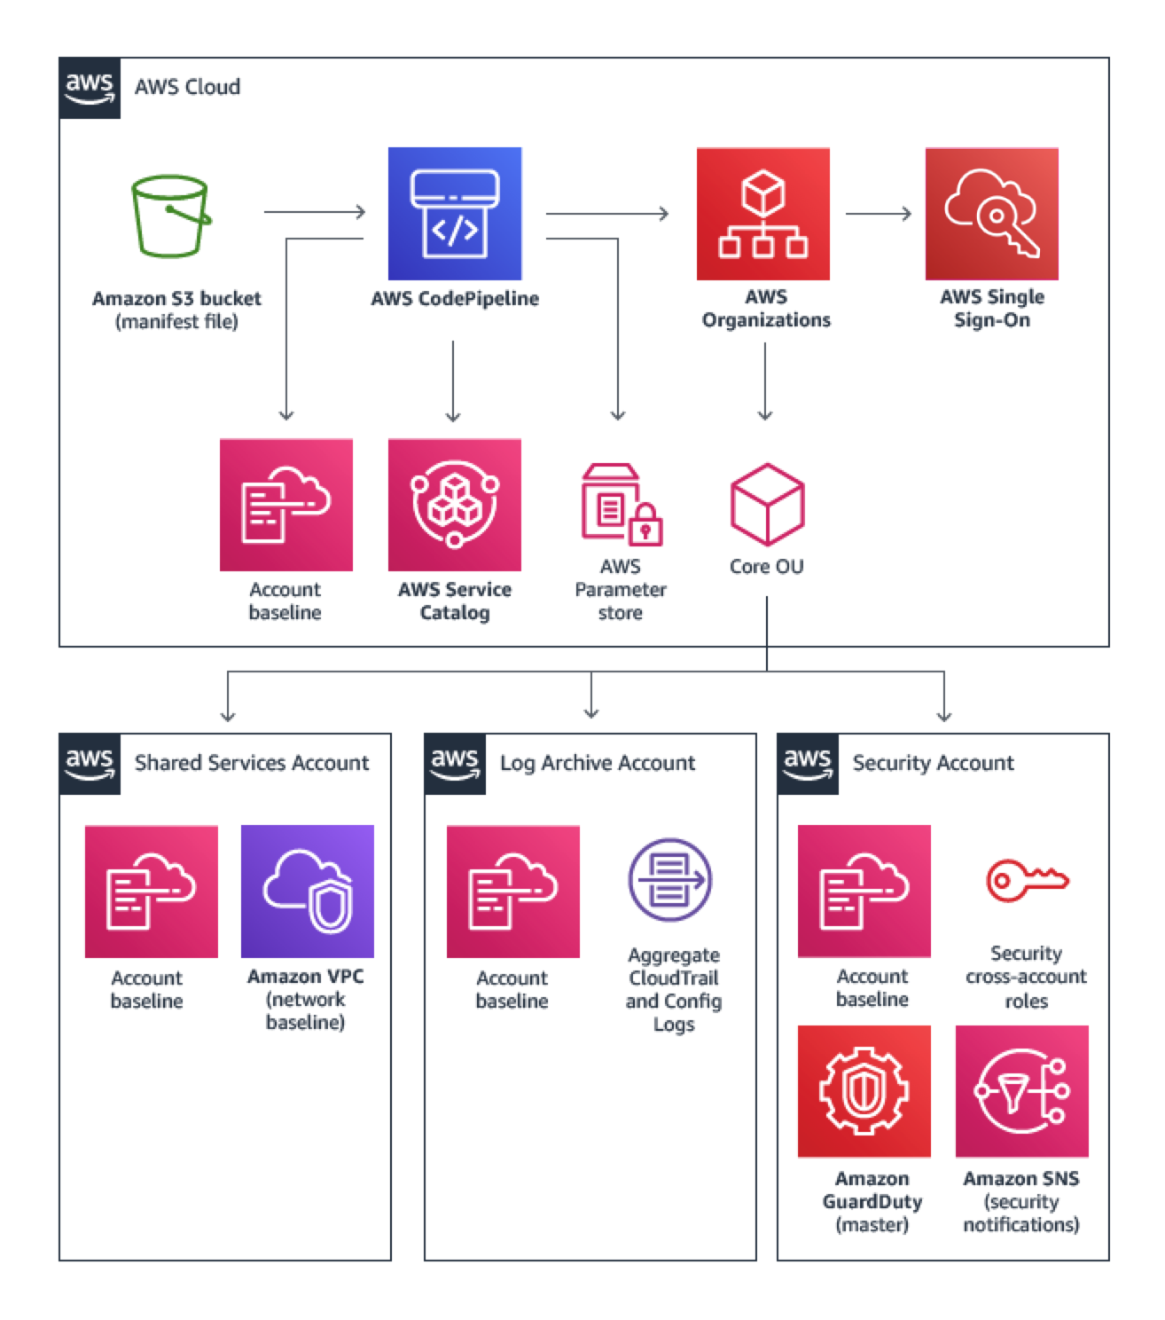
Account Structure
“Master Payer” account
Shared services
Logging
Security

Slide 5
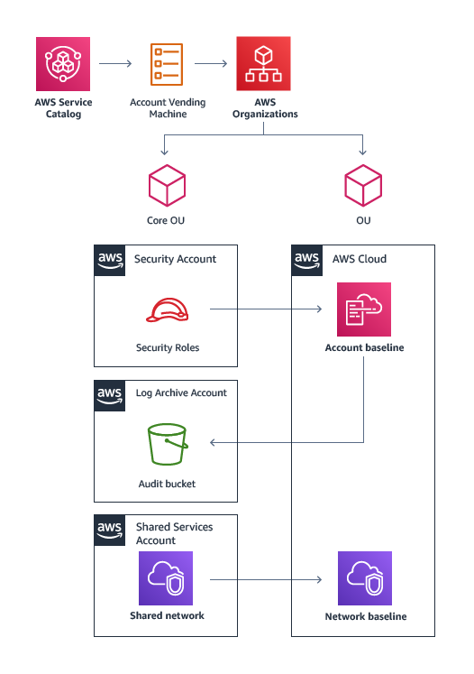
Account Vending Machine (AVM)
Uses AWS Service Catalog templates to capture the desired state of AWS accounts

Slide 6
Landing Zone Goals
Ensuring compliance is built into AWS accounts
Centralized logging
Limiting blast radius for accounts
Isolating workloads
Billing visibility

Slide 7
2.
AWS TLZ
Terraform Landing Zone

Slide 8
Terraform Landing Zone
Uses Terraform instead of CF to deploy and manage accounts
Allows deployments to span clouds and/or cloud partitions
The AVM is implemented in Lambda instead of Service Catalog
Requires Terraform Enterprise (or Terraform Cloud)

Slide 9
3.
AWS Control Tower AFT
Account Factory for Terraform

Slide 10
AFT Development Warnings
Control Tower is not yet available in GovCloud
Control Tower does not yet support us-west-1
AFT uses CodeCommit, which does not yet directly support GitLab as a VCS

Slide 11
Timeline
Jun 2019
AWS Control Tower Introduced
November 2020
AWS Landing Zone solution reaches EOL
December 2021
TLZ is deprecated in favor of AFT
MAY 2018
SEP 2018
JAN 2019
MAY 2019
SEP 2019
JAN 2020
MAY 2020
SEP
2020
JAN
2021
MAY
2021
SEP
2021
JAN
2022
Jun 2018
AWS Landing Zone solution Introduced
Oct 2019
AWS TLZ Accelerator Preview announced
November 2021
AWS Control Tower AFT is released

Slide 12

Thanks!
Any questions?
https://linkedin.com/in/eamador
eric.amador@nimbisservices.com

Slide 13
Resources and Credits
AWS Solution Library - AWS Landing Zone
AWS Control Tower- AFT Documentation
HashiCorp - AWS TLZ Accelerator
HashiCorp - TLZ at Eventbrite
HashiCorp - AFT Tutorial
Presentation template by SlidesCarnival

