Slide 1

From Checkerboards to Cities:
Testing Schelling with Real Preferences & Data
Notes:
Today we stress test Schelling's key claim by changing the shape of individual preferences and by anchoring models in real data. We'll also preview how to build empirically grounded ABMs (Bruch & Atwell, 2015).

Slide 2
Schelling's Minimal Prejudice Principle
Small, local preferences → City-wide segregation
Threshold Rule
Micro → Macro
Move if < 50% own-group
Individual moves tip neighborhoods
Schelling 1971, 1978
Notes:
Schelling posited a step (threshold) utility: neighborhoods are either acceptable or not; people are indifferent within regions on either side of the threshold. That indifference is central to tipping dynamics.

Slide 3
Are Results Robust to Realistic Preferences?
1. Preference Shape
Threshold
Continuous
vs
2. Empirical Grounding
• Connect to survey preferences (DAS & MCSUI)
• Use real cities & actual populations
Bruch & Mare 2006
Notes:
Bruch & Mare (2006) test the threshold assumption by substituting continuous response functions (linear or nonlinear). They also compare to survey-elicited preferences (DAS & MCSUI).

Slide 4
Preference Shape Changes Everything
Threshold → Tipping | Continuous → Potential Integration
Threshold Preferences
Continuous Preferences
Regions of indifference
Every change matters
Unacceptable
Acceptable
→ Tipping dynamics
→ Integration cascade
Survey data supports continuous, not threshold
Bruch & Mare 2006
Notes:
Schelling's regions of indifference above/below 50% produce tipping. Continuous functions reward even small composition changes, potentially stabilizing integration. Bruch & Mare argue survey data (DAS/MCSUI) aligns with continuous nonlinear preferences, not hard thresholds.

Slide 5
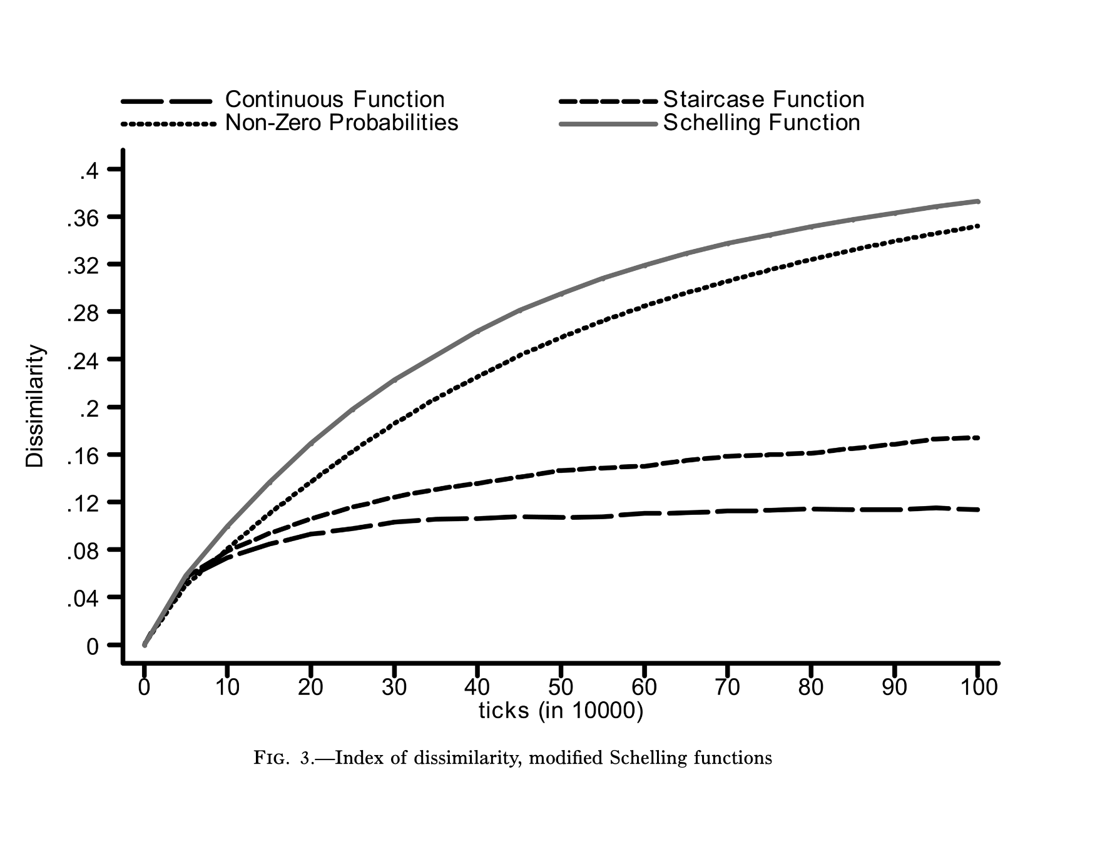
Initial Simulations: Integration Wins?
D ≈ 0.1 under continuous assumptions
Bruch & Mare 2006
Notes:
Under continuous preference assumptions, they saw a 'cascade toward integration': small random inflows raise local own-group share slightly, nudging more co-ethnics to follow, which stabilizes rather than tips.

Slide 6
The Replication Crisis
Integration depends on randomness level
High Randomness
Low Randomness (High β)
Lines converge low
Lines climb high
⚠️ Key: Sensitivity to chance vs sensitivity to change
Van de Rijt et al. 2009
Notes:
Van de Rijt, Siegel & Macy reran B&M with the random utility scale turned down (bigger β). Result: even continuous preferences segregate. Key message: both the function shape and the error scale matter.

Slide 7
The Resolution: Both Can Segregate
With strong preferences (high β), both segregate
Aspect | Threshold | Continuous
Segregation outcome | High D | High D
Speed to equilibrium | Slower | Faster
Pathways | Tipping cascades | Gradual sorting
Functional form shapes HOW segregation happens, not just WHETHER
Bruch & Mare Reply 2009
Notes:
B&M acknowledged code error; corrected figures show segregation under high β. Still: functional form shapes pathways & speed to equilibrium. With high β & long runs, both converge, but continuous segregates faster.

Slide 8
Integration Can Be Stable
Wide tolerance bands → Robust integration
Region of indifference
DAS blacks: broad tolerance from 29-86% white
Bruch & Mare 2009
Notes:
B&M show if both groups shared the integration-friendly shape expressed by Black respondents (DAS), the system can resist drift. Three scenarios—both white prefs; both black prefs; actual black+white—yield dramatically different D trajectories.

Slide 9
Race × Income: Offsetting Effects
Three Levers:
Offsetting Effects
Between-group inequality
Within-group inequality
3. Group size
Affluent → Integration
Poor → Isolation
Net effect on D can attenuate due to opposing forces Depends on minority group size (critical mass)
Bruch 2014
Notes:
Bruch 2014 demonstrates when within-group inequality is high, increasing between-group inequality can simultaneously intensify isolation at the bottom while pulling some affluent minorities into high-income (often whiter) areas. Net effect on D can attenuate because of these offsets—and depends on minority group size (critical mass).

Slide 10
From Stylized to Empirical ABMs
Low-dimensional
High-dimensional
Mechanism probes
Policy scenarios
ABMs link micro rules ↔ macro outcomes under interdependence
Choose approach based on research question:
• Stylized: Isolate mechanisms
• Empirical: Test real-world scenarios
Bruch & Atwell 2015
Notes:
2015 lays out a playbook: use abstract models to isolate mechanisms; use empirically calibrated models for forecasts/policy design. They highlight sociology's core need to model feedback, heterogeneity, and interdependence credibly.

Slide 11
Recipe for Empirical ABMs
Data
Data
Data
Initialize
Estimate
Simulate
Validate
1. Initialize populations
Census, ACS
2. Estimate behavior
E.g., Conditional logit from PSID mobility
3. Run simulations
Sample draws realize choices
4. Validate & test
Sensitivity analysis, compare to known outcomes
Bruch & Atwell 2015
Notes:
Population initialization: use iterative proportional fitting to reconstruct joint distributions from tables. Behavior: estimate discrete choice from observed moves; let agents sample from predicted probabilities. Validation: uncertainty & sensitivity analysis, then compare ABM outputs with real spatial/temporal patterns.

Slide 12
From Checkerboards to Multi-Domain Research
New Directions in Segregation Research :
• Intersectionality & multi-attribute sorting • Multi-domain segregation: home-school-work-leisure • Activity-space data from mobile traces • Machine learning for preference estimation
Ubarevičienė et al. 2024
Notes:
A 2024 bibliometric review: Schelling inspired broad literatures, but empirical validation is hard; many now tackle segregation as multi-scalar and multi-domain (residence, schools, work, leisure) and lean on activity-space data.

Slide 13
What Would You Change?
Preference Shape
Randomness
Threshold vs continuous vs hybrid vs ?
How much “noise” in decisions?
Multi-attribute
Neighborhood Scale
Race + income + education + ?
Block vs tract vs activity space?
Notes:
Invite students to defend one modeling change and forecast how it might alter macro outcomes; tie back to validation strategies.

