Slide 1
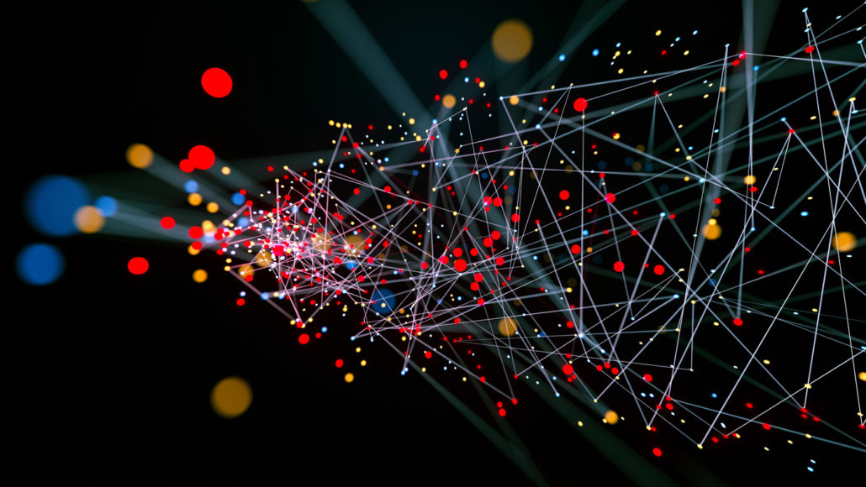
Complex Contagion & Networks
When Does a Movement Catch Fire?
From thresholds → topology → reinforcement

Slide 2
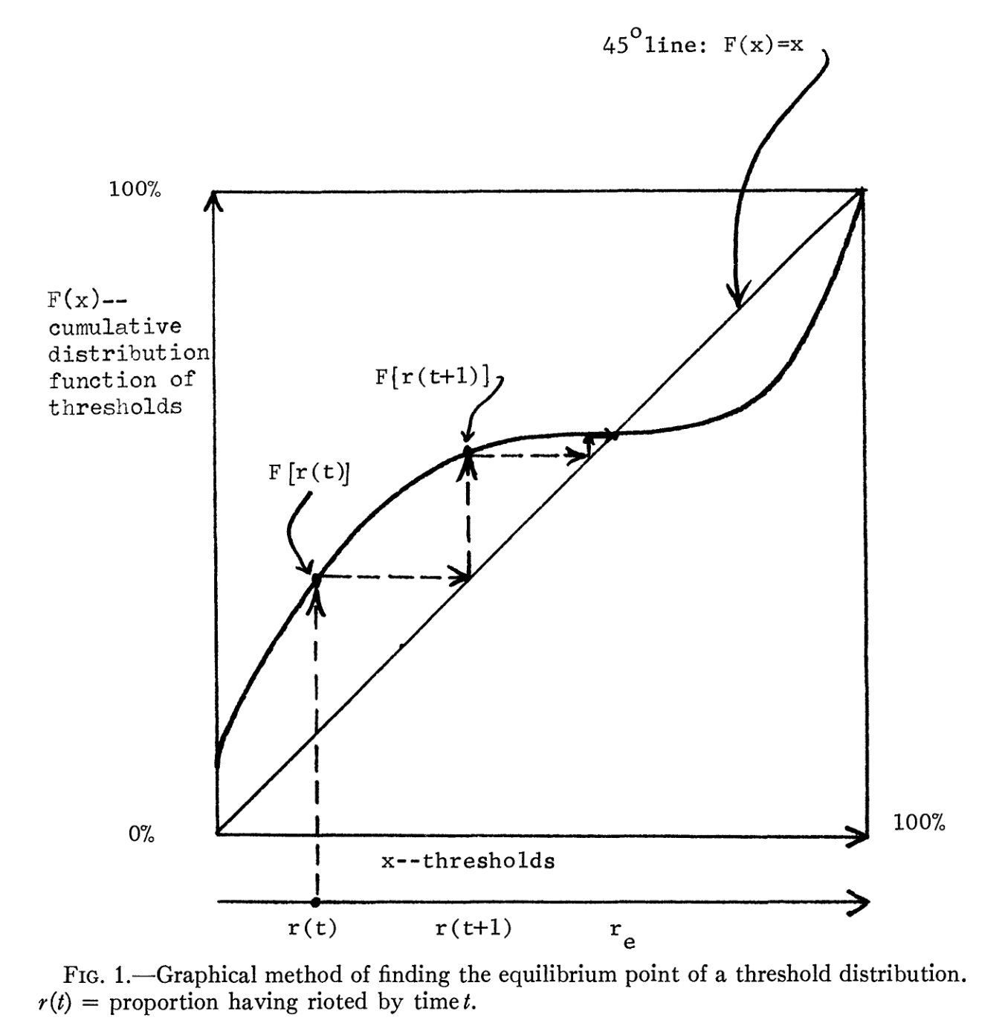
From Thresholds to Networks
Thresholds explain when individuals act
Network structure explains how far and how fast behaviors spread
Transitioning from individual thresholds to collective contagion models
Cascade Diagram
(Building from last week)

Slide 3
Two Kinds of Contagion
Simple Contagion
Complex Contagion
k = 1 exposure
k ≥ 2 exposures
Examples:
Diseases
Gossip
Viral memes
Examples:
Joining protests
Adopting risky innovations
Starting exercise routines
Key: Weak ties accelerate spread
Key: Dense networks promote reinforcement

Slide 4
Centola & Macy (2007): The Puzzle
"Wide bridges, not long ties, drive the spread of complex contagions."
— Centola & Macy, American Journal of Sociology
Weak ties speed information, but not adoption
Reinforcement within clusters fosters commitment

Slide 5
Simulation Results
Key Findings:
Simple contagion: More randomness → faster spread
Complex contagion: Moderate clustering is optimal
Too random disrupts reinforcement
Discussion:
Why might too many weak ties slow diffusion?

Slide 6
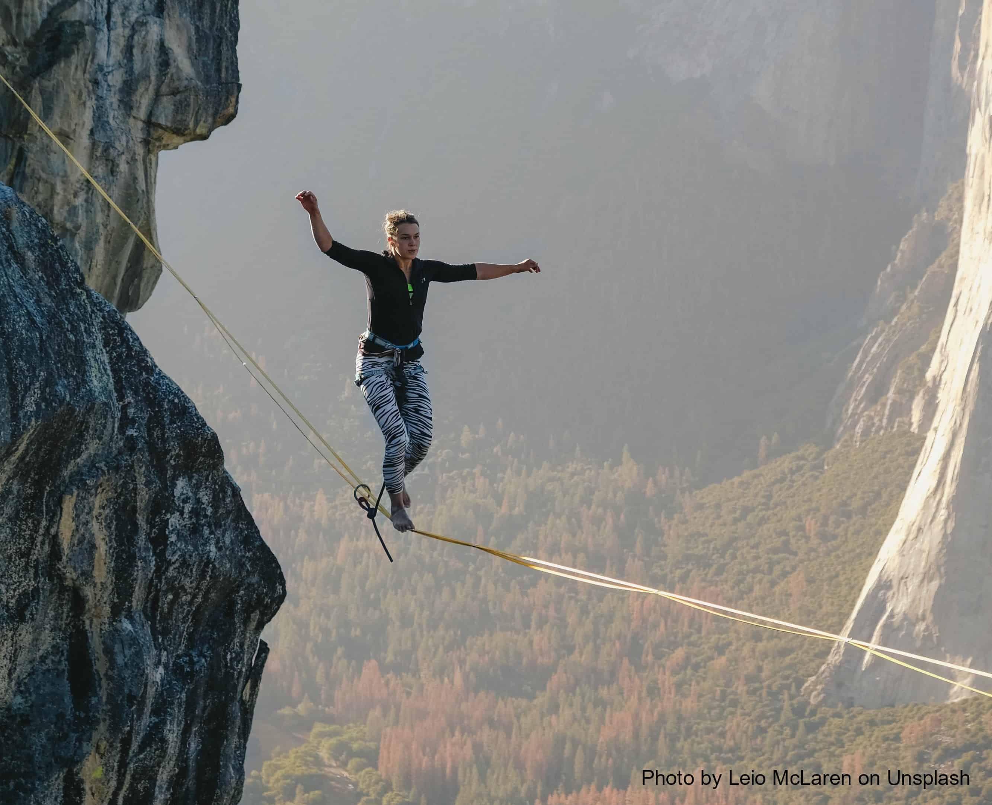
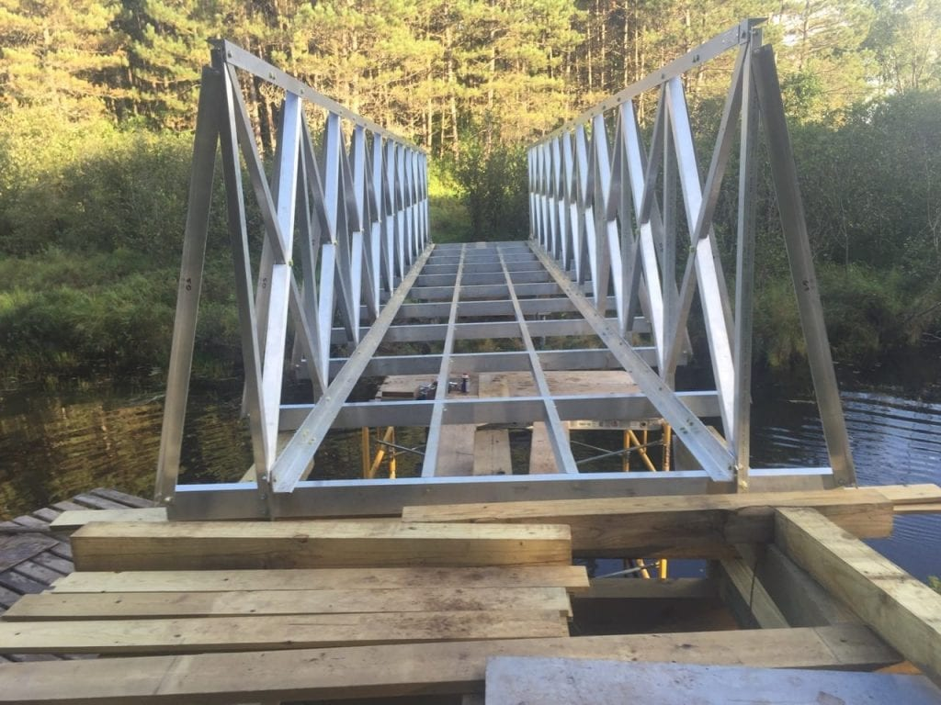
Bridge Width Matters
Narrow
Rope Bridge
Wide
Stone Bridge
Long but Weak
Wide and Strong
Good for information
Good for adoption
"Length enables reach; width sustains adoption."

Slide 7
Mechanisms of Complex Contagion
1. Strategic Complementarity
2. Credibility
Innovations are costly for early adopters. Benefits depend on the number of prior contributors—the critical mass needed for adoption.
Innovations lack credibility until adopted by neighbors. Multiple confirmations increase trust before reporting to others.
3. Legitimacy
4. Emotional Contagion
Having several close friends participate increases acceptance. Critical mass of early adopters needed to avoid being shunned.
Expressive impulses can be communicated and amplified in spatially and socially concentrated gatherings.

Slide 8
Centola (2010) Experiment
Testing Complex Contagion Online
Online health behavior study
N = 1,528 participants
Identical average degree (Z = 6)
Different network topologies
Clustered Network
High local clustering Overlapping neighborhoods
✓ 53.7% adoption
Random Network
Low clustering Long-range shortcuts
✗ 38.3% adoption
Result:
Clustered networks had faster and wider adoption than random networks

Slide 9
Reinforcement Accelerates Diffusion
Key Findings:
Each additional exposure increases adoption probability
Clustering promotes repeated confirmation
Not redundancy—reinforcement
Empirical Validation:
2+ signals → 2× more likely to adopt 3+ signals → even stronger effect

Slide 10
Let's Talk
1. Where in social life do we see complex contagion?
2. How does risk or cost affect the kind of contagion?
3. Does social media make contagion simpler or more complex?

Slide 11
Social Reinforcement & Collective Action
Movement Diffusion Through Networks
1964
2011
2017
2020
Freedom
Summer
Arab
Spring
#MeToo
BLM
Social movements rely on redundant, trusted ties for mobilization
Reinforcement builds courage and collective efficacy
High-risk activism requires multiple sources of social support

Slide 12
Key Insights
1. Costly behaviors require reinforcement (complex contagion)
2. Dense clusters build resilience; randomness builds reach
3. Movements spread when network structure matches behavioral demands

