Slide 1
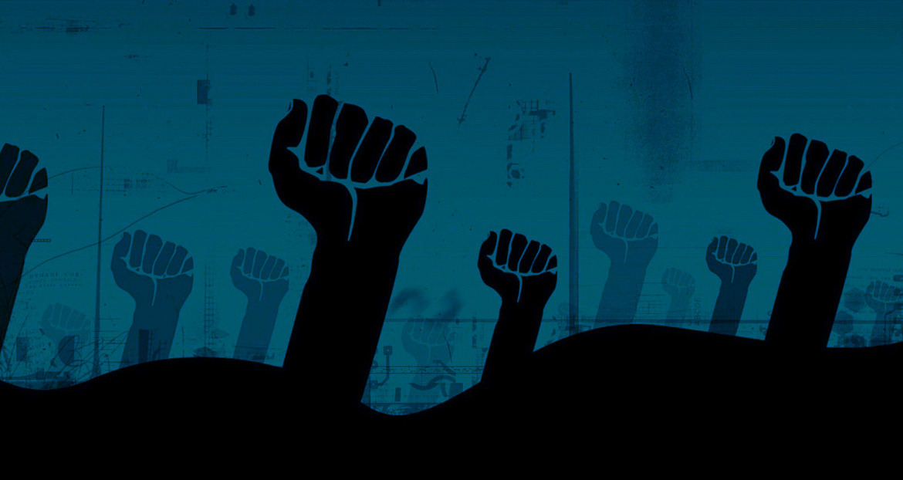
Collective Behavior: From Thresholds to Contagions
Agent-based modeling, crowd theory, and social movements
Fall 2025

Slide 2
Learning Objectives
Understand classical and modern theories of collective behavior
Explain Granovetter's threshold model and its dynamics
Distinguish between simple and complex contagions
Connect agent-based models to contemporary social movements

Slide 3
Agenda
Historical Theories
Segregation & ABMs
Threshold Models
Contagion Types
Networks & Media
Resources vs Grievances
Applications
Summary & Next Steps

Slide 4
Historical Theories of Collective Behavior
Le Bon's Crowd Psychology
Emergent Norm Theory
Value-Added Theory
Structural conduciveness
Structural Strain
Generalized beliefs
Precipitating factors
Mobilization for action
Social control
Submergence in crowd
Contagion of emotions
Suggestibility increases
Critics: oversimplifies crowd behavior
Norms emerge during events
Not irrational behavior
Situational definitions
Collective action follows norms
Notes:
Le Bon’s perspective is associated with deindividuation theory. Crowd’s weaken personal control (e.g., feelings of guilt or shame).
VAT (Smelsner): These six determinants are structural conduciveness, structural strain, generalized beliefs, precipitating factors, mobilization for action, and social control.

Slide 5
From Segregation Models to Collective Behavior
Micro-level preferences generate macro-level patterns
Mild preferences can lead to high segregation
Individual thresholds underpin emergent behavior
Sets foundation for Granovetter's model

Slide 6
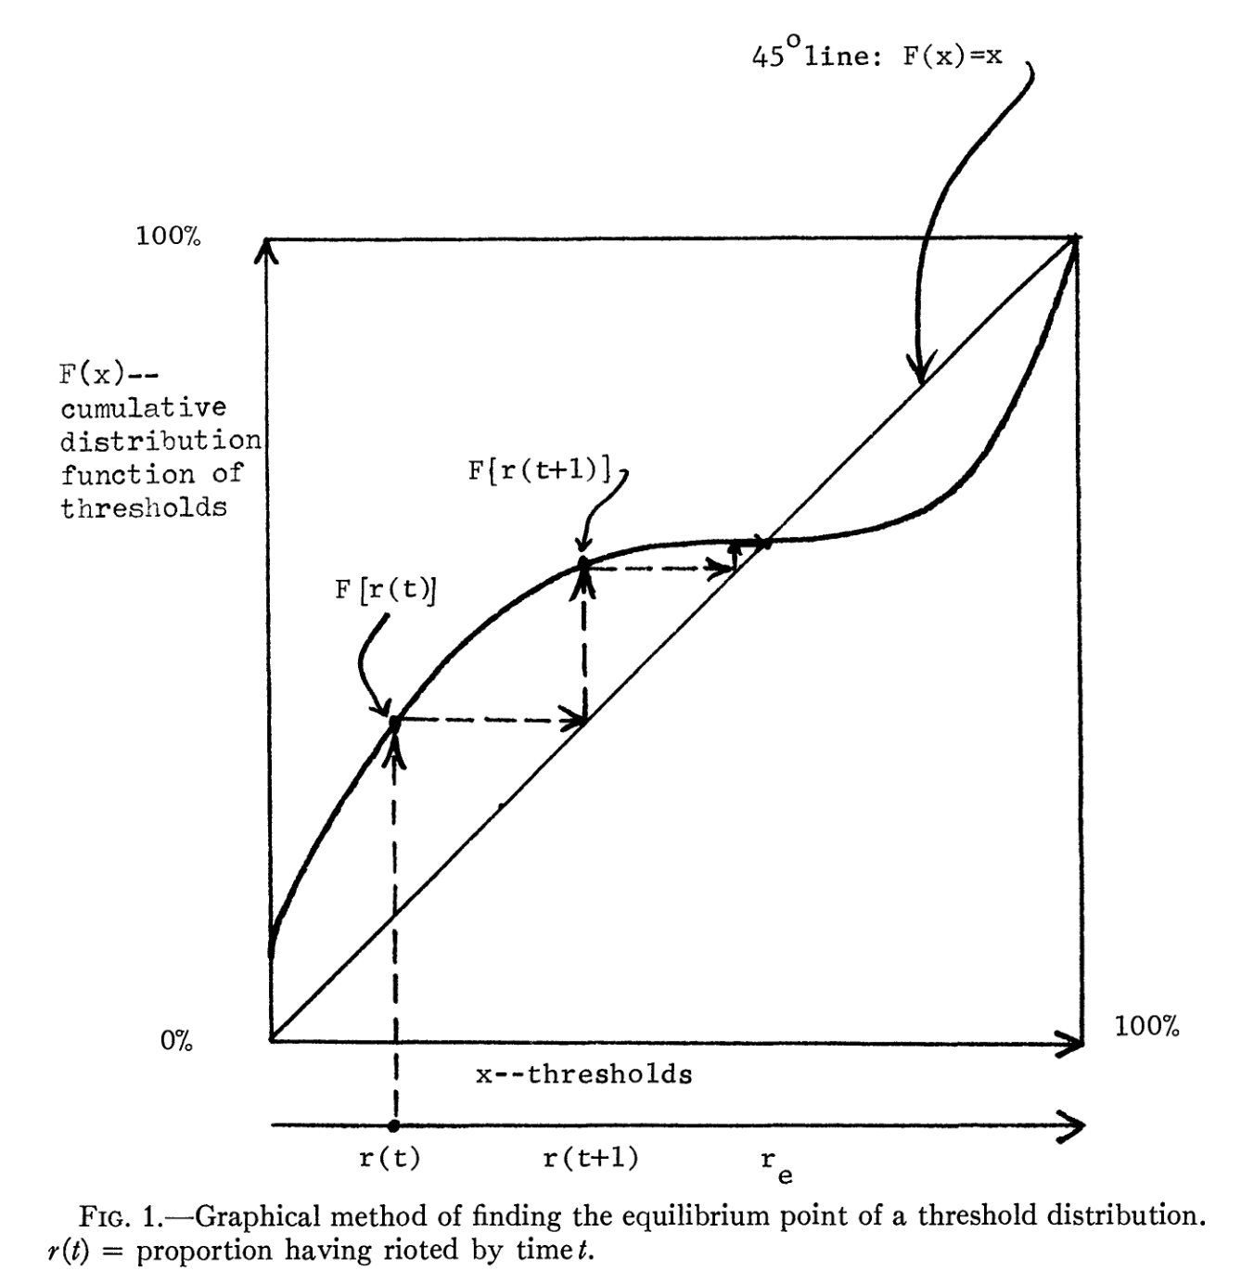
Granovetter's Threshold Model
Threshold
Proportion of others who must act before an individual participates
Types of Actors
Low: Instigators
High: Conservatives
Small changes in threshold distribution can trigger cascades

Slide 7
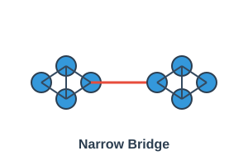
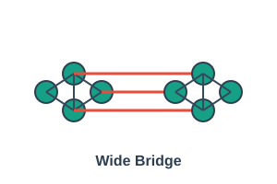
Simple & Complex Contagions
Simple Contagions
Complex Contagions
Single exposure suffices
Examples: disease, gossip, information
Weak ties accelerate spread
Bridges connect clusters
Requires social reinforcement
Multiple exposures needed
Strong ties and dense networks
Wide bridges enable adoption

Slide 8
Networks & Social Media
Social media creates informal networks for celebrations, campaigns, and fundraisers
Platform control and national restrictions demonstrate its power
Reflects fundamental human need for communication
Enables rapid information diffusion across geographic boundaries
Complex Contagions Online
Movements like Arab Spring and Black Lives Matter relied on social reinforcement via online networks, creating wide bridges

Slide 9
Resource Mobilization vs. Grievances
Resource Mobilization
Grievance-Based
Moral, cultural resources
Organizational capacity
Material resources
Human capital
Views movements as rational, professional entities
Relative deprivation
Moral shocks
Perceived injustice
Collective identity
Emotional motivation for action
Movements require both grievances and resources

Slide 10
Applications of Threshold & Contagion Models
Riots & Sampling
Technology Adoption
Social Movements
Slight threshold changes trigger riots
Sampling variability matters
Tipping points unpredictable
Ice Bucket Challenge
Arab Spring
Black Lives Matter
Complex contagions
Solar panels
Electric vehicles
Digital innovations
Require reinforcement

Slide 11
Summary & Takeaways
1
Collective behavior emerges from interdependent individual decisions
2
Early crowd theories evolved into sophisticated sociological perspectives
3
Granovetter's threshold model reveals tipping points and sensitivity to distributions
4
Simple vs. complex contagions differ in required reinforcement and tie strength
5
Social media and networks play critical roles in modern movements

Slide 12
Next Steps & Discussion
Coming Up
Thursday: NetLogo contagion lab
Next Tuesday: Social movements session with readings from Tilly
Consider: How to incorporate resource mobilization and grievances into ABMs
Discussion Question
How would you design an agent-based model to study a movement like the Arab Spring?

