Slide 1
The Sociology of Segregation
Landmark Ideas • Measures • Mechanisms
Notes:
We'll move from Du Bois to contemporary measures and end by asking why modeling is useful.

Slide 2
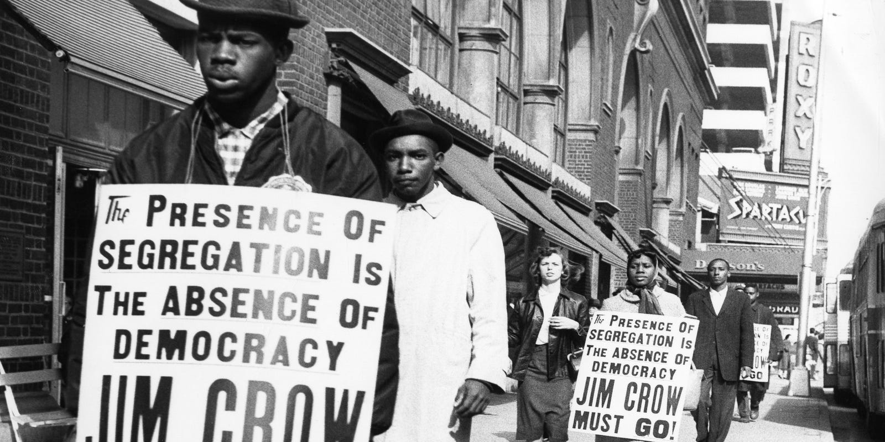
Agenda
📚
📏
⚙️
🔬
History
Measurement
Mechanisms
Modeling
Du Bois → Today
Indices & Meaning
How & Why
ABM Applications
Notes:
.

Slide 3
Why Study Segregation?
🏫
⚖️
🔄
Life Chances
Persists
Emergence
Schools, jobs, health
Despite formal equality
Micro → Macro patterns

Slide 4
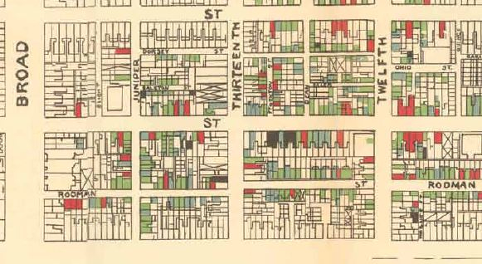
W.E.B. Du Bois: The First Data Scientist (1899)
The Philadelphia Negro
✓ Empirical maps
✓ Survey methodology
✓ Data visualization
✓ Structural analysis

Slide 5
Chicago School: Ecological Zones
Park • Burgess • McKenzie
Limits of ecological metaphor
What about racial hierarchy & policy?

Slide 6
Timeline
1930s: HOLC Redlining
1940s: FHA/VA Underwriting
1948: Shelley v. Kraemer
1950s: Suburban Exclusion
1960s+: Zoning Laws

Slide 7
Two Forms of Segregation
DE JURE
DE FACTO
Law & Policy
Practice & Behavior
📜 Restrictive Covenants
🏛️ Exclusionary Zoning
⚖️ Explicit Legal Rules
💰 Credit Access
🏠 Real Estate Steering
👥 Social Networks

Slide 8
American Apartheid (1993)
Massey & Denton's Breakthrough
HYPERSEGREGATION
Key Finding:
Not just one dimension—multiple forms of separation compound

Slide 9
Five Dimensions of Segregation
EVENNESS
Distribution
CLUSTERING
EXPOSURE
Contiguity
Contact
CENTRALIZATION
CONCENTRATION
Core proximity
Space
Notes:
Not just one index; a profile of separation.
Evenness is the degree to which the percentage of minority members within resdential areas equals the citywide minority percentage; as areas depart from the ideal of
evenness, segregation increases.
Exposure is the degree of potential contact between minority
and majority members; it reflects the extent to which groups are exposed to one another by
virtue of sharing neighborhoods in common.
Clustering is the extent to which minority
areas adjoin one another in space; it is maximized when minority neighborhoods form one
large, contiguous ghetto and minimized when they are scattered widely in space.
Centralization is the degree to which minority members are settled in and around the center of an
urban area, usually defined as the central business district.
Finally, concentration is the
relative amount of physical space occupied by a minority group; as segregation rises, minority
members are increasingly concentrated within a small, geographically compact area

Slide 10
Contemporary Patterns
↑
↑
↔
↑
Suburban Diversity
Black-White Evenness
School Segregation
Economic Segregation
Complex & Uneven Change

Slide 11
Measure 1: Dissimilarity Index (D)
Before:
After:
D = % who must move for evenness

Slide 12
Measure 2: Isolation & Exposure (P*)
Group A
?
Group B
Probability of same-group or different-group contact

Slide 13
Measure 3: Theil's H / Entropy
Group A
Group B
Group C
Group D
Captures multigroup evenness (not just binary)

Slide 14
Measure 4: Spatial Statistics
Moran's I & Spatial D
Captures geographic clustering patterns

Slide 15
Activity: Calculate D
Metro Total: 50% / 50%
Neighborhood A
80% / 20%
Neighborhood B
20% / 80%
Notes:
Answer: D = 0.60

Slide 16
Four Mechanisms of Segregation
❤️
🚫
🏛️
🔗
Preferences
Discrimination
Institutions
Networks
Tolerance
Homophily
Credit
Steering
Zoning
Schools
Info flow
Markets

Slide 17
Evidence Base
📊
Audit Studies
→
Discrimination persists
💳
Credit Analysis
→
Appraisal gaps
⚖️
Legal Review
→
Zoning excludes
🔍
Network Studies
→
Constrained search

Slide 18
Two Interlocking Systems
Individual
Cognition
Structural
Systems
They reinforce each other!

Slide 19
Why Agent-Based Modeling?
MICRO
RULES
EMERGENCE
MACRO
PATTERNS
Test mechanisms • Explore sensitivity • Visualize dynamics

Slide 20
Schelling Model
Simple rule → Complex pattern
Random Start
Segregated End

