Slide 1
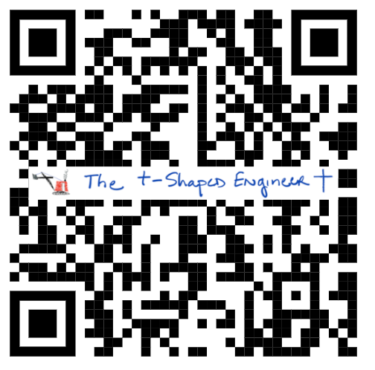
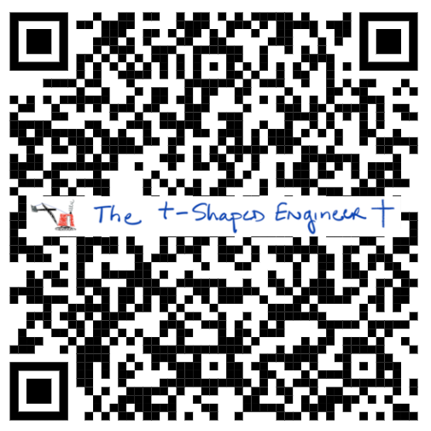
A Roadmap for Integrating AI into Christian Engineering Education
Substack Book
Dr. Michael McGinnis
Dean of Engineering and Engineering Technology
LeTourneau University

Slide 2
Wipeout
Substack Book

Slide 3
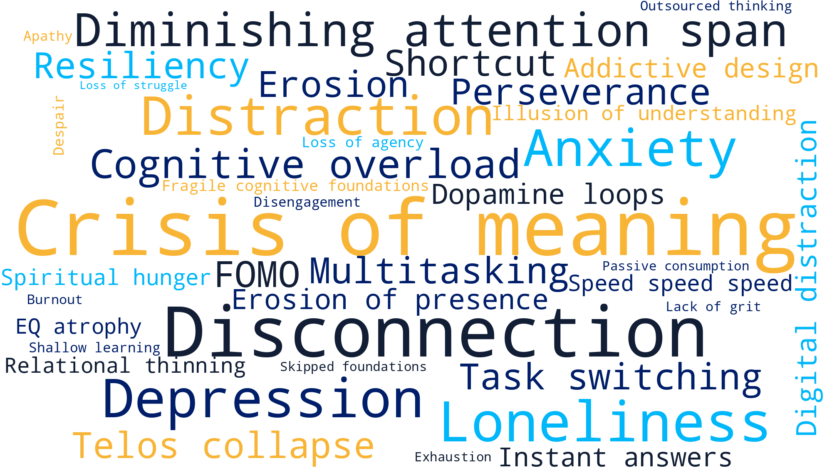
The Cultural Moment

Slide 4
The Moment
  🔍 Cognitive Science & Learning
    Bjork & Bjork (2011) – Desirable Difficulties: Effortful learning enhances retention
    Bransford et al. (2000) – How People Learn: Brain-based learning and metacognition.
    Duckworth (2016) – Grit: Passion and perseverance as predictors of success.
    Frankl (2006) – Man’s Search for Meaning: Meaning-making as essential to flourishing.
  📱 Digital Distraction & AI
    Greenfield (1999) – Virtual Addiction: Early warning - addictive design of digital environments.
    Kang (2024) – The Illusion of Learning (New Yorker): AI may simulate understanding but can erode deep learning.
    Lui & Wong (2020) – Cognitive limitations of multitasking and task-switching.
    Zhai, Wibowo & Li (2024) – AI dialogue systems reduce critical thinking and perseverance.
    Ward et al. (2024) – AI use improves GPA but weakens deep learning and engagement.
  🧠 The Crisis of Meaning
    Taylor (2007) – A Secular Age: The “buffered self” and the loss of default belief.
    Burton (2020) – Strange Rites: Remix spiritualities and the search for meaning in secular culture.
    Frankl (2006) – Repeated here for its relevance to vocational clarity.
    Putnam (2000) – Bowling Alone: Decline of social capital and communal life.
    Cox (2024) – The State of American Friendship: Declining friendship, especially among men; loneliness as epidemic.

Slide 5

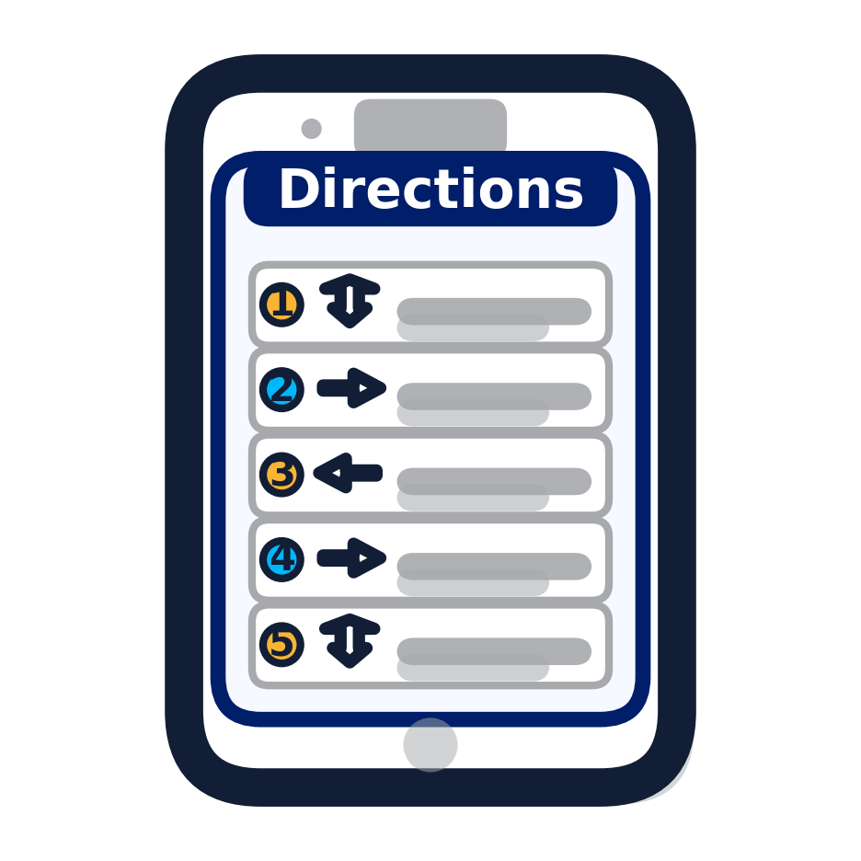

Agenda and Outline
Compass
Roadmap
Turn-by-turn

Slide 6
Agenda and Outline
Compass
Roadmap
Turn-by-turn
2x2 Matrix for AI Formation
The t-Shaped Engineer Model
Transformation Initiatives

Slide 7
AI Formation Mindset
Student Posture

Slide 8
AI Formation Mindset
Get-To
Student Posture
Have-To

Slide 9
AI Formation Mindset
Get-To
Student Posture
Faculty Approach
Have-To

Slide 10
AI Formation Mindset
Get-To
AI-Proofed
AI-Enhanced
Student Posture
Faculty Approach
Have-To

Slide 11
AI Formation Mindset
Get-To
Purposeful and Protective
Joyful and Wise
AI-Proofed
AI-Enhanced
Student Posture
Faculty Approach
Resistant and Rigid
Efficient but Empty
Have-To

Slide 12
AI Formation Mindset
Get-To
Ethical rigor with intrinsic motivation
Students value challenge
Faculty resist AI but inspire ownership
Formation for foundational concepts
AI-Proofed
AI-Enhanced
Student Posture
Faculty Approach
Compliance driven education
Focus on cheating prevention
Low engagement, high resistance
Superficial AI use
Students use tools without ownership
Faculty adopt tech without pedagogy
Have-To

Slide 13
AI Formation Mindset
Get-To
Ethical rigor with intrinsic motivation
Students value challenge
Faculty resist AI but inspire ownership
Formation for foundational concepts
Transformative learning
AI used to deepen understanding
Faculty & students co-evolve
AI-Proofed
AI-Enhanced
Student Posture
Faculty Approach
Compliance driven education
Focus on cheating prevention
Low engagement, high resistance
Superficial AI use
Students use tools without ownership
Faculty adopt tech without pedagogy
Have-To

Slide 14
Agenda and Outline
Compass
Roadmap
Turn-by-turn
2x2 Matrix for AI Formation
The t-Shaped Engineer Model
Transformation Initiatives

Slide 15
T-Shaped Engineer
T-Shaped
  British Computer Society, Colin Palmer, Michael Earl, Templeton College Oxford, David Guest 1991 The Independent
  Leonard-Barton 1995 Wellsprings of Knowledge, Harvard Business School Press
  Dean James Plummer, Stanford 2011
  J. Tranquillo “The T-Shaped Engineer” Journal of Engineering Education Transformation, 2017

Slide 16
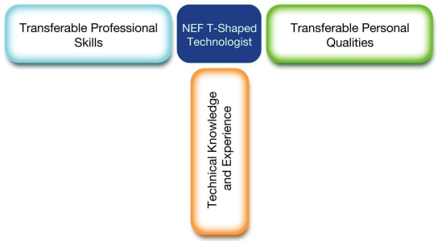
T-Shaped Engineer
T-Shaped
  As originally coined, the term referred to people with deep learning and skills in one technical area who could also function across multi-disciplinary teams (contrast with I-shaped)
Medhat, Peers
“T-Shaped Learning for the New Technologist, The Innovation Institute, 2012

Slide 17
T-Shaped Engineer
T-Shaped
  “those with technical depth as well as cross-disciplinary breadth” Tranquillo, 2017

Slide 18
T-Shaped Engineer
Communication
Grit
Drive
Motivation
Leading
Following
Relationship Building
Ethics
T-Shaped – McGinnis 2020
Professional (Soft) Skills
Ohm’s Law
Thermodynamics
Statics
Hooke’s Law
Kinematics
Reaction kinetics
Technical Skills

Slide 19
T-Shaped Engineer
Communication
Grit
Drive
Motivation
Leading
Following
Relationship Building
Ethics
T-Shaped – McGinnis 2023
Relationship Skills
Ohm’s Law
Thermodynamics
Statics
Hooke’s Law
Kinematics
Reaction kinetics
Technical Skills

Slide 20
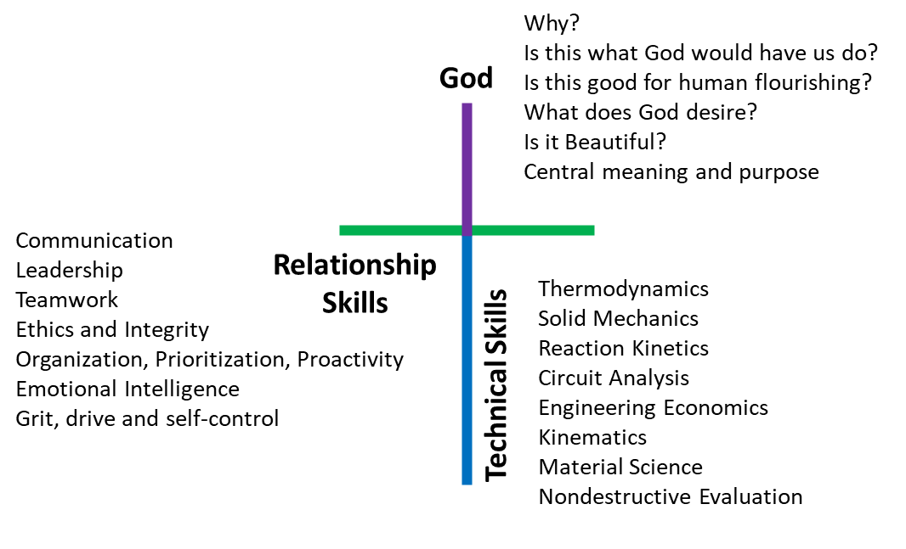
t-Shaped Engineer*
t-Shaped –
*McGinnis & Lett “Engineering, Meaning and Faith: Professional Formation of Engineers with Magnitude and Direction,” 2024 Christian Engineering Conference. Best Paper Nominee

Slide 21
t-Shaped Engineer*
Christ-Centered Purpose
t-Shaped –
*McGinnis & Lett “Engineering, Meaning and Faith: Professional Formation of Engineers with Magnitude and Direction,” 2024 Christian Engineering Conference. Best Paper Nominee

Slide 22
Engineering
Working Definition:
Application of math and science to solve problems
Notes:
A slightly better one you sometimes see

Slide 23
Engineering
Working Definition:
Application of math and science to solve problems
Working out of the greatest commandment – to love God and love people through application of math and science to solve problems to benefit the Kingdom
Notes:
A slightly better one you sometimes see

Slide 24
Agenda and Outline
Compass
Roadmap
Turn-by-turn
2x2 Matrix for AI Formation
The t-Shaped Engineer Model
Transformation Initiatives

Slide 25
Five Initiatives for Transformation
  Reframe: “Get-To” culture

Slide 26
Five Initiatives for Transformation
  Reframe: “Get-To” culture
  Embed: critical AI engagement in courses

Slide 27
Five Initiatives for Transformation
  Reframe: “Get-To” culture
  Embed: critical AI engagement in courses
  Equip: faculty with PERMA tools

Slide 28
Five Initiatives for Transformation
  Reframe: “Get-To” culture
  Embed: critical AI engagement in courses
  Equip: faculty with PERMA tools
    Faculty development that helps instructors build classroom cultures supporting flourishing (Positive Emotion, Engagement, Relationships, Meaning, Accomplishment)

Slide 29
Five Initiatives for Transformation
  Reframe: “Get-To” culture
  Embed: critical AI engagement in courses
  Equip: faculty with PERMA tools
  Train: students in prompting + discernment

Slide 30
Five Initiatives for Transformation
  Reframe: “Get-To” culture
  Embed: critical AI engagement in courses
  Equip: faculty with PERMA tools
  Train: students in prompting + discernment
  Launch: Gen Ed “AI & Human Flourishing”

Slide 31
Summary
  Cultural moment
    Disconnection, crisis of meaning, digital distraction, loss of telos
  Compass
    2x2 Matrix for AI Discernment (Get-To and AI Enhanced = Joyful and Wise)
  The t-Shaped Engineer
    Technical, relational and Christ-centered purpose
  Transformational initiatives
    Reframe (Get-To), Embed (AI engagement), Equip (faculty training), Train (AI prompting), Launch (General Education)

Slide 32
Commissioning – Something to Say
Substack Book

Slide 33
Back-Up Slides

Slide 34
Five Initiatives for Transformation
Cultivate a “Get‑To” culture
  Reframe learning as vocation and privilege rather than obligation (“have‑to”)
Embed critical engagement with AI into the curriculum
  Make AI a visible, explicit part of coursework in ways that teach wise, critical use rather than naïve adoption or avoidance.
Equip faculty through workshops on the PERMA model of well‑being
  Faculty development that helps instructors build classroom cultures supporting flourishing (Positive Emotion, Engagement, Relationships, Meaning, Accomplishment)
Train students in AI prompting and discernment
  Explicitly teach prompt craft and, crucially, the judgment to know when/why/how to use AI in ways that support formation rather than shortcut it.
Launch a new general education course: “AI and Human Flourishing”
  A campus‑wide course framing AI through technological, ethical, and spiritual dimensions—aimed at formation and human flourishing.

