Slide 1
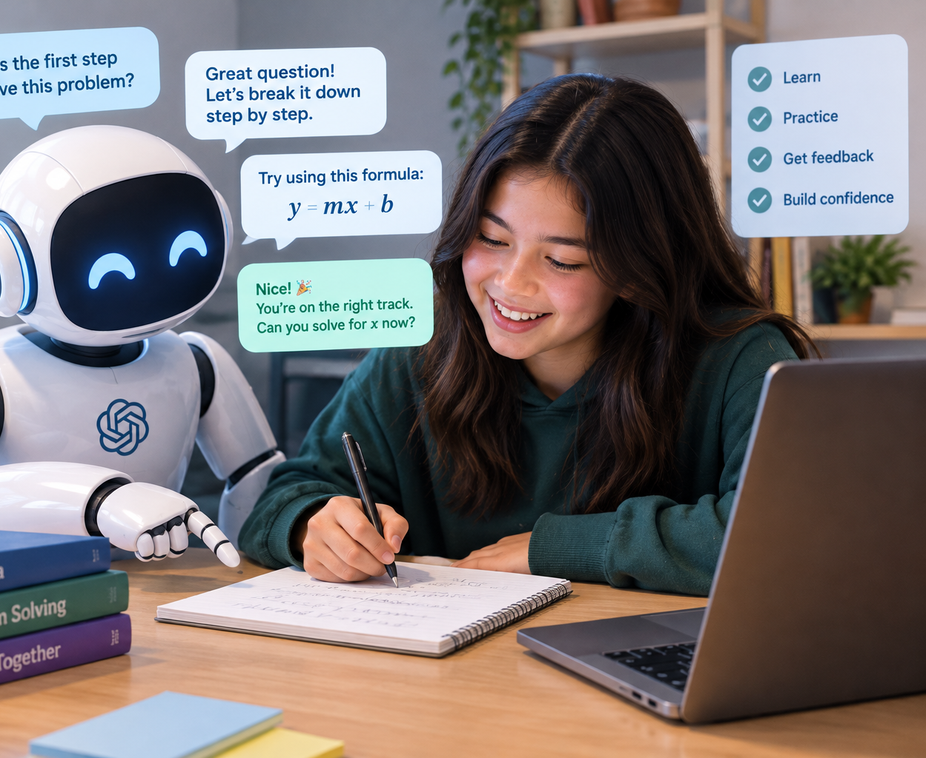
Leveraging AI to extend learning without short-circuiting understanding
Herb Fynewever
Professor of Chemistry
Calvin University
Herb.Fynewever@calvin.edu

Slide 2
Learning requires effort
Learning is facilitated by active retrieval
Students remember what they repeatedly recall, not what they merely reread
Testing is a learning event, not just an assessment event

Slide 3
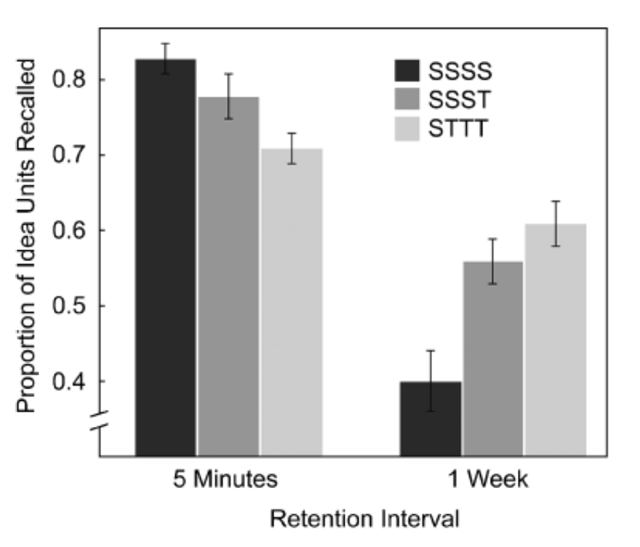
Retrieval practice evidence
Repeated testing outperforms repeated study for long-term retention
Benefits persist over days to weeks
Retrieval improves conceptual understanding, not just recall
Example of “desirable difficulty”
Roediger and Karpicke, Psychological Science, 2006.

Slide 4

Traditional STEM pedagogy is somewhat aligned with retrieval practice
Lecture → guided examples → homework → quizzes → tests → exam
The most effective part of the learning happens when students struggle working through homework problem sets, retrieving knowledge repeatedly.

Slide 5
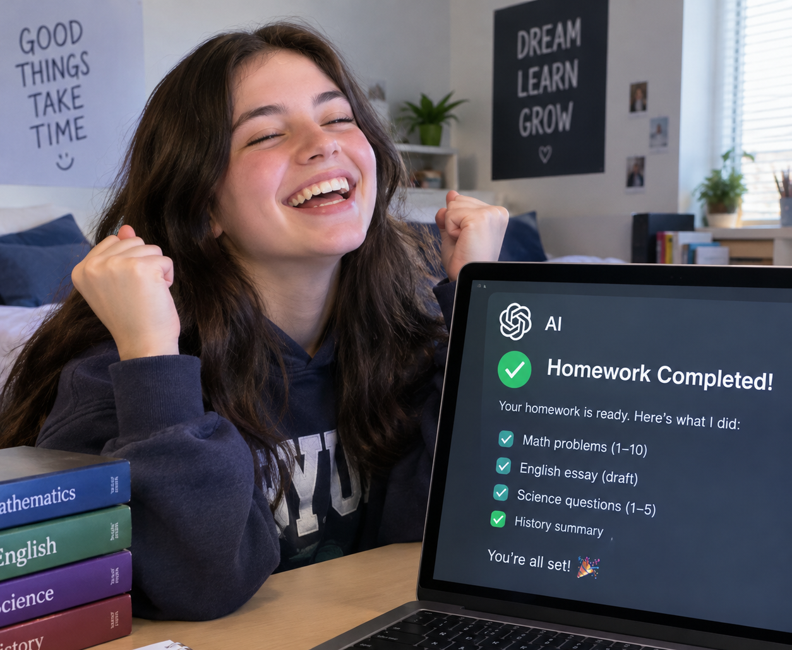
How AI can short-circuit learning
When AI become an answer generating machine
Product replaces process
Difficulty disappears
Retrieval practice is bypassed
Students experience an illusion of understanding (“that answer makes sense”)

Slide 6
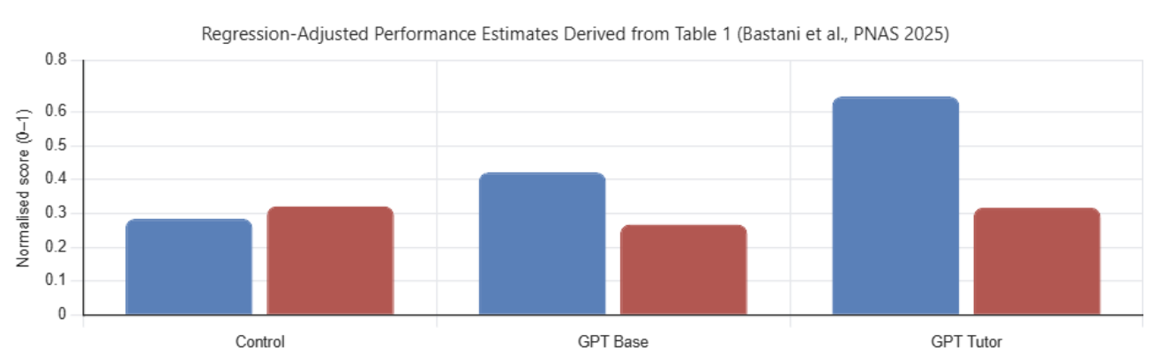
Univ of Penn study: AI with and without guidance
Nearly 1000 high school math students in Turkey, control + two treatment groups
GPT Base (no restrictions or guidance):
  +48% in practice performance but -17% exam performance after AI was removed
  Students often directly asked for answers and copied results
GPT Tutor
  Hints instead of answers
  Guidance through mistakes
  Best on practice performance and matched control on exam performance
Bastani et al. Proceedings of the National Academy of Sciences, 2025.

Slide 7
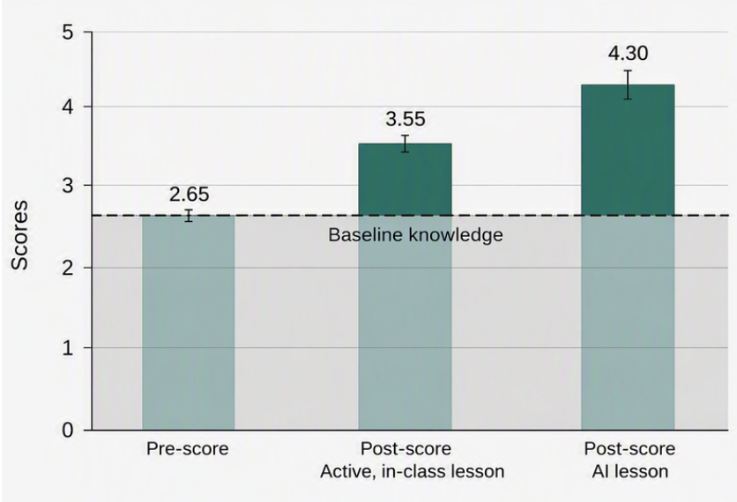
Harvard physics study: AI as interactive tutor
A structured GPT-4 tutor built around active learning principles outperformed an active learning classroom in a randomized, controlled trial
Key feature: students actively engaged with questions, feedback, scaffolding, and self-paced learning.
Kestin et al. Scientific Reports (2025)

Slide 8
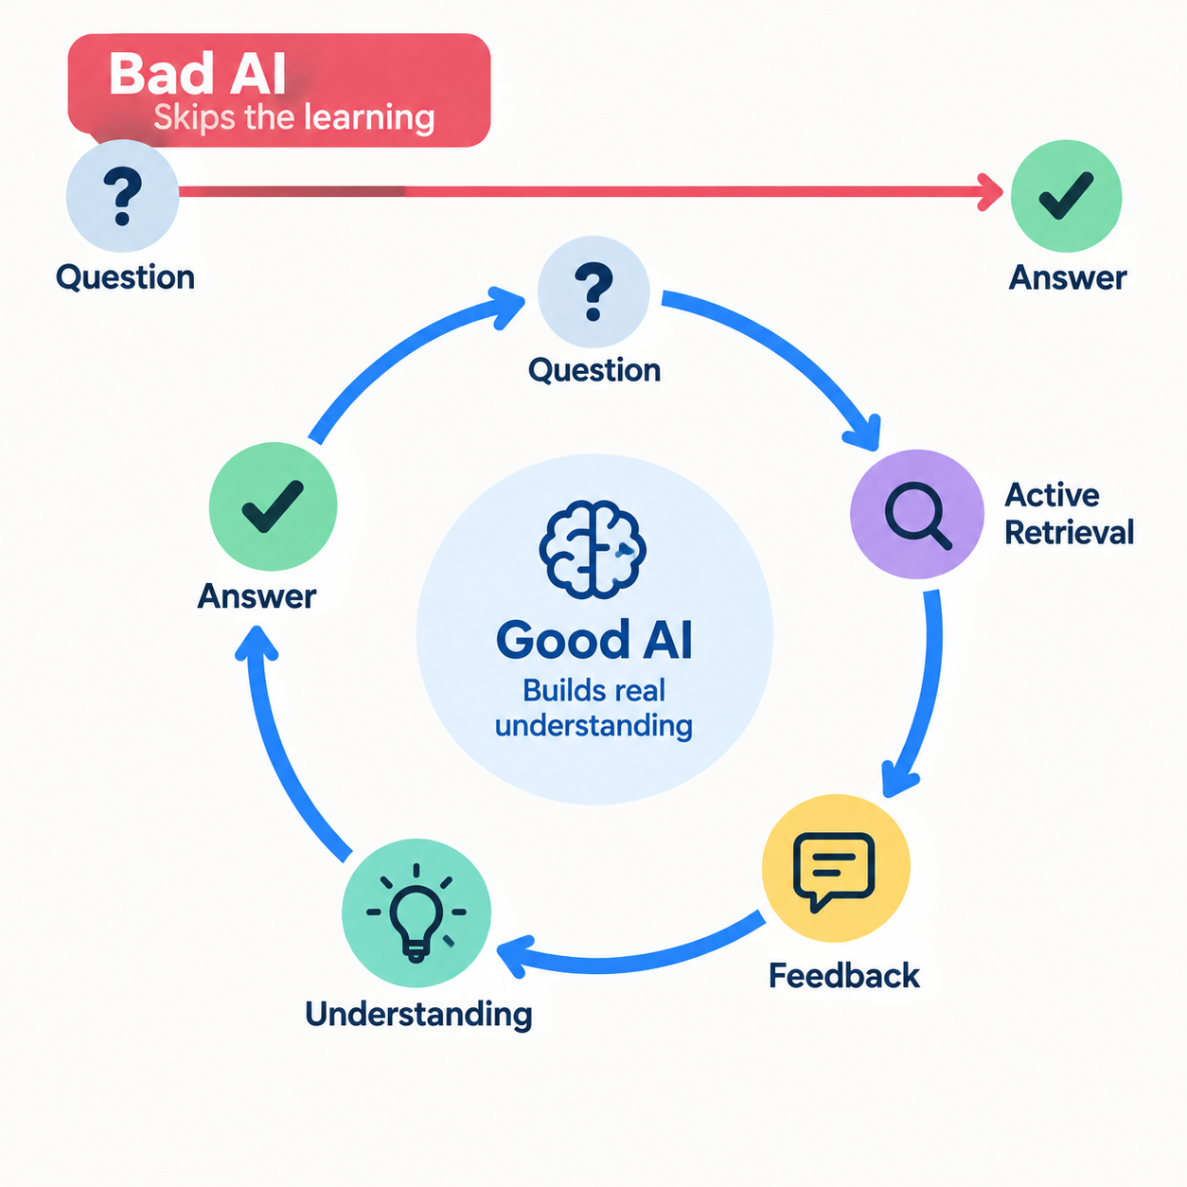
A conceptual model

Slide 9
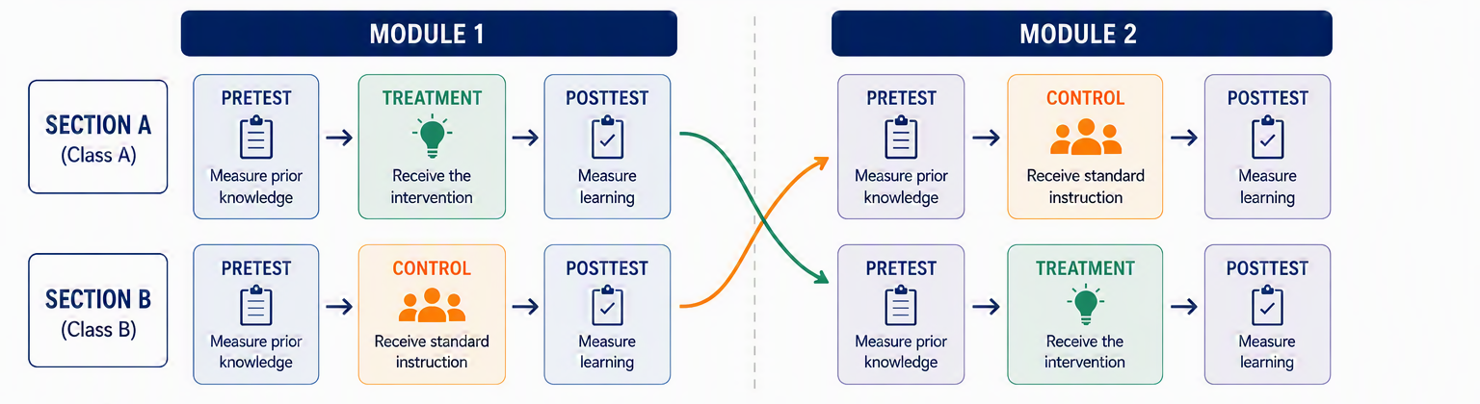
Calvin Chemistry Study (Planned)

Slide 10
Takeaways
Learning requires effortful retrieval
Unguided AI can improve immediate performance while reducing learning
Properly designed AI tutors can restore or exceed classroom learning
Future work will include going to new, complex learning outcomes
herb.fynewever@calvin.edu

