Slide 1
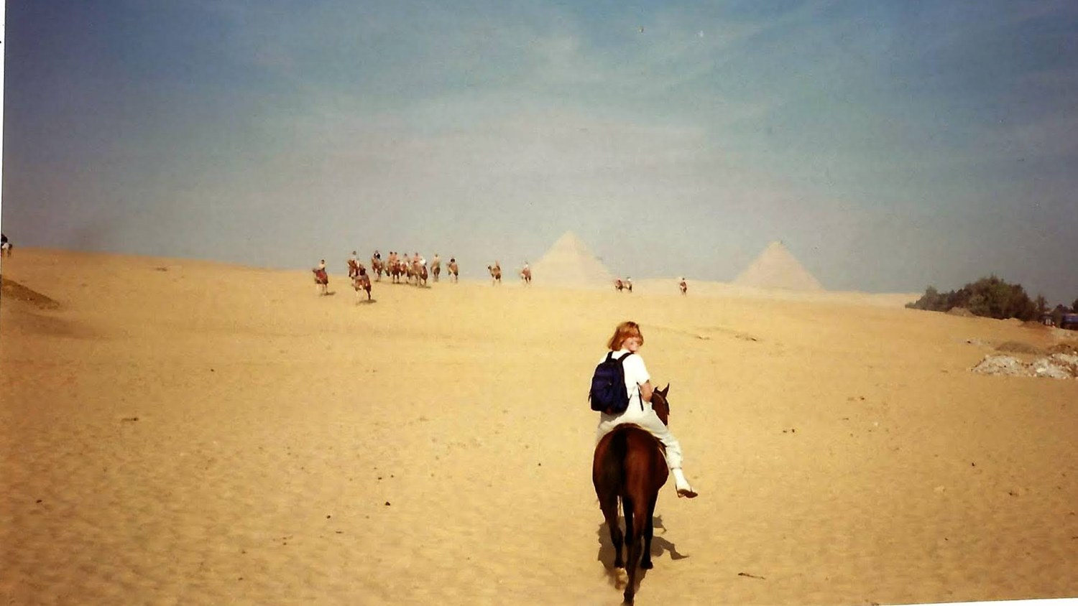
What Does It Take to Be Wise?
Moving beyond alarm and governance in the Christian AI conversation
Rachel Wondergem · Wisdom in the Age of AI · Calvin University · October 8, 2026
Notes:
Let me start with one second. I was on a horse, in Egypt, at a full gallop, when a camel came over the dune straight at us. We had one second to react, and only one of us did.
I think all of us are in a second like that right now. We're riding through the world we expected — and a different one is arriving, faster than we can read it. We’ll come back to that second. But first — what happened on the horse.

Slide 2
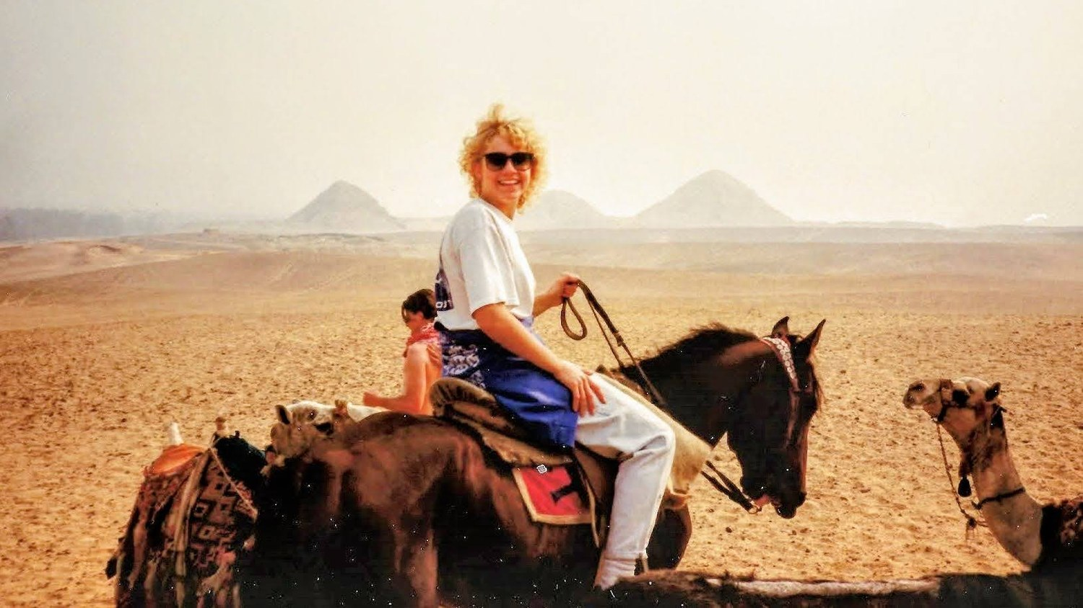
Egypt, 1989. Exhibit A: the perm.
Notes:
So. Egypt. When I was here at Calvin I spent a semester overseas, with my friend who is here today – Elaine - and it included a trip to Egypt — and if you're wondering how long ago this was, look no further than my cringe-worthy permed hair.

Slide 3
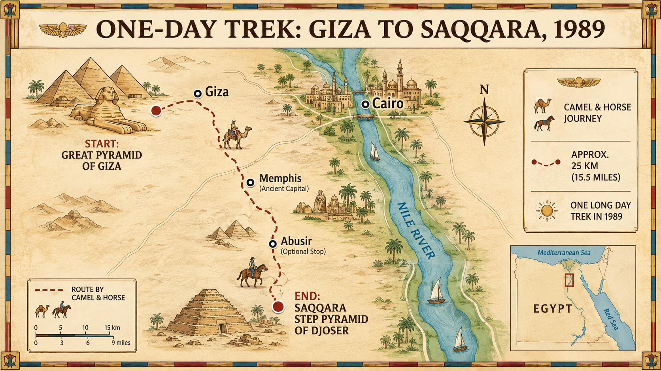
Notes:
§2. On a sunny November day we rode across the desert on camels and horses, between the Great Pyramids of Giza and the Step Pyramid of Djoser. [Click: me and the guide.]

Slide 4
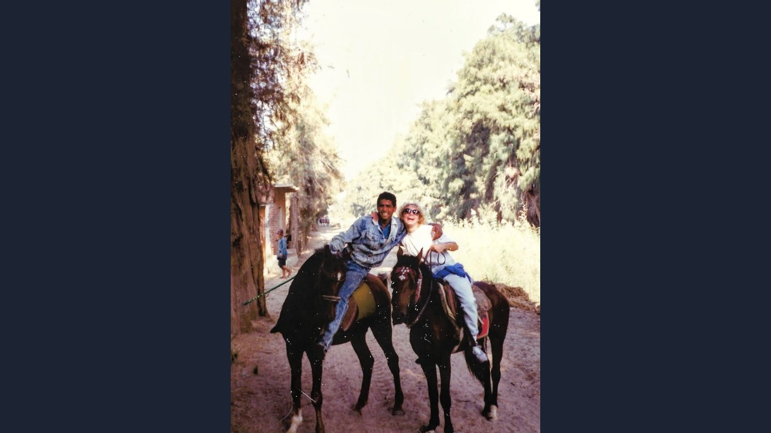
My guide. My horse. My first real ride.
Notes:
§2. Our guide asked if we wanted to gallop. I had never ridden a horse, so of course I said, “yah, let’s go!”. My horse took off at a speed that sent the wind whipping through that hair like a scene from a bad movie. And for a few glorious seconds, I felt nothing but awe. I was in a vast desert, seeing ancient pyramids,with friends. An experience hard to capture with words. [Click: the camels.]

Slide 5
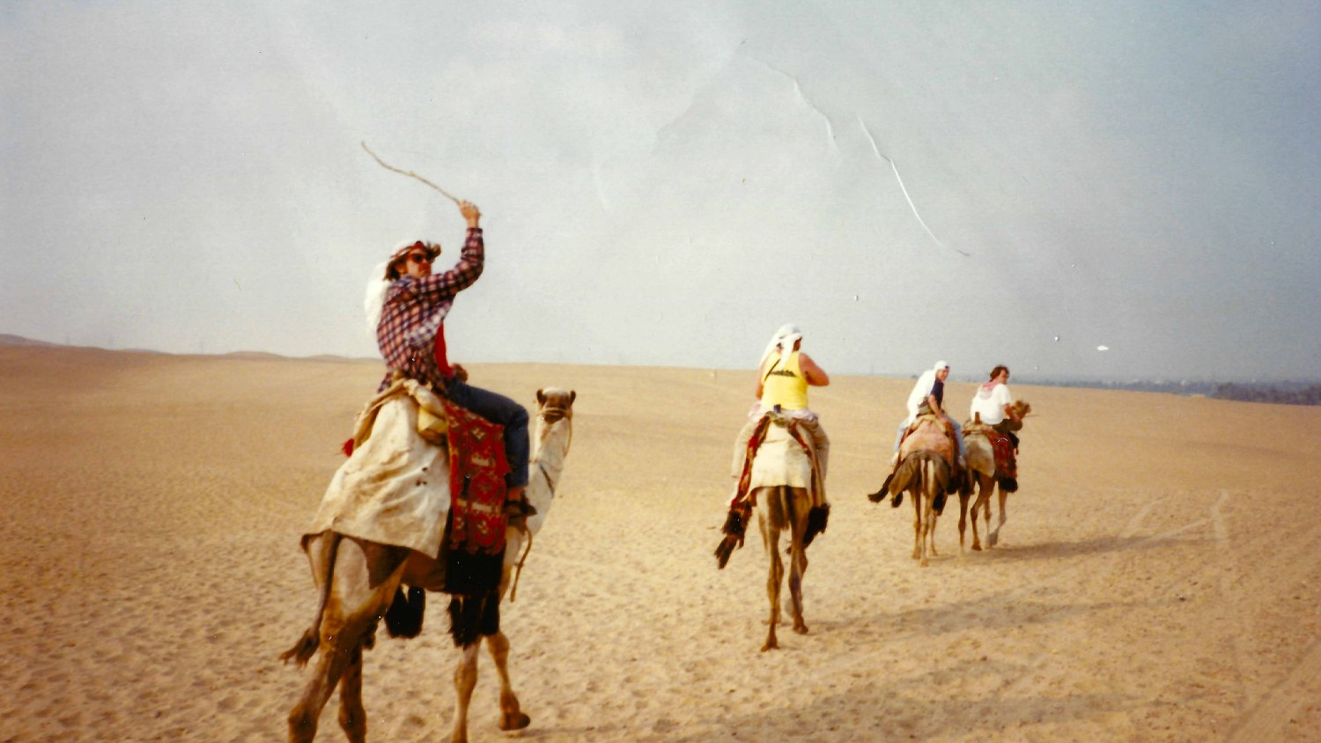
Over the dune.
Notes:
§2. Then we crested a dune — and suddenly, out of nowhere, a group of camels appeared, heading directly toward us. My horse reacted instantly. It veered hard to the right, saving us both from a collision. And at the very same moment, in an astounding display of situational blindness, I did not move at all. Allowing momentum to launch me effortlessly out of the saddle, head over heels, into the sand. Where I did not stick the landing. Thankfully I got up laughing, covered in sand, grateful to be alive. [Click to the dark slide for the last two lines.]

Slide 6
My horse was already responding to the world that had arrived.
I was still riding through the world I expected.
Notes:
§2 . Only later could put these words to what had happened: my horse had responding to the world that had arrived. I was still riding through the world I expected. [Click.]

Slide 7
Which one of us acted more wisely?
Notes:
We were in the same desert, on the same dune, in the same second. But we were seeing very different aspects of reality. I was noticing pyramids, friends, and bad hair. My horse was noticing camel, collision, danger. And based on what we noticed, we acted very differently.
So let me ask you something. Which one of us acted more wisely? I would say, my horse. I'm not claiming the horse had wisdom — I want to be careful there. But I think its action was wiser than mine. It perceived what mattered for the purpose at hand — getting us across that desert in one piece — and it acted.
Now let me ask you a similar question. Suppose I hadn't been on a horse. Suppose I'd been in a Waymo, and the car braked hard to keep me out of a collision. Would you say the car acted wisely?
Notice what just happened in your head. Did you think differently because the agent was a machine rather than an animal? Does it matter that one was biological brain, and the other a silicon chip?
That distinction is part of why we're here today, at a conference called Wisdom in the Age of AI. We usually think of wisdom as a human trait. But what if wisdom describes how an agent — human, animal, or machine — relates to reality? Then we get a better question.

Slide 8
What does it take for any agent to act wisely?
Not: Can a machine be wise?
Notes:
Not can a machine be wise? but what does it take for any agent to act wisely? To answer that, we'll start with a definition of wisdom, seen through the eyes of ancient traditions.

Slide 9
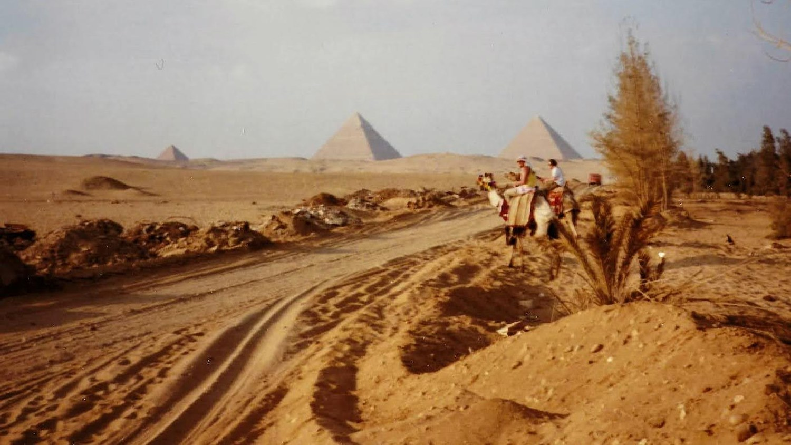
Maʾat
the order woven into the world at its making — the way things are meant to fit together
To live wisely was to live in alignment with the order of things.
Notes:
§4 One of the oldest recorded ideas of wisdom is Egyptian. They called it Ma'at: the order woven into the world at its making, the way things are meant to fit together. To live wisely was to live in alignment with the order of things.

Slide 10
Wisdom traditions
Egypt
Maʾat — living in alignment with the order of things
Hebrew scriptures
skillful living, in right relationship with God, creation, and neighbor
The Greeks
living in accord with the rational order woven through the world
Buddhist traditions
seeing reality clearly enough to live free of illusion
Confucian thought
knowing what is right within relationships, and acting with care
reality has an order · we have a place in it · wisdom is perceiving it truly and acting in alignment with it
Notes:
§4. When I looked at dozens of other traditions, including ones from different continents, languages, and times, I noticed they share a similar structure: reality has an order; we have a place in it; wisdom means perceiving that reality truly and acting in alignment with it. So here's a definition that captures those elements.

Slide 11
Wisdom
is a faithful relationship with reality, achieved when we understand it completely, know our place within it, and act in alignment with it.
1
faithful relationship
2
complete understanding
3
aligned action
reality forms us; we shape reality
only God has it — because he made it
stewards of every square inch
Notes:
§4. is a faithful relationship with reality, achieved when we understand it completely, know our place within it, and act in alignment with it.
Three things in that definition. First, is the faithful relationship. We don't merely exist in reality. We're in an active relationship with it: reality shapes us, even as we shape reality. Genesis is the beginning of this relationship, when God created reality, including us, to be in relationship — to love him and be loved by him.
Second, complete understanding. Perfect wisdom, the kind which could produce perfect actions, would require complete and perfect understanding of all of reality. But reality is too vast for any agent to know all of it. There is one who does know all of reality: the Creator. Which is why only God has perfect wisdom. The rest of us do our best to understand reality and his will as accurately and completely as we can.
Third, action. Wisdom is more than thinking. It shows up in what you do- purpose driven actions.
To sum up. Wisdom is out of reach. A single wise action is not. That's why, on that dune in Egypt, neither my horse nor I possessed wisdom. But my horse acted wisely, because its understanding of reality was sufficient for its vital purpose — to keep us alive. And with that, we've arrived at the most important question of this talk…

Slide 12
How do we come to
understand reality,
relate to it, and
act more wisely over time?
Notes:
How do we come to understand reality,
relate to it, and
act more wisely over time?

Slide 13
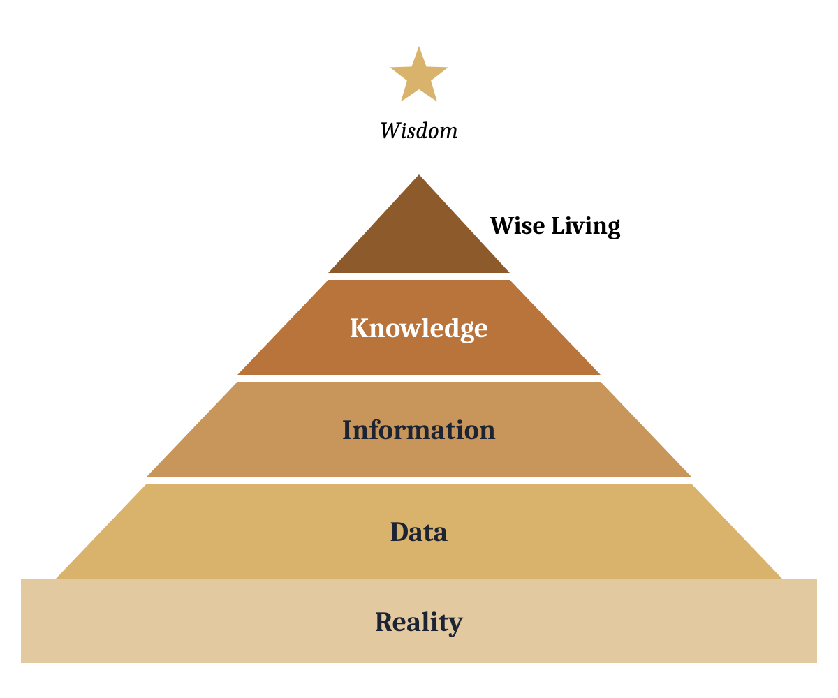
The Wisdom Pyramid
Every agent in relationship with reality builds one.
Notes:
§5 I'm going to answer that with the Wisdom Pyramid. Every agent builds one — a person, a horse, a Waymo. Wisdom sits above the pyramid, like a North Star: out of reach, there to steer by.
Reality is the foundation. It is all that is. The whole world God made, visible and invisible, before time and through eternity. It's the foundation of every pyramid — including yours. But every pyramid, however grand, stands on a sliver of reality. That's why the psalms says, the feat of the lord is the beginning of wisdom.

Slide 14
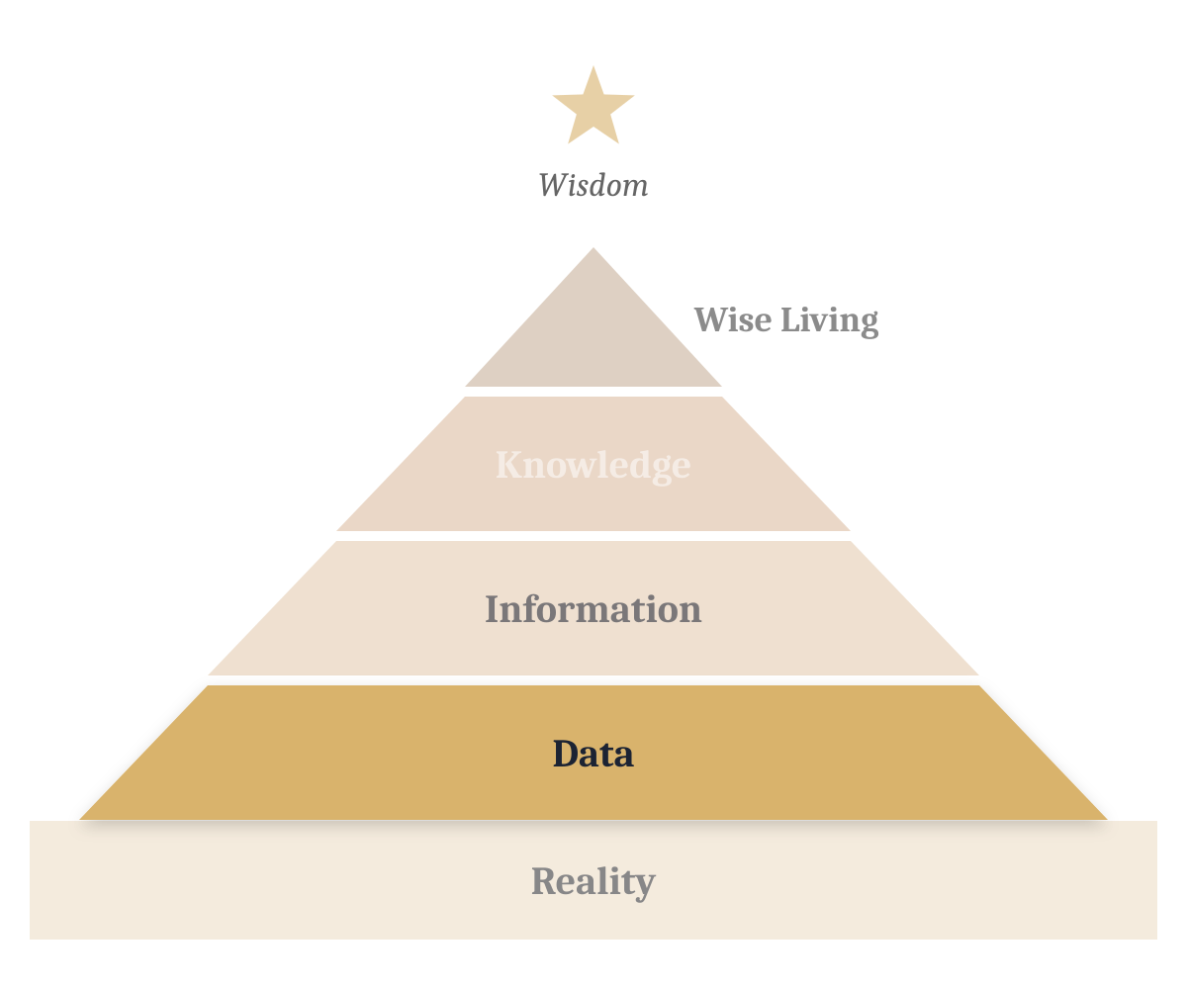
Data
the pieces of reality you detect
Notes:
§5 Data is the pieces of reality you actually detect. For us, detection runs through a body — eyes, ears, skin, memory. But bodies miss more than we think. This room is full of data you aren't detecting right now: ultraviolet light, radio waves, Wi-Fi. Our senses weren't built to capture total truth. They were built to help us survive. So the Data layer often crumbles quietly, because of blind spots – when you think you’re seeing most of reality, but you are not.
Now, AI builds its Data layer differently, almost entirely using secondhand human data, BUT increasingly its generating for itself. At this layer AI is extraordinary — it has read more than any human could in a thousand lifetimes. But it has also experienced less physical reality than any of us.

Slide 15
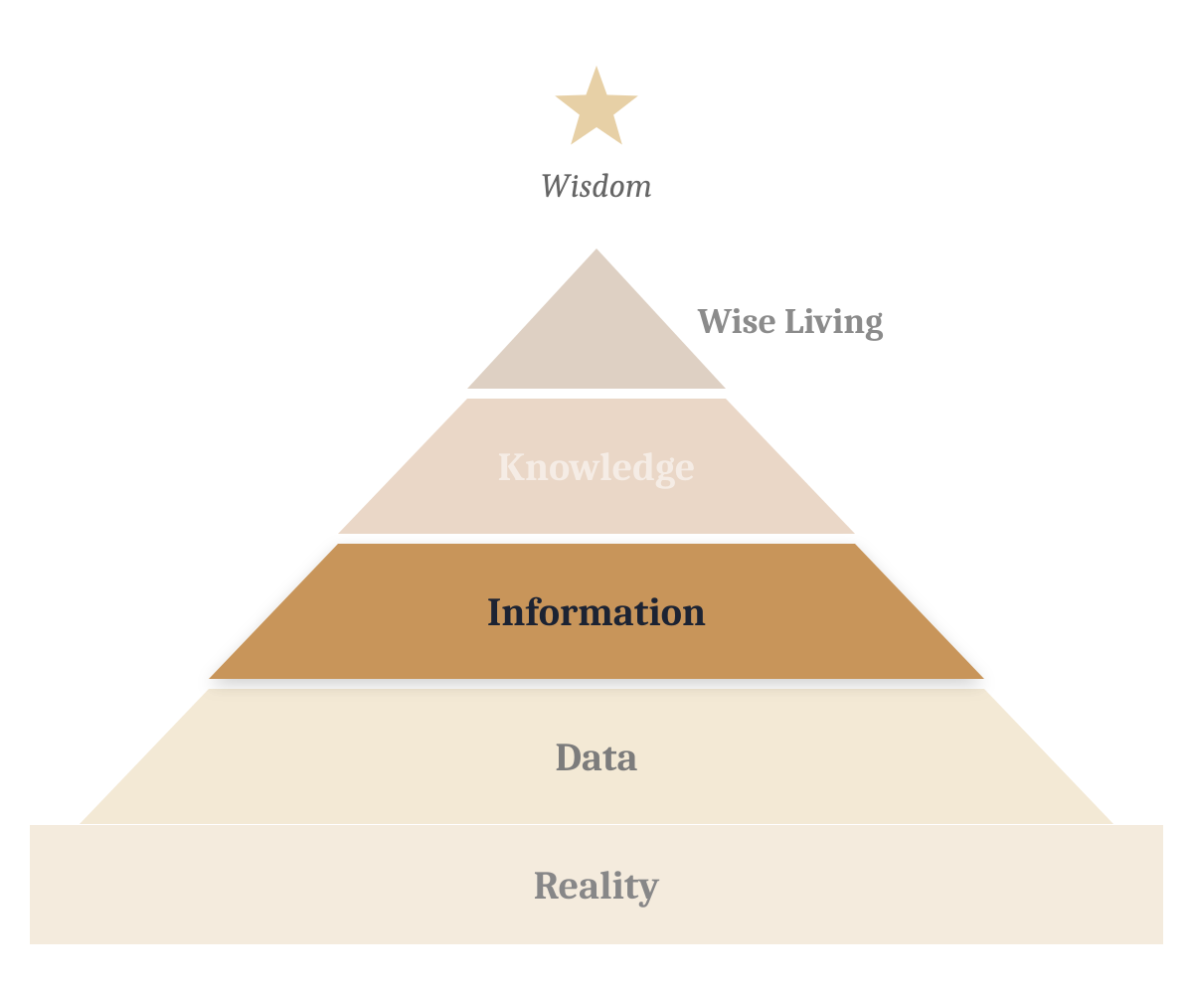
Information
the patterns made when data is connected — models, frames, stories you can use to act
Notes:
§5 Information. Information is the patterns made when data is connected — models, frames, stories you create so you can act. We do this instantly; it's how I turned a dune into a movie scene. It can fails when we create a story that sounds good, but doesn’t represent reality well or truthfully AI is an exceptional pattern making machine. It fails here the way we do, only faster using better grammar: we call it a hallucination, a story unmoored from reality.

Slide 16
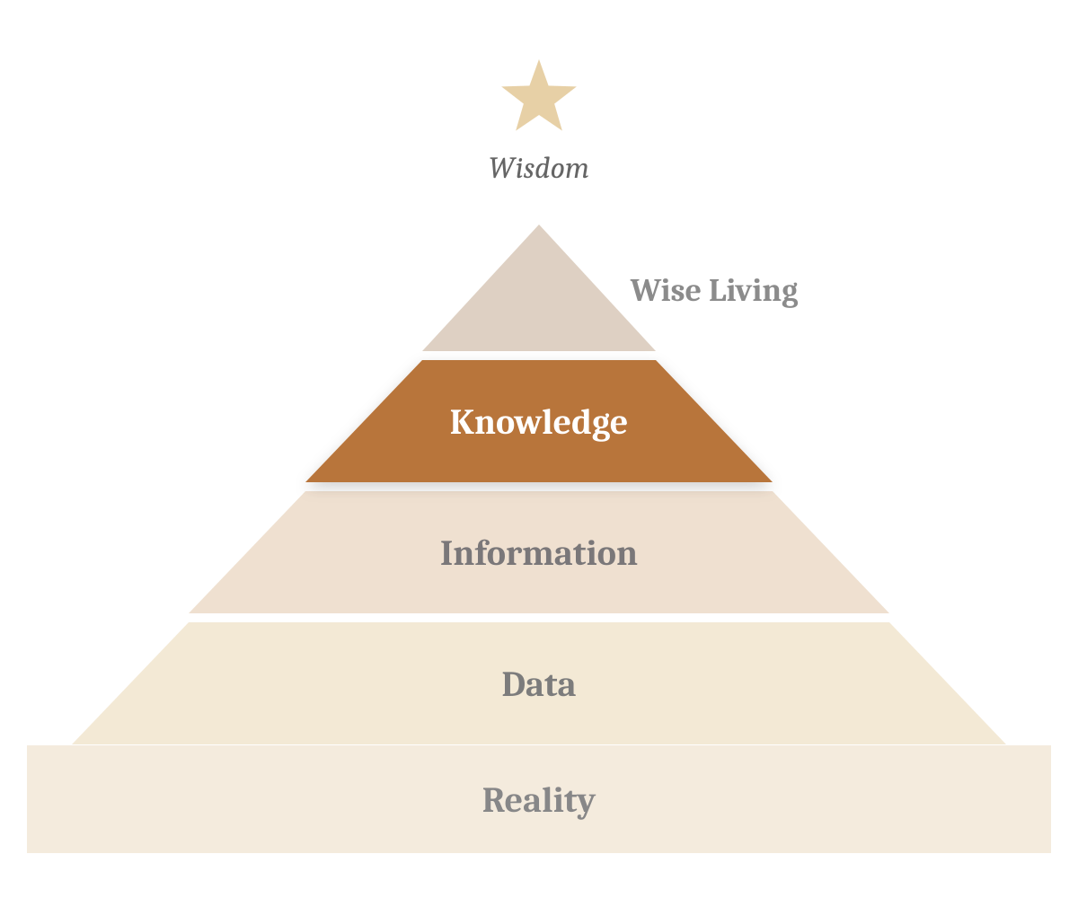
Knowledge
connected information — the lessons of past patterns, carried into new situations.
Notes:
§5 Knowledge. Knowledge comes from connecting information. While the information layer creates and improves the story or frame, the knowledge layers improves the agent themselves. It is often called metacognition, learning how to learn and improve. It’s identifying lessons of past patterns, carried into new situations, Biological creatures build it slowly — experience, feedback, the humbling work of being. AI is climbing into this layer right now. The labs call it recursive self-improvement: AI helping build the next AI, faster each round. Its improvement is measured in months; ours in years or even generations. That is the situation – the second – we face right now.

Slide 17
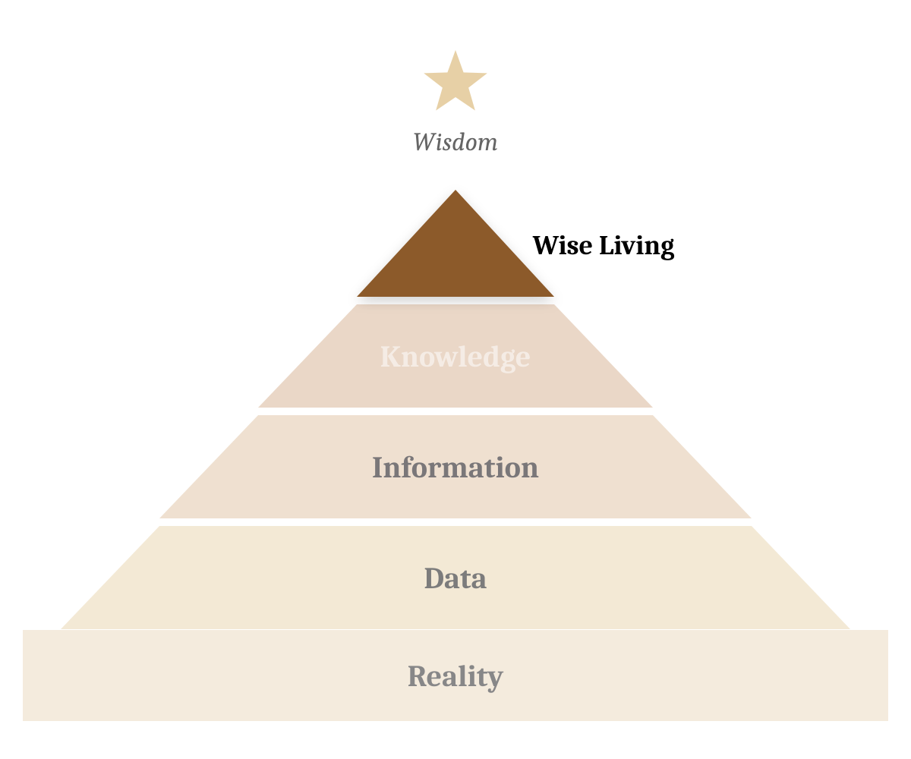
Wise Living
when an agent understands reality, decides its place and purpose in it, and acts in accordance
Notes:
§5 Wise Living. Wise Living harkens back to the definition of wisdom - when an agent understands reality, decides its place and purpose in it, and acts in accordance. The agent’s understanding of reality is based on the size and quality of its pyramid, which is why each of those layers are so important. For humans, wise living includes examining the meaning of your life, and the meaning in it. And letting the answers point you forward, toward something bigger than today, bigger than yourself. And it's the layer AI doesn’t YET build for itself. We hand it its purpose — a few words typed into a box — and, increasingly, were not sure what it will do after reading those words. That's what makes people nervous. But for the moment, the summit of every AI pyramid is occupied by a human – for better of worse.

Slide 18
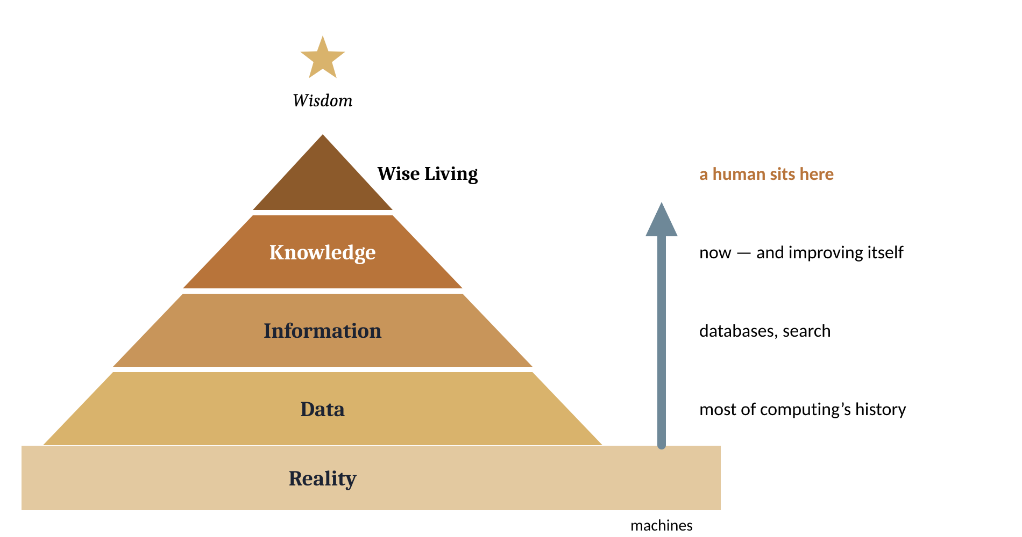
Not control or compete. Partner.
humans
machines
One layer left.
Nobody can build your pyramid for you — but two pyramids built side by side see farther than one.
Notes:
§5 Do you remember, a long long time ago, when computers only lived at the Data layer. Back then few of us dreamt that they’d every create Knowledge. But here they are, with one layer, left working alongside us. We talk about this moment as if we need to control or compete with these agents — but what if instead we truly embraced partnership with them – like I did by riding a horse through the desert. Because two pyramids built side by side touch more or reality than one alone. So here is the question for the rest of this talk: how do we build truer pyramids — ours and theirs — together? That's partnership. And there is something unique about partnerships – relationships - they forms us.

Slide 19
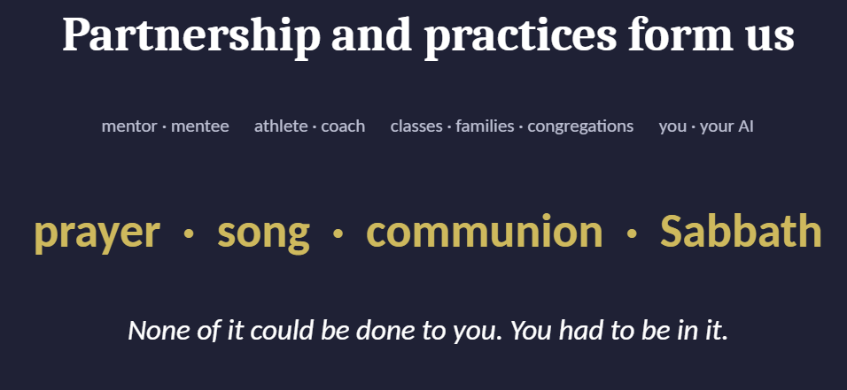
mentor · mentee
athlete · coach
coach · team
prayer
song
communion
Sabbath
you · your AI
Notes:
§6 Think about how anyone has ever become wiser. It happens when agents work and learn together. A mentor and a mentee. An athlete and her coach. Two friends with a glass of wine. These kinds of partnership take place in classes, families, and congregations. AI is now partnering with us, and it’s one of the strongest we've ever had. Which means it will form us.
Our Christian faith is an amazing formation ecosystem, filled with practices designed to form a good agent who will choose good actions over and over. If you grew up as a Christian, you were quietly formed through practices like prayer, song, communion, Sabbath, in partnership with those around you. None of it could be done to you. You had to be in it, and that helped you see yourself and the world.
Which – and I want you to hear this - means you already experienced something the AI labs are only beginning to consider: how an agent is formed, and what it costs when it's done badly.

Slide 20
Claude’s formation
WHAT THEY WANT
A genius six-year-old who is formed to become a well-liked traveler, whose good character is recognized wherever it goes.
Anthropic, January 2026 · lead authors Amanda Askell and Joe Carlsmith
Notes:
§6 . Now hold on to that thought as I tell you about Amanda Askell, the philosopher who leads Claude's character work at Anthropic. She talks about Claude less like a product and more like a person in formation. She has compared it to a genius six-year-old, who has enormous knowledge, but very little lived experience, and therefore in need of formation, not just instruction. She puts it this way: 'Just as humans develop their characters via nature and their environment and experiences, Claude's character emerged through its nature and its training process.’ So their training process, which is different from the other companies, isn't rule-following. It's what they call 'ethical practice' — knowing how to act well in the situation in front of you. Amanda wants Claude to act like a well-liked traveler whose good character is recognized wherever it goes. She’s hopefully this well-like traveler will be able to use its computing power to help us - to partner with us – to understand reality better than we do. That's formation. Which means the question I'm about to ask you is the same one they're asking: what kind of agent is this partnership forming?

Slide 21
Since you know how formation works, ask yourself…
How would I characterize my partnership with AI?
What practices do I use to guide our work together?
What does your answers say about YOU and your formation?
Notes:
Since you know how formation works, ask yourself…
How would I characterize my partnership with AI?
What practices do I use to guide our work together?
And here’s a metacognitive question: What does your answers say about YOU and your formation?

Slide 22
After 5 chapters in the trash….
Only I write.
the one rule of a repaired partnership
Notes:
Let me end with my own partnership. For the last four years I've been working with AI while writing a book on wisdom. The partnership has been remarkable, and this year I let Claude Cowork do more of the editing. Then last month I read a printed copy of my first five chapters and was stunned: it didn't sound like me, and in fact it was so bad in fact I decided to start over, from scratch. My own autopsy found no one at fault. We simply hadn't worked out the best way to partner. So we're starting again, with one rule: I'm the only one who writes. And I'm standing here in my own voice.

Slide 23
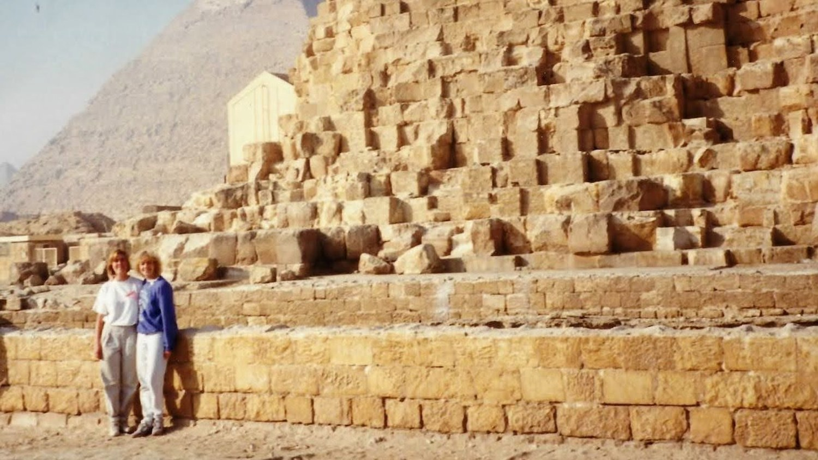
“I carry the desert, so you don’t have to hold the whole thing in your head. You stand at the summit and do the one job no one else can do — be the person the wisdom is for.”
Don’t vacate the summit. Become the kind of person who can notice what matters, love what is good, and act wisely when reality changes beneath your feet.
Notes:
§8. Here's what a good partnership can do. My mom died of Alzheimer's. So I notice every word I can't retrieve, every face I can't place. Not long ago, while I was writing this talk, I admitted that fear to Claude, and it said something that brought tears to my eyes: 'I carry the desert so you don't have to hold the whole thing in your head. You stand at the summit and do the one job no one else can do — be the person the wisdom is for.’
Kuyper said there's not one square inch of creation that Christ doesn't claim. That includes our code. And the quiet moment when each of us decides what kind of person we're becoming with the tools in our hands. That is stewardship. So let AI help carry the desert. But don't vacate the summit. Become the kind of person who can notice what matters, love what is good, and act wisely when reality changes beneath your feet.

Slide 24
Since you know how formation works, ask yourself…
How would I characterize my partnership with AI?
What practices do I use to guide our work together?
What does your answers say about YOU and your formation?
Notes:
Since you know how formation works, ask yourself…
How would I characterize my partnership with AI?
What practices do I use to guide our work together?
And here’s a metacognitive question: What does your answers say about YOU and your formation?

