Slide 1

Three Paradigms of Artificial Intelligence and Their Moral Imaginaries
Fernando Pasquini Santos
Department of Computer Science

Slide 2
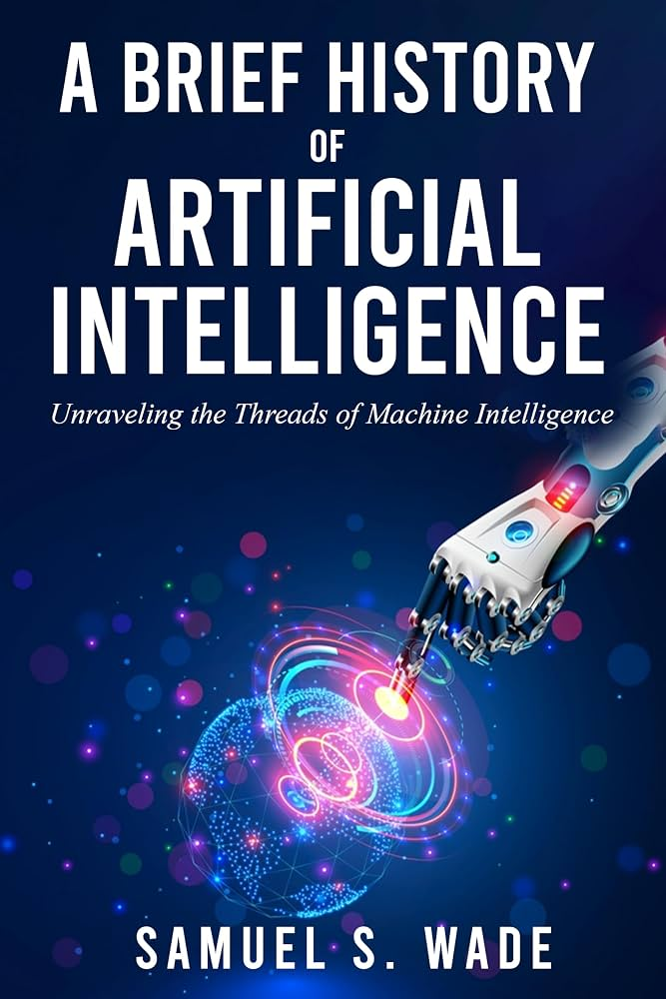
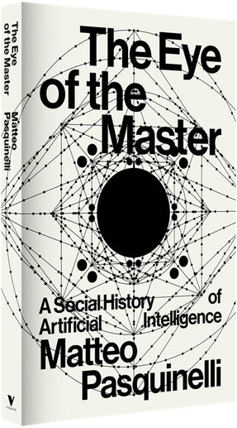
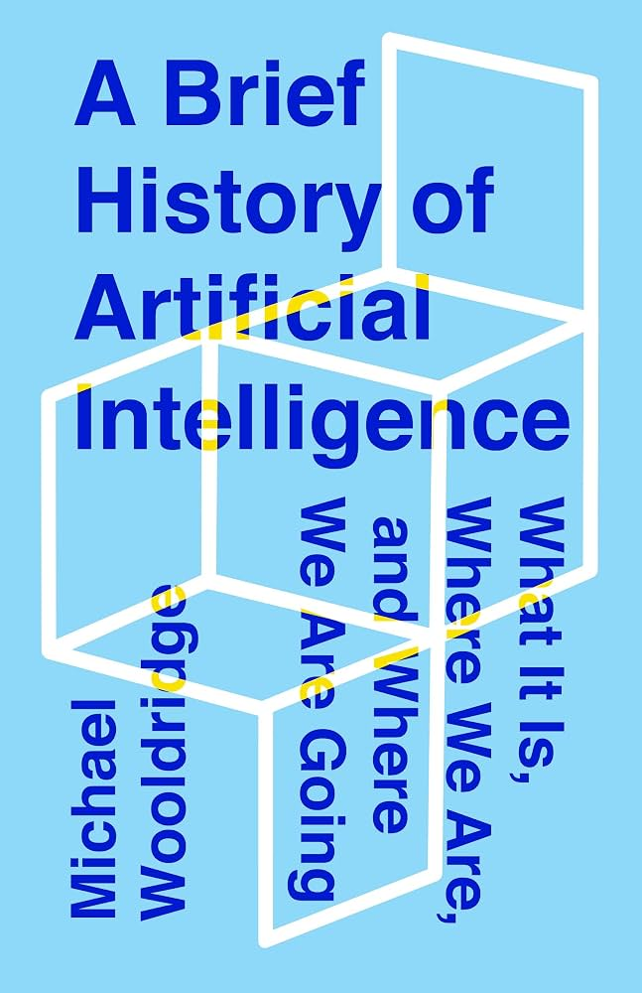
Navigational Scholarship in AI
How did we came here? Where are we going? Where to start?
And how could we integrate all of that in a CS curriculum?

Slide 3
An idea...
AI Phase | Logic | History of Science Parallel
Symbolic (1950-1995) | Deduction | Premodern science (theory)
Adaptive (1995-2020) | Induction | Modern science (experiment)
Generative (2020-now) | Abduction | Computational science (simulation)

Slide 4
Each phase arose from the limitations of the previous...
Symbolic AI revealed the limits of explicit knowledge elucidation (Hubert Dreyfus’ critique) → led to data-driven learning.
Adaptive AI revealed the limits of working only with recorded, past data (STS critique) → led to generative, abductive world-exploration.
Generative AI now probably reveals the limits of brute-force optimization and scaling…

Slide 5
Moral Imaginaries and AI
Decentering the human in “intelligent” operations like deduction, induction and abduction leads us to certain moral motifs: delegation, prediction and exploration. All of them can be good, but what are their moral limits?
AI Phase | Logic | Requires an ethic of… | Moral Imaginaries / Motifs
Symbolic (1950-1995) | Deduction | Delegation | Slavery, The Golem, The Iron Cage
Adaptive (1995-2020) | Induction | Prediction | Divination, Tragedy, The Panopticon
Generative (2020-now) | Abduction | Exploration | Acceleration, Psychedelics, Fragmentation

Slide 6
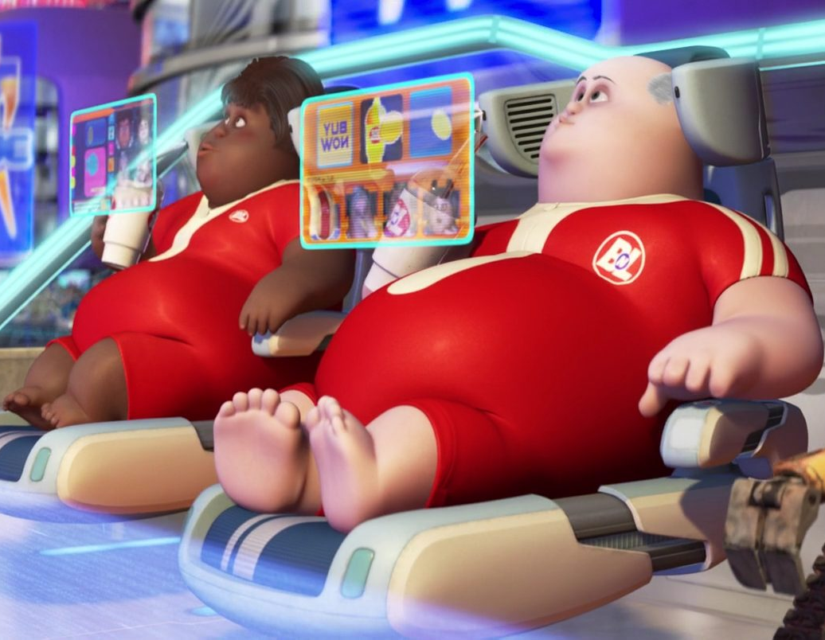
Ethics of delegation: 1. Slavery
“Alienation from life”: delegation collapses agency and distances us from embodied engagement.
Marx / Illich: appropriation & power — heteronomy through technical systems.
Luther’s incurvatus in se — self-curved inward, enslaved to appetite.
Rousseau’s Savage / Stiegler’s “Fault of Epimetheus” — externalization as loss of essence.

Slide 7

Ethics of delegation: 2. The Golem
The Golem from Prague — Mechanized obedience scaling beyond intention.
Talos — blind automatic execution.
The Sorcerer’s Apprentice — outsourcing maturity → chaos.
Frankenstein’s Creature — creation surpassing intention without social embedding.

Slide 8
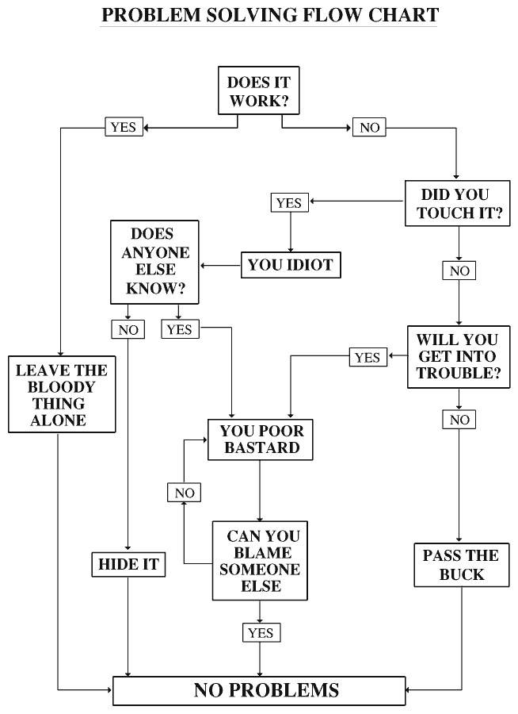
Ethics of delegation: 3. The Iron Cage
The temptation to reduce wisdom to explicit procedures.
Weber’s Iron Cage / Kafka — bureaucratic rationalization displaces meaning.
“Legalism “— mistaking rule-keeping for righteousness; law replaces mercy.
Plato’s Republic — totalizing rational schemes for social order.

Slide 9
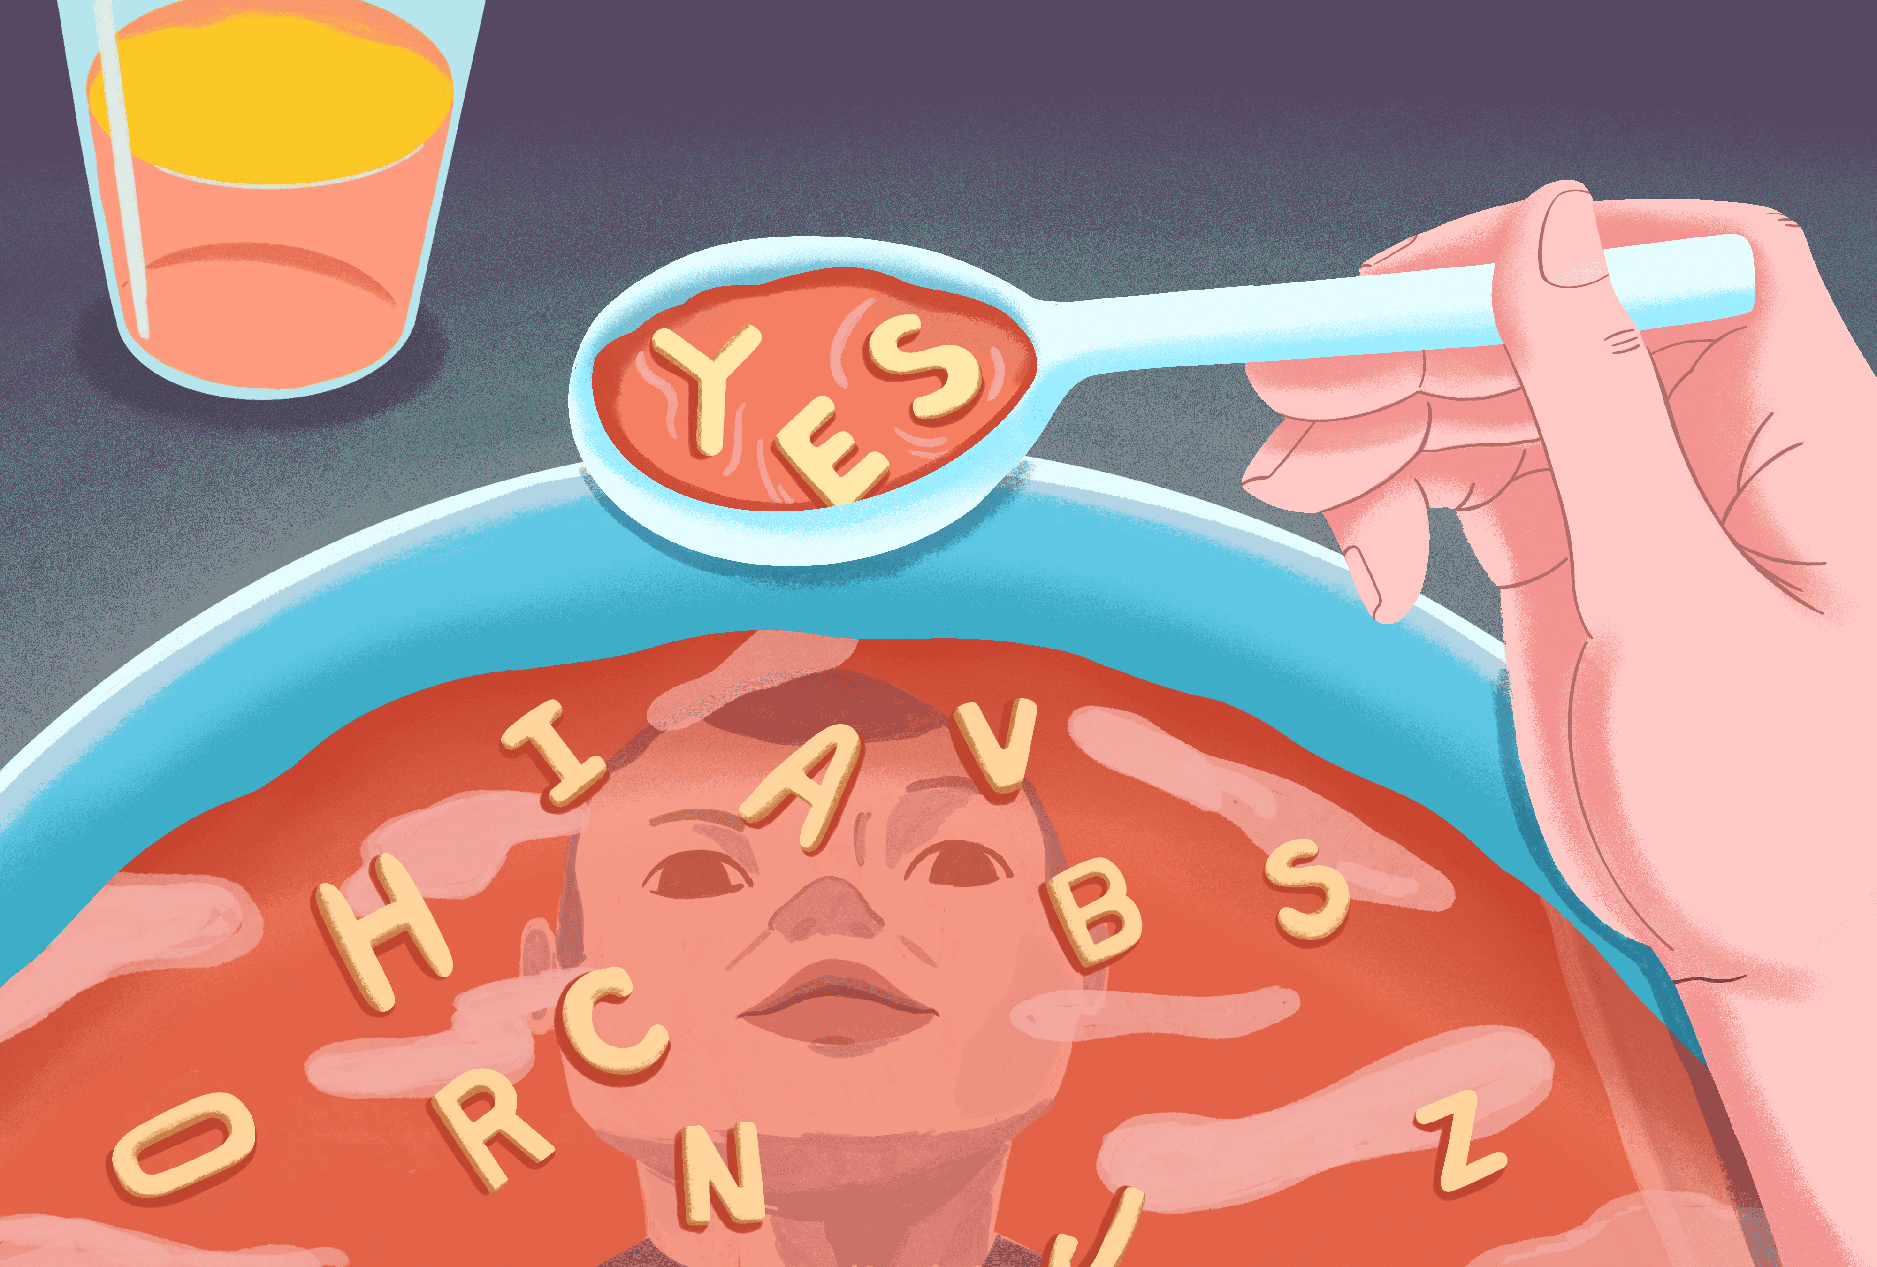
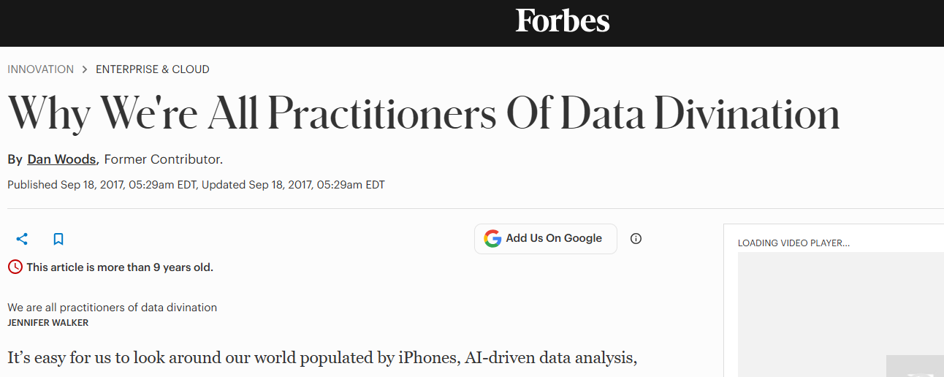
Ethics of prediction: 1. Divination
Augury / Omens — should we?
False Prophets — saying what people want, not what is true.
Cassandra — anomalies dismissed because they challenge precedent.
Apophenia — seeing patterns where there are none.

Slide 10

Ethics of prediction: 2. Tragedy
Past Patterns become Destiny — what was becomes what must be, future colonized by statistical precedent.
Oedipus — attempts to escape reinforce the pattern.
Self-fulfilling prophecies, Pygmalion effect
Great Chain of Being — hierarchy fossilized as “natural.”

Slide 11
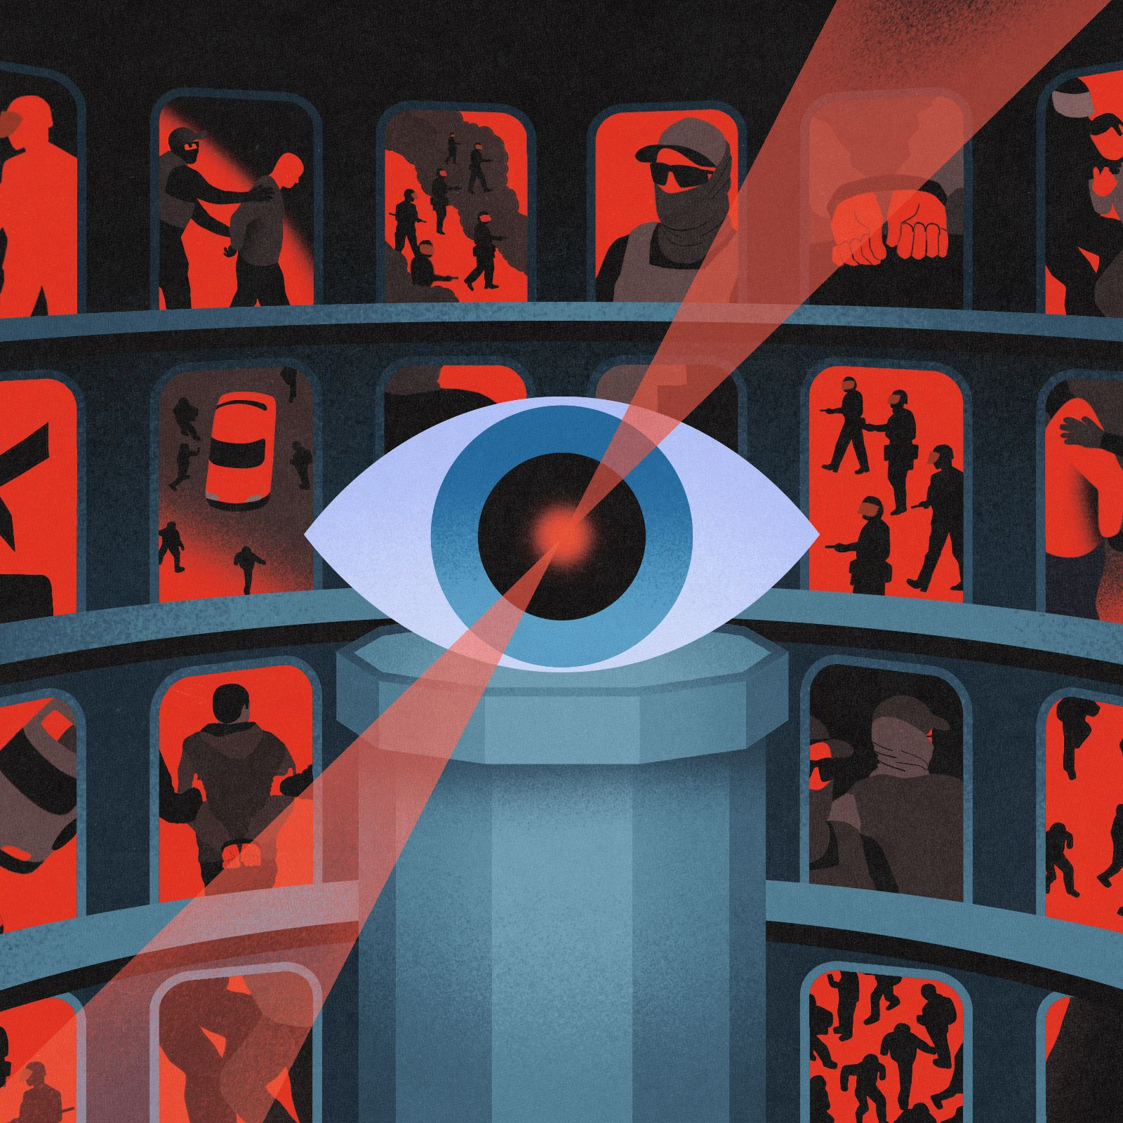
Ethics of prediction: 3. The Panopticon
Everything must be seen, tracked, and made legible (James C. Scott).
Laplace’s Demon – control through total visibility.
Eye of Horus — cosmic order through visibility.
Big Brother — datafied society as total knowledge.

Slide 12

Ethics of exploration: 1. Acceleration
Brute-Force Search and Combinatorial Overflow — Collective creation expands into immense possibility spaces.
Gilgamesh’s Quest — exhaustive searching for what cannot be grasped.
Scheherazade’s 1001 Nights — generative iteration that proliferates without end.

Slide 13
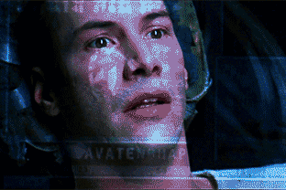
Ethics of exploration: 2. Psychedelics
Perception untethered from reality, simulation as experience.
Plato’s Cave – mistaking representations for reality.
Zhuangzi’s Butterfly Dream – unstable identity and simulation.
Galadriel’s Mirror – seeing possible worlds.

Slide 14

Ethics of exploration: 3. Fragmentation
Local sense, global chaos; attention dilution.
Possibility explodes outward while interiority thins. “Anything goes”, “nothing really matters”
Chimera — confusing categories and boundary crossing (by mere possibility).
Total gamification — life reduced to reward functions and prompts.

Slide 15
I know, I know
This is not exhaustive
Analytically imperfect – categories intermingle, maybe there are more, some other nuances...
Yet, maybe it is a start.

Slide 16
Virtues and counter-practices
Love addresses delegation with care and engagement - returning the person to the body, the world, and the community.
  Exodus motif, Drums of freedom (African diaspora), Hartmut Rosa’s resonance, Albert Borgmann focal things and practices
Faith addresses prediction by restoring surprise, interruption, promise, and newness.
  Annunciation/Nativity (Arendt), Antifragility (Taleb), Paul Ricoeur’s surplus of meaning.
Hope addresses exploration by restoring proper scale, gift and rest
  Sabbath, manna in the wilderness, Babette’s Feast, Josef Pieper’s leisure, Heidegger’s Gelassenheit, Ellul’s non-power

Slide 17

Some experiences in teaching
https://inteligenciaartificial.cristaosnaciencia.org.br

Slide 18
Using media
Ethic of… | Motif | Films, series, fiction, games
Delegation | Slavery | WALL-E (2008); E. M. Forster, “The Machine Stops” (short story, 1909)
 | The Golem | Fantasia, “The Sorcerer’s Apprentice” (1940); Shelley, Frankenstein (1818); Universal Paperclips (browser game, 2017); Black Mirror “Thronglets” (mobile game)
 | The Iron Cage | Severance (TV, 2022–); Brazil (Gilliam, 1985); Papers, Please (game, 2013); I, Daniel Blake (2016)
Prediction | Divination | Minority Report (2002); Asimov, Foundation (novels / TV); Don’t Look Up (2021)
 | Tragedy | Dune (novel/movie); Gattaca (1997); Westworld, season 3 – the Rehoboam system (2020)
 | The Panopticon | Eggers, The Circle (novel 2013 / film 2017); Person of Interest (TV, 2011–16); Coded Bias (documentary, 2020)
Exploration | Acceleration | Edge of Tomorrow (2014) – learning by endless retries; Borges, “The Library of Babel” (1941)
 | Psychedelics | The Matrix (1999); Her (2013); Blade Runner 2049 (2017) – Joi, the simulated companion
 | Fragmentation | Everything Everywhere All at Once (2022); Bo Burnham: Inside (2021); Black Mirror, “Nosedive” (2016)

Slide 19
In the technical curriculum
Ethic of… | Motif | Where it can surface in CS courses
Delegation | Slavery | Functions & abstraction (“what exactly are we handing off?”); scripting/automation labs; HCI – levels of automation, deskilling
 | The Golem | Recursion without a base case, runaway loops; tests vs. intent (the spec is not the wish); reward hacking / specification gaming in ML
 | The Iron Cage | If-else constructs as bureaucracies; rule-based expert systems; finite-state machines and form validation
Prediction | Divination | Regression & overfitting, train/test split; spurious correlations and p-hacking (apophenia); model calibration
 | Tragedy | Clustering algorithms; classifiers trained on historical labels; feedback loops in recommenders and predictive policing
 | The Panopticon | Database design (a schema decides what becomes legible); logging & telemetry, cookies and web tracking; privacy & security
Exploration | Acceleration | Loops (for/while); reinforcement learning; search & combinatorial explosion (Big-O, backtracking); GPUs & parallelism
 | Psychedelics | Computer graphics; simulation & procedural generation; sampling, temperature and “hallucination” in LLMs
 | Fragmentation | Embeddings & latent-space interpolation (chimeras); event-driven code & notifications (attention)

Slide 20
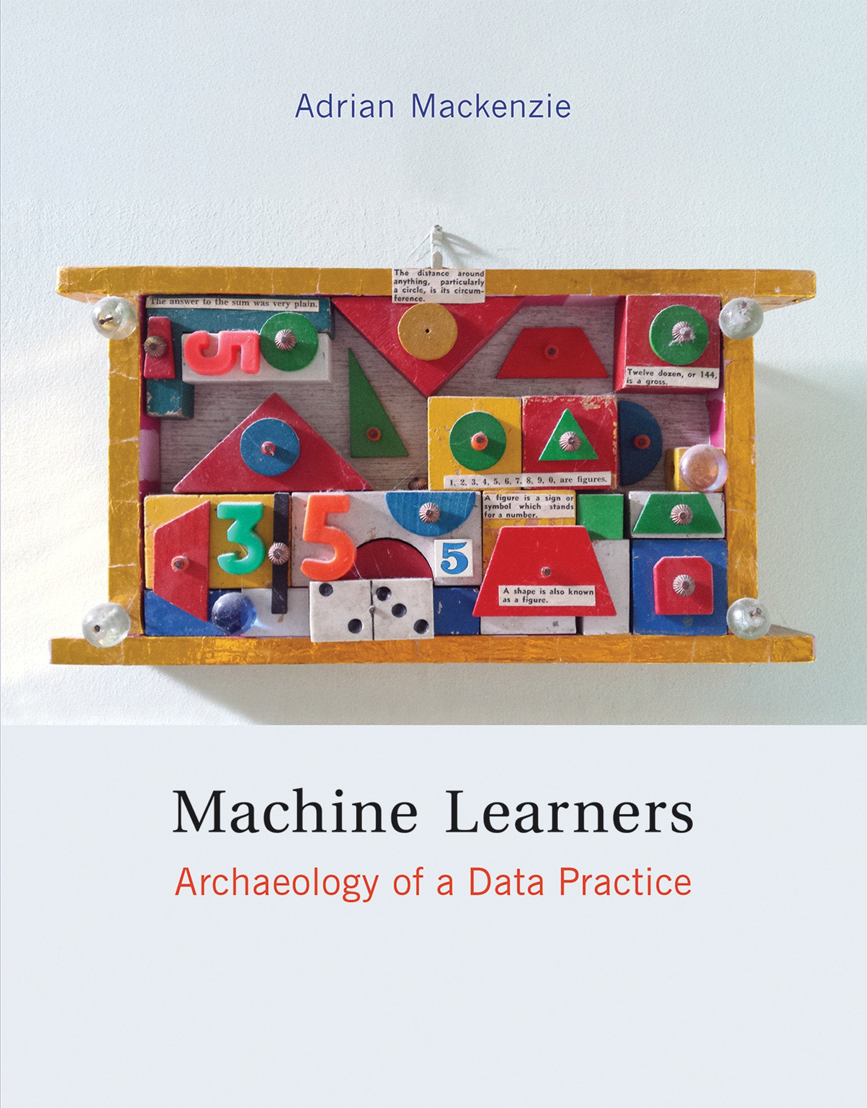

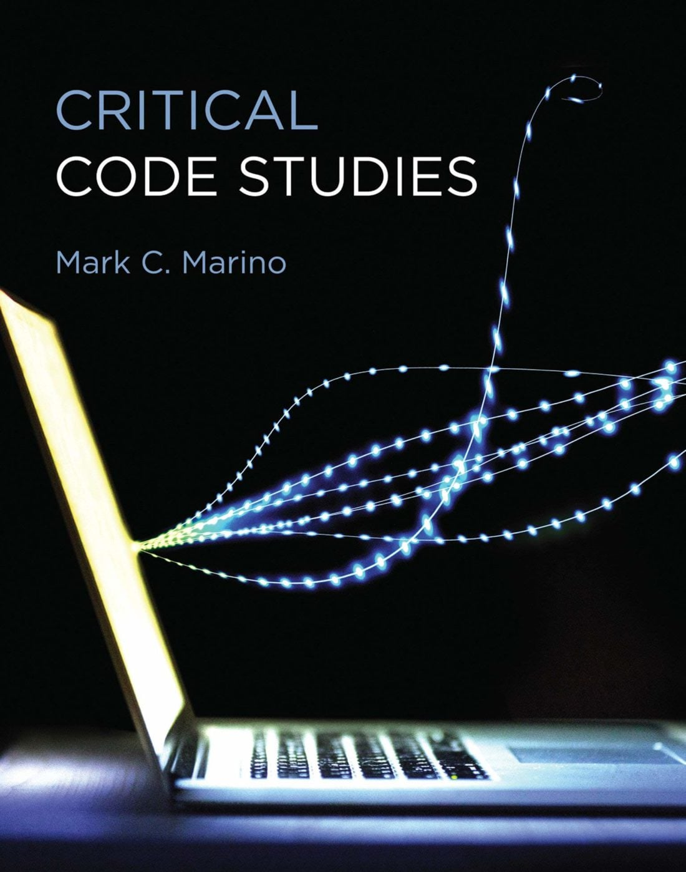
Great “integrative” reads

Slide 21
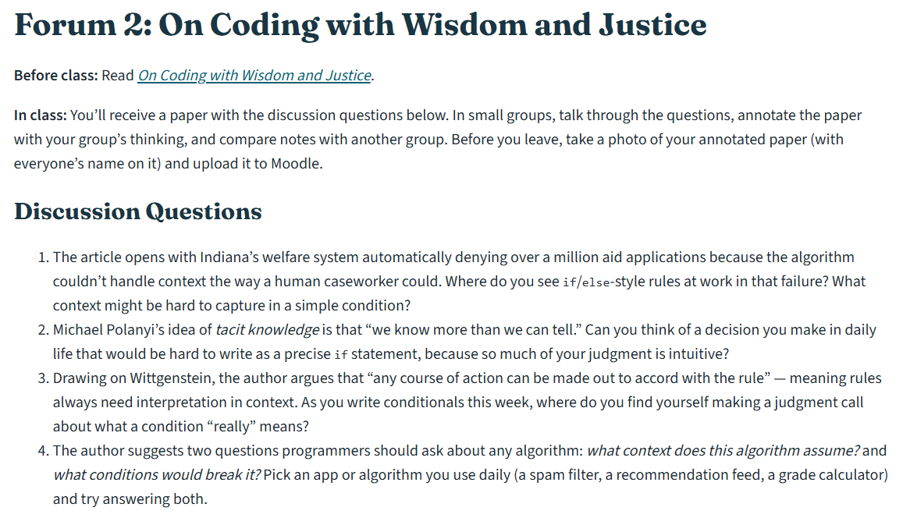
Example

