Slide 1
SermonPress AI: Empowering Churches with Innovative AI Solutions
Wisdom in the Age of AI Conference 2026
Paul Griffioen
Dordt University
10/09/2026
Notes:
regulative principle of AI vs. normative principle of AI
most people in the church hold to a regulative principle of AI: we are not allowed to use AI unless specifically prescribed that it is okay (Westminster Theological Seminary’s position)
I hold to more of a normative principle of AI: we should use it unless it violates one of the things God has prohibited
AI can be used for wonderful things, in many cases to help the church, so here is one of them

Slide 2



Need and Motivation
How do we increase the proclamation of the gospel, sound theology, and church visibility via the internet when there is:
No time: busy pastors and limited/no church staff
Lack of technical expertise among pastors and church staff
Limited church financial resources
Notes:
With any technological innovation in history has come the ability to better amplify and more efficiently proclaim the gospel message: printing press, radio, internet, AI
Pastors and church staff are typically stretched thin and do not have the additional labor or time required for effective digital dissemination, which includes generating transcripts, formatting blog posts, tagging metadata, creating social media reels, and adapting content for multiple platforms

Slide 3
Mission
SermonPress AI exists to help churches proclaim God’s Word more effectively using AI workflow automation technology. We equip local congregations with open-source tools—including n8n workflows and WordPress plugins—that make it easier to publish, distribute, and repurpose sermons across:
Church websites
Search engines
Social media platforms
Foreign languages
“How then will they call on him in whom they have not believed? And how are they to believe in him of whom they have never heard? And how are they to hear without someone preaching? … ‘How beautiful are the feet of those who preach the good news!’” – Romans 10:14-15
Note: our goal is emphatically NOT content origination
Notes:
SermonPress.AI holds the firm conviction that the true proclamation of the Gospel is strictly the work of the Holy Spirit, operating through called men and ordinary means of grace within the life of the local church.
AI cannot replace the preacher.
Instead, SermonPress AI serves as a digital printing press - converting audio recordings to written transcripts and articles, automating the hosting of multimedia content globally, and translating faithful exposition into foreign languages to maximize its global impact.

Slide 4
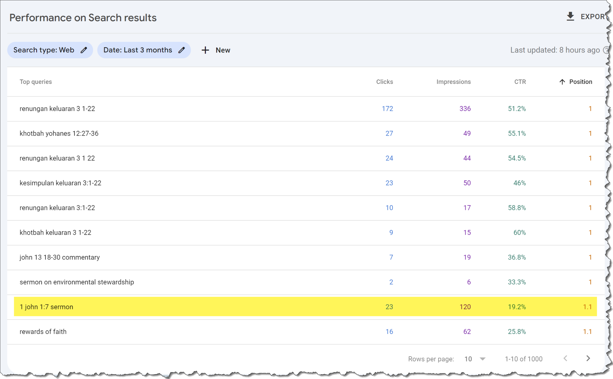
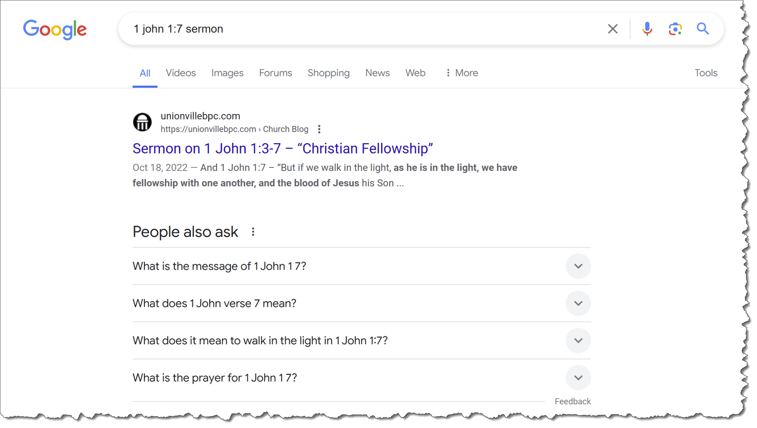
Increasing Search Engine Visibility
The Importance of Online Evangelism
How do churches increase their visibility and the proclamation of the gospel across the internet, websites, YouTube, SermonAudio, LLMs, podcasts, social media, and more?
How does a church increase its ranking in search engine results and LLM outputs?
Notes:
People are Googling questions about the Bible all the time or are encountering biblical content through all of the above platforms
Project born out of Five More Talents

Slide 5
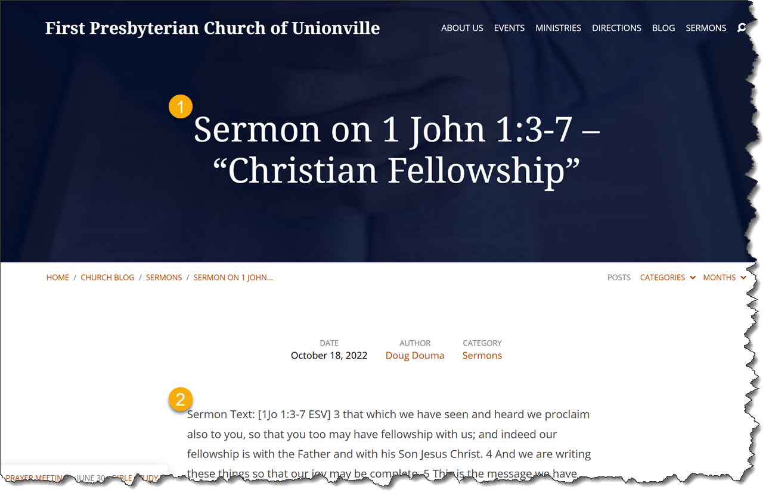
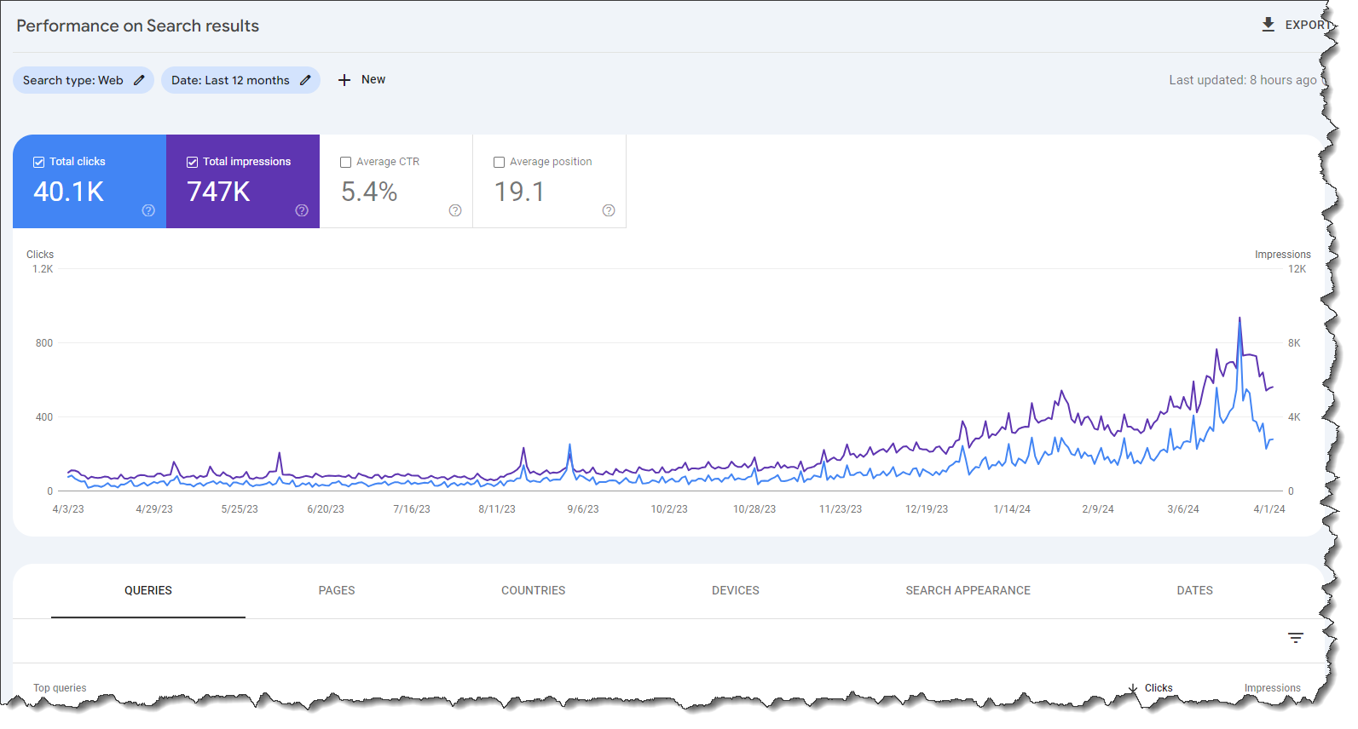
Increasing Search Engine Visibility
Full-text transcripts/blogs, clear titles/metadata, and embedded audio/video all increase search engine visibility:

Slide 6
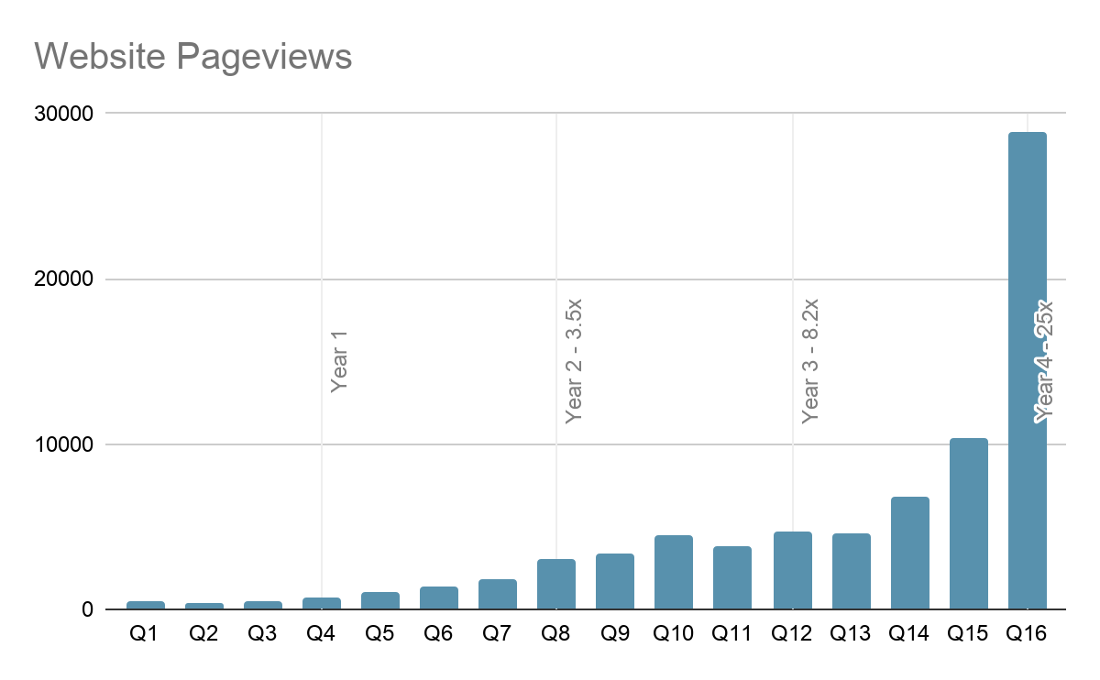
Increasing Search Engine Visibility
(sample size = 77 church websites) | Without Full-Text Transcripts/Blog | With Full-Text Transcripts/Blog
Average Total Clicks | 335 | 607
Average Total Impressions | 6,292 | 31,498
1.8x increase
5x increase
(data taken from 06/23/2026 – 09/21/2026)
Clicks: the number of times a user clicked on the website’s link on a Google search results page
Impressions: the number of times the website appeared in Google’s search results
Full-text transcripts/blogs on a church website results in increased visibility over time:

Slide 7
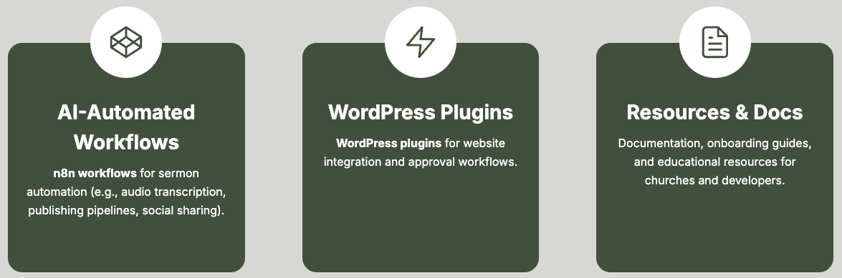
What We Do
SermonPress AI equips churches with open-source automation tools that make it easier to publish, share, and repurpose sermons across the web.

Slide 8
Built for the Church Community
We believe technology should serve the church, not the other way around, so we have designed SermonPress AI to be:
Fully open-source: MIT licensed, free for all to use and adapt
Modular and extensible: can be used by agencies, students, and churches of all sizes
Friendly and inclusive: easy to use for both tech experts and non-technical church staff
Notes:
Current integrations with SermonAudio and others, but desire to be totally open-source
INSERT MAP OF SERMONPRESS AI USE HERE

Slide 9
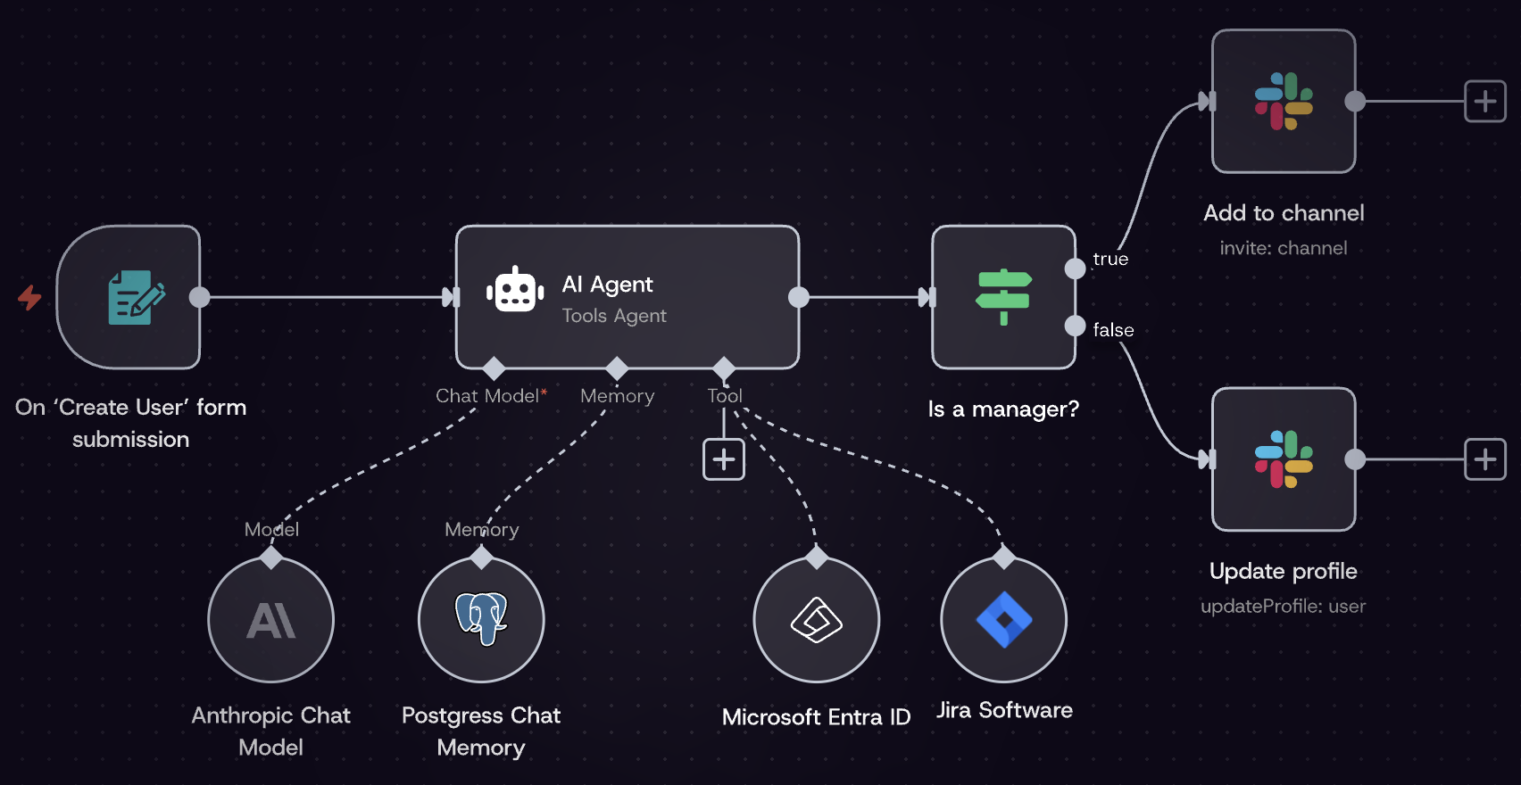
n8n Workflows
n8n Workflow
A visual, node-based automated sequence built on the n8n platform that connects different apps, databases, and APIs to execute tasks automatically
Our n8n workflows use AI to take an audio/video recording, transcribe it, and publish the text, audio, and video to a church’s website or social media
Notes:
Workflows are built on a visual canvas using building blocks called nodes:
Triggers: The starting point of a workflow (such as receiving a new email, submitting a web form, or a scheduled timer).
Actions/Logic: Intermediate or ending steps that process data, make conditional decisions (if/else), loop through items, or integrate with tools like Slack, Google Sheets, or OpenAI.
Code Execution: Optional custom logic written in JavaScript or Python to transform complex data inside a node.
Why Use n8n Workflows Instead of Standard AI Tools?
Reliability and structure: Standard AI chatbots operate as isolated "black boxes" that require manual prompt entry and lack persistent connection to software. n8n forces AI to execute tasks through predictable, auditable sequences.
Multi-app orchestration: Standard AI tools cannot natively read your database, update a spreadsheet, send a Slack alert, and log an event in one seamless chain without heavy custom coding.
Data privacy and self-hosting: You can self-host n8n on your own infrastructure, keeping sensitive business data and API tokens secure rather than relying entirely on third-party cloud interfaces.
Operational controls: n8n provides built-in run history, automatic retries for failed API calls, and credential management, reducing invisible failures common in raw AI application development.
Why Use n8n Workflows?
Self-Hosting and Data Privacy: You can host n8n on your own servers or private cloud (via Docker), meaning your sensitive data never leaves your infrastructure.
Cost-Effective Scaling: Unlike cloud competitors that charge high fees per task execution, self-hosting is free, and pricing tiers do not penalize you for high-volume data handling.
Advanced Customization: You are not locked into rigid templates; you can insert custom JavaScript/Python code, handle deep API branching, and manage complex error retries.
Built-in AI & LLM Orchestration: N8n natively supports multi-agent AI systems, Retrieval-Augmented Generation (RAG), and connections to tools like OpenAI and Hugging Face.

Slide 10
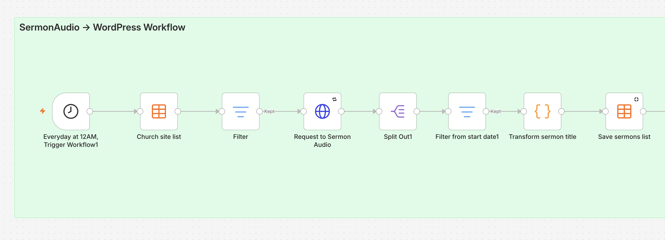
n8n AI Workflow Example
SermonAudio to WordPress
Publishes sermons from a church’s SermonAudio account to WordPress
Builds a search engine optimized library on the church’s website
Each sermon is given its own page, which features a video embed, audio embed, transcript, and video clips
Notes:
Once a day the workflow:
Asks the SermonAudio API for the broadcaster's most recent sermons.
Ignores anything preached before your configured start date.
Records each sermon in an n8n Data Table, which acts as the memory of what has already been published — so a sermon is never posted twice.
For each sermon not yet published, fetches full details, any video clips, and the transcript.
Creates a WordPress sermon post with the title, date, speaker, Bible book(s), audio embed, video embed, transcript, and a clips gallery.
Marks the sermon as published in the Data Table.

Slide 11
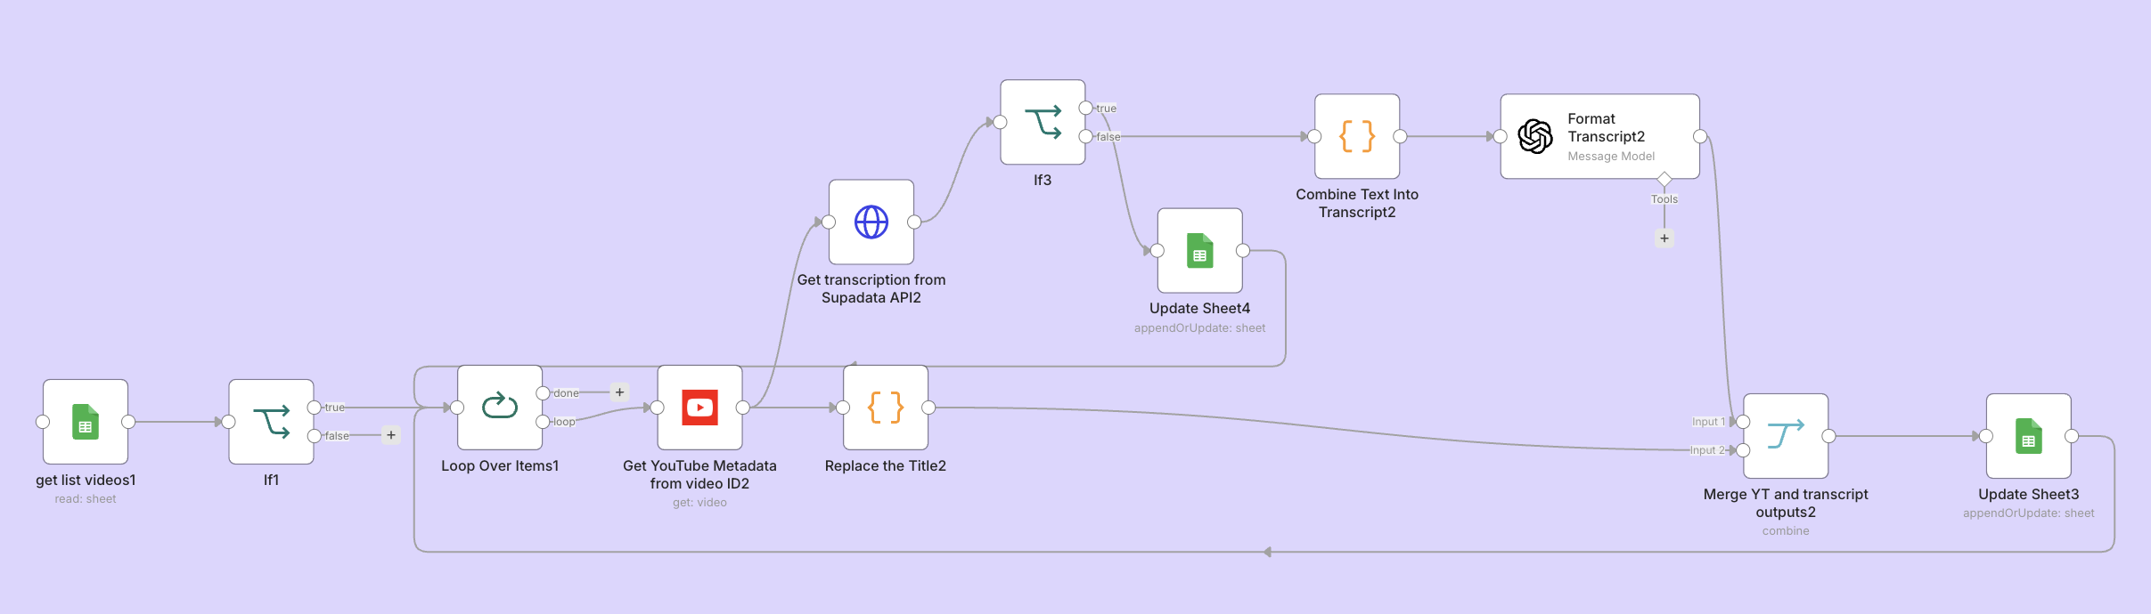
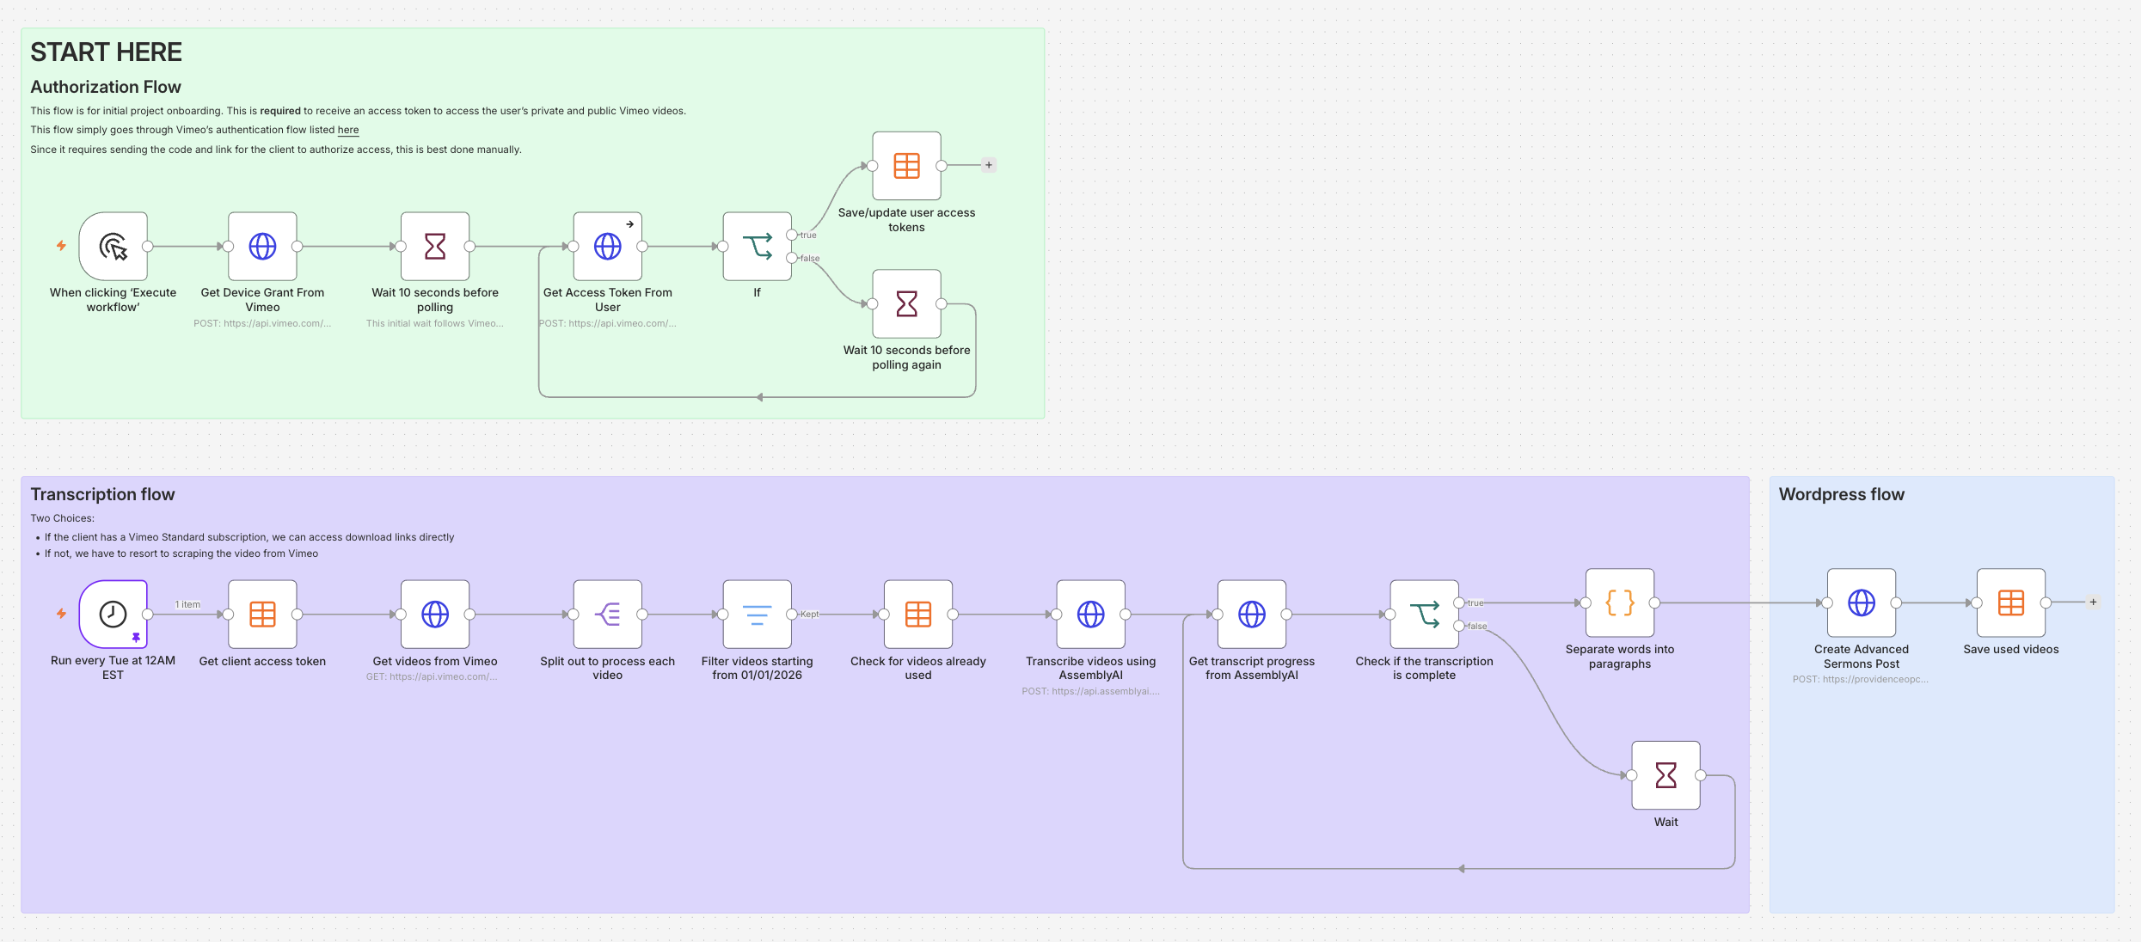
n8n AI Workflow Example
YouTube/Vimeo to WordPress
Automates the transcription and sermon publishing of videos from YouTube/Vimeo to WordPress
Automatically checks for new YouTube uploads on a channel
Downloads video audio and transcribes it using OpenAI models
Formats transcripts into readable paragraphs
Posts transcripts as WordPress drafts with metadata (title, description, etc.)
Optionally logs processed videos to Google Sheets to prevent duplicates

Slide 12
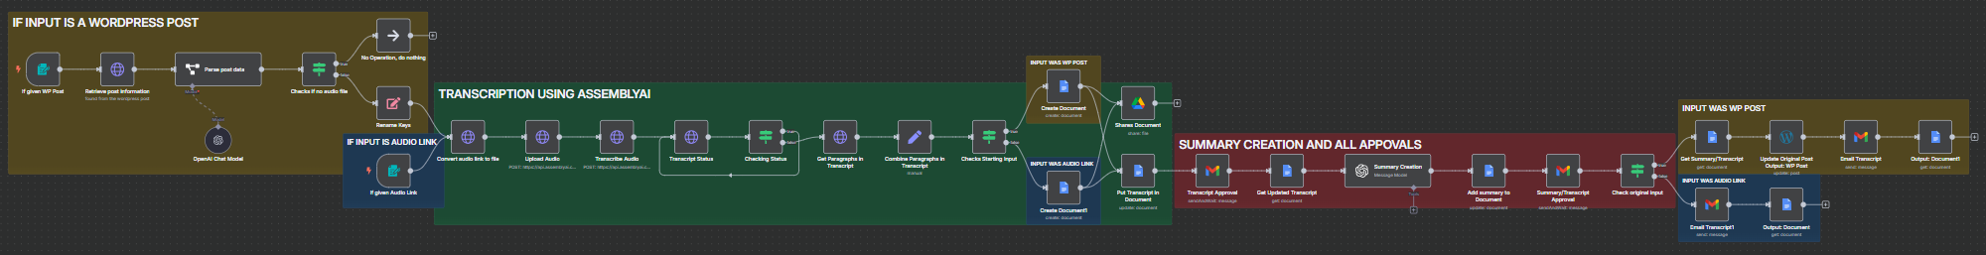
n8n AI Workflow Example
Audio Transcription and Summary Creation
Transcribes a WordPress post or audio link and creates a summary
Splits the transcript into paragraphs
The transcript is output in a Google document or WordPress post with an approval sent via Gmail
Notes:
Uses AssemblyAI to transcribe an audio file when given an audio link
If the input is a WordPress post, OpenAI extracts the information out of it, including the audio link within
OpenAI is used to summarize the transcript, and that summary is added to the document

Slide 13
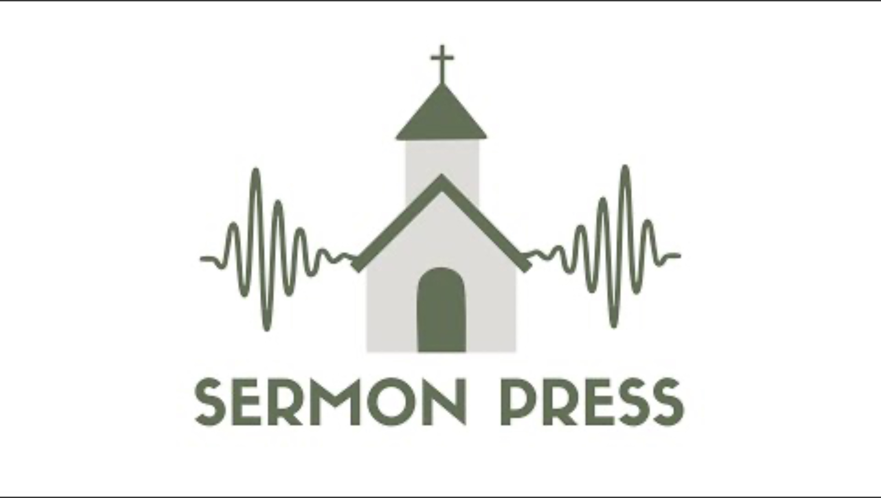

Slide 14
Long-Term Vision
Four Stages
Capture: ingestion of an audio recording or text
Transform
  Editing and cleanup: filler removal, paragraph structuring, auto-generated titles, summaries, and pull-quotes
  Scripture integrity: citing Scripture references correctly and respecting translation licensing
  Platform-native reformatting: WordPress, Substack, and other social platforms
  Translation: text and audio translation (for both voice and caption)
  SEO/Search Engine Metadata Optimization: maximize findability
Distribute: multi-platform publishing from the same source material
Amplify: a permanent, searchable archive of every message passing through the platform
Notes:
Limitations of our current project code: one input format (audio), one output destination (WordPress), no translation, no adaptation for how different platforms actually expect content to be shaped (inclusive of SEO), and a fully manual review-and-publish step
This is a good foundation that we can build and expand on
Capture
The entry point for the larger platform
Supports direct sources (mp4 recording files and docx document files) as well as platform sources (SermonAudio)
Can be expanded to support direct streaming ingestion and other sources of written files and audio recordings
Transform
Translation: preserve the original speaker’s voice with a clear disclosure that the audio is synthesized
Distribute
Source material: WordPress, Substack, podcast RSS, YouTube with captions, email digest to a congregation list, etc.
Include scheduling once a draft is reviewed and approved
Amplify
Topical or semantic search across a ministry’s entire back catalog (“every message that touches on forgiveness”)

Slide 15
Long-Term Vision
Three Distribution Scopes
Local congregation: local church pastor
Single region: denomination, parachurch organization, teacher
International: missionaries, mission organizations
Goal
A church/organization using SermonPress AI tools will reach 10 times more people online without requiring church staff to spend any extra time on their weekly sermon publishing process
Notes:
Local congregation
Translating their sermon audios to text and publishing on their website (may include translation into one or more languages to support local demographics)
Platforms that host the translations and transcriptions are limited to platforms hosted and/or maintained by the local church
Single region
A country or significant portion of it
Includes multiple language support for both text and audio as well as multiple platform publishing
International
Enable entry into other countries with translation support into foreign languages and publishing onto foreign-accessible platforms for access

Slide 16
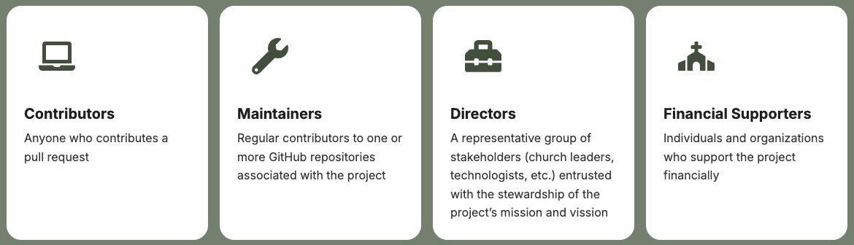
Get Involved
Whether you are a pastor, media volunteer, or curious learner, you are welcome to contribute, test, or use SermonPress AI in your own ministry.
Notes:
Conduct a survey of churches’ preferences and processes regarding online sermon publishing
Output: Better requirements for SermonPress AI technology … identifying the gaps in the marketplace/ecosystem.
How much time do you have to spend on this?
Would you like to publish your sermons online to a larger audience?
What’s keeping you from doing this?

Slide 17
Questions?
SermonPress AI
Website: https://sermonpress.ai
Github Repository: https://github.com/SermonPress-AI

Slide 18
Backup Slides

Slide 19
n8n AI Workflow Example
WordPress to Social Media (Facebook)
Automatically generate and post sermon announcements to social media
When a church uploads its latest sermon:
  Pull the sermon’s title, passage, description, and link
  Format them into multiple ready-to-use post options for platforms like Facebook
  Each post is biblically grounded, engaging, and written to encourage viewers to watch the full sermon
Features
Automatic post generation: creates multiple post variations when a new sermon is uploaded
Biblically rooted content: pulls from the sermon’s text and theme to produce Christ-centered summaries
Custom formatting: includes clickable links to the full sermon and can embed Scripture references
Multi-platform ready: posts can be sent to Facebook automatically, with options to add Instagram, Twitter/X, etc.
Workflow modularity: churches can adapt templates, tone, and formatting to fit their congregation’s style
No manual copy/paste: automates repetitive posting tasks while maintaining quality and theological accuracy

