Slide 1
Man as a Machine:
Artificial Intelligence and the Image of Man
Esa M. Rantanen, PhD, CPE
Rochester Institute of Technology
Rochester, NY

Slide 2
An Argument in Three Parts
A long history of the materialistic worldview
We have been warned!
Surrender is a choice!

Slide 3
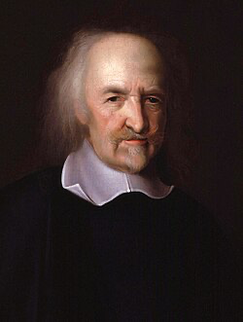
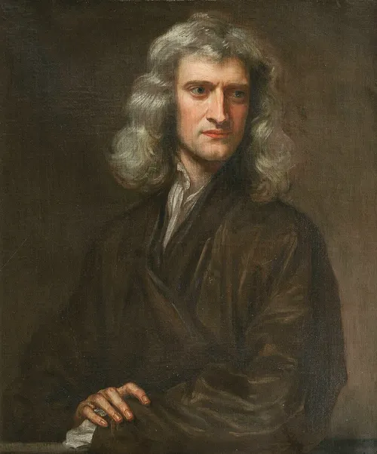
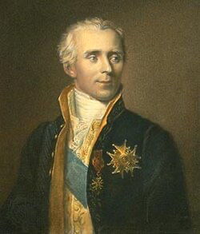
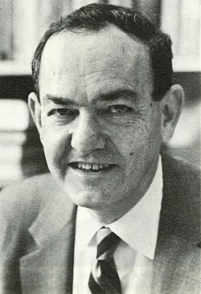
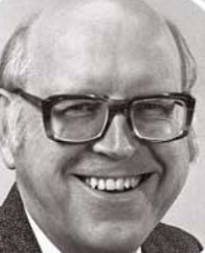
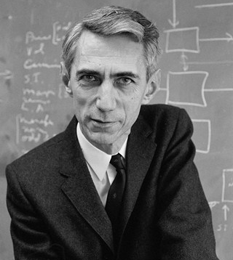
A long history of the materialistic worldview
Notes:
Thomas Hobbes, 1588-1679: Description of the human body in strictly mechanistic terms, as strings and wheels responsible for its motion
Sir Isaac Newton, 1643-1727: Philosophiæ Naturalis Principia Mathematica. Unification of physics. Classical mechanics
Pierre-Simon, Marquis de Laplace 1749 –1827: Mécanique céleste (Celestial Mechanics). With Lavoisier explained animal respiration in terms of combustion using atmospheric oxygen
Herbert Simon (1916—2001): Nobel prize in Economics 1978
Allen Newell (1927—1992): ACM Turing Award in 1975 with Simon
Claude Shannon, Apr 30, 1916 – Feb 24, 2001: “Human is a machine”

Slide 4
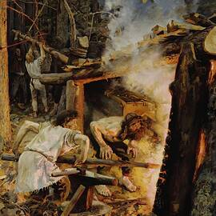
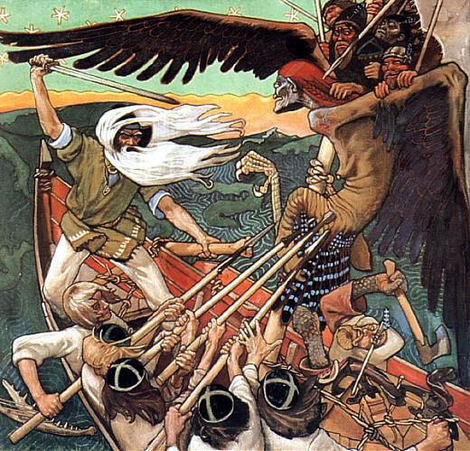
The Myth of the Machine

Slide 5




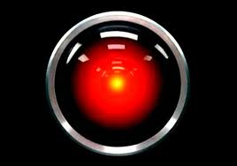
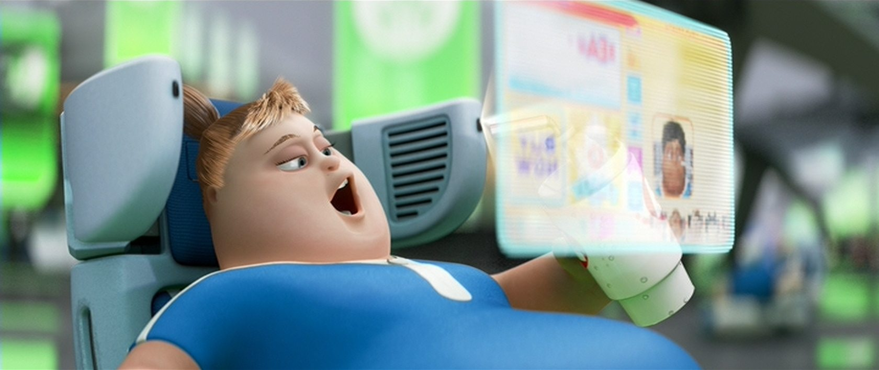
We Have Been Warned

Slide 6
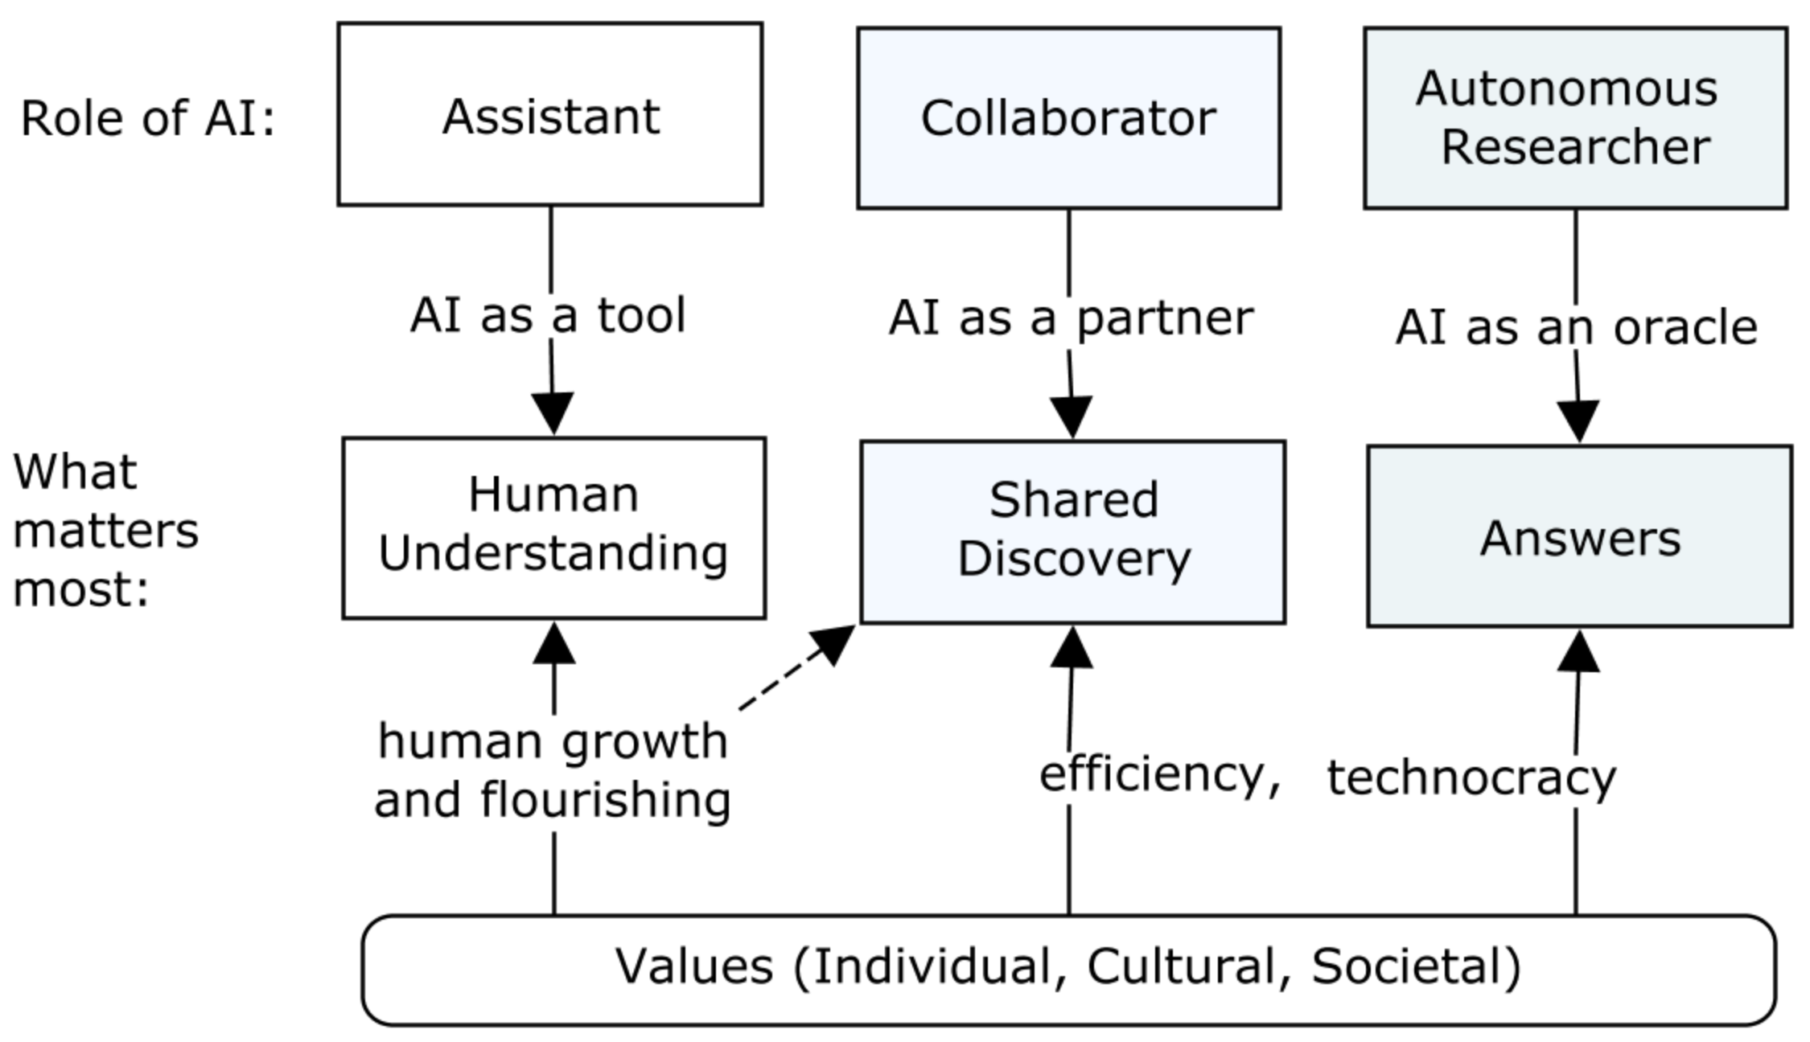
Human Roles in Interactions with AI

Slide 7
Surrender is a Choice
Human Image
AI Capability
Transhumanism?
Time

Slide 8
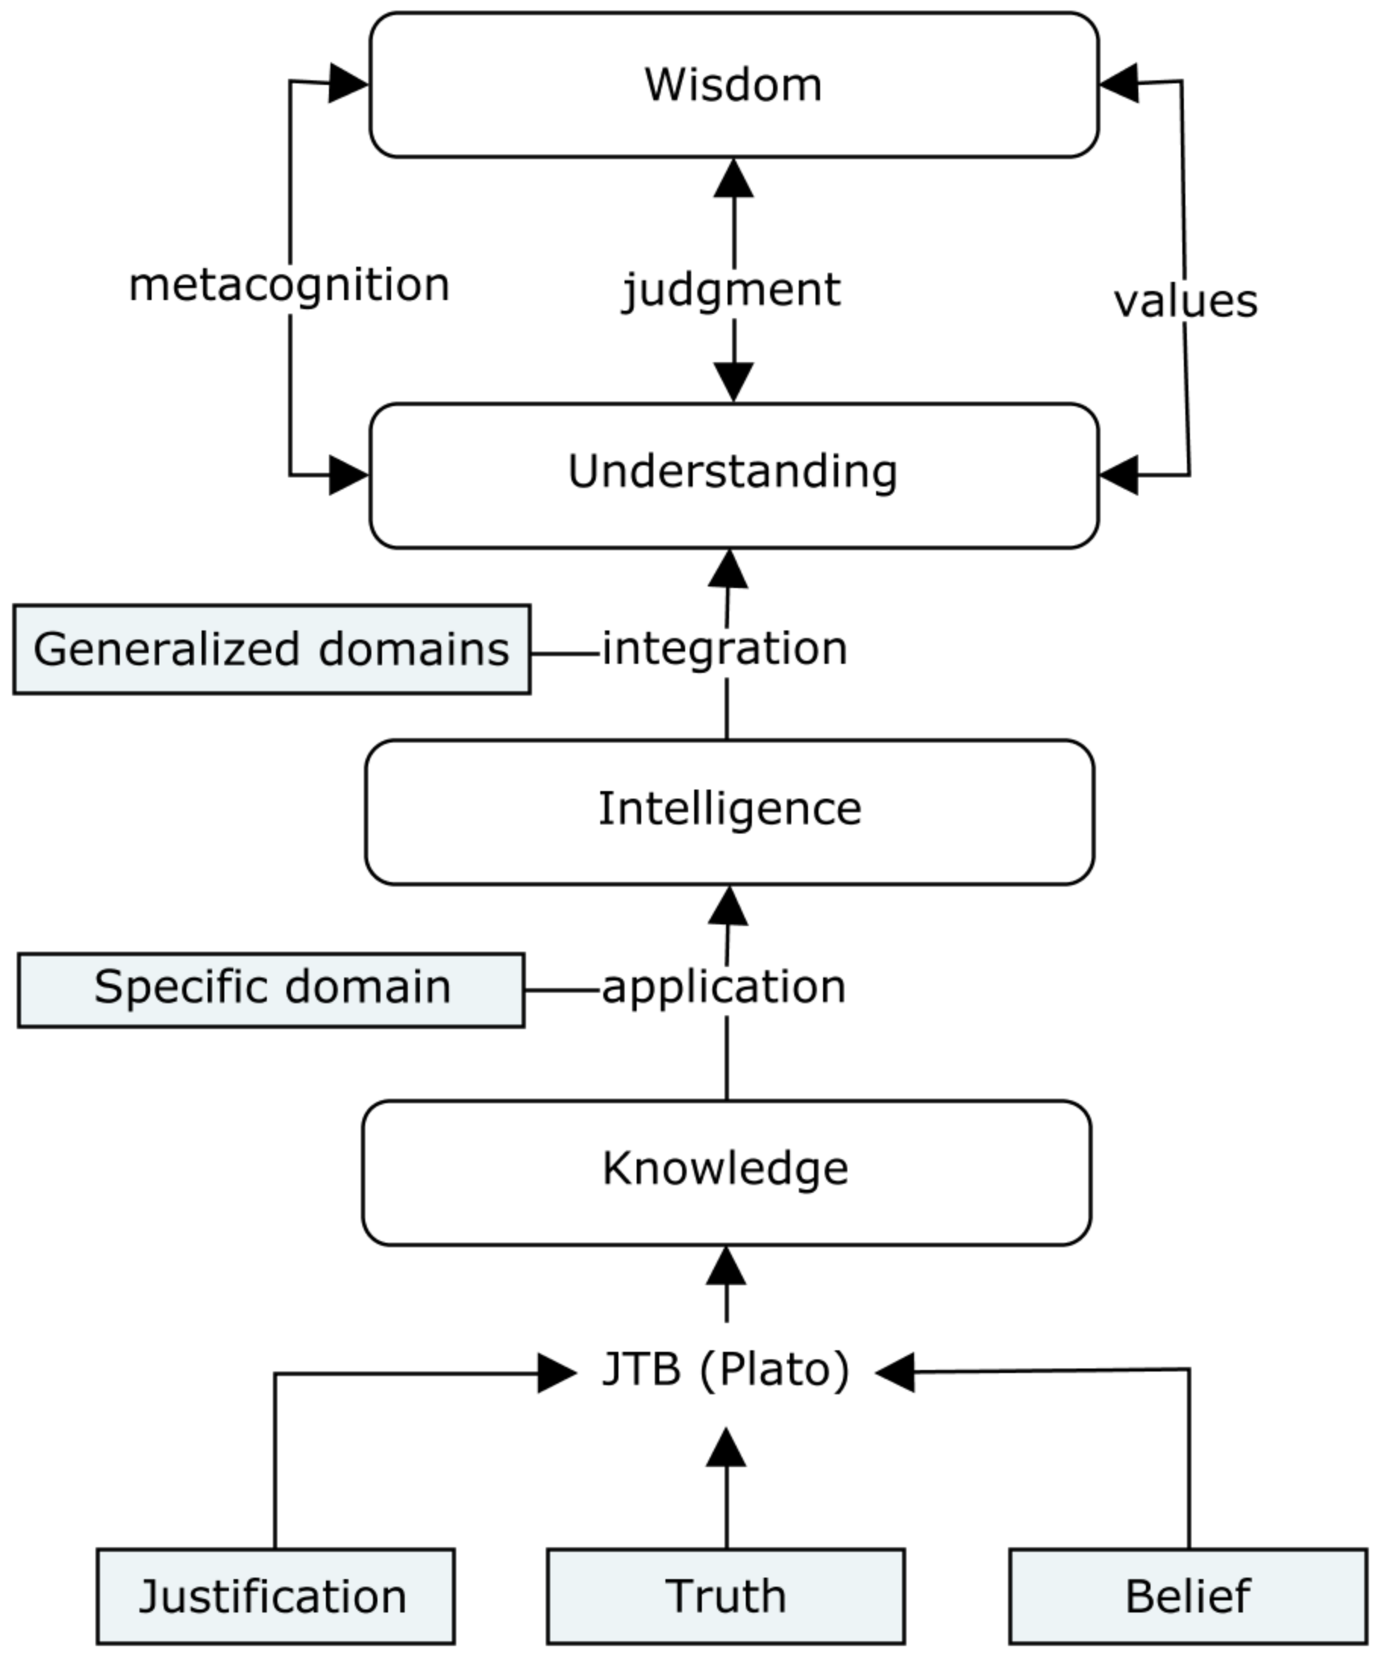
The Cognitive Ladder
The unique human factors of
  intelligence,
  understanding, and
  wisdom
But also
  “a thinking reed”,
  both “great and wretched”,
  “neither angel nor brute”,
  “a chimera”,
  inconstancy
  (Pascal)

Slide 9
Whither Human Factors in the Age of AI?
What is a human?
What is the ultimate purpose of a human?
Are we using technology for human flourishing or dulling of the human mind?
What does human flourishing look like?
These are not scientific questions

Slide 10
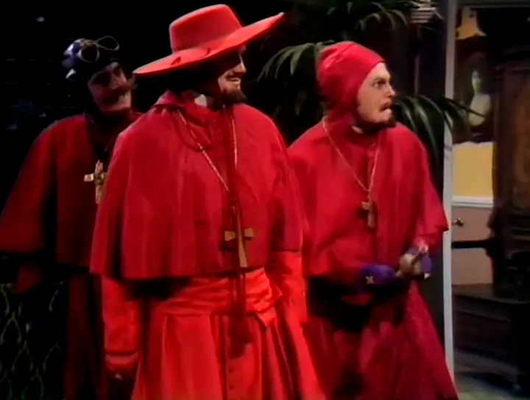
Thank You!
Questions?
Critique?
Discussion?
Diabolical laughter?

