Slide 1

WISDOM IN THE AGE OF AI CONFERENCE 2026 · AI & STEM TRACK
CALVIN UNIVERSITY · OCTOBER 8–10, 2026
AI as a Bridge
Supporting Human Dignity in Justice-Impacted Communities
“A human test for the technology we are building.”
Sandra E. Mosley · Founder, First Choice Together

Slide 2

COMPOSITE SCENARIO
Maya is more
than a list of tasks.
Work. Transportation. A required appointment. Family. A future.
She is trying to rebuild a life.

Slide 3
A system sees separate problems.
A person lives one life.
THE SYSTEM SEES
THE PERSON CARRIES
Appointment
Employment
Housing
Compliance
One life.
All at once.
Technology must meet that reality.

Slide 4
THE HUMAN TEST
When AI touches your work, does it make
you more capable—and more in control?
AI is already shaping decisions. The question is how.

Slide 5
THE BRIDGE THESIS
A bridge helps someone move forward.
It does not decide whether they deserve
to cross.
AI should expand human agency, not replace it.

Slide 6
The line we cannot cross
AI may support decisions. It must not make consequential judgments about people.
AI MAY SUPPORT
AI MUST NOT DECIDE
Options · Reminders · Resources · Better questions
Who deserves housing, work, liberty, or another chance
Efficiency is not the same thing as wisdom.

Slide 7
Dignity must show up in the design
Protect the person.
Explain and correct.
Preserve meaningful choice.
Use only what is needed. Never turn support into surveillance.
Make AI understandable. Give people a real way to fix what is wrong.
Keep people active participants in decisions that shape their lives.

Slide 8
A REAL-WORLD CASE STUDY
Why I built MyPathForward.
A planning and resource-support tool for people navigating probation, parole, and reentry.
County-aware guidance. Practical next steps. Human support stays central.
Built from direct local experience.

Slide 9
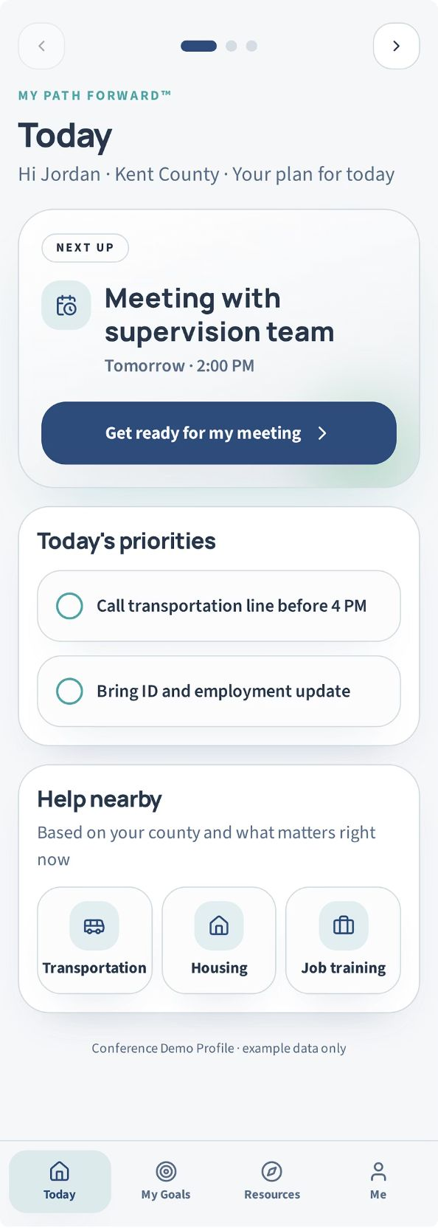
My plan, not a pile of tasks.
Context becomes a usable plan.
The first job is to help someone see what needs attention today.

Slide 10
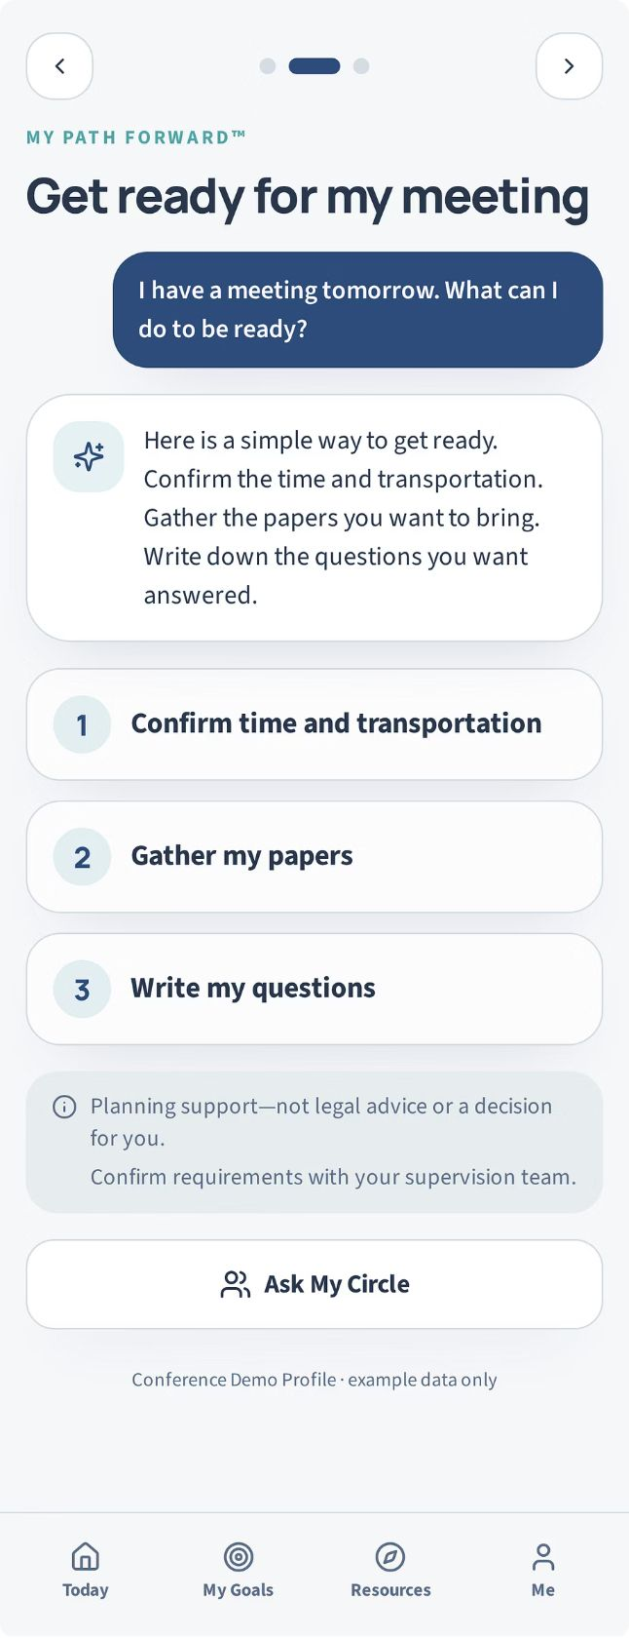
Support, not substitution.
Planning support—not an official decision.
The tool helps someone prepare. It does not decide for them.

Slide 11
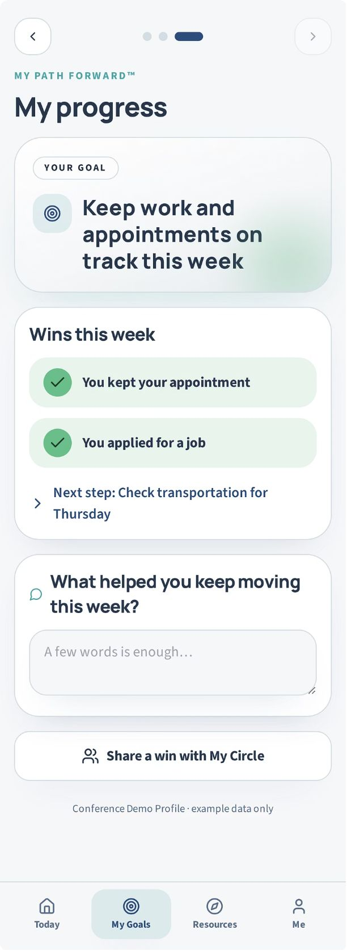
Progress is more than compliance.
Growth is visible.
The goal is consistent action and growth—not a score assigned to a person.

Slide 12
A CHRISTIAN AND HUMAN-DIGNITY STANDARD
Dignity is inherent. It is not a score,
a prediction, or a category.
Technology should serve people without reducing people.

Slide 13
Before you build or deploy AI, ask:
1
Who is this system really serving?
2
Does it understand the context of people's lives?
3
What can it support—and what must remain human?

Slide 14
Keep asking:
4
What values are built into the way it works?
5
How will we know it is helping—not just speeding up a process?
Use this test before you build, buy, deploy, or approve AI.

Slide 15
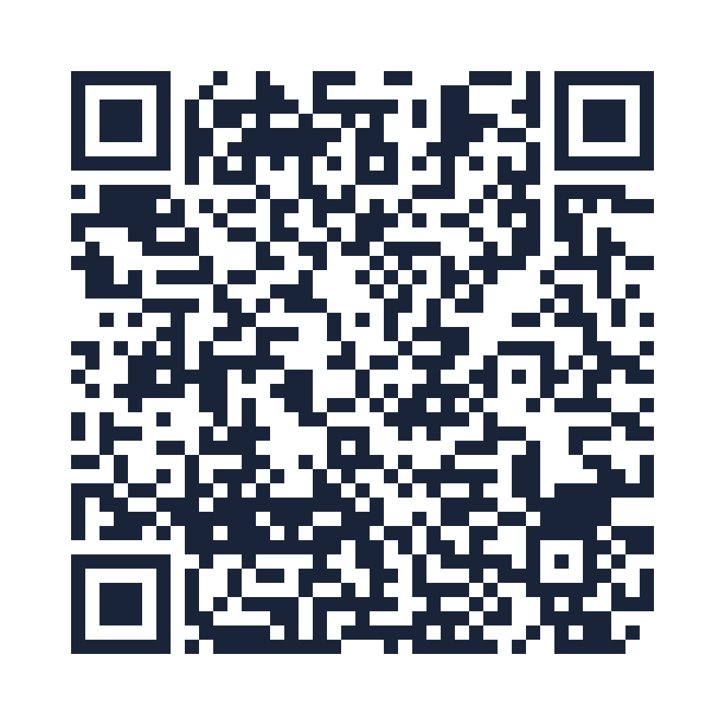
Stay Connected
Scan for the handout, the five-question test, and other resources.
Sandra E. Mosley
First Choice Together
sandra@firstchoicetogether.com
firstchoicetogether.com
linkedin.com/in/sandraemosley
The bridge we are responsible for building.

