Slide 1
Emissions, impacts, and embodiment
A techno-economic sustainability analysis of AI data centers
Jeremy VanAntwerp & Matthew Kuperus Heun
Calvin Engineering
Wisdom in the Age of AI
October 8, 2026
Notes:
Good afternoon. Matthew Heun and I have been considering AI through a sustainability lens.
I am going to present some thoughts about AI through the 3 pillars of sustainability: environmental, social, and economic.
This conference is called “Wisdom in the age of AI” so I will begin with working definitions for “wisdom” and “AI.”

Slide 2

Biblical Wisdom
Prudence | Discernment | Self-control
Logic | Spiritual Perception | Will
Shrewd vs. simple Prov 8:5 Prov 14:15 | Prophet vs. scoffer Prov 8:6-12 Prov 14:16 1 Thes 2:13 | Disciplined vs. sluggard Prov 25:28 Prov 19:24 Prov 4:23; 5:8; 7:8,25
Constraints Cost/Benefit Risk Prioritization | Can I see the truth? What is really going on? What are motives or intentions? | Can I do the good thing I’ve already decided to do? Can I avoid avoidable temptation?
Notes:
Wisdom, in the bible, encompasses three distinct traits. First is prudence, which is the application of logical principles to make good decisions from available data. The book of Proverbs calls those have prudence “shrewd” and those that lack it “simple.” Prudence considers constraints, cost/benefit analysis, risk, and prioritization.

Slide 3
Biblical Wisdom
Prudence | Discernment | Self-control
Logic | Spiritual Perception | Will
Shrewd vs. simple Prov 8:5 Prov 14:15 | Prophet vs. scoffer Prov 8:6-12 Prov 14:16 1 Thes 2:13 | Disciplined vs. sluggard Prov 25:28 Prov 19:24 Prov 4:23; 5:8; 7:8,25
Constraints Cost/Benefit Risk Prioritization | Can I see the truth? What is really going on? What are motives or intentions? | Can I do the good thing I’ve already decided to do? Can I avoid avoidable temptation?
Notes:
The second kind of Biblical wisdom is discernment, which involves spiritual perception. Proverbs contrasts those who can recognize truth with those who can’t. We might call bold truth-tellers “prophets.” Proverbs calls those who deal in lies and half truths “mockers” or “scoffers.”

Slide 4
Biblical Wisdom
Prudence | Discernment | Self-control
Logic | Spiritual Perception | Will
Shrewd vs. simple Prov 8:5 Prov 14:15 | Prophet vs. scoffer Prov 8:6-12 Prov 14:16 1 Thes 2:13 | Disciplined vs. sluggard Prov 25:28 Prov 19:24 Prov 4:23; 5:8; 7:8,25
Constraints Cost/Benefit Risk Prioritization | Can I see the truth? What is really going on? What are motives or intentions? | Can I do the good thing I’ve already decided to do? Can I avoid avoidable temptation?
Notes:
The book of Proverbs most emphasizes the third type of wisdom, self-control, which is an exercise of the will towards righteous living. Proverbs contrasts the disciplined and the sluggard. Two keys for self-control are “can I do the good thing I have already decided to do” and “can I avoid avoidable temptation?” With those definitions for wisdom, let’s turn next to defining AI for this talk.

Slide 5
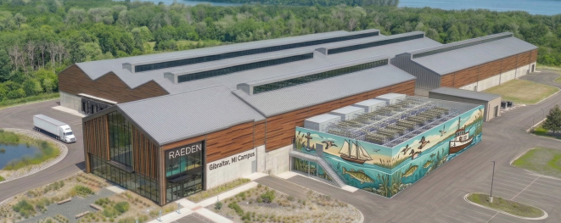
AI is Embodied
Information
Material
Energy
Computing
Machine
Wall-I [proposed] Gibraltar, MI (Raeden 2025)
Machine
Notes:
There is a tendency to think --- because “intelligence” is in the name --- that Artificial Intelligence is disembodied.
Nothing could be further from the truth. AI is embodied in grid-scale infrastructure [click]. Here we see a proposed 100-MW data center for the small town of Gibraltar, Michigan. It’s a massive, physical building. But a machine without energy is just an expensive statue.
AI is a computing machine, that is, a massive construction, that uses substantial energy, for the purpose of manipulating information.
We’re going look particularly at the sustainability implications of AI energy use.

Slide 6
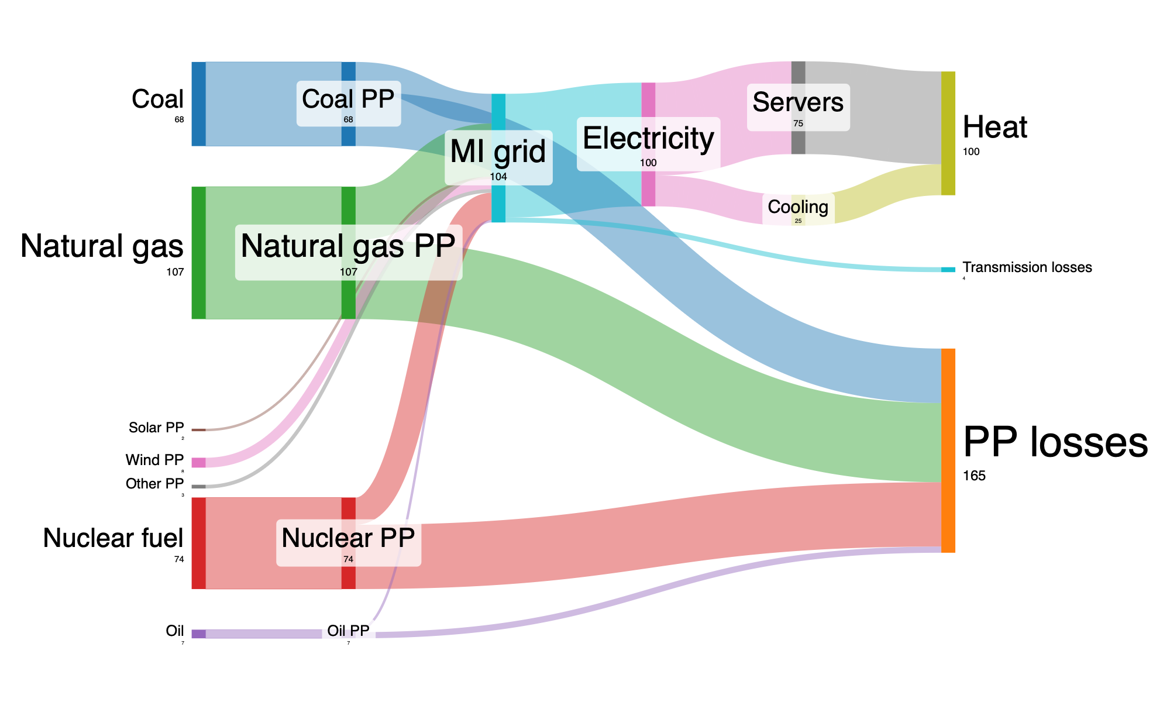
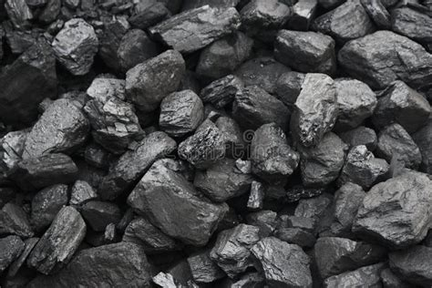
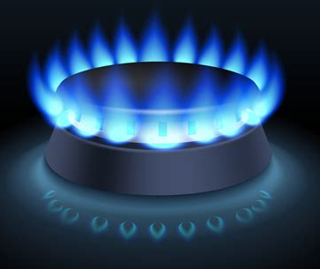
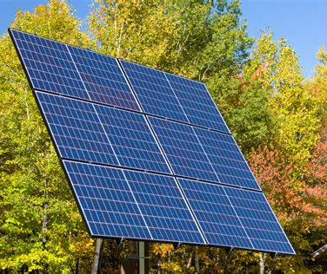
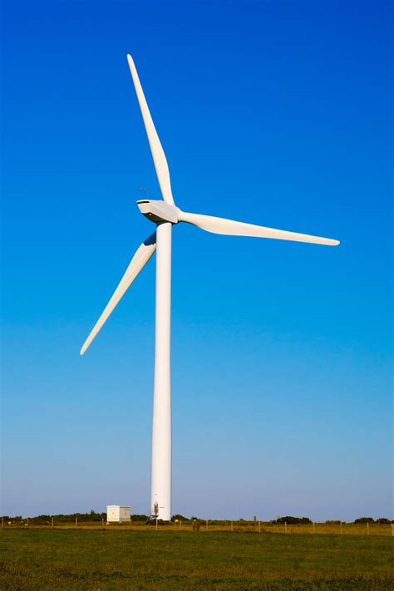
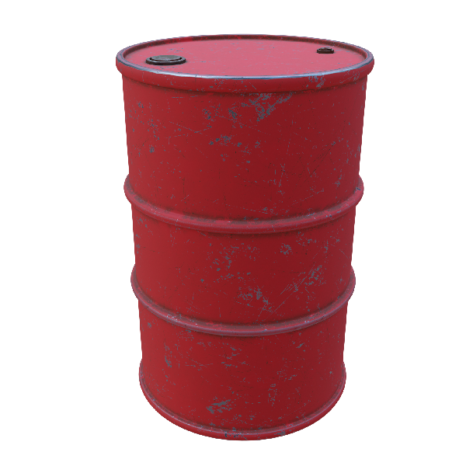
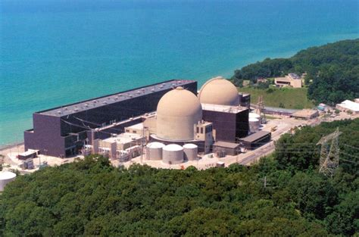
100 MW data center
All units MW
Notes:
This Sankey diagram shows the flow of energy from left to right. The amount of energy is represented by the thickness of each line.
Of the 100 MW of electricity [click] fed to a data center about 75 MW is used by the servers and about 25 MW is used for cooling. [click]
The Michigan electrical grid is fed with a mix of coal, natural gas, and nuclear power plants (PP), with small amounts of renewable energy and oil. [click] Ultimately, energy is dissipated as heat, either from the data center itself, from the electrical grid as transmission losses, or within the powerplants that generate electricity.

Slide 7
100 MW data center
180 Mgal water/yr
200,000
tonnes CO₂/yr
175,000
tonnes CO₂/yr
All units MW
Notes:
Overall, 269 MW of primary energy is needed to supply 100 MW for the AI data center. 68 MW of Coal power generates 200K tonnes of carbon dioxide per year. 107 MW of natural gas power generates 175K tonnes of CO2 per year. And cooling uses 180 Million gallons of water per year. All of this is for just one data center.

Slide 8
Number of US data centers
Total rated power
GW
175 MW average
GW
GW
50 MW average
Notes:
Currently, there are 1300 data centers operating in the US using about 60 GW of power.
About 2200 more are coming soon with a total power rating of an additional 390 GW.
For context, the Michigan electricity grid is about 32 GW [in 2024 (US EIA)], So that’s about 12 more Michigan electrical grids.
The trend toward “more” and “bigger” is called Hyperscaling.
Midcontinent Independent System Operator (MISO) is about 91 GW, peak.

Slide 9
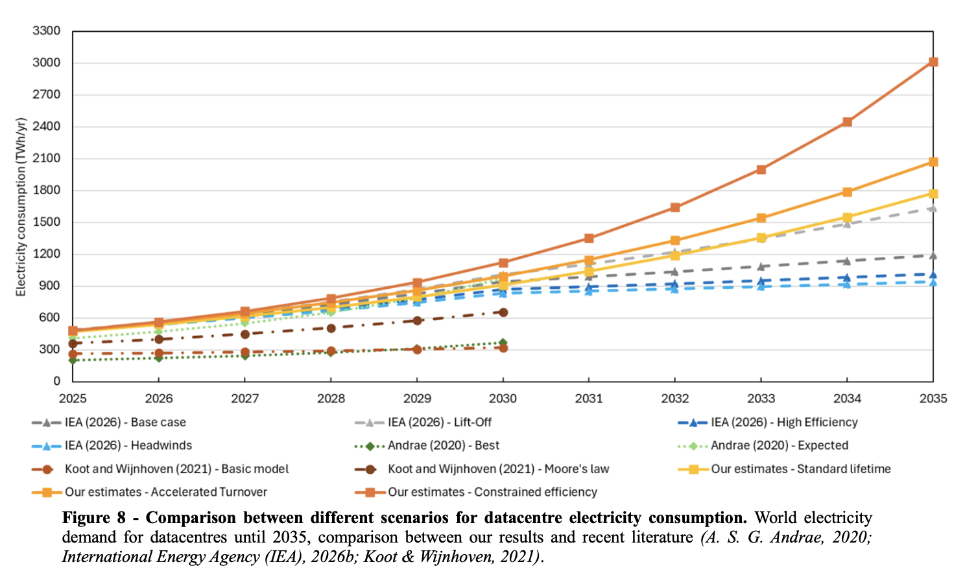
Projected global data center electricity use 2005-2035
2–6x
in 10 years
Pinto, Ricardo, Tiago Domingos, Paul E. Brockway, Matthew Kuperus Heun, and Tânia Sousa. 2026. Energy Demand of Computing Devices to 2035: Efficiency, Scenarios, and the Role of Datacentres. Draft paper in preparation likely to be submitted to Energy.
Notes:
Currently, data centers use 1-3% of electricity globally. Within 10 years, hyperscaling will increase electricity used by data centers by a factor of 2-6. Electricity is only one of our sources of final energy. (Some others include refined petroleum for transportation and natural gas for residential heating.) Even with dramatic increases for DIRECT AI data center ELECTRICITY use, direct CO2 emissions for DATA CENTERS are a relatively small fraction of total CO2 emissions.

Slide 10
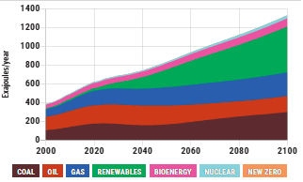
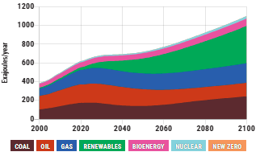
Net effect of AI on environment depends on economy
+3.6 °C
+3.3 °C
Energy +20%
AI
2%
Notes:
The real impact of AI on the environment depends on the impact of AI on the economy. EN-ROADS is a climate simulator put out by MIT. The comparison on this slide is between a business-as-normal 2% economic growth through the end of the century VERSUS AI-accelerated economic growth. Two percent has been the average since 1950. On the left is the amount of energy used, with coal on the bottom, then oil, gas, and renewables in green. It may be a little hard to see, but with AI-accelerated economic growth, we’re using an EXTRA 230 exajoules per year by 2100. That results in about an extra 15 Gigatons of CO2 per year in the last half of the century. In 2100, for instance, from 75 GT/yr to about 90. The EXTRA carbon emissions result in 0.3 degrees C of extra warming by the end of the century.
I’m NOT claiming the EN-ROADS model is gospel truth. It’s DIRECTIONALLY correct and it is illustrative of the broader point that the economy’s use of resources, energy in particular, causes global climate change.
This sort of economic growth is the intentional goal of hyperscaling. Because no one is responsible for the environmental effects.
OK, now let’s return to the wisdom piece of the talk.

Slide 11

Prudential Wisdom
Cost/Benefit
Constraints
Priorities
Risk
Environmental
Economic
Social
Is this a good idea?
Notes:
Remember that prudence applies logical thinking to make good decisions from available information by asking questions about such things as cost/benefit, constraints, priorities, and risk. Basically, “Is this is a good idea?”
I don’t have time to examine all of these areas or to give definitive answers for AI. Instead, I want to 1) Define risk. AND 2) Look at each of the 3 legs of the sustainability triangle, social, economic, and environmental, and see what prudential judgement about AI might tell us.

Slide 12
Prudential Wisdom
Cost/Benefit
Constraints
Priorities
Risk
Ignorance
Uncertainty
Risk
= likelihood x
consequences
Environmental
Economic
Social
Is this a good idea?
Notes:
Ignorance is the absence of knowledge. Uncertainty is impartial knowledge. Neither is the same as risk, which is likelihood multiplied by consequences. If we give a preschooler a chainsaw, we should not claim ignorance about what will happen.
While it’s technically true that “anything could happen” and that we don’t “absolutely know” what will happen, There’s a fair likelihood of significant injuries to body and/or property. A preschooler with a chainsaw is unacceptably risky.
Let’s pull apart our sustainability triangle and apply examples of ignorance, uncertainty, and risk to the 3 pillars of sustainability.

Slide 13
Prudential Wisdom
Cost/Benefit
Constraints
Priorities
Risk
Ignorance
Uncertainty
Risk
= likelihood x
consequences
Environmental
Economic
Social
Is this a good idea?
Notes:
There are concerns, because AI is new and we don’t KNOW what WILL happen, about rogue AI.
More extreme versions of this fear include Skynet, from the Terminator franchise, or the machine overlords from the Matrix movies.
It’s really fear of the unknown that fundamentally drives these concerns, hence why the nature of the threat might be classed as speculative fiction. Let’s put this in the SOCIAL sphere.

Slide 14
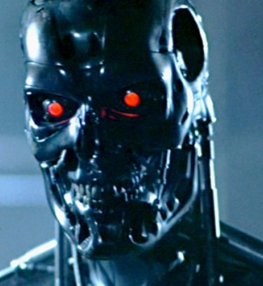
Prudential Wisdom
Cost/Benefit
Constraints
Priorities
Risk
Ignorance
Uncertainty
Risk
= likelihood x
consequences
Environmental
Economic
Social
Is this a good idea?
Notes:
If you’ve been following any of the business news lately about AI, there are questions about the massive investment in the build out of AI data centers, the IPOs of AI-centric companies, and the market power of those companies. These concerns are based in part about the unknown future, but also in present knowledge and stated future intentions. We read the news and see the headlines. We *wonder* whether AI will be “worth it” so let’s connect uncertainty to our economic sphere.

Slide 15
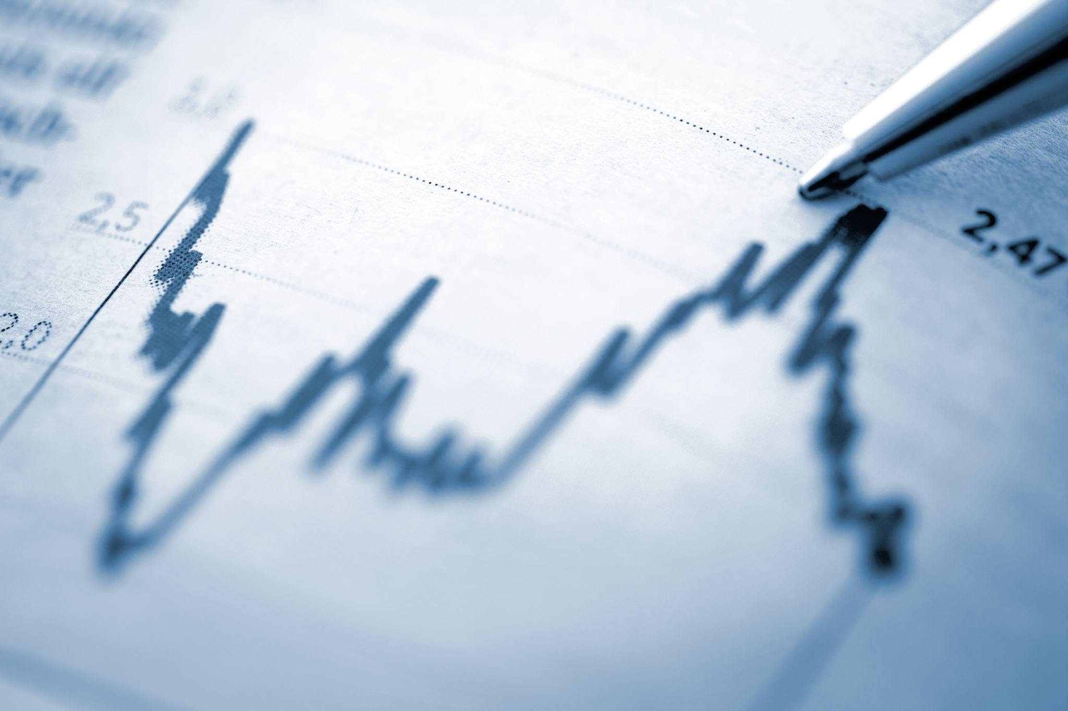
Prudential Wisdom
Cost/Benefit
Constraints
Priorities
Risk
Ignorance
Uncertainty
Risk
= likelihood x
consequences
Environmental
Economic
Social
Is this a good idea?
Notes:
Environmentally, the RISK of climate change is high because the consequences are severe, long lasting, and widespread. The likelihood that AI will accelerate economic growth seems reasonably high because the goal of hyperscaling is growth and we’ve already invested significant dollars into the effort.

Slide 16
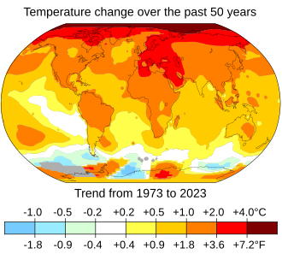
Prudential Wisdom
Cost/Benefit
Constraints
Priorities
Risk
Ignorance
x
Uncertainty
Risk
= likelihood x
consequences
Environmental
Economic
Social
Is this a good idea?
Notes:
Proverbs 14:15 says “The simple believe anything, but the prudent give thought to their steps.” Let’s not worry about science fiction.
In the economic realm, there are lots of credible questions about the massive amounts of money being spent on AI and whether there will, or even can, ever be a payback. This is not investment advice, but I would say that AI looks like a risky bet right now in October of 2026.
Environmentally, we can’t afford to “go on” as we have been, let alone accelerate economic growth. The previous several slides demonstrated the environmental consequences of hyperscaling. Regardless of whether AI is “worth it,” in a financial sense we CAN’T afford, environmentally, to hyperscale our economy.

Slide 17

Discernment
Two lies
The lie of truth
The lie of creativity
How do the sunglasses stay on the cat’s face?
Notes:
Discernment is about recognizing the truth of a situation. There has been a lot of popular backlash to AI recently. Why?
Let me give you TWO LIES and THREE TRUTHS that I think help illustrate what’s “really going on” in our society and our economy.
We’ve been told by AI companies that AI will do two things for us: 1) it will accelerate the information superhighway and bring us more truth faster.
Second, that AI is generative. In contrast, we ALL have direct experience that both of these promises fail to live up to expectations.
AI hallucinates. AI slop is a thing. Large language models, by definition, aren’t “creative” because they deliver that which is “MOST STATISTICALLY LIKELY.”

Slide 18
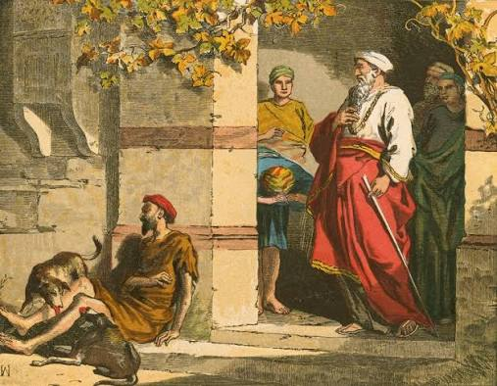
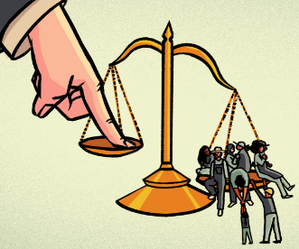
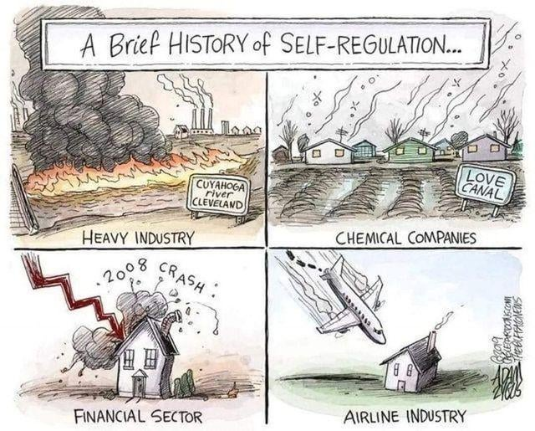
Discernment
Three truths
Unvalued workers
Imbalance of power
Vested interests
The rich man and Lazarus
Notes:
And yet. Businesses are eager to replace workers with AI, not because AI is better – Artificial Intelligence is demonstrably WORSE than human intelligence – but because AI is CHEAPER. And people resent being told how little they are worth.
AI has become a tool to widen the gap, in our society and our economy, between the “haves” and the “have nots.”
AI is the power behind not just Surveillance pricing algorithms, it has now been deployed for Surveillance wages.
Michigan Public Act 233 (2023) instead of promoting green energy, has become a tool for utilities and AI companies to prevent locals from having any control over data center projects. This means AI and utility companies are the ones making decisions about new power infrastructure without regard to the effects on climate, water, or energy prices to the consumer. AI isn’t bad. It’s just a powerful tool in the hands of sinful people that inhabit a broken and sinful world.

Slide 19
Self-control
Individual
Corporate
Notes:
The third aspect of Biblical wisdom involves the exercise of the WILL to do good.
As Christians, we are called to not only personal righteousness, but also communal righteousness within our convent community.

Slide 20
Self-control
Individual (virtue)
Corporate (justice)
Notes:
We could call individual self-control “virtue” but what does corporate self-control look like? I think that’s a harder question to answer. Let’s agree that, at least, it could begin with justice. That is, just laws justly applied.
But what do we do when we live in a society where that is injustice and where we aren’t seeing the shalom we would like to see?

Slide 21
Self-control
Lament
Prophetic voice
Organize
Notes:
Ancient wisdom literature suggests answers, because the questions of injustice are not new. We can lament. We can speak the truth (with discretion). And we can organize to work together.

Slide 22
Self-control
“A sluggard buries his hand in the dish;
he will not even bring it back to his mouth!”
Prov 19:24
“The lips of the adulterous woman drip honey,
and her speech is smoother than oil;
but in the end she is bitter as gall,
sharp as a double-edged sword.
Her feet go down to death;
her steps lead straight to the grave.”
“Keep to a path far from her,
do not go near the door of her house,”
“lest strangers feast on your wealth
and your toil enrich the house of another.”
Prov 5:3-5, 8, 10
Notes:
In Proverbs, self-control often involves forgoing a short-term pleasure for a long-term gain. In Proverbs 19:24 the sluggard is too lazy to even eat. If only he could postpone sleep just a little to finish eating. Then he would be OK. There’s a proper time and place for both sleeping and eating. Adultery is a somewhat different matter. It has both moral (Prov 5:5) and practical consequences (v. 10). Both prudence and discernment play into the analysis. It’s risky. Do you see what’s going on here? The remedy, according to Proverbs, is to stay away (5 verse 8). Just avoid the situation.
Our current climate crisis is exactly the same lack of self-control. It’s not that we don’t know how to prevent climate change. We do and have for 40 or 50 years. It’s just that securing our long-term future would require forgoing fossils fuels (and the associated economic growth) in the present day. We’ve failed to live in accordance with our own long-term interests both individually and corporately. And at every scale in between. We have decades of failure to exercise self-control with respect to climate change. Will we also fail with AI?

