Slide 1
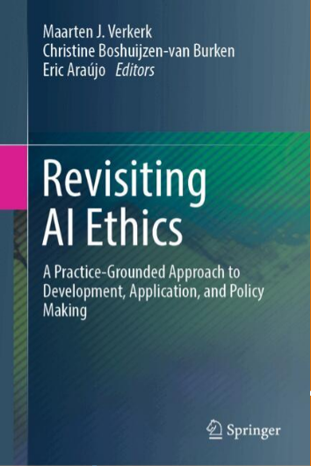
AI AND STEM · FRIDAY 9 OCTOBER · PRINCE BOARD ROOM
Revisiting AI Ethics
A Practice-Grounded Approach to Development, Application, and Policy Making
Edited by
Maarten J. Verkerk, Christine Boshuijzen-van Burken, Eric Araújo
Springer · forthcoming February 2027
Christine Boshuijzen-van Burken Eindhoven University of Technology
Eric Araújo Calvin University
Notes:
Introduce the book and the two presenters. Edited volume with Maarten Verkerk, Springer, February 2027.

Slide 2
Exploring the Field
2
AI Ethics Frameworks
A Pandemonium
PART I
3
AI
Demystifying the Technology
4
Exploring Ethics
A Practice-Grounded Approach
Chapters 2 to 5
5
Five Lenses Model
A Heuristic for AI Ethics

Slide 3





The Five Lenses Model
Four lenses bring the relevant values of a concrete practice into view. The fifth turns them into design specifications.
LENS I
LENS II
LENS III
LENS IV
Core values
What is the practice’s raison d’être? Its qualifying values come first.
Enabling values
Which other value categories make the practice possible, and how critical is each?
Stakeholders’ core values
Which primary and secondary stakeholders have justified interests?
Worldview values
What personal and shared convictions does the team bring?
Identify all relevant values of the practice
LENS V
Translate values into design
Value categories
›
Specific values
›
Norms
›
Design specs
Notes:
The Five Lenses Model (Ch. 5, Verkerk and Voordijk). We chose the word lenses deliberately: like glasses, each lens lets you see values in a practice that are not immediately apparent.
Lens I: identify the practice's core values, its raison d'etre. Anna's AI R&D practice is led by technological values, Charlotte's hospital practice by care values, Peter's municipal policy practice by legal values.
Lens II: determine the enabling values (every other value category: social, economic, juridical, and so on) and assess how critical each is.
Lens III: assess stakeholders' core values, primary and secondary, and ask which interests are justified.
Lens IV: review worldview values, the personal and shared convictions of the team.
Lens V: translate all of these into design specifications through a cascade adapted from Van de Poel: value category, specific values, norms, design specifications.
No standard list of values for every practice. Applying the lenses takes time and teamwork with stakeholders; it is not done in an afternoon.

Slide 4
AI in Action
6
AI and the Digital Public Square
Normative landscape of social media algorithms
13
AI and Farming
Towards a sustainable and equitable agriculture
7
AI and Sex
Design of sex tech to support sexual flourishing
14
AI and Cybersecurity
Navigating the ethics of AI
PART II
8
AI and Healthcare
Trade-offs in AI for patient care
15
AI and Engineering
Wind turbine foundations and project costs
9
AI and Banking
Blind spots, challenges, and flourishing of society
16
AI and Education
A non-reductionist critique of learning with or without generative AI
10
AI and Military Operations
The case of Lavender
17
AI and Research
Voices of novice researchers matter
Chapters 6 to 18
11
AI and Court
Automatic speaker comparison in forensic practice
18
AI and Generativity
Affordances, reductions, and ethical responses
12
AI and Public Administration
Simply tech support?

Slide 5
Deep Dive
19
Thinking About Practices
The philosophical basis of the Five Lenses Model
20
Learning Lessons from the First Wave of AI
For future AI
PART III
21
AI and the Human/Machine Distinction
Intelligence and agency
22
AI and Worldview
23
Foreign Electoral Interference and the Rule of Law
AI shield, responsibility gap, and state accountability
Chapters 19 to 25
24
Wisdom of the Spheres
AI, situational awareness, and our world of personal relations
25
Revisiting AI Ethics
Conclusion

Slide 6




FROM THE AUTHORS
Nick Brems
Writing a chapter with a philosopher
Practice
The chapter
Philosophy
What happens when practice and philosophy share one chapter?
Notes:
Hand over to Nick Brems for a few minutes on his experience co-writing his chapter with a philosopher.

Slide 7

COMING FEBRUARY 2027
Thank you
An ethical framework firmly rooted in AI practices and supported by well-established ethical and philosophical principles.
20% off with code
SPRAUT
link.springer.com/book/9783032412539

