Slide 1

Advanced R
Tools for Advanced Data Analytics in R
A Course Designed by Data Smart Science
&
Presented by
Dr. Eric Asare & Seth Appiah

Slide 2
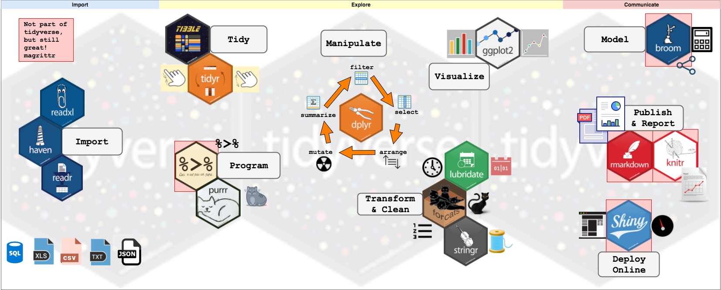
Tidyverse

Slide 3
GGPLOT2: Graphing Package R
Developed by Hadley Wickham
GGPLOT has 2 main plotting functions: qplot() and ggplot()
We will focus on ggplot because it is more robust, flexible and elegant than qplot()
More information: 3 Data visualisation | R for Data Science (had.co.nz) ; A Review of the R Graphics Cookbook | R-bloggers

Slide 4
Today’s Outline
GGPLOT Template
ggplot(data = <DATA>,
mapping = aes(<MAPPINGS>)
) +
<GEOM_FUNCTION>( )
Or
ggplot(DATA, aes() ) +
GEOM_FUNCTION( )

Slide 5
Today’s Outline
Definition of sub-components or drivers of ggplot()
Data is the data.frame that contains the variables you will use for plotting.
AES also called aesthetics: this is where you indicate x and y variables You can also control some aesthetics (appearance) of the plot (shape, size and color and others).
More information : Aesthetic specifications • ggplot2 (tidyverse.org)
Geom allows you to define the geometry function. The geom function determines the type of plot (linear, scatter, box_plot, ...). More: Function reference • ggplot2 (tidyverse.org)

Slide 6
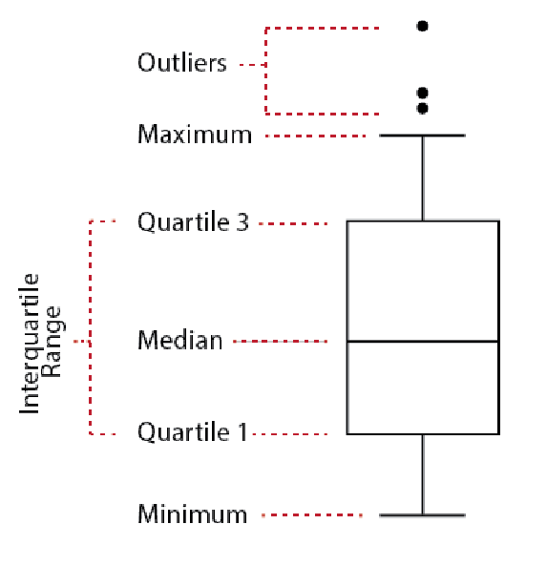
Outliers

