Slide 1

Advanced R
Tools for Advanced Data Analytics in R
A Course Designed by Data Smart Science
&
Presented by
Dr. Eric Asare & Seth Appiah

Slide 2
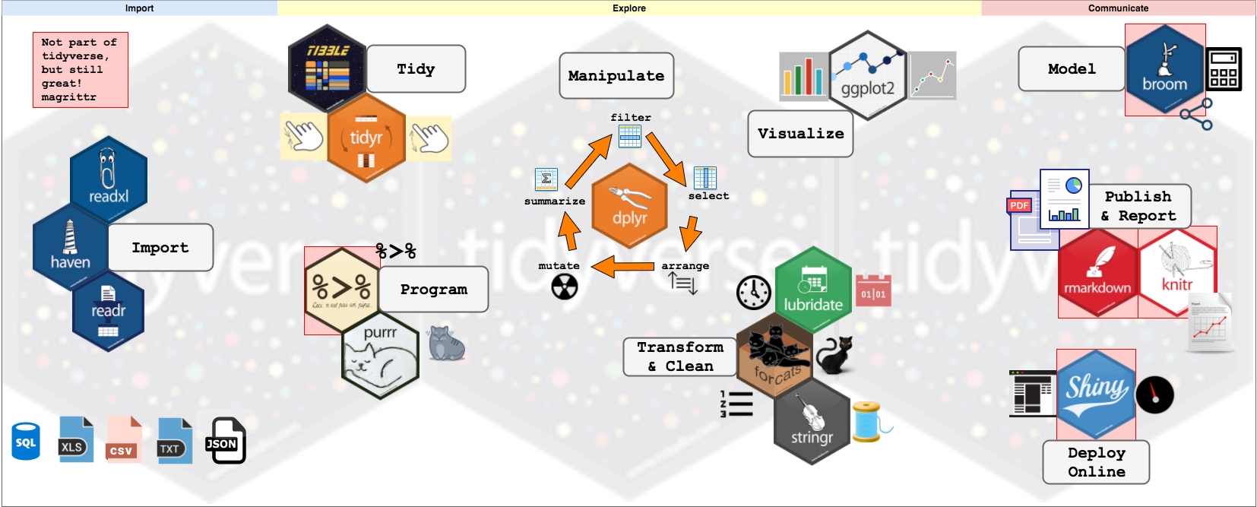
Tidyverse

Slide 3
Character manipulations
What is a character?
What functions in Stringr that can help us work with characters”
STR_LENGTH() : counts the number of characters in a string.
name <- “eric” --- number of characters are 4 which are: 1:e 2:r 3:I 4:c
str_length(name) will be 4.
2. STR_SUB(string, start, end): access individual characters in a string from the specified position.
Ex. Access character “r” in eric. It is in the 2rd position.
str_sub(name, start =2, end =2) : “r”
3. Replace characters in a string
Ex. Replace the “c” in eric with “K”
str_sub(name, 4) <- “k”

Slide 4
Whitespace manipulations
What is a whitespace?
What functions in Stringr that can help us work with whitespaces”
str_trim(arguments) : removes leading and trailing whitespaces.
name <- c(“eric”, “is “, “good” )
str_trim(name) : “eric” “is “ “good”

Slide 5
Pattern matching & manipulations
What is a pattern?
General structure: str_”pattern function” (string to process, pattern to search)

Slide 6
Pattern matching: Detect
Detect: If the pattern is present in the string or text, returns true.
Similar to str_subset() which returns the actual element(s) of the character vector.
Ex. Lets define a character vector: names
names <- c(“eric”, “jacob”, “seth”, Sammy”)
pattern <- “eric”
a) Is “eric” present in names? Str_detect(names, pattern): True False False False
Or str_subset(names, pattern): “eric”
b) Count number of matches: str_count(names, pattern): 1

Slide 7
Pattern matching: Extract, replace, split
Extract: extract the first match in the string.
str_extract(string, pattern)
2) Replace the match pattern: str_replace()
Pattern <- “eric”
str_replace(names, pattern, “erik”)
3) Split text based on a pattern
let say you have a date: today_date <- “2022 - March - 28”
separator <- “-”
str_split(today_date, separator)

