Slide 1

Advanced R
Tools for Advanced Data Analytics in R
A Course Designed by Data Smart Science
&
Presented by
Dr. Eric Asare & Seth Appiah

Slide 2
Recap of last’s week lesson
We illustrated how to combine if-else and loops (al wrapped in a function
to solve an applied problem
Compared R and Python functions and control statements
Index | 1 | 2 | 3 | 4 | 5
Value | 2 | 4 | 6 | 8 | 10
Index | Even_numbers | Names | Boolean
1 | 2 | Eric | True
2 | 4 | Akua | False
3 | 6 | Sammy | True
4 | 8 | Seth | False
5 | 10 | Naa | True
Index | 1 | 2 | 3 | 4 | 5
Value | Eric | Akua | Sammy | Seth | Naa
Index | 1 | 2 | 3 | 4 | 5
Value | True | False | True | False | True

Slide 3
Today : Vectorized Programming
Index | 1 | 2 | 3 | 4 | 5
Values | 2 | 4 | 6 | 8 | 10
Function: f(x) = x/2
Values | 1 | 2 | 3 | 4 | 5

Slide 4
Apply Family of Functions from Base R
Apply function by row: proxy is 1
Across columns: apply(data, 1, function)
Let’s say the function is sum(), and we want create a new column named Answer.
Apply(data, 1, sum) for row 1 is: 2+1 = 3
Index | Even_numbers | odd | Answer
1 | 2 | 1 | 3
2 | 4 | 3 | ?
3 | 6 | 5 | ?
Apply function by column: proxy is 2
Across rows: apply(data, 2, function)
Let’ say you need sum of columns:
Apply(data, 2, sum) for column (even_numbers) is:
2+4+6 = 12
*proxy is why we capture it. So, for ex 1 means across columns

Slide 5
Apply() Function
Apply function by row: proxy is 1
Across columns: apply(data, 1, function)
Let’s say the function is sum(), and we want create a new column named Answer.
Apply(data, 1, sum) for row 1 is: 2+1 = 3
Index | Even_numbers | odd | Answer
1 | 2 | 1 | 3
2 | 4 | 3 | ?
3 | 6 | 5 | ?
Apply function by column: proxy is 2
Across rows: apply(data, 2, function)
Let’ say you need sum of columns:
Apply(data, 2, sum) for column (even_numbers) is:
2+4+6 = 12
*proxy is why we capture it. So, for ex 1 means across columns

Slide 6
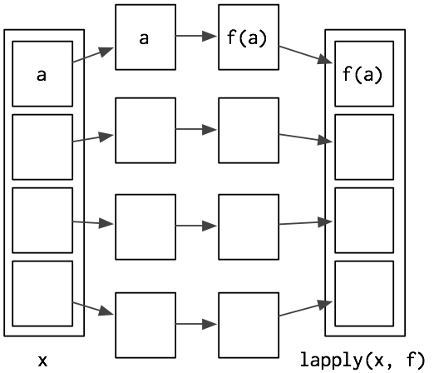
Lapply() Function
The “L” in Lapply stands for list.
So lappy() allows you to perform data transformations on a elements in a list.
Returns a list of the same length as input list.
X
1,
2
3
Lapply(X, runif())
1
runif()
runif(n =1, min = 0, max = 0)
2
runif()
runif(n =2, min = 0, max = 0)
3
runif()
runif(n =3, min = 0, max = 0)
Lapply(X, f)

Slide 7
Sapply() Function
The “S” in Lapply stands for simple and it is a wrapper of Lapply.
So compared to lappy(), sapply outputs are simple and easy to read.
Returns a vector or matrix
X
1
2
3
Sapply(X, runif())
runif(n =1, min = 0, max = 0)
1
runif()
runif(n =2, min = 0, max = 0)
2
runif()
runif(n =3, min = 0, max = 0)
runif(n =3, min = 0, max = 0)
3
runif()

Slide 8
Vapply()
Vapply is similar to sapply().
In Vapply() you specify the output type explicitly
Returns a vector or matrix
Sapply(X, runif())
Vapply(X, runif(), integer)

Slide 9
Tapply()
tapply(X, INDEX ,FUN)
It is a group by function.
It is used to perform group analysis
It splits data into subgroups and apply the function to each sub-group.
Even_numbers | Boolean
2 | True
4 | False
6 | True
8 | False
10 | True
True | False
2+6+10 | 4+8
tapply(X = data, INDEX = Boolean, FUN = sum)

Slide 10
Mapply()
It is a multivariate version of Lapply
Applies a function to first element of each argument, second elements, and so on.
str(mapply)
function (FUN, …, MoreArgs = NULL, SIMPLIFY = TRUE, USE.NAMES = TRUE)
Arguments | Meaning
Fun | Function to apply
… | R objects to apply function to
MoreArgs | List of other arguments to function
Simplify | If you want to simplify results

Slide 11
Mapply()
mapply(rep, 1:3, 3:1)
1
2
3
3
2
1
1 1 1
2 2
3
FUN = replicate function.

