Slide 1

Advanced R
Tools for Advanced Data Analytics in R
A Course Designed by Data Smart Science
&
Presented by
Dr. Eric Asare & Seth Appiah

Slide 2
Recap of last’s week lesson
Apply()
apply(df, 2, sum)
apply(df[ c(1, 3), ], 1, sum)
apply(df[, c(1, 3)], 2, sum)
Lapply()
Apply family (ALASVATM)
Sapply()
Vapply()
Tapply()
Mapply ()

Slide 3
Today’s Outline
What are R packages? How do we install them?
What is Tidyverse Ecosystem.
How do we read data into R.
Introduction to the Dplyr Package in Tidyverse.

Slide 4
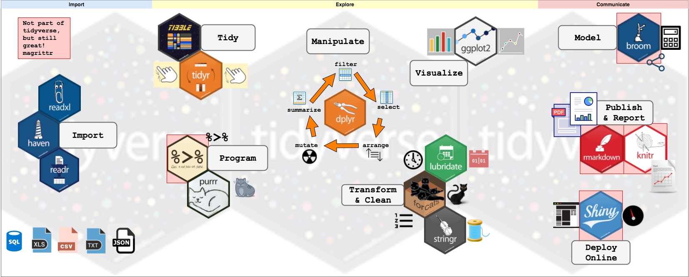
Tidyverse

Slide 5
Dplyr Package
The grammar of Dplyr
select() : select columns
Filter() : Select rows
Arrange() : sort columns
Rename() : Rename variables
Mutate(): Transform existing columns or add new columns
Group_by() : To conduct grouped data manipulations
summarize(): Create summary statistics
%>% : Pipes which links multiple data manipulation actions together

Slide 6
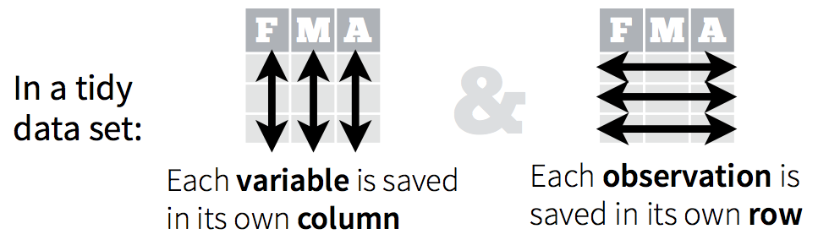
Dplyr Package
It is an awesome package for working with tidy data
What is a tidy data. It has the following characteristics:

Slide 7
Commenting
Resources to review before next week’s class:
Commenting:
Best practices for writing code comments - Stack Overflow Blog
GitHub and R-studio: The pdf file is in the Advanced R week 3 folder
Code review:
Code Reviews (github.com)
Pull request:
How to make your first pull request on GitHub (freecodecamp.org)

Slide 8
Lab Section
R folder management system.
Writing function scripts and sourcing.
Apply Dplyr package on Gapminder Data.

Slide 9
Key resource future sessions
Welcome | Advanced R (hadley.nz)
Welcome | R for Data Science (had.co.nz)

