Slide 1

Advanced R
Tools for Advanced Data Analytics in R
A Course Designed by Data Smart Science
&
Presented by
Dr. Eric Asare & Seth Appiah

Slide 2
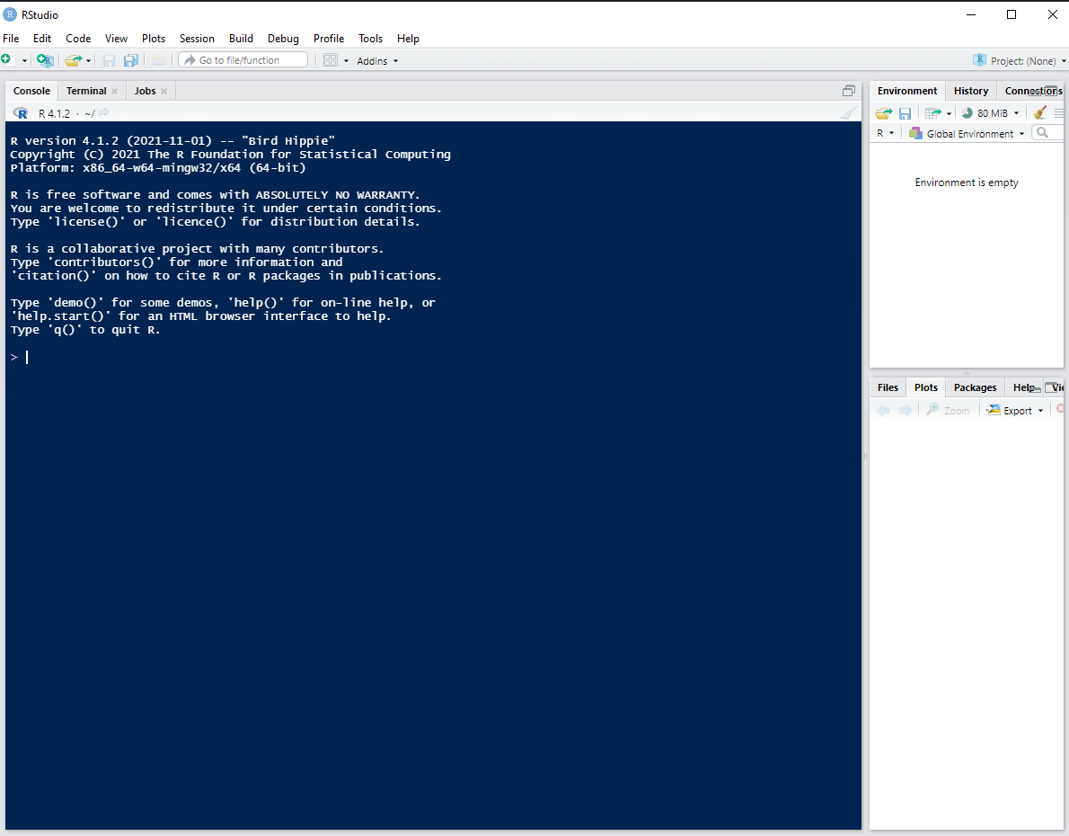

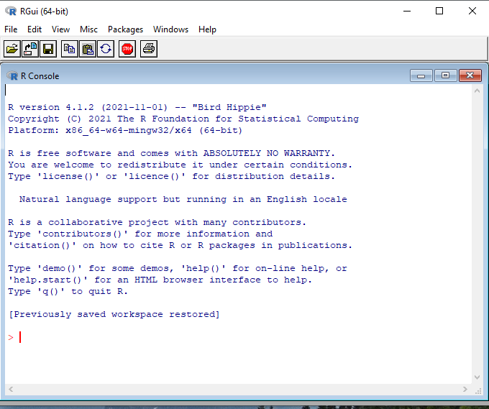
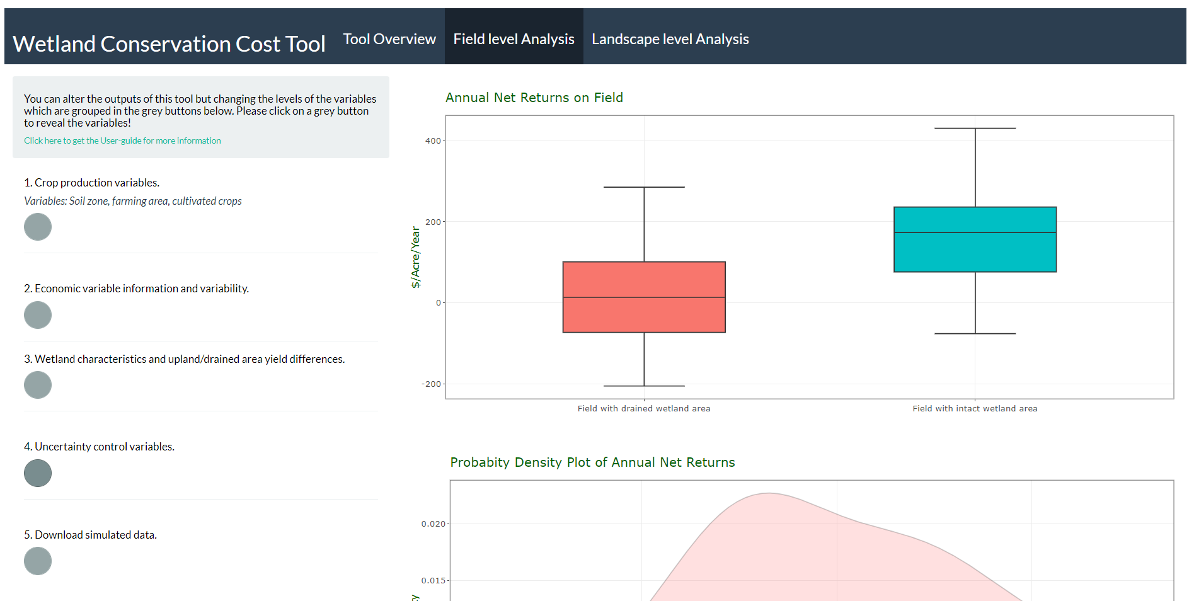
Fundamentals of R Programming
Programming Language: A set of rules or scripts that instructs a computer
to perform a specified action or output.
IDE
scripts
output

Slide 3
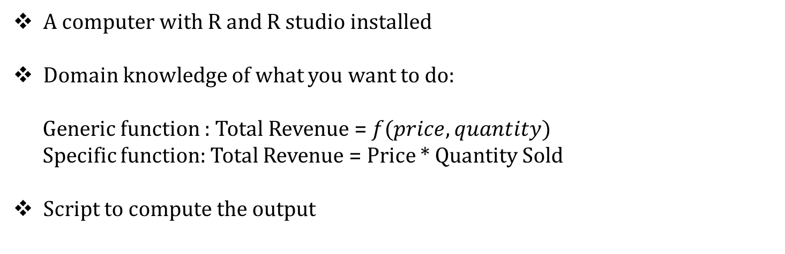
Fundamentals of R Programming
How do you instruct the computer to calculate total revenue in a particular day for Ericus Convenient Store?
What will you need?
A computer with R and R studio installed
Domain knowledge of what you want to do:
Generic function : Total Revenue = $f(price, quantity)$
Specific function: Total Revenue = Price * Quantity Sold
Script to compute the output

Slide 4

Fundamental Information for a Script
What data or datatypes can you put in a. container/variable ?
Numeric
Strings/Characters : ex. Eric, Seth, Ghana
Boolean: True /False
Integer ex. 3 and 5000
Double ex. 3.23 and 5000.70
Variable
Data

Slide 5
How do you assign data to variables?
We use the assignment operator: <-
Recall our Total Revenue Formula : Total Revenue = Price * Quantity Sold
Price is a variable. Since at any period it could take on any of these values 2, 5, 6, etc.
Quantity sold is a variable. It can also take on any of these values 2, 40, 2000, etc.
Creating price variable in R:
Let us represent price by P and assume price takes on value 5 then in R: P <- 5
Variable naming conventions
Let us say price is the price of corn. Then we may be specific on the kind of price: price_corn or priceCorn

Slide 6
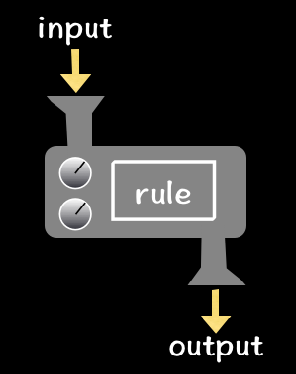
Creating Functions in R
What is a function?
What is a function?
Specification in R
Function name <- function(inputs){
rule
return (output of rule)
}
Calculated<- Function name (inputs)
Total Revenue ex
Total_Revenue <- function(price_corn, quantity_corn_sold){
output <- price_corn * quantity_corn_sold
return(output)
}
Calculated <- Total_Revenue(price_corn=5, quantity_corn_sold=20)

Slide 7
Control Structures
What if we want our function to produce an output based on some external condition?
Total Revenue (TR)
Did it Rain?
Yes
No
Price*Q = 5 *20
Price*Q = 5 *30
Specification in R
Total Revenue ex
Function name <- function(inputs){
if(condition){
rule
return (output of rule)
}
else{
rule
return (output of rule)
}
}
Total_Revenue <- function(price_corn, quantity_corn_sold, rain){
if(rain == “yes”){
output <- price_corn *(quantity_corn_sold)
return(output)
}else{
output <- price_corn *(quantity_corn_sold +10)
return(output)}
}

