Slide 1

‘R’ Foundational Programming Part One A
Eric Asare (Ph.D.)
DataSmartScience

Slide 2
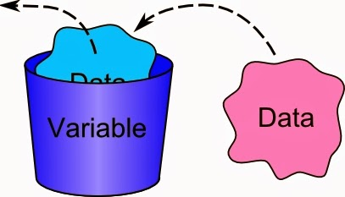
Part 1: Data Centric Foundational R Programming
What is a variable?
A place holder for expressions or quantities that may change.
In R we call such variables objects.
e.g., age is a variable. It could store values such as 30, 40 60 …
The opposite of a variable is a constant is Gravity = 6.67430(15)×10−11 m3⋅kg−1⋅s⁻²

Slide 3
Foundational Objects in R
A vector is a function in R that is used to create variables.
It is the most basic R object?
Vectors mostly contain objectives of the same type or class
An exception to the rule is a list.
There are five basic or atomic classes of objects in R
Character
Numeric (real numbers or double)
Numeric (Integer)
Complex
Logical (True or False)

Slide 4
Character
Characters are also called string variables.
They are mostly words or non-numbers
e.g., names = [ ‘robin’ , ‘Nancy’, ‘Yakubu’ ………………………………]

Slide 5
Numeric
Double.
e.g., Money_in_bank = [ 1.2, 3000.003, 500.043, …]
Integers
e.g., Age = [ 10, 40, 60, …]

Slide 6
Complex Numbers
It is an imaginary value
Often expressed in the form a + bi
a & b are real numbers
i is an imaginary value
e.g., -1 +0i

Slide 7
Attributes of Objects
They are the meta data for the object.
Extra information that describes the object
Common attributes of objects
class (check if object is numeric, complex number, character …)
length
and many others

Slide 8
Case Study: Microsoft Excel
We are going to create a data in excel.
Must contain basic variables about our class.
Age
sex
names
height
savings
What types of data types or classes must we use to construct these variables? Let’s discuss.

Slide 9
Created Excel Data
Name | Age | Sex | Height (inch) | Money_In_Account
Eric | 30 | Male | 6 | 30
Seth | 60 | Male | 5.6 | 40.01
John | 15 | Male | 4 | 6000.04
Bonsu | 70 | Male | 6.1 | 400.98
Elizabeth | 25 | Female | 5.7 | 4999.8
Regina | 26 | Female | 5.6 | 300000.9

Slide 10
Create same Data in R
We will construct the variables with a vector. In ‘R’ we do the following:
#Age
Age <- c(30, 60, 15, 70, 25, 26)
#Name
Name <- c(‘Eric’, ‘Seth’, ‘John’, ‘Elizabeth’, ‘Regina’)
#Sex
Sex <- c(“Male’, “male”, ‘Male’, “Male’, “Female’, ‘ Female’)
#Money_in_account
Money_in_Account <- c(30, 40.01, 600.04, 400.98, 4999.9, 300000)

