Slide 1

R Part B
Eric Asare (Ph.D.)
DataSmartScience
21/8/21

Slide 2
Lecture Outline
Last Week’s Recap
Filter data
Select columns
Select rows
Select rows and columns
Install and activate Packages
Use packages to import data and save
Convert data : Convert STATA, SPSS, SAS, and … to R
Create functions
Control structures
If-else
For loops
Nested loops
While loops

Slide 3
Last week’s Recap
Defined a variable: Container to store varying information.
Looked at the fundamental information types we can use to create variables (also called atomic information)
Character/string
Variables created with this information cannot be used in mathematical operations such as +, -,
*, /
Numeric - Double or Integer
Variables created with this information can be used in mathematical operations
Complex
In the form a +bi
Logical : True of False
Used a vector to create variables
Created a data frame

Slide 4
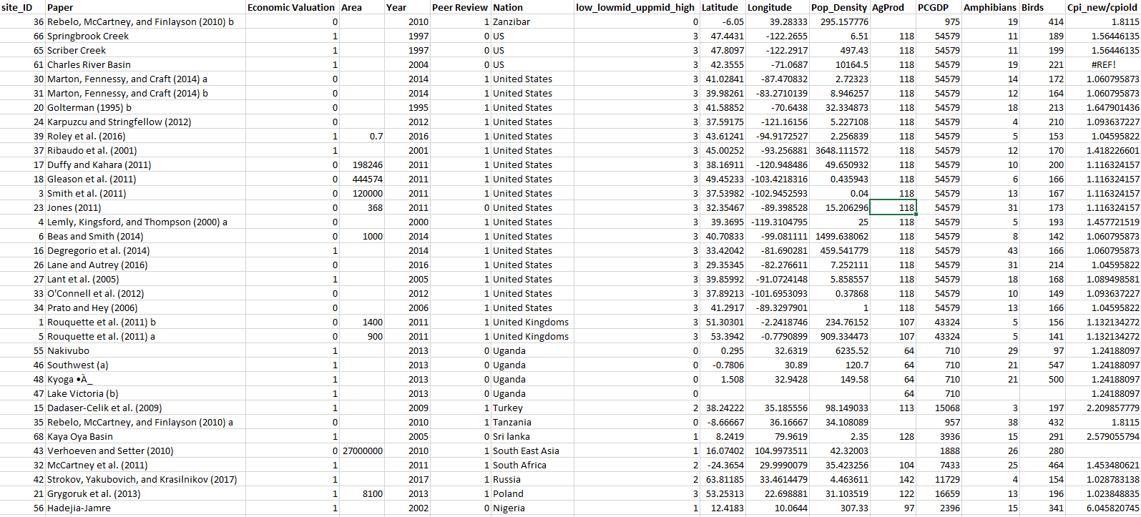
A most common form of data we mostly work with

