Slide 1

R Part D
Eric Asare (Ph.D.)
DataSmartScience
28/8/21

Slide 2
Lecture Outline
What we have done so far!
Creation of variables
Creation of Data Frames
Accessing attribute information of variables and data frames
Creation of functions
Control Structure (if-else, for loops)

Slide 3
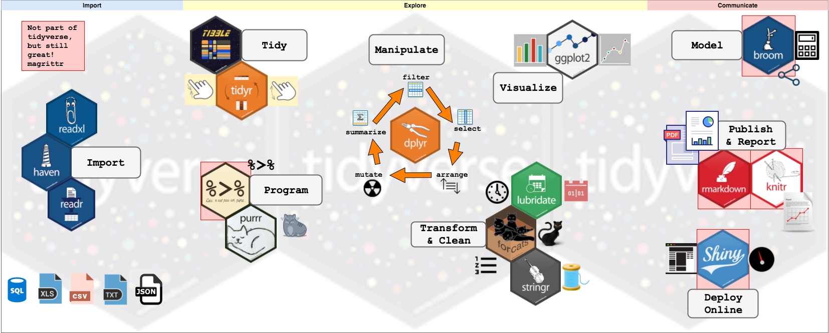
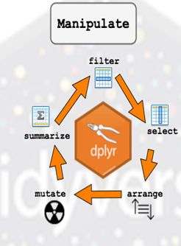
Tidyverse Package (Ecosystem)
https://www.storybench.org/getting-started-with-tidyverse-in-r/

Slide 4
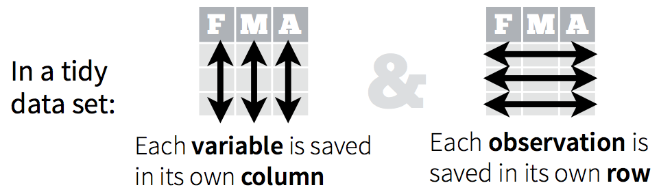
Dplyr Package
It is an awesome package for working with tidy data
What is a tidy data. It has the following characteristics:

Slide 5
Dplyr Package
The grammar of Dplyr
select() : select columns
Filter() : Select rows
Arrange() : sort columns
Rename() : Rename variables
Mutate(): Transform existing columns or add new columns
Group_by() : To conduct grouped data manipulations
summarize(): Create summary statistics
%>% : Pipes which links multiple data manipulation actions together
Everything Dplyr can do you can do it in base R.
Dplyr makes it very easy and elegant

Slide 6
Applied Dplyr in Action
We are going to work with Dplyr verbs in R studio

